Slide 1
Integrating HDF5 with SRB
NCSA/SDSC
May 17, 2005
Sponsored by NALDR, NFS PACI Project
in Support of NCSA-SDSC Collaboration

Slide 2

Introduction
Collaboration between Storage Resource Broker (SDSC) and Hierarchical Data Format (NCSA)
Goal is to integrate these two successful technologies to create a new, more sophisticated data services
  SRB as standard middleware to transfer data between the server and client
  HDF5 to provide interactive and efficient access to objects and subsets of objects in large files
Together, we will produce a working prototype

Slide 3

Outline
Brief introduction (Bob Mcgrath, NCSA)
An overview of SRB (Michael Wan, SDSC)
An overview of HDF5 (Peter Cao, NCSA)
Project Description (Peter Cao, NCSA)
The HDF5-SRB model (Peter Cao, NCSA)
Summary of work done so far (NCSA/SDSC)
Future plans: milestones and beyond (NCSA)

Slide 4
Overview of SRB
What is SRB
What is SRB ?
  Classified as Data Management or Data Grid software
An overview of SRB from a software development perspective

Slide 5
Overview of SRB
Initial Design of SRB
Transparency and Uniformity
  Data are increasingly distributed
  Design Goal –
    use a single interface and authorization mechanism to access data on:
      Multiple hosts
      Multiple OS platforms
      Multiple resource type (UNIX FS, HPSS, UniTree, DBMS ..)

Slide 6
Overview of SRB
Initial Design of SRB
Data Organisation
  Global Logical Name space -
    UNIX like directories (collections) and files (data)
    Mapping of logical name to physical attributes - host address, physical path.
    UNIX like API and utilities

Slide 7
Overview of SRB
SRB architecture
Federated middleware system
Client/server model –
  Federated servers with uniform interfaces
    client-server
    server-server
  Single client signOn on any one of the servers
  Access to all resources in the federation
  Robust access control
    user level, grant access to multiple users
    group level
    tickets
MCAT –
  Metadata catalog

Slide 8
Overview of SRB
Federated Resource Servers
MCAT DB
Mcat Server
Server1
Server2

Slide 9
Overview of SRB
Enhancements
Early releases of SRB were not successful
  Performance issues
  Not enough features
  Configuration not sufficiently flexible
Enhancements
  Performance
    Parallel I/O – transfers large files
    Bulk Operation – transfer large number of small files
    Containers – archives large number of small files

Slide 10
Overview of SRB
Feature Enhancements
User defined metadata for data description
  Query and locate data
  Data archival
Use of checksum for Data verification
Many new type of data operations
  Replication
  Rsync
  Phymove – move data from one resource to another

Slide 11
Overview of SRB
SRB Configuration – Peer-to-peer Data Grid
Resource
server
Data sharing, no central resource
Projects – NARA, BIRN
Resource
server
Resource
server
Resource
server

Slide 12
Overview of SRB
SRB Configuration - Exploding Star
Satellite
server
Satellite
server
Data source – physics experiment
Projects – Babar, kek
Source
Server
Satellite
server
Satellite
server
Satellite
server

Slide 13
Overview of SRB
SRB Configuration - Imploding Star
Satellite
source
server
Satellite
source
server
Central
Archival
server
Central
Cache
Server
Archival Storage Model
Projects – UK eScience –
BBSRC
Satellite
source
server
Satellite
source
server
Satellite
source
server

Slide 14
Overview of SRB
Peer to peer Federation of MCAT Zone
MCAT1
Server1.1
Server1.2
MCAT3
Server3.1
MCAT2
Server2.1
Server2.2

Slide 15

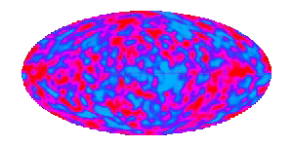


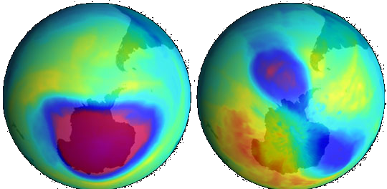
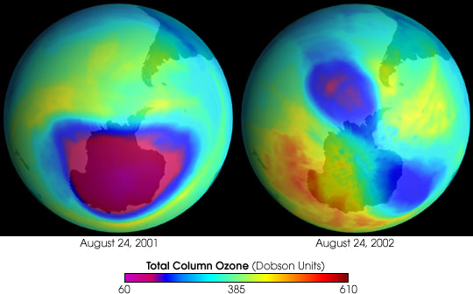
Overview of HDF5
Answering big questions …
Matter & the universe
Life & nature
Weather & climate
August 24, 2001
August 24, 2002
Total Column Ozone (Dobson)
60 385 610

Slide 16
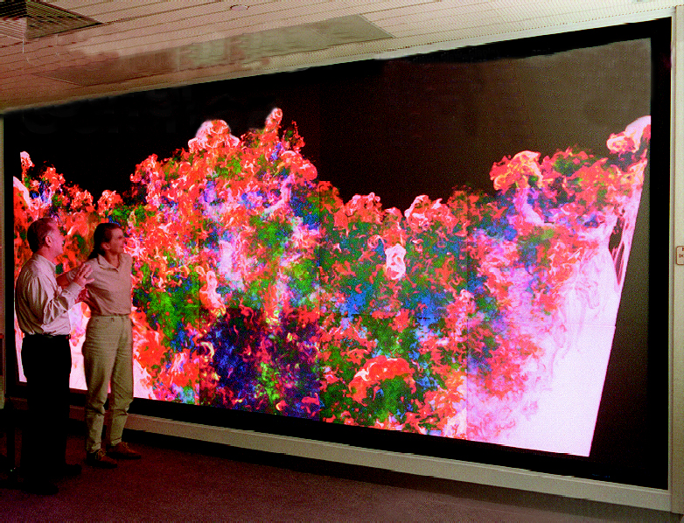
Overview of HDF5
Involves big data …

Slide 17
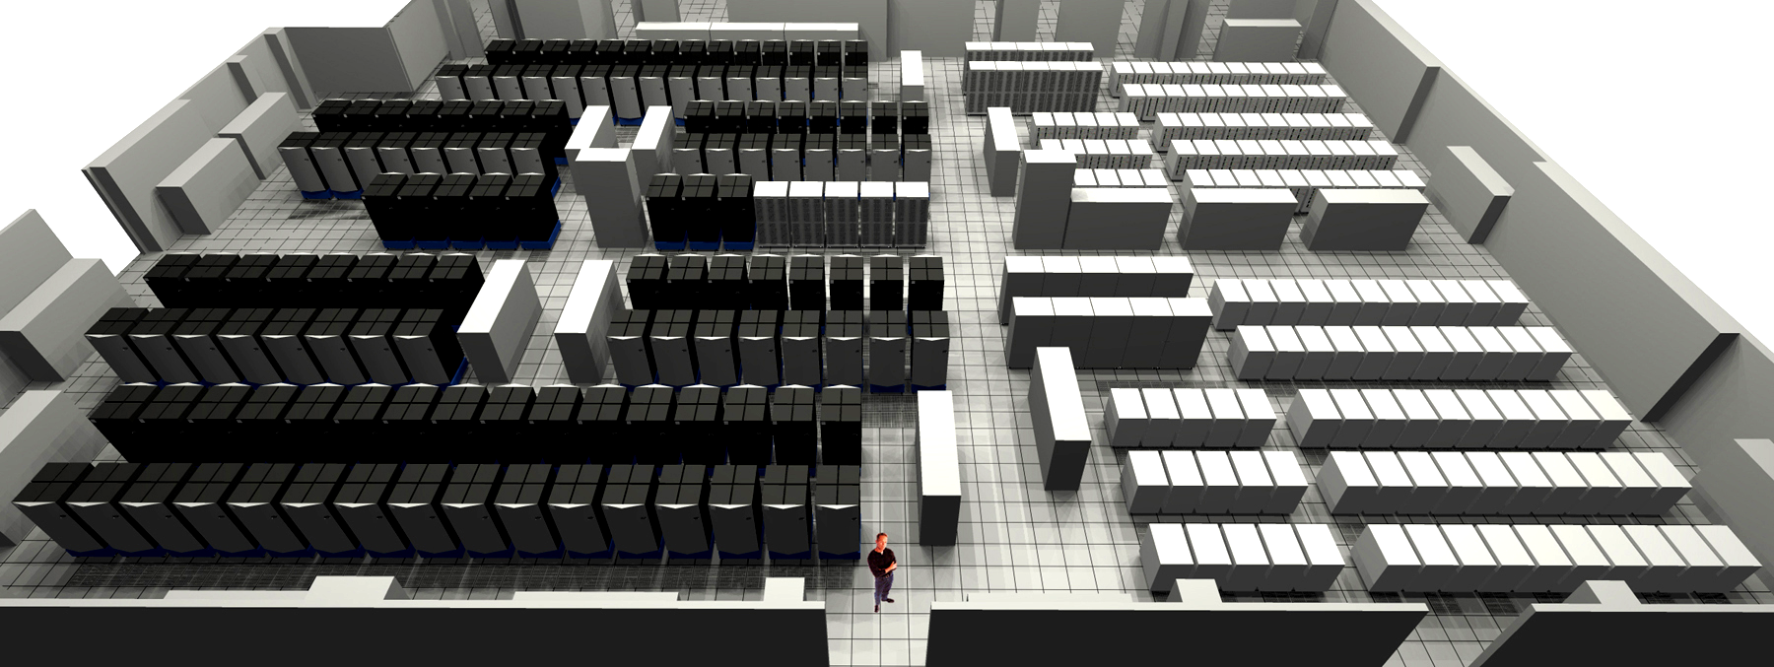
Overview of HDF5
On big computers …

Slide 18
Overview of HDF5
HDF solution …
File format
for all kids of data
Efficiency
storage & IO
Common
models
extensions
Software
& tools
open source &
multiple platform
Standard
APIs
conventions
& easy use

Slide 19


Overview of HDF5
Example HDF5 file
“/” (root)
“/foo”
3-D array
palette
URL
lat | lon | temp
----|-----|-----
12 | 23 | 3.1
15 | 24 | 4.2
17 | 21 | 3.6
Raster image
2-D array
Table

Slide 20
Overview of HDF5
Object model
Primary Objects
  Groups
  Datasets
Additional ways to organize data
  Attributes
  Sharable objects
  Storage and access properties

Slide 21

Overview of HDF5
Groups
A mechanism for collections of related objects
Every file starts with a root group
Similar to UNIX
directories
Can have attributes
“/”
tom
dick
harry
temp

Slide 22
Overview of HDF5
Datasets
Metadata
Data
Dataspace
Rank
Dimensions
3
Dim_1 = 4
Dim_2 = 5
Dim_3 = 7
Datatype
IEEE 32-bit float
Attributes
Storage info
time = 32.4
Chunked
pressure = 987
compressed
temp = 56

Slide 23
Overview of HDF5
Goals of HDF5 library
Flexible API to support a wide range of operations on data
High performance access in serial and parallel computing environments
Compatibility with common data models and programming languages

Slide 24
Overview of HDF5
Structure of HDF5 library
Object API (C, Fortran 90, Java, C++)
Specify objects and transformation properties
Invoke data movement operations and data transformations
Library internals
Performs data transformations and other prep for I/O
Configurable transformations (compression, etc.)
Virtual file I/O (C only)
Perform byte-stream I/O operations (open/close, read/write, seek)
User-implementable I/O (stdio, network, memory, etc.)

Slide 25
Overview of HDF5
Data subsetting
(a) Hyperslab from a 2D array to the corner of a smaller 2D array
(b) Regular series of blocks from a 2D array to a contiguous sequence at a certain offset in a 1D array
(c) A sequence of points from a 2D array to a sequence of points in a 3D array.
(d) Union of hyperslabs in file to union of hyperslabs in memory.

Slide 26


Overview of HDF5
Virtual file I/O layer
  Public API for writing I/O drivers
  Allows HDF5 to interface to disk, the network, memory, etc.
Virtual file I/O drivers
Stdio
File Family
MPI I/O
Memory
Network
“Storage”
File
File
Family
Memory
Network

Slide 27
Project Description
Motivation
SRB | HDF5
Indexing and searching Distributed Access control | Large and diverse data High performance access Interactive and subsetting
High performance distributed data system with access control

Slide 28
Project Description
Goals
Working prototype of client/server system for
object-level access to HDF5 stored in the SRB
Use SRB as middleware to transfer data between the server and client
Interactive and efficient access to large files and dataset

Slide 29
Project Description
Team roles
SRB team - Supporting role
  SRB software provides the client/server framework
  Add SRB features to aid the integration
  Help with SRB installation
HDF5 team
  Implement HDF5 object structures
  Implement the HDF5 client API and Client
  Implement the proxy handling routine on the server

Slide 30
HDF5-SRB Model
Architecture
Client Application
HDF5 file
HDF5 Library
HDF5 Object
(File, Group, Dataset, Attribute)
HDF5 Object
(File, Group, Dataset, Attribute)
MCAT
SRB Server
HDF5-SRB Module
(unpackMsg/packMsg)
HDF5-SRB Module
(unpackMsg/packMsg)

Slide 31
HDF5-SRB Model
Data flow
Client API
srbObjRequest(void *obj, int objID)
Server API
srbObjProcess(void *obj, int objID)
6. unpackMsg()
5. packMsg()
3. H5Obj::op()
HDF5 Library
1. packMsg()
2. unpackMsg()
4. Access file
SRB Server
HDF5 file

Slide 32
HDF5-SRB Model
Pack/Unpack routine enhancements
Pack/Unpack routines
  Exchange structured data between client/server
  Struct is packed into a single byte stream before sending
  Byte stream received is unpacked back into structure
  Handles complicated struct – string, pointers, pointers to arrays, arrays of pointers, etc

Slide 33
HDF5-SRB Model
A New SRB API - srbGenProxyFunct
srbGenProxyFunct
  General Proxy Function request
  Can handle other types of request besides HDF5
  Some Inputs:
    int functType – e.g., HDF5_TYPE
    void *inputStruct - Pointer to an arbitrary input struct.
    inputFormat - packing format for inputStruct.
    void *outputStruct - Pointer to an arbitrary output struct.
    outputFormat - packing format for outputStruct

Slide 34
Work Being Done So Far
HDF5 Object Structures
Client/Server APIs
packMsg()/unpackMSg()
Integrate HDF5 into SRB source
Test client/server access. ***it works***

Slide 35
Milestone
Module specifications
  RFC 02/11/05
  Tech. seminar 02/24/05
  final publication 03/04/05
Implementation
  Compile and install test SRB server 03/18/05
  Client-side module 03/31/05
  Server-side module 04/22/05
  Client application 05/20/05
Testing and merge source with SDSC 07/15/05
Documentation and release 08/31/05

Slide 36
Further Work
Metadata Ingest
  srbObjPut() calls the HDF5 ingest program to put file information into MCAT
Datacutter
  searching and filtering HDF5 data
HDF5 Indexing
  store HDF5 indexing table into MCAT

Slide 37

Last Words
Great team work between NCSA/SDSC
Organizational aspect
Technical aspect

Slide 38

Question / Comments?

