Slide 1

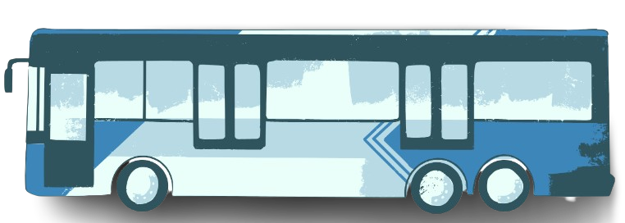
BRTS PORTAL
NAME :: JADEJA HETRAJ
ENROLLMENT NUMBER :: 23002171310060
BRANCH :: CST
ROLL NUMBER :: 9

Slide 2
02
ADMIN PORTAL
Add station
Add BUS between route
Get report on total revenue
Get report on bus delays
03
SW PORTAL
Print tickets for passengers
Issue fine for passengers
Recharge pass for users
01
USER PORTAL
Route info
Bus info
Fair calculation
Bus schedule
Find bus number
Station-bus info
BRTS PORTAL'S

Slide 3
03
SW PORTAL
Print tickets
Add station worker
Register pass
Pass recharge
Pass cancelation
View Pass balance
Issue fine
01
USER PORTAL
Route info
Bus info
Fair calculation
Bus schedule
Find bus number
Station-bus info
02
ADMIN PORTAL
Add bus to route
Remove bus from route
Declare bus breakdown
Review daily report
Add station worker

Slide 4
04
DRIVER PORTAL
START BUS
WILL KEEP TRACK OF SCHEDULED BUS START TIME , AND ACTUAL TIME DRIVER STARTED
STATION ANNOUNCING
03
SW PORTAL
Print tickets
Add station worker
Register pass
Pass recharge
Pass cancelation
View Pass balance
Issue fine
01
USER PORTAL
Route info
Bus info
Fair calculation
Bus schedule
Find bus number
Station-bus info
02
ADMIN PORTAL
Add bus to route
Remove bus from route
Declare bus breakdown
Review daily report
Add station worker

Slide 5
05
CENTRAL BRTS PORTAL
ADD STATION
REPORT OF WHOLE BRTS SYSTEM AT 11:30
LOG IN AND LOG OUT (TIME BASED PASSWORD APPROACH)
04
DRIVER PORTAL
START BUS
WILL KEEP TRACK OF SCHEDULED BUS START TIME , AND ACTUAL TIME DRIVER STARTED
STATION ANNOUNCING

Slide 6

05
CENTRAL BRTS PORTAL
ADD STATION
REPORT OF WHOLE BRTS SYSTEM AT 11:30
LOG IN AND LOG OUT (TIME BASED PASSWORD APPROACH)
04
DRIVER PORTAL
START BUS
WILL KEEP TRACK OF SCHEDULED BUS START TIME , AND ACTUAL TIME DRIVER STARTED
STATION ANNOUNCING

Slide 7

GENERAL MAP OF BRT SYSTEM
6
4
1
3
5
2

Slide 8

EXISTANCE OF LOOP
6
4
1
3
5
2

Slide 9

NON - EXISTANCE OF LOOP
6
4
1
1
3
5
2
2

Slide 10
NON - EXISTANCE OF LOOP
4
6
1
THE MAP CAN BE SEEN FROM A DIFFERENT POINT OF VIEW , BY THE BUS NO WHICH CONNECTS THE DEPOT ( 1 AND 6)
LETS SAY BUS 2U GOES FROM 1 TO 6
BUT WHEN THAT BUS RETURNS ITS CHNAGES ITS NUMBER FROM 2U TO 2D.
1
3
5
2
6
4
6
4
1
1
1
1
3
3
5
5
2D
2
2U
2

Slide 11

PREV STATION
NODE
NEXT LEFT STATION
NEXT RIGHT STATION

Slide 12
LEFT
TO
RIGHT
FILLING CRITERIA
A
B

Slide 13
LEFT
TO
RIGHT
FILLING CRITERIA
A
B
C
TO MAKE TRAVERSAL MORE EFFICIENT , ADDRESING OF NODE HAS BEEN USED.
IT’S A UNIQUE CODE , THAT SHOWS ITS HIERARCHY IN THE MAP FROM OUR MAIN(ROOT) STATION.
THE STATION CODE OF ROOT IS "0", AND IF WE MOVE LEFT OF ROOT THEN
STATION CODE = PREV.STATIONCODE+"1"
IF WE MOVE RIGHT OF ROOT THEN STATION CODE WILL BE PREV.STATIONCODE+"2"

Slide 14
STATION CODE
A
ROOT STATION CODE :: 0
TO MAKE TRAVERSAL MORE EFFICIENT , ADDRESING OF NODE HAS BEEN USED.
IT’S A UNIQUE CODE , THAT SHOWS ITS HIERARCHY IN THE MAP FROM OUR MAIN(ROOT) STATION.
THE STATION CODE OF ROOT IS "0", AND IF WE MOVE LEFT OF ROOT THEN
STATION CODE = PREV.STATIONCODE+"1"
IF WE MOVE RIGHT OF ROOT THEN STATION CODE WILL BE PREV.STATIONCODE+"2"
B
C

Slide 15
FINDING ROUTE
A
0
SAMPLE TEST CASE
SOURCE :: A , DESTINATION :: D
SOURCE :: D , DESTINATION :: E
SOURCE :: B , DESTINATION :: D
SOURCE :: E , DESTINATION :: F
01
C
B
02
D
011
E
F
021
022

Slide 16
BUS SUGGESTION TO USER
<1U,15E>
A
Firstly , we will start from source busset and then start retaining all common bus no in the set , if we find bus set which is not empty at reaching destination , that means we have direct bus.
<1U,15E>
B
C
<1U,15E>
D
<1U>

Slide 17
What if there is no direct bus?
A
<15E>
In this case we will similary start from source and its hashset will be compared to the next station in the route , when our hashset is empty after retaining commons , then the previous station will be our interchange.
<1U,15E>
B
C
<15E>
D
<1U>

Slide 18
TRACKING OF DELAY IN BUS TIMING
A relation bus schedule which has scheduled start time , and when driver from driver portal starts the bus , that time will be recorded in this relation and a delayed time will be calculated and stored.
A bus will only start if it’s the scheduled start time or within the one hour of scheduled start time.
Admin can keep the track of frequent bus delays through this relation.

Slide 19




META DATA OF BRTS DATABASE
EMPLOYEE_DETAILS
A RELATION TO KEEP TRACK OF EMPLOYEE'S DATA AND HIS/HER LOGIN AND LOGOUT TIME
THROUGH THESE ADMIN ARE ALSO ABLE TO KEEP TRACK ON EMPLOYEES WORKING HOURS.

Slide 20
META DATA OF BRTS DATABASE
EMPLOYEE_DETAILS
A RELATION TO KEEP TRACK OF EMPLOYEE'S DATA AND HIS/HER LOGIN AND LOGOUT TIME
THROUGH THESE ADMIN ARE ALSO ABLE TO KEEP TRACK ON EMPLOYEES WORKING HOURS.
STATION_DETAILS
A RELATION THAT KEEPS STATION DETAILS SUCH AS NAME,PREVIOUS STATION , NEXT LEFT AND RIGHT STATION ,
TOTAL REVENUE GENERATED INDIVIDUALLY BY STATIONS ARE ALSO STORED HERE.

Slide 21
META DATA OF BRTS DATABASE
DRIVER_DETAILS
A RELATION THAT KEEPS DRIVER DETAILS AND ALL THE 4 BUS NUMBER THAT HE/SHE DROVE ON THAT DAY.

Slide 22
META DATA OF BRTS DATABASE
BUS_DETAILS
A RELATION THAT KEEPS BUS INFO ABOUT SOURCE STATION,DESTINATION STATION,ITS TOTAL JOURNEY DISTANCE , ITS STATUS.
ADMIN CAN CHANGE STATUS OF BUS TO BREAKDOWN IN HERE.
DRIVER_DETAILS
A RELATION THAT KEEPS DRIVER DETAILS AND ALL THE 4 BUS NUMBER THAT HE/SHE DROVE ON THAT DAY.

Slide 23
META DATA OF BRTS DATABASE
BUS_SCHEDULE
A RELATION THAT KEEPS BUS SCHEDULE INFO , WITH SCHEDULED START TIME , END TIME , START TIME , DELAY TIME

Slide 24
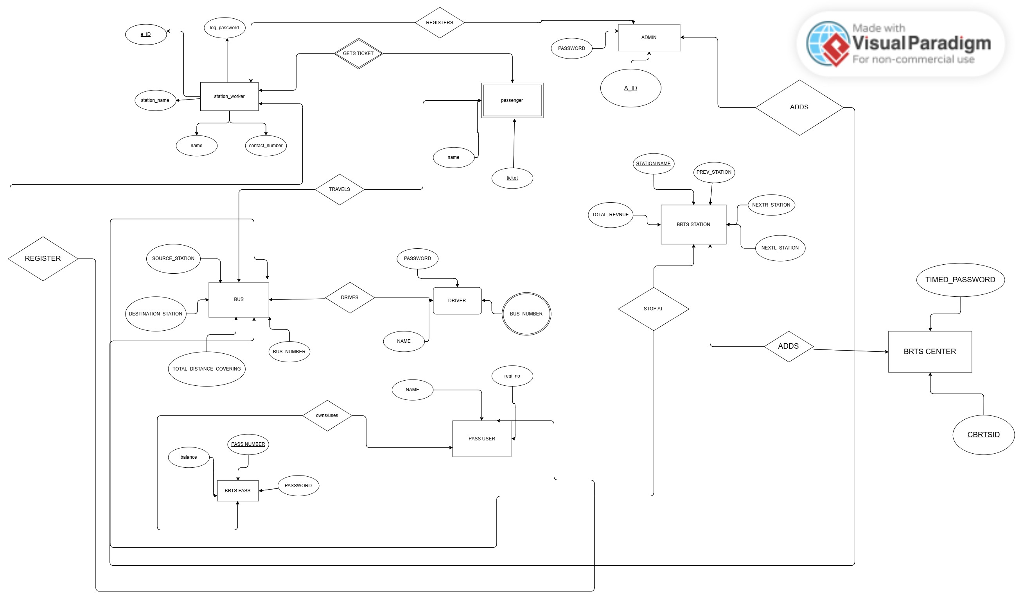



Slide 25
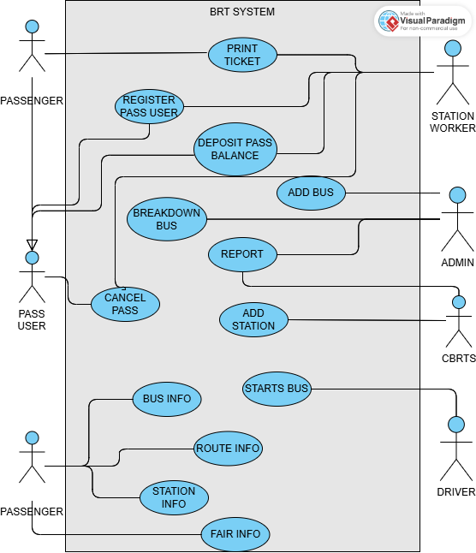

Slide 26
CONCEPT'S COVERED IN BRTS PORTAL PROJECT
DATA STRUCTURE | DATA BASE MANGEMENT | JAVA
TRIVIAL-DOUBLY TREE | CONCEPT OF JOIN | IO PROGRAMING
SINGLY LINKED LIST | TRIGGER'S | THREAD CONCEPT
 | PROCEDURE'S | JDBC
 | CONSTRAINT'S | COLLECTION'S

Slide 27










THANK YOU

