Slide 1

PYNQ Automated System-on-Chip Builder
Luke Canny 19339166 Supervisor: Dr. Fearghal Morgan
Masters Electronic and Computer Engineering Co-assessor: Mr Liam Kilmartin
6
Project Objectives
PYNQ SoC Builder
The aim of this project is to:
Create a remote PYNQ laboratory for students
Extend the functionality of HDLGen-ChatGPT to automatically deploy projects to PYNQ-Z2 FPGAs
Develop an interactive challenge-based RISC-V learning platform
PYNQ SoC Builder
Project Overview
This section will either be connected to the objectives section above or added more information :>
Remote PYNQ FPGA Laboratory
Remote PYNQ FPGA Laboratory
RISC-V Challenge-Based Learning Platform
This section will either be connected to the objectives section above or added more information :>
Future Work
Acknowledgements
I would like to thank Dr. Fearghal Morgan for his support and guidance, and Roshan George, JP Byrne and Abishek Bupathi for their previous work on HDLGen-ChatGPT, PYNQ and RISC-V.

Slide 2
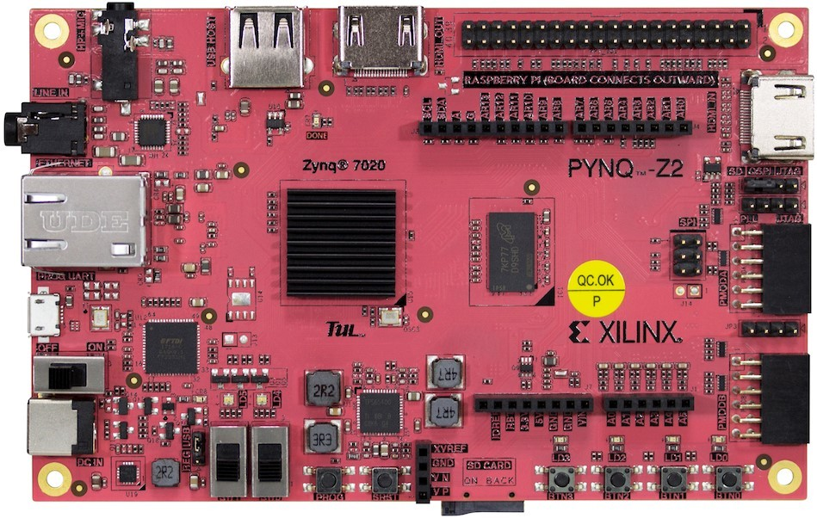
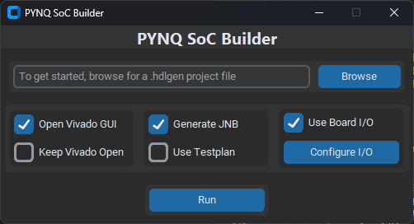
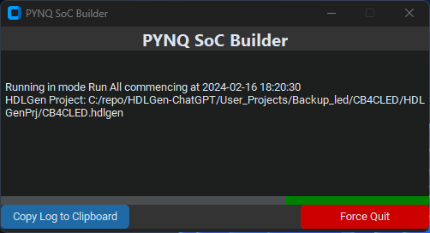
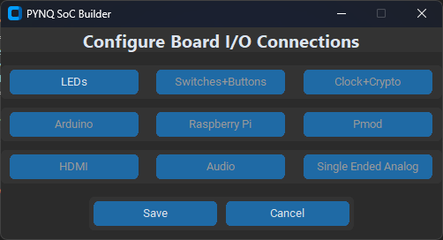
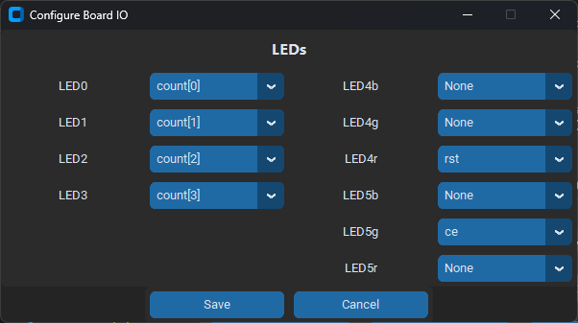
PYNQ Automated System-on-Chip Builder
Luke Canny 19339166 Supervisor: Dr. Fearghal Morgan
Masters Electronic and Computer Engineering Co-assessor: Mr Liam Kilmartin
GitHub.com/HDLGen-ChatGPT/PYNQ-SoC-Builder
6
Project Objectives
PYNQ SoC Builder
The aim of this project is to:
Create a remote PYNQ laboratory for students
Extend the functionality of HDLGen-ChatGPT to automatically deploy projects to PYNQ-Z2 FPGAs
Develop an interactive challenge-based RISC-V learning platform
PYNQ SoC Builder is a standalone Python application which:
Configures Vivado project for PYNQ-Z2 board
Generates and imports PYNQ-Z2 physical constraints
Creates and populates a Vivado Block Design
Configures PYNQ board I/O Connections
Performs synthesis, implementation and bitstream generation
Generates a Jupyter Notebook project based on test plan
Project Overview
Flow Diagram
This section will either be connected to the objectives section above or added more information :>
Remote PYNQ FPGA Laboratory
The purpose of the remote FPGA laboratory is to make real PYNQ Z2 hardware available to students and enthusiasts.
This is achieved by using a tunnelling service. This service runs as a background daemon on the PYNQ’s ARM processor.
PYNQ SoC Builder Main Menu
In Progress Screen
I/O Connections Menu
Sample LED Signal Configuration
RISC-V Challenge-Based Learning Platform
This section will either be connected to the objectives section above or added more information :>
Future Work
Acknowledgements
Develop more RISC-V challenges of varying difficulty
Develop an online platform to allow user-sessions
Future Work #3
I would like to thank Dr. Fearghal Morgan for his support and guidance, and Roshan George, JP Byrne and Abishek Bupathi for their previous work on HDLGen-ChatGPT, PYNQ and RISC-V.

