Slide 1


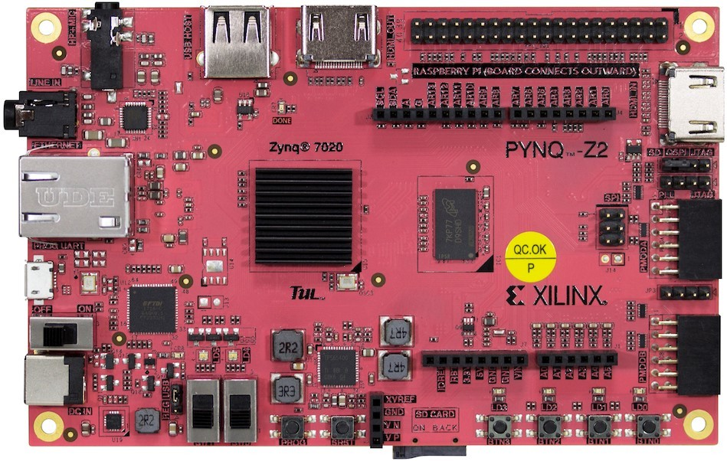

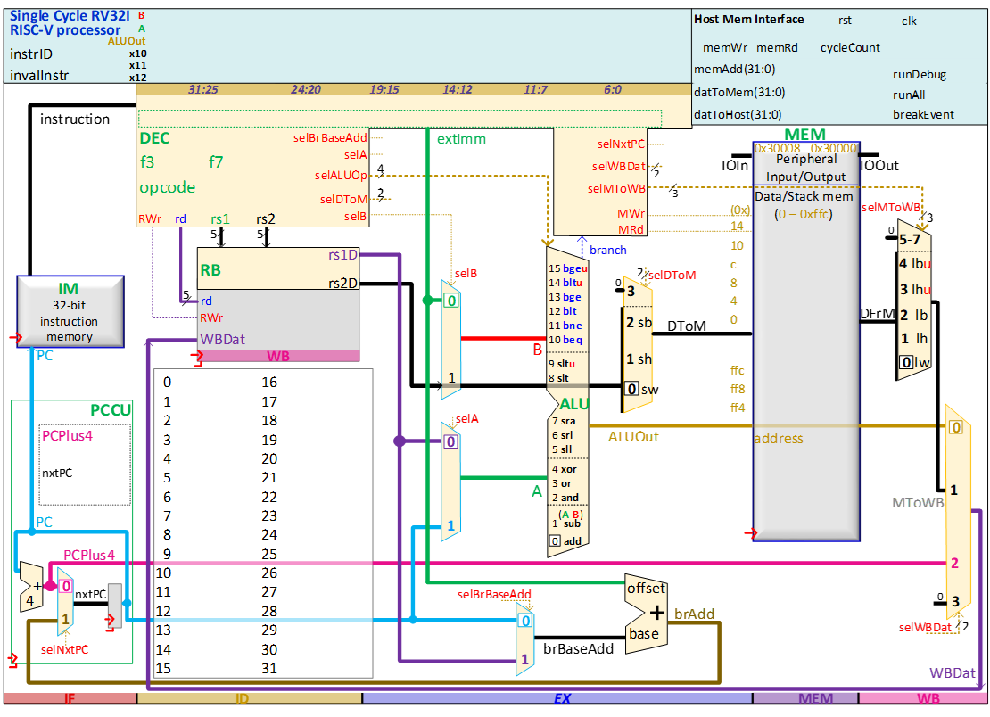

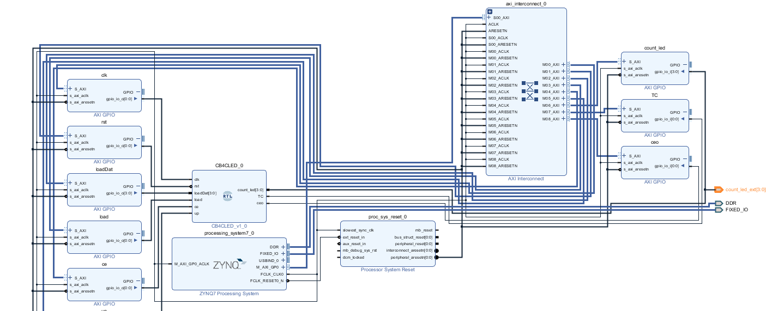


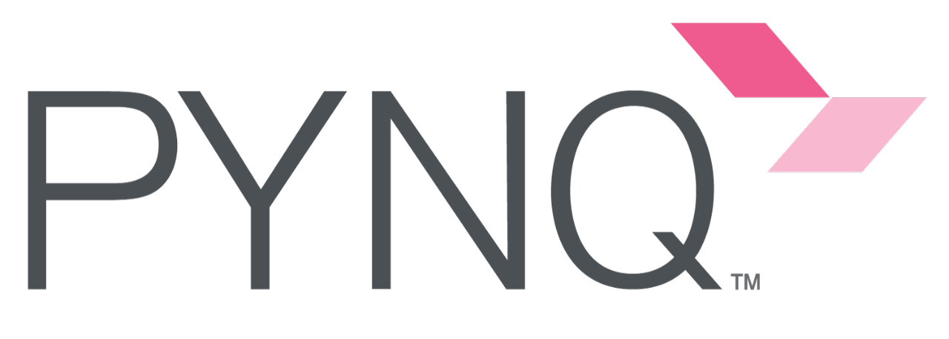
PYNQ Automated System-on-Chip Builder
& Remote RISC-V Learning Platform
Luke Canny 19339166 Supervisor: Dr Fearghal Morgan
Masters Electronic and Computer Engineering Co-assessor: Mr Liam Kilmartin
GitHub.com/HDLGen-ChatGPT/PYNQ-SoC-Builder
6
Project Workflow
Design Specification
Project Overview and Objectives
PYNQ SoC Builder
The aim of this project is to:
Create a remote PYNQ laboratory for students
Extend the functionality of HDLGen-ChatGPT to automatically deploy projects to PYNQ-Z2 FPGAs
Develop an interactive challenge-based RISC-V learning tool
HDLGen-ChatGPT is an open-source Python tool developed in the University of Galway to enable fast capture of HDL-based SoC capture and implementation, by automated VHDL/Verilog, testbench and waveform generation. PYNQ SoC Builder is a Python application which builds HDLGen-ChatGPT projects.
PYNQ SoC Builder completes the following:
Generates and imports PYNQ-Z2 constraints and configuration
Creates and populates a Vivado Block Design
Configures PYNQ board I/O Connections
Performs synthesis, implementation and bitstream generation
Generates a Jupyter Notebook project based on test plan
Remote PYNQ FPGA Laboratory
The purpose of the remote FPGA laboratory is to make real PYNQ Z2 hardware available to students and enthusiasts.
This is achieved by using a tunnelling service called ngrok. This service runs as a background daemon on the PYNQ’s ARM processor. Ngrok encrypts all data using HTTPS and authenticates users using OAuth 2.0. OAuth allows users to authenticate using their @universityofgalway.ie Microsoft accounts.
HDLGen Project XML Data
PYNQ
SoC
Builder
Output Binaries
.hwh, .tcl, .bit, .ipynb
Component Name, Description,
Date, Author,
Email, Company
Sub-Components
Signal Type
Sub-components
Ports
Internal Signals
Architecture
Test Plan
1. Read
Data
2. Prepare a Tcl script which applies build steps in Vivado
6. Export Binaries and JNB to output folder
5. Generate Jupyter NB based on Test plan
Connection is tunnelled through ngrok servers
3. Invoke script in Vivado IDE
4. Vivado exports binaries
7. User
uploads
output to
PYNQ
FPGA
RISC-V Architecture
Block Diagram generated by SoC Builder for a 4-bit Counter
RISC-V Assembly/C Challenge-Based Learning Platform
The purpose of the RISC-V learning platform through the remote laboratory is to encourage interaction and exploration of RISC-V ISA on real hardware, rather than simulation
The learning platform will consist of two RISC-V cores. One of which the user will program using assembly or C, The other will remain hidden, only visible to the core #1 by I/O ports. Core #2 will imitate a peripheral device.
The goal of the user is to interface with the hidden peripheral. The hidden peripheral changes depending on the difficulty level. For example, an interrupt controller or I²C device.
PYNQ Jupyter Notebook Interface
User uploads assembly to Core #1
User may read memory to view results
Core #1
Core #2
Core #2 runs hidden program
Future Work
Acknowledgements
Automate RISC-V Core Bitstream Creation
Develop a range of RISC-V challenges of varying difficulty
Gather feedback from potential users of RV learning platform
I would like to thank Dr. Fearghal Morgan for his support and guidance, and Roshan George, JP Byrne and Abishek Bupathi for their previous work on HDLGen-ChatGPT, PYNQ and RISC-V.

Slide 2
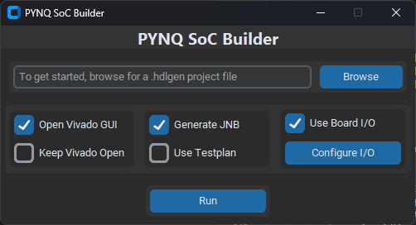
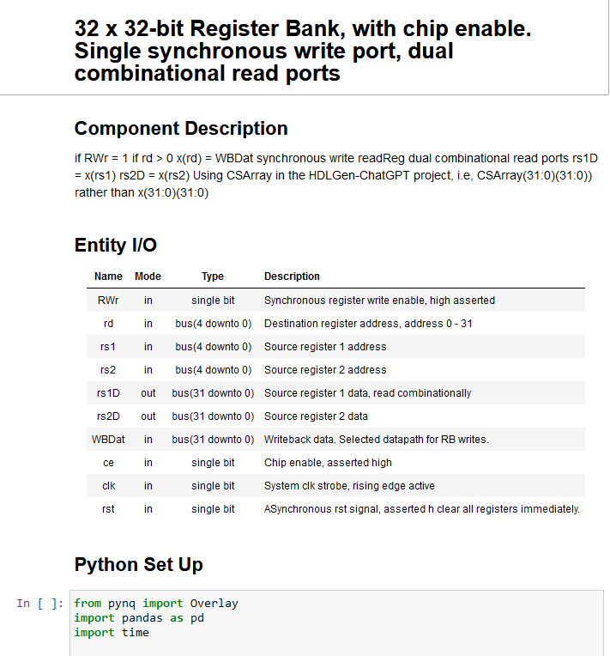
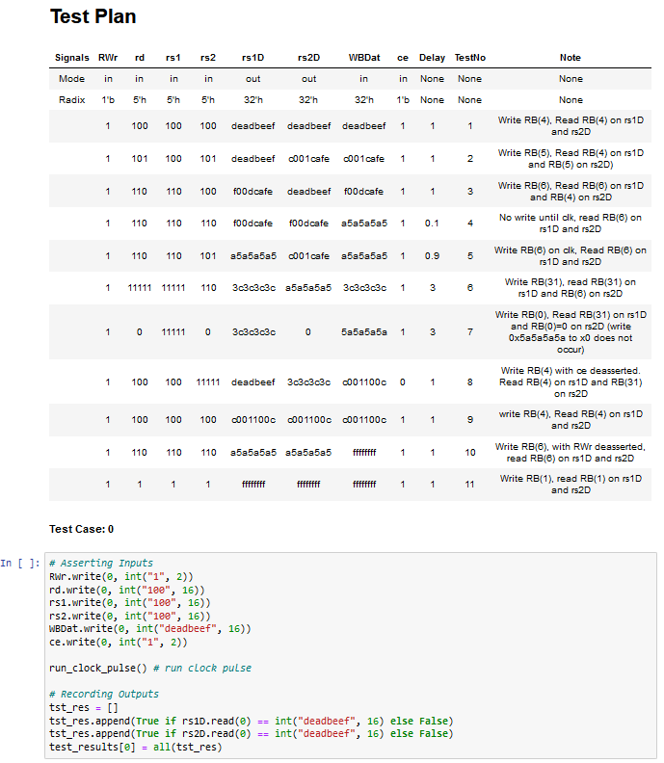
PYNQ Automated System-on-Chip Builder
& Remote RISC-V Learning Platform
Luke Canny 19339166 Supervisor: Dr Fearghal Morgan
Masters Electronic and Computer Engineering Co-assessor: Mr Liam Kilmartin
GitHub.com/HDLGen-ChatGPT/PYNQ-SoC-Builder
6
PYNQ SoC Builder
PYNQ SoC Builder is a standalone Python application which builds HDLGen-ChatGPT projects.
HDLGen-ChatGPT is an open-source Python tool developed in the University of Galway to enable fast capture of HDL-based SoC capture and implementation, by automated VHDL/Verilog, testbench and waveform generation.
PYNQ SoC Builder completes the following:
Configures Vivado project for PYNQ-Z2 board
Generates and imports PYNQ-Z2 physical constraints
Creates and populates a Vivado Block Design
Configures PYNQ board I/O Connections
Performs synthesis, implementation and bitstream generation
Generates a Jupyter Notebook project based on test plan
Project Overview and Objectives
The aim of this project is to:
Create a remote PYNQ laboratory for students
Extend the functionality of HDLGen-ChatGPT to automatically deploy projects to PYNQ-Z2 FPGAs
Develop an interactive challenge-based RISC-V learning platform
Remote PYNQ FPGA Laboratory
The purpose of the remote FPGA laboratory is to make real PYNQ Z2 hardware available to students and enthusiasts.
This is achieved by using a tunnelling service called ngrok. This service runs as a background daemon on the PYNQ’s ARM processor.
Ngrok secures tunnels over HTTPS by default, encrypting all data transferred over the network. For authentication, ngrok supports OAuth 2.0, which allows users to login using third party platforms. For the duration of this project, users are authenticated by logging in using their @universityofgalway.ie Microsoft accounts.
HDLGen Project XML Data
PYNQ
SoC
Builder
Output Binaries
.hwh, .tcl, .bit, .ipynb
Component Name, Description,
Date, Author,
Email, Company
Sub-Components
Signal Type
Sub-components
Ports
Internal Signals
Architecture
Test Plan
1. Read
Data
2. Prepare a Tcl script which applies build steps in Vivado
6. Export Binaries and JNB to output folder
5. Generate Jupyter NB based on Test plan
Connection is tunnelled through ngrok servers
3. Invoke script in Vivado
4. Vivado exports binaries
7. User
uploads
output to
PYNQ
FPGA
PYNQ SoC Builder Main UI
Vivado Block Diagram
Could be replaced with R-V architecture
I/O Connections Menu
Sample LED Signal Configuration
RISC-V Challenge-Based Learning Platform
The purpose of the RISC-V learning platform through the remote laboratory is to encourage interaction and exploration of RISC-V ISA on real hardware, rather than simulation
The learning platform will consist of two RISC-V cores. One of which the user will program using RISC-V assembly, The other will remain hidden, only visible to the core #1 by I/O ports. Core #2 will imitate a peripheral device.
The goal of the user is to interface with the hidden peripheral. The hidden peripheral changes depending on the difficulty level. For example, an interrupt controller or I²C device.
PYNQ Jupyter Notebook Interface
User uploads assembly to Core #1
User may read memory to view results
Core #1
Core #2
Core #2 runs hidden program
Future Work
Acknowledgements
Automate RISC-V Core Bitstream Creation
Develop a range of RISC-V challenges of varying difficulty
Gather feedback from potential users of RV learning platform
I would like to thank Dr. Fearghal Morgan for his support and guidance, and Roshan George, JP Byrne and Abishek Bupathi for their previous work on HDLGen-ChatGPT, PYNQ and RISC-V.

