Slide 1

PYNQ Automated System-on-Chip Builder
Luke Canny 19339166 Supervisor: Dr. Fearghal Morgan
Masters Electronic and Computer Engineering Co-assessor: Mr Liam Kilmartin
6
Project Objectives
PYNQ SoC Builder
The aim of this project is to:
Create a remote PYNQ laboratory for students
Extend the functionality of HDLGen-ChatGPT to automatically deploy projects to PYNQ-Z2 FPGAs
Develop an interactive challenge-based RISC-V learning platform
PYNQ SoC Builder
Project Overview
This section will either be connected to the objectives section above or added more information :>
Remote PYNQ FPGA Laboratory
Remote PYNQ FPGA Laboratory
RISC-V Challenge-Based Learning Platform
This section will either be connected to the objectives section above or added more information :>
Future Work
Acknowledgements
I would like to thank Dr. Fearghal Morgan for his support and guidance, and Roshan George, JP Byrne and Abishek Bupathi for their previous work on HDLGen-ChatGPT, PYNQ and RISC-V.

Slide 2


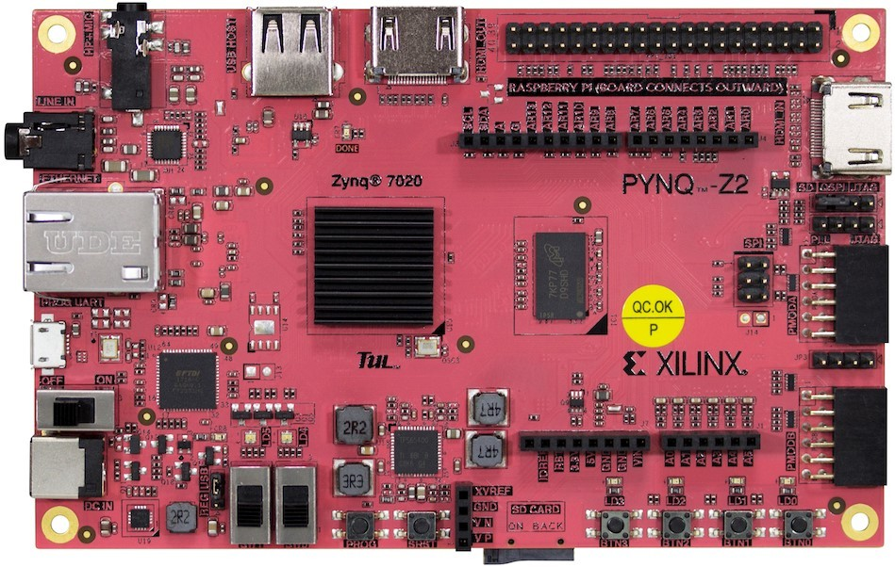
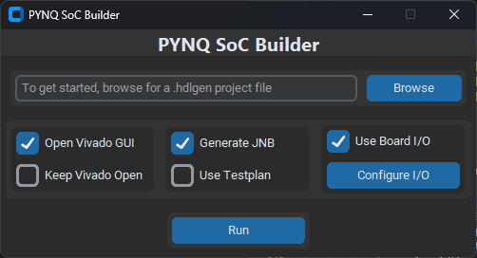
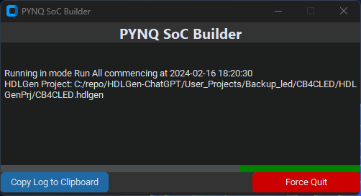
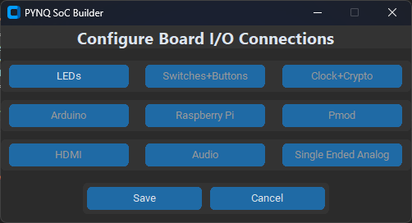
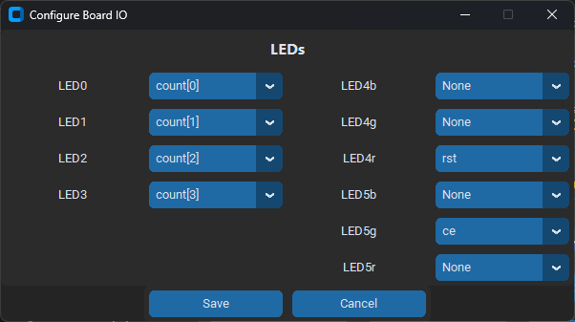
PYNQ Automated System-on-Chip Builder
Luke Canny 19339166 Supervisor: Dr. Fearghal Morgan
Masters Electronic and Computer Engineering Co-assessor: Mr Liam Kilmartin
GitHub.com/HDLGen-ChatGPT/PYNQ-SoC-Builder
6
Project Objectives
PYNQ SoC Builder
The aim of this project is to:
Create a remote PYNQ laboratory for students
Extend the functionality of HDLGen-ChatGPT to automatically deploy projects to PYNQ-Z2 FPGAs
Develop an interactive challenge-based RISC-V learning platform
PYNQ SoC Builder is a standalone Python application which:
Configures Vivado project for PYNQ-Z2 board
Generates and imports PYNQ-Z2 physical constraints
Creates and populates a Vivado Block Design
Configures PYNQ board I/O Connections
Performs synthesis, implementation and bitstream generation
Generates a Jupyter Notebook project based on test plan
Project Overview
This section will either be connected to the objectives section above or added more information :>
HDLGen Project XML Data
PYNQ
SoC
Builder
Output Binaries
.hwh, .tcl, .bit, .ipynb
Name, Description,
Date, Author, Email, Company
Component
Signal Type
Sub-components
Ports
Internal Signals
Architecture
Test Plan
1. Read
Data
2. Prepare a Tcl script which applies build steps in Vivado
6. Export Binaries and JNB to output folder
Remote PYNQ FPGA Laboratory
5. Generate Jupyter NB based on Test plan
The purpose of the remote FPGA laboratory is to make real PYNQ Z2 hardware available to students and enthusiasts.
This is achieved by using a tunnelling service. This service runs as a background daemon on the PYNQ’s ARM processor.
3. Invoke script in Vivado
4. Vivado exports binaries
7. User
uploads
output to
PYNQ
FPGA
PYNQ SoC Builder Main Menu
In Progress Screen
I/O Connections Menu
Sample LED Signal Configuration
RISC-V Challenge-Based Learning Platform
This section will either be connected to the objectives section above or added more information :>
This section is going to be difficult to produce. We will try our best B)
Future Work
Acknowledgements
Automate RISC-V Core Bitstream Creation
Develop a range of RISC-V challenges of varying difficulty
Gather feedback from potential users of RV learning platform
I would like to thank Dr. Fearghal Morgan for his support and guidance, and Roshan George, JP Byrne and Abishek Bupathi for their previous work on HDLGen-ChatGPT, PYNQ and RISC-V.

Slide 3


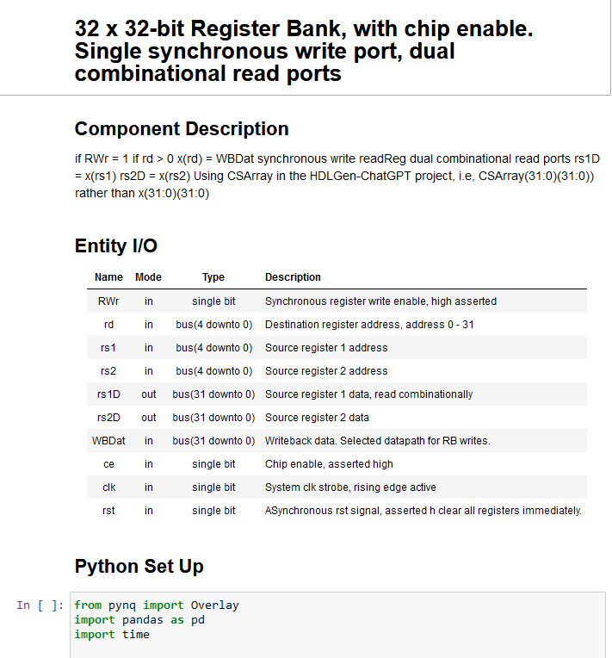
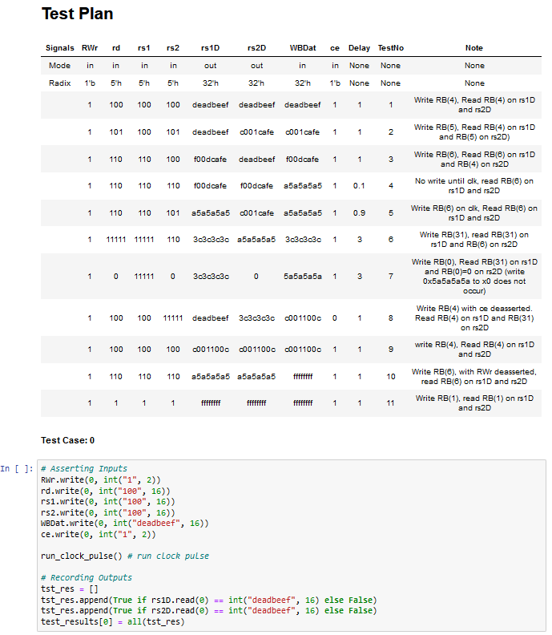


PYNQ Automated System-on-Chip Builder
Luke Canny 19339166 Supervisor: Dr. Fearghal Morgan
Masters Electronic and Computer Engineering Co-assessor: Mr Liam Kilmartin
GitHub.com/HDLGen-ChatGPT/PYNQ-SoC-Builder
6
Project Overview and Objectives
PYNQ SoC Builder
This project is an implementation of three key components required to enable faster SoC project deployment and increase accessibility and interaction between PYNQ FPGA hardware, RISC-V Core implementations and students, enthusiasts and educators.
The aim of this project is to:
Create a remote PYNQ laboratory for students
Extend the functionality of HDLGen-ChatGPT to automatically deploy projects to PYNQ-Z2 FPGAs
Develop an interactive challenge-based RISC-V learning platform
PYNQ SoC Builder is a standalone Python application which builds HDLGen-ChatGPT projects.
HDLGen-ChatGPT is an open-source Python tool developed in the University of Galway to enable fast capture of HDL-based SoC capture and implementation, by automated VHDL/Verilog, testbench and waveform generation.
PYNQ SoC Builder completes the following:
Configures Vivado project for PYNQ-Z2 board
Generates and imports PYNQ-Z2 physical constraints
Creates and populates a Vivado Block Design
Configures PYNQ board I/O Connections
Performs synthesis, implementation and bitstream generation
Generates a Jupyter Notebook project based on test plan
Remote PYNQ FPGA Laboratory
The purpose of the remote FPGA laboratory is to make real PYNQ Z2 hardware available to students and enthusiasts.
This is achieved by using a tunnelling service called ngrok. This service runs as a background daemon on the PYNQ’s ARM processor.
Ngrok secures tunnels over HTTPS by default, encrypting all data transferred over the network. For authentication, ngrok supports OAuth 2.0, which allows users to login using third party platforms. For the duration of this project, users are authenticated by logging in using their @universityofgalway.ie Microsoft accounts.
HDLGen Project XML Data
PYNQ
SoC
Builder
Output Binaries
.hwh, .tcl, .bit, .ipynb
Component Name, Description,
Date, Author,
Email, Company
Sub-Components
Signal Type
Sub-components
Ports
Internal Signals
Architecture
Test Plan
1. Read
Data
2. Prepare a Tcl script which applies build steps in Vivado
6. Export Binaries and JNB to output folder
5. Generate Jupyter NB based on Test plan
Connection is tunnelled through ngrok servers
3. Invoke script in Vivado
4. Vivado exports binaries
7. User
uploads
output to
PYNQ
FPGA
PYNQ SoC Builder Main Menu
In Progress Screen
Jupyter Notebook generated by SoC Builder opened on remote PYNQ accessed over Ngrok Tunnel
I/O Connections Menu
Sample LED Signal Configuration
RISC-V Challenge-Based Learning Platform
The purpose of the RISC-V learning platform through the remote laboratory is to encourage interaction and exploration of RISC-V ISA on real hardware, rather than simulation
The learning platform will consist of two RISC-V cores. One of which the user will program using RISC-V assembly, The other will remain hidden, only visible to the core #1 by I/O ports. Core #2 will imitate a peripheral device.
The goal of the user is to interface with the hidden peripheral. The hidden peripheral changes depending on the difficulty level. For example, an interrupt controller or I²C device.
PYNQ Jupyter Notebook Interface
User uploads assembly to Core #1
User may read memory to view results
Core #1
Core #2
Core #2 runs hidden program
Future Work
Acknowledgements
Automate RISC-V Core Bitstream Creation
Develop a range of RISC-V challenges of varying difficulty
Gather feedback from potential users of RV learning platform
I would like to thank Dr. Fearghal Morgan for his support and guidance, and Roshan George, JP Byrne and Abishek Bupathi for their previous work on HDLGen-ChatGPT, PYNQ and RISC-V.

