Slide 1
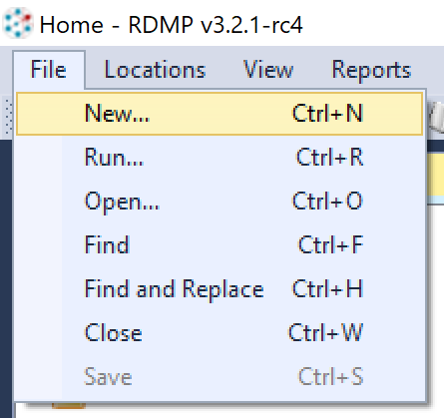
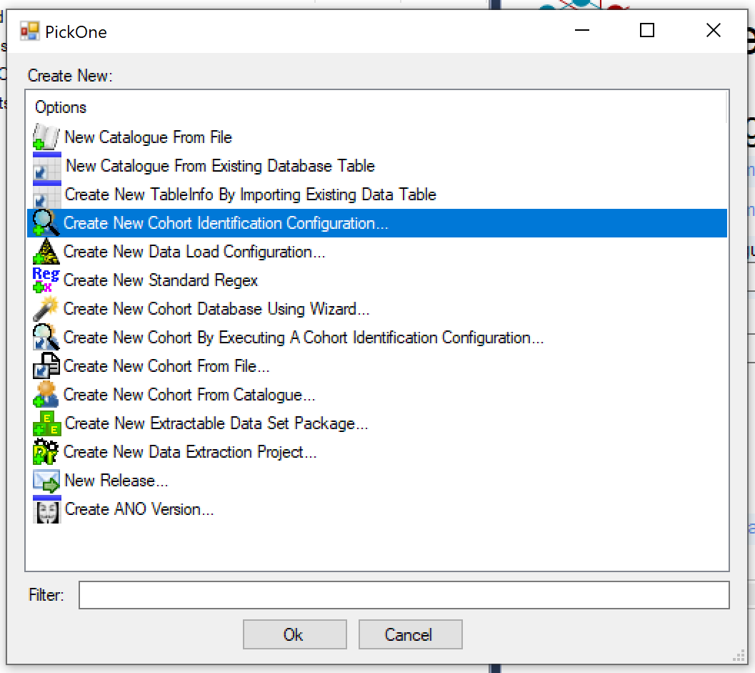
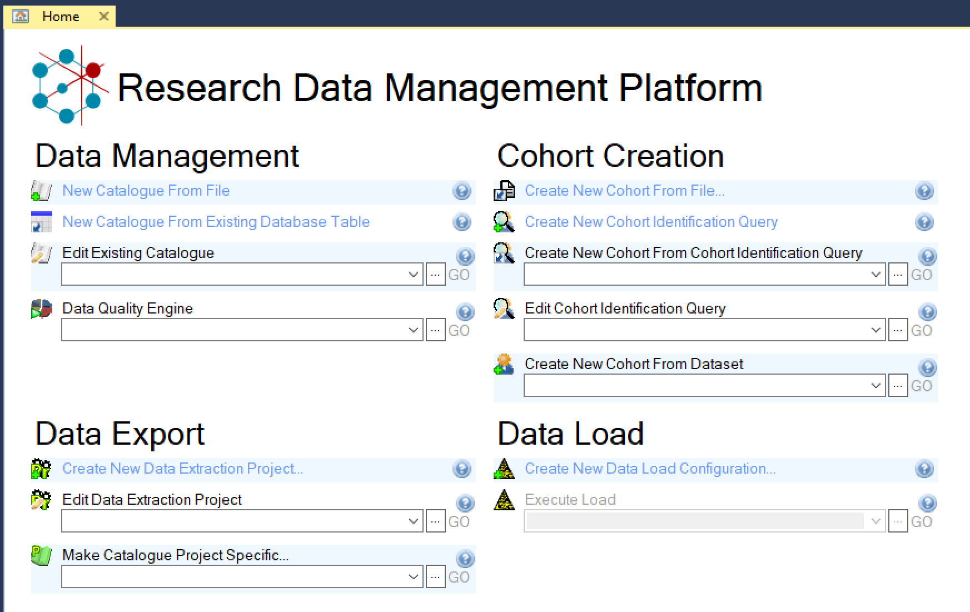

Slide 2
Cohort Generation
Cohort Manager

Slide 3
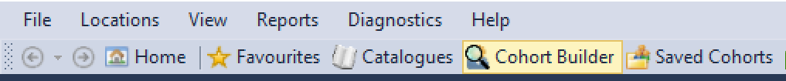
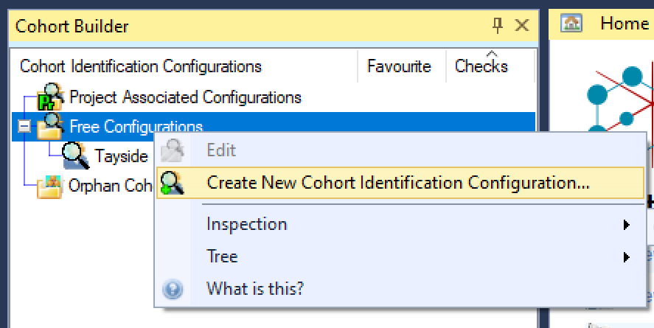
How to open the Cohort Builder
From the Home Screen:
From the File menu:
From the Cohort Builder context menu:
Notes:
All the 3 methods above take you to the Wizard, so it’s really just a matter of preferences and of what people remember.

Slide 4
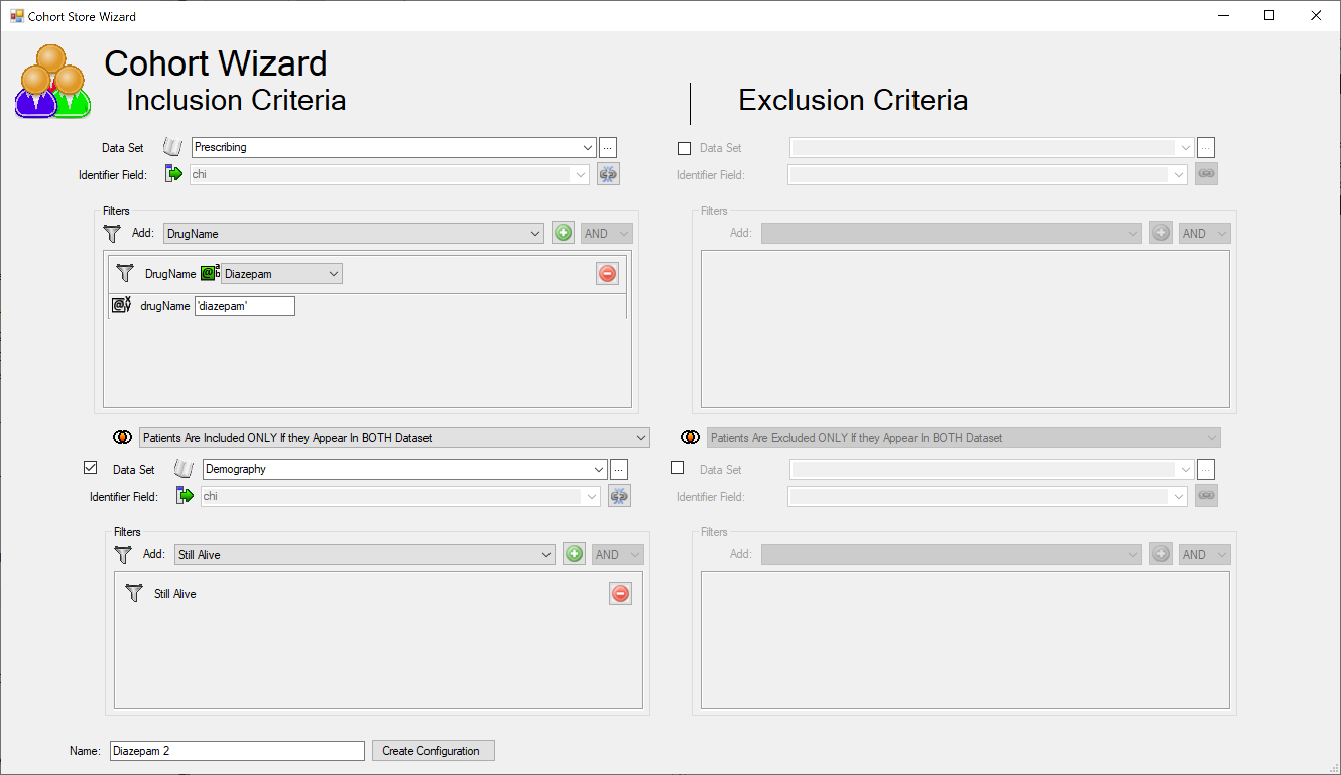
The wizard
First dataset
Filters
Known params
Second dataset
Datasets join type (Union or Intersection)

Slide 5
The wizard
All that you need for simpler cohort
Good for starting more complex cohorts
Gotchas:
Can only use pre-defined filters from datasets (not new ones)
Can only use 2 datasets for inclusion and 2 for exclusion

Slide 6
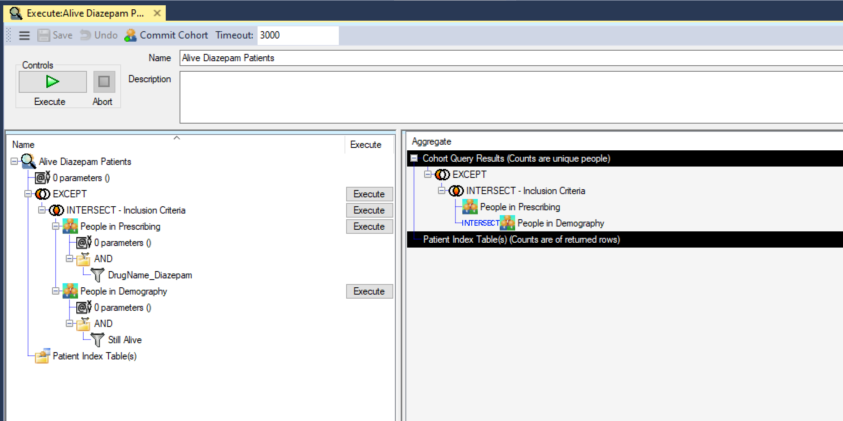
The Result from the wizard
First dataset
Datasets join type
Filters
Second dataset

Slide 7
The sample cohort
“I want all patients who have been prescribed Diazepam for the first time after 2000 and who are still alive today”
Identify distinct sets:
“I want all patients who have been prescribed Diazepam¹ for the first time after 2000² and who are still alive today³”
Then identify set interactions…

Slide 8
Sets interaction
Set 1
People who have ever had Diazepam prescriptions
Set 2
People who collected diazepam prescriptions before 2000
Set 3
People who are still alive
Set 1 EXCEPT Set 2
People who have ever had Diazepam prescriptions only after 2000
(Set 1 EXCEPT Set 2) INTERSECT Set 3
People who have ever had Diazepam prescriptions only after 2000 and are still alive

Slide 9
Translate into tree structure
The outermost operation becomes the root
INTERSECT in this case
Every operand is on the same level
“Set 3” and “(Set 1 EXCEPT Set 2)”
Other operations become a node
The EXCEPT in this case
Other operands are nested
“Set 1” and “Set 2”
Order is important!
(Set 1 EXCEPT Set 2) is different than (Set 2 EXCEPT Set 1)
Operation with 0 or 1 child will be flagged
(Set 1 EXCEPT NIL) is the same as just Set 1
(Set 1 EXCEPT Set 2) INTERSECT Set 3
People who have ever had Diazepam prescriptions only after 2000 and are still alive

Slide 10
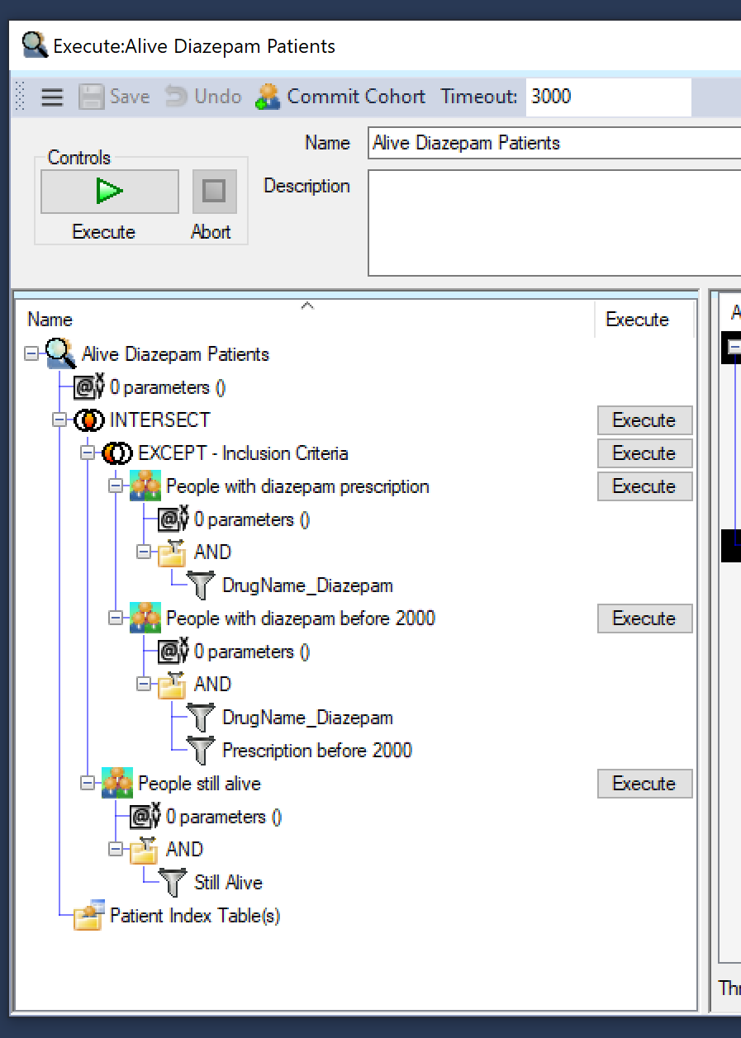
The result
INTERSECT
EXCEPT
People who have ever had Diazepam prescriptions
People who collected Diazepam prescriptions before 2000
People who are still alive

Slide 11
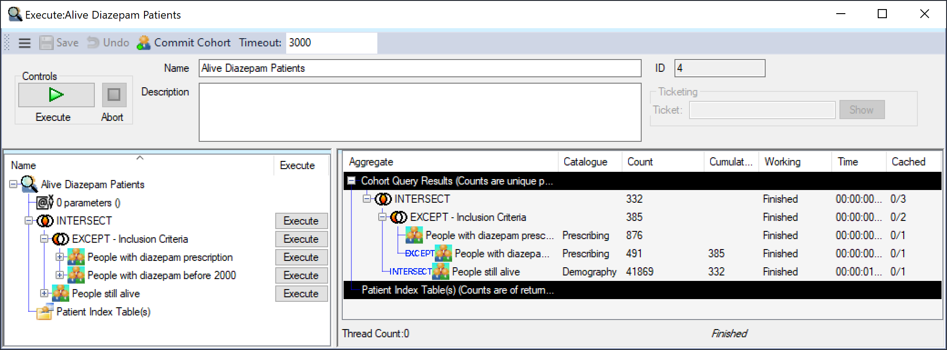
Execute
The system will decide an appropriate caching strategy if a Caching DB has been set (not in this example)
Execute full Cohort Query
Individual & cumulative patients counts
Execute subqueries individually

