Slide 1
RDMP
Understanding the main UI

Slide 2
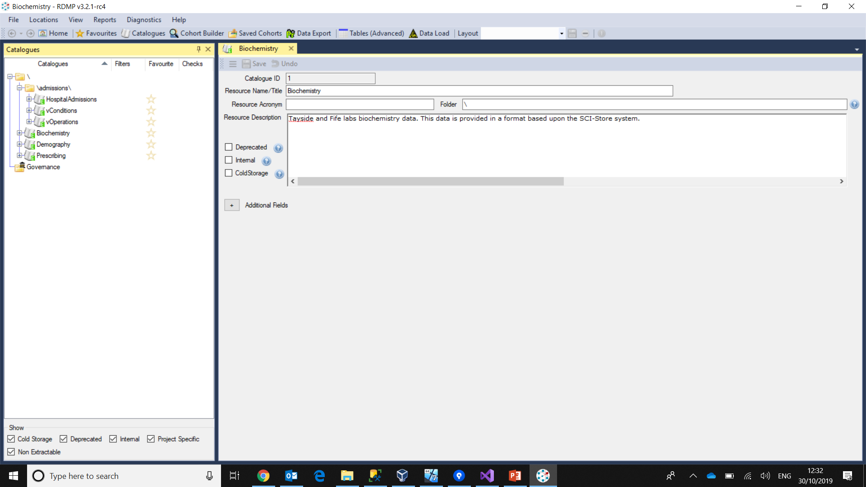
At a glance
Menu area
Collection area: list of all elements of a particular type
Working area: main activities happen here (editing a Catalogue, running a cohort builder, etc.)

Slide 3
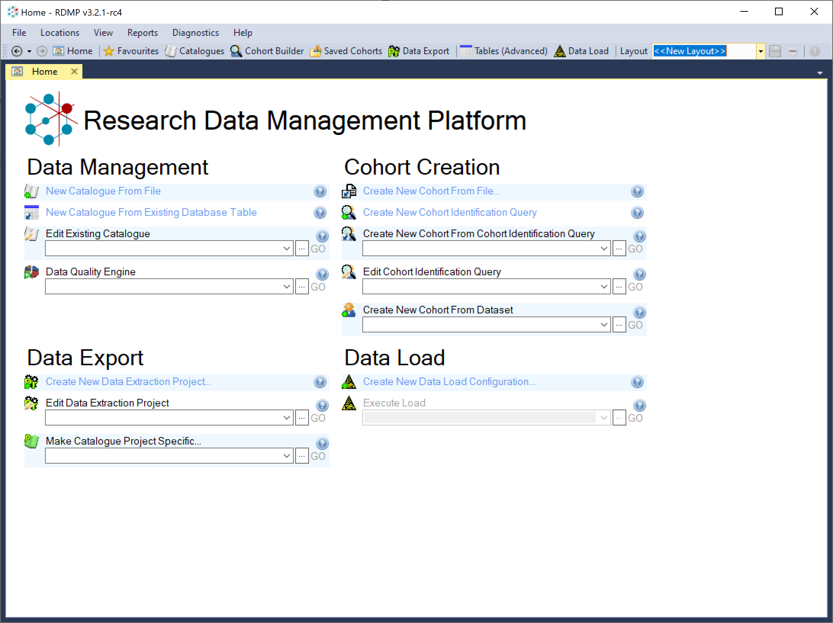
Top menu
Home button
More advanced functions
Save and retrieve windows layout
Main functions

Slide 4
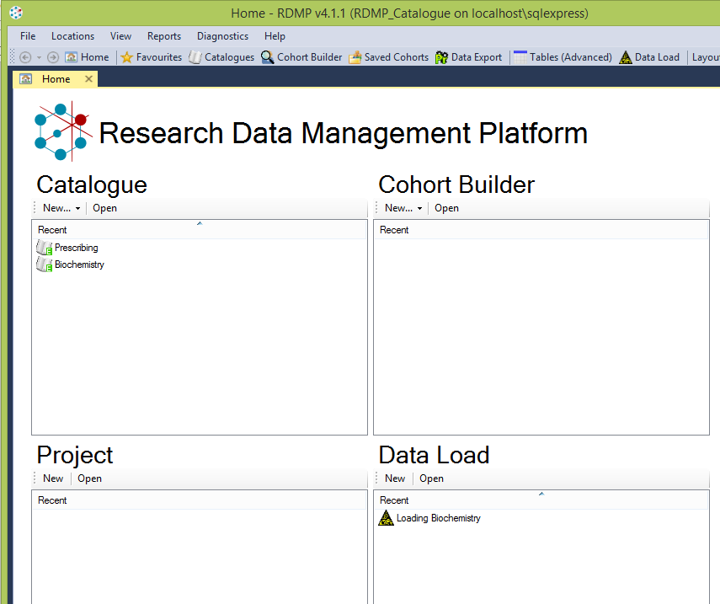
Home
Notes:
Quick access to some of the more used functionality of RDMP. Always good to start here or go back here when starting new work

Slide 5
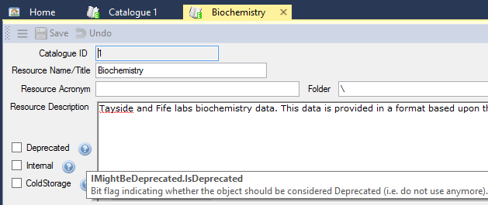
Help!
You can hover on top of almost every item to receive a brief help of the function performed
Where you see a help button, clicking it will show some more information
Hover or click here for more help
Hover here for more help

Slide 6
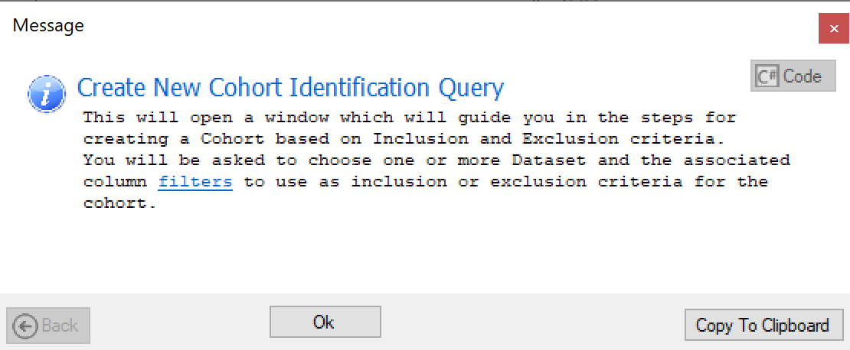
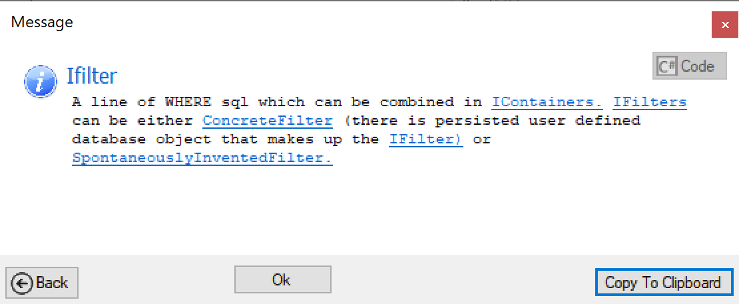
Help can be navigated
Click here for more help
Continue browsing…
… or go back

Slide 7
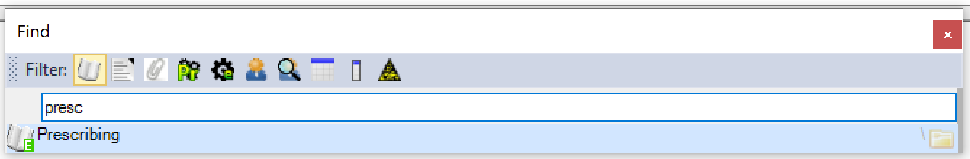
Find your work
Filter the object type(s) you want to find…
File -> Find…
File -> Open…
Ctrl-F
…start typing
Click or press Enter to open

Slide 8
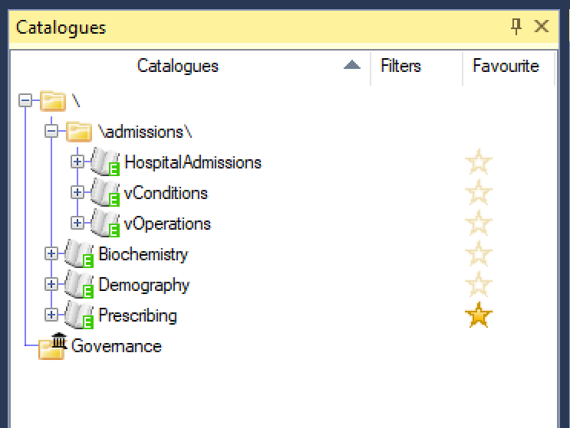
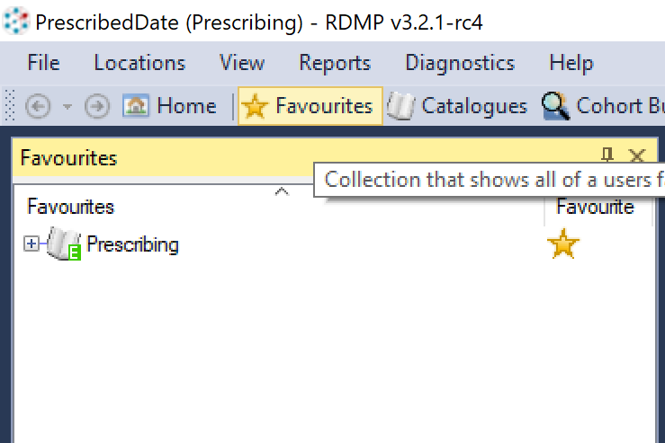
Find your work 2: Favourites
Find it in the “Favourites” list
Add something to your Favourites
This can contain object of various types (Catalogues, Projects, Cohorts, etc)

Slide 9
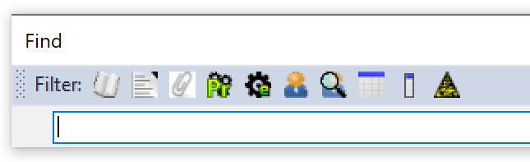
I’m lost!
Go Home!
This will always reset the windows layout
File -> Open… or Find… (Ctrl-O or Ctrl-F)
“Find” will find the object you want and pin it to the left, it will not alter the windows layout
“Open” will set up the layout in a meaningful manner to work with the chosen item

Slide 10
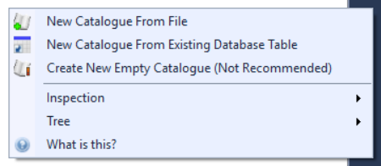
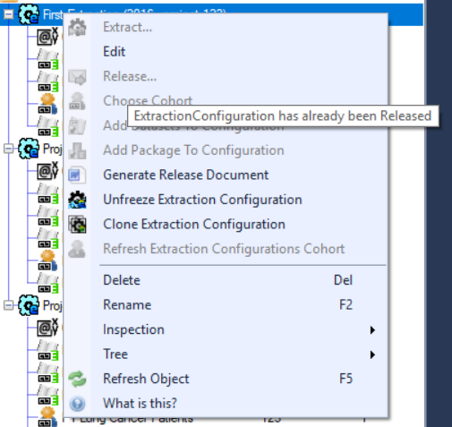
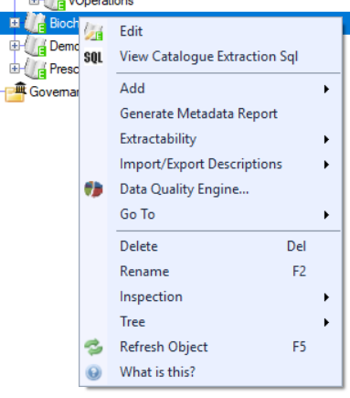
Context menu
You can “right click” on pretty much everything!
On empty space it will give most “Create…” options
If a command is greyed out, hover on it to see why!
On an object it will show the most useful related actions

