Slide 1
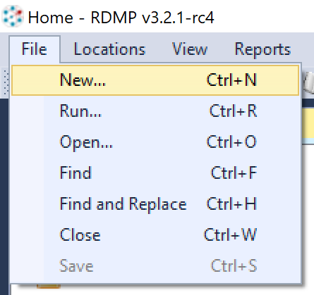
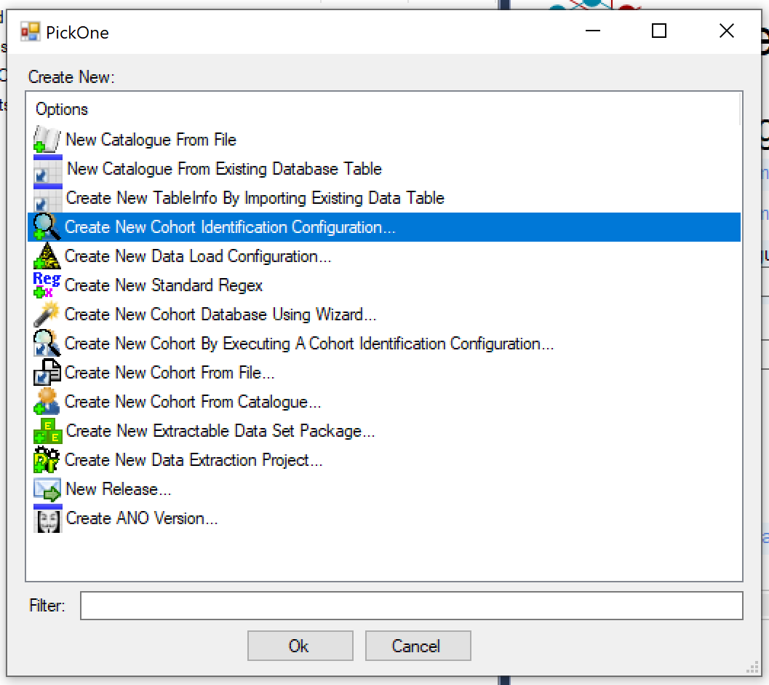
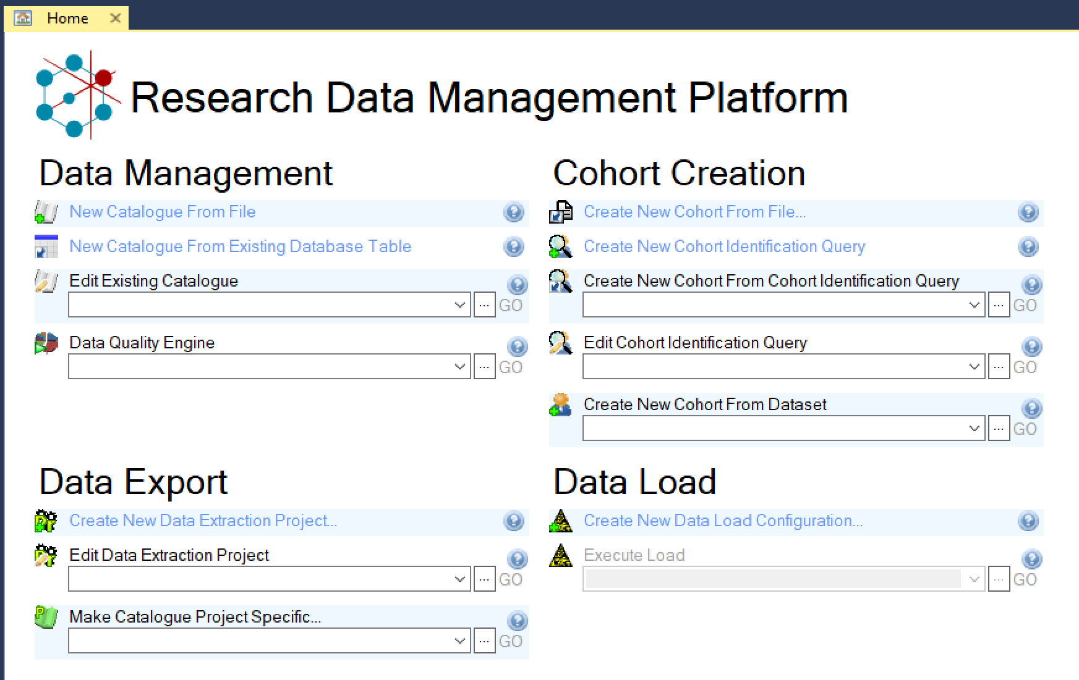

Slide 2
Cohort Generation
Cohort Manager

Slide 3
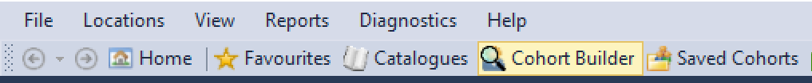
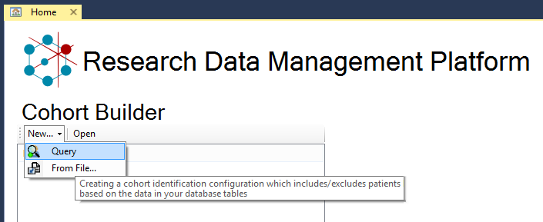
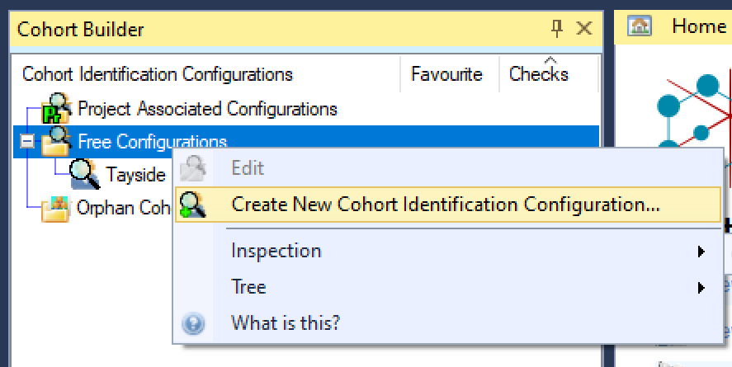
How to open the Cohort Builder
From the Home Screen:
From the File menu:
From the Cohort Builder context menu:
Notes:
All the 3 methods above take you to the Wizard, so it’s really just a matter of preferences and of what people remember.

Slide 4
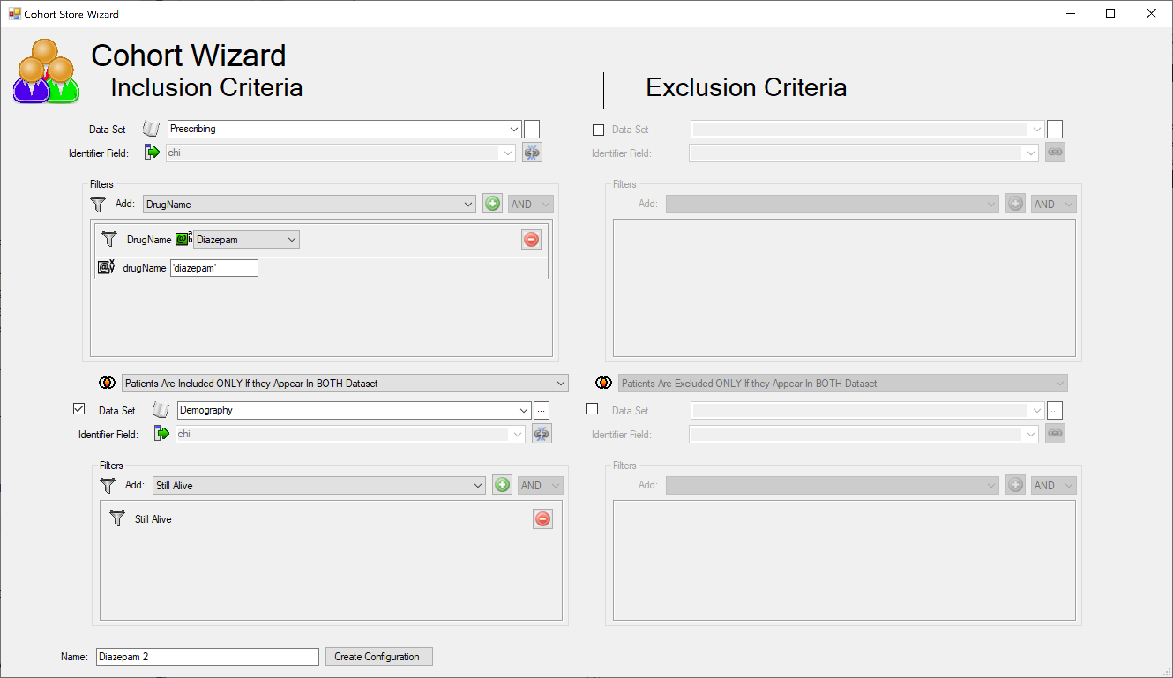
The wizard
First dataset
Filters
Known params
Second dataset
Datasets join type (Union or Intersection)

Slide 5
The wizard
All that you need for simpler cohort
Good for starting more complex cohorts
Gotchas:
Can only use pre-defined filters from datasets (not new ones)
Can only use 2 datasets for inclusion and 2 for exclusion

Slide 6
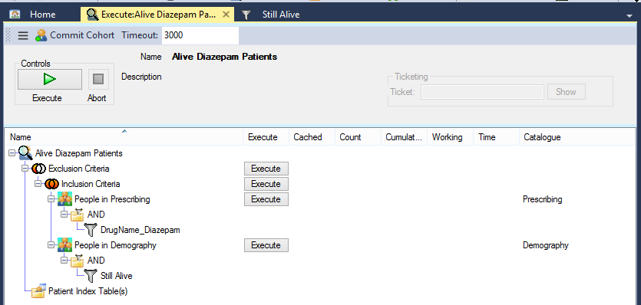
The Result from the wizard
First dataset
Datasets join type
Filters
Second dataset

Slide 7
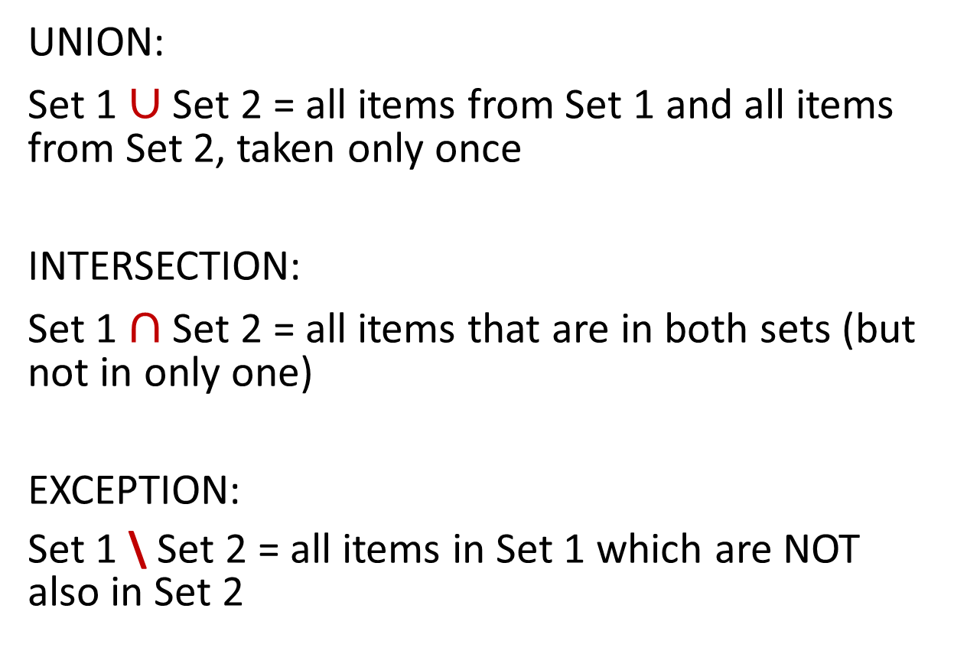
A bit of Set Theory
UNION:
Set 1 $∪$ Set 2 = all items from Set 1 and all items from Set 2, taken only once
INTERSECTION:
Set 1 $∩$ Set 2 = all items that are in both sets (but not in only one)
EXCEPTION:
Set 1 \ Set 2 = all items in Set 1 which are NOT also in Set 2
Set 1
Set 2

Slide 8


Visually
A $∩$ B
A $∪$ B
A \ B

Slide 9
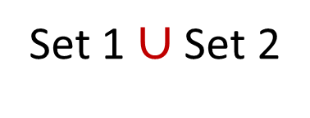
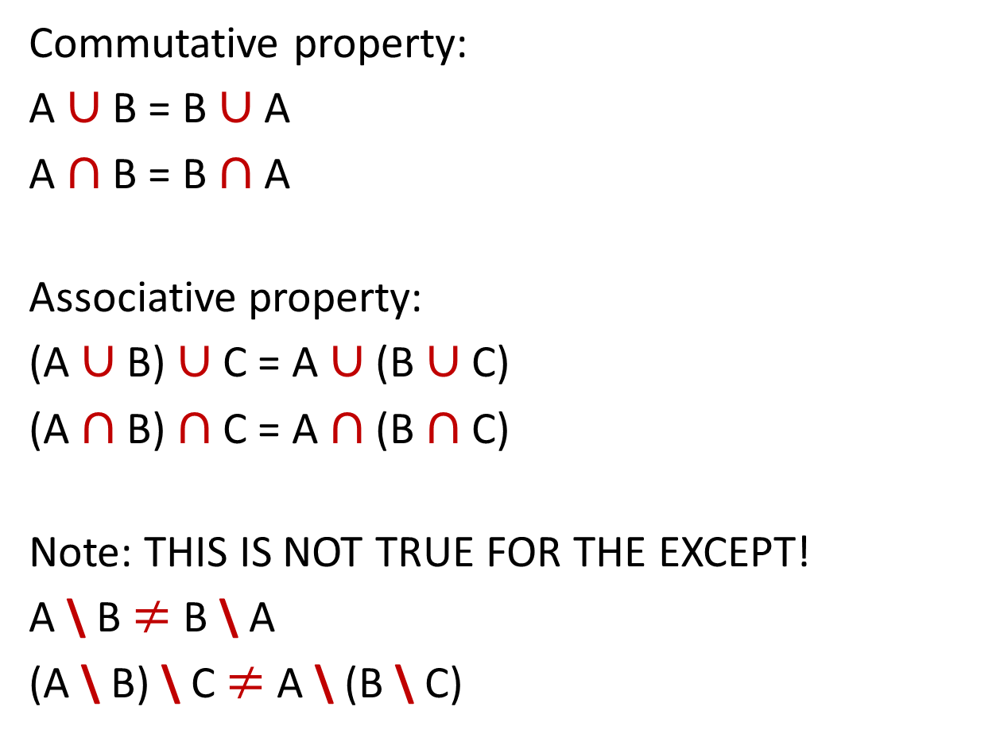
A bit of Math
Commutative property:
A $∪$ B = B $∪$ A
A $∩$ B = B $∩$ A
Associative property:
(A $∪$ B) $∪$ C = A $∪$ (B $∪$ C)
(A $∩$ B) $∩$ C = A $∩$ (B $∩$ C)
Note: THIS IS NOT TRUE FOR THE EXCEPT!
A \ B $≠$ B \ A
(A \ B) \ C $≠$ A \ (B \ C)
Set 1 $∪$ Set 2
OPERATOR
LEFT OPERAND
RIGHT OPERAND

Slide 10
The sample cohort
“I want all patients who have been prescribed Diazepam for the first time after 2000 and who are still alive today”
Identify distinct sets:
“I want all patients who have been prescribed Diazepam¹ for the first time after 2000² and who are still alive today³”
Then identify set interactions…

Slide 11
“I want all patients who have been prescribed Diazepam¹ for the first time after 2000² and who are still alive today³”
Set 1
People who have ever had Diazepam prescriptions
Set 2
People who collected diazepam prescriptions before 2000
Set 3
People who are still alive
Set 1 EXCEPT Set 2
People who have ever had Diazepam prescriptions only after 2000
(Set 1 EXCEPT Set 2) INTERSECT Set 3
People who have ever had Diazepam prescriptions only after 2000 and are still alive

Slide 12
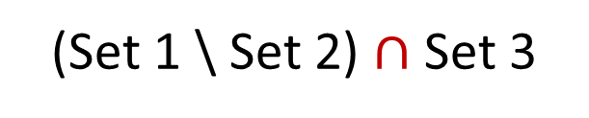
“I want all patients who have been prescribed Diazepam¹ for the first time after 2000² and who are still alive today³”
(Set 1 \ Set 2) $∩$ Set 3
(Set 1 EXCEPT Set 2) INTERSECT Set 3
People who have ever had Diazepam prescriptions only after 2000 and are still alive

Slide 13
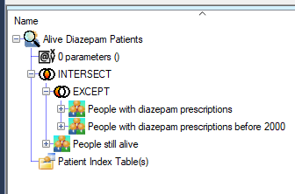

Place into tree structure
The outermost operation becomes the root
Every operand is on the same level
Other nested operations become a node
Order is important!
Operation with 0 or 1 child will be flagged
(Set 1 \ Set 2) $∩$ Set 3

Slide 14
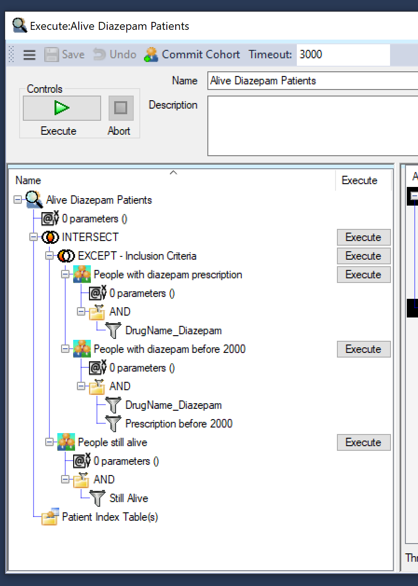
The result (expanded)
INTERSECT
EXCEPT
People who have ever had Diazepam prescriptions
People who collected Diazepam prescriptions before 2000
People who are still alive

Slide 15
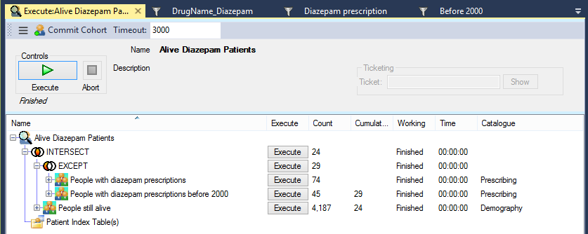
Execute
Individual & cumulative patients counts
Execute full Cohort Query
Execute subqueries individually

Slide 16

Using patient index tables
INDEX:
Aggregate:
Patients’ first prescription having YEAR >= 2000
Filter:
Name = ‘diazepam’
Cohort Set:
People who are still alive
Important: you have to select the MIN prescription date, GROUPING by the patient CHI and HAVING the year of prescription >= 2000.
If you use a WHERE you risk getting patients prescribed before 2000. We’ll look at the demo later

Slide 17
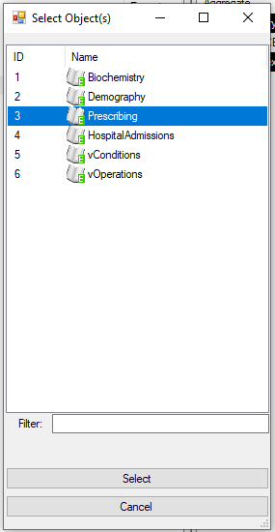
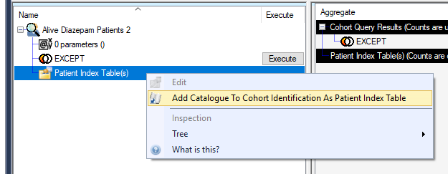
Create the Index
Right click and Add a Catalogue to the P.I.T.
Select “Prescribing”

Slide 18
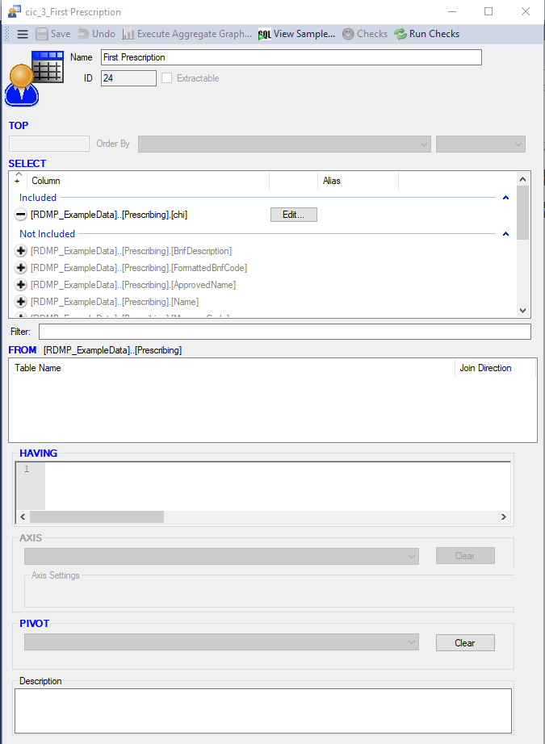

Create the Index
Here you can change the name
Here you can select what columns to use
Double click to get into the Edit screen
If available, here you can add JOINs…
…with an optional condition

Slide 19
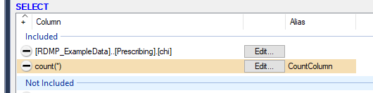
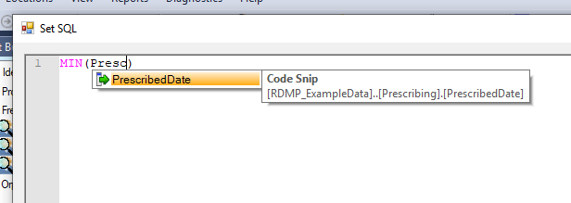
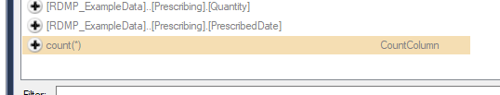
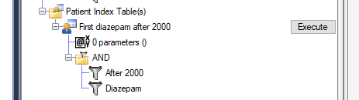
Create the Index
Click on “Edit…”
Click here to change the Alias
From here…
Select the aggregate column (which is count(*) by default)
Change to the desired aggregate
Finish up adding the filters as usual
Notes:
The index still needs to be joined to a cohort set, but at least the “View Sample” will show the SQL query generated.

Slide 20
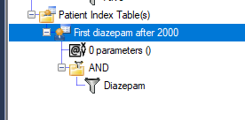
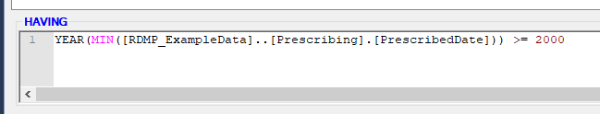
Create the Index
Click on “Edit…”
Click here to change the Alias
From here…
Select the aggregate column (which is count(*) by default)
Change to the desired aggregate
Specify your HAVING clause
Finish up adding the name filter as usual
Notes:
The index still needs to be joined to a cohort set, but at least the “View Sample” will show the SQL query generated.

Slide 21
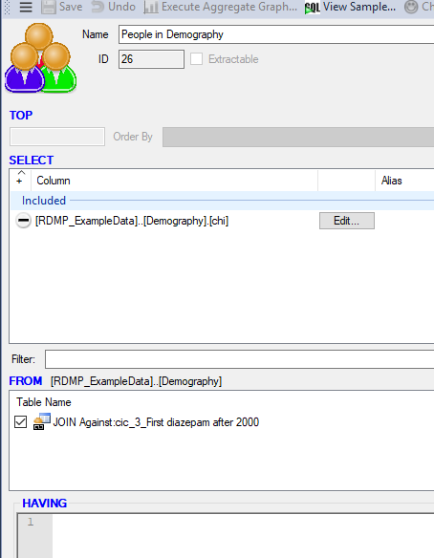
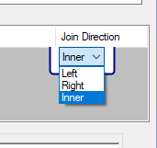
Create the JOINed cohort set
After you add a Catalogue go into Edit by double-clicking
Here you can now JOIN with the Index Table…
…and REMEMBER to change the JOIN type!

Slide 22
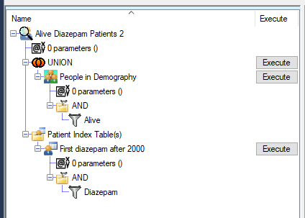
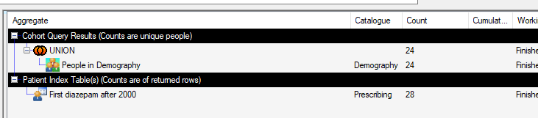
The result (and execution)
Alternatively, the “After 2000” can be added as a filter in the “People in Demography” cohort set instead of the HAVING clause in the Patient Index Table

