Slide 1

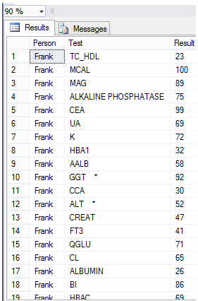
Input File (e.g. CSV)
(+100 more columns)
Table Populated
KVPAttacher

Slide 2
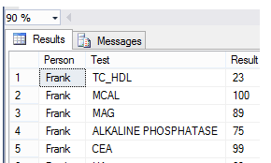
Optional - Primary Key Column(s)
Input File
Primary Key Column
Primary Key Column(s) are optional. They refer to columns that appear in the data table which are not reinterpreted into KeyValue pairs. Instead each column is preserved into the key / value row with it’s original value
Primary Key Column
Appears on every row
Resulting Table
(After KVPAttacher run)

Slide 3


Pipeline
KVP values surmised and imported into RAW bubble
All files matching FilePattern are passed through load pipeline.
(Note that Pipeline is created and executed from scratch for each File.)
KVPAttacher
Hosted Pipeline (PipelineForReadingFromFlatFile)
Pipeline
Source
Pipeline
Middle
Pipeline
Middle
Pipeline
Destination
(KVPAttacher)

