Slide 1




1. Unconstrained version created
80% of errors
3
3
2. Mirror created
19% of errors
3
Input file
RAW
STAGING
LIVE

Slide 2
STAGING (New records being loaded)
LIVE (Existing records)
LabResult:300 Test Code: ABC Result 0.00
Novel Primary Key: Inserted
LabResult:103 Test Code: ABC Result 11.20
Same Primary Key: Update
LabResult:103 Test Code: ABC Result 00.00
LabResult:106 Test Code: Hz1 Result 0.00
Exact Duplicate: Ignored
LabResult:106 Test Code: Hz1 Result 0.00
LabResult:105 Test Code: ABC Result 1.10
A dataset where the primary key is LabResult which is
assigned by the data provider and globally unique within
their system. Occasionally they correct/adjust the results
of old tests based on their regular QC process. This means
we receive a volatile record set with some new records,
some old ones and some which have updated result values.
LabResult:104 Test Code: ABC Result 3.12
Old State Stored
In Archive
LabResult:103 Test Code: ABC Result 0.00
LIVE Archive (longitudinal history of each Primary Key)

Slide 3
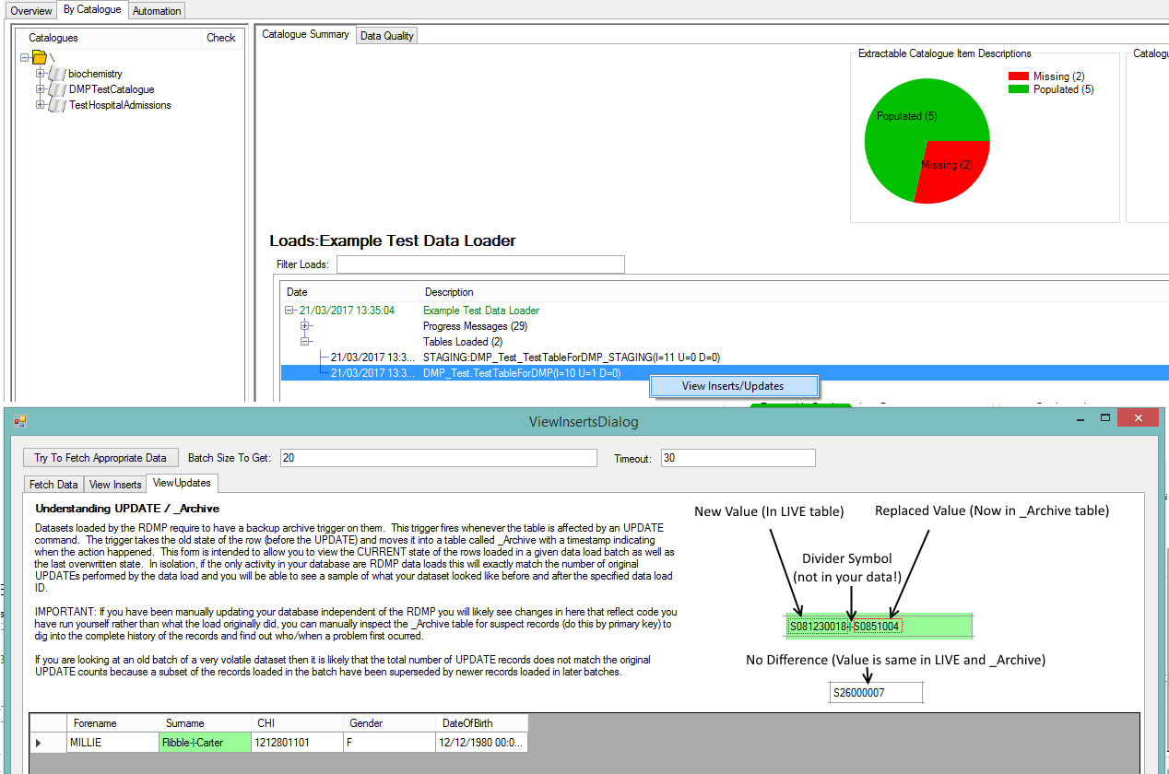
Dataset being loaded
Load History
Table(s) Loaded
Record(s) that changed value

