Slide 1
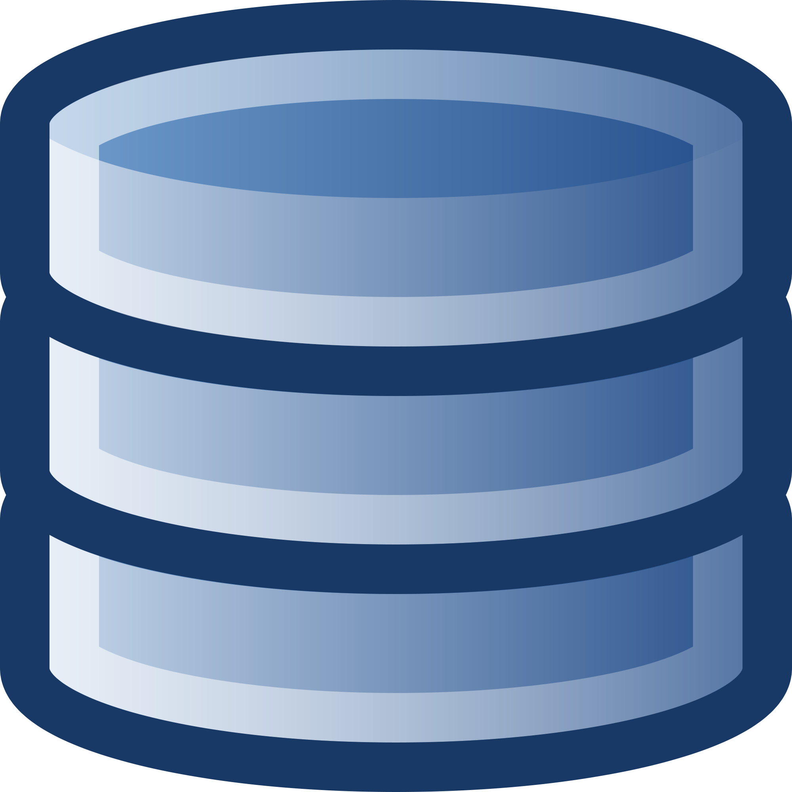

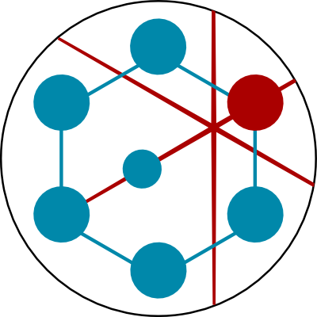
Secure Network
Contains
Information About
Platform Databases
Data Repository(s)
RDMP User
RDMP User
RDMP User

