Slide 1

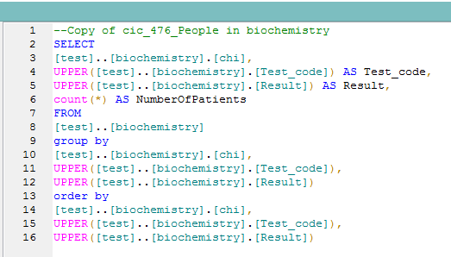

Slide 2
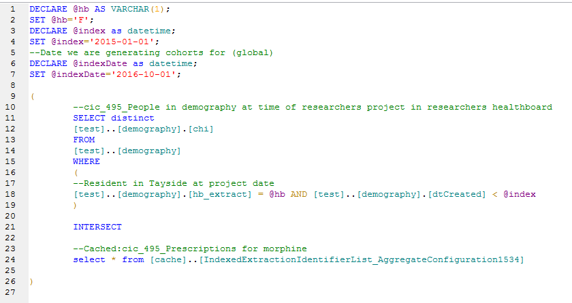


Metadata Objects
Query Builder
SQL
Catalogue Database

Slide 3
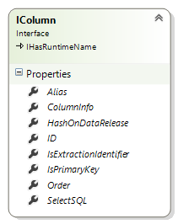
Query Builder Might Produce:

Slide 4
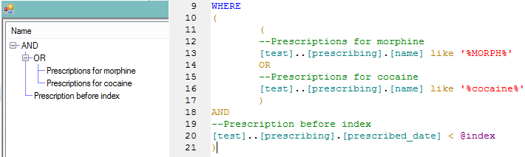
IContainers
IFilters

