Slide 1


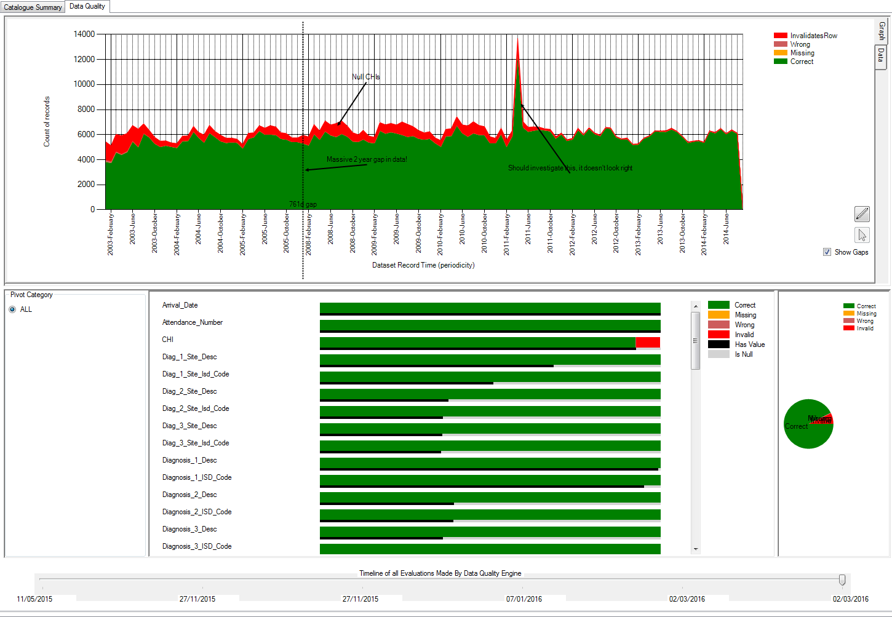
Extractable Columns
Verbatim Columns
Transformed
Columns
Data Catalogue
Query Builder
Data Repository
Validation Rules
Extraction ‘View’ of Records
Consequence
Extraction
‘View’ of
Records
Consequence
Computes worst consequence per row
By data load batch
By month in dataset time
By date of evaluation
By pivot category
Computes worst consequence per column
By month in dataset time
By date of evaluation
By pivot category
Rule
Consequence
Rule
Rule
Data Quality Engine
Results
Annotations
All results
from all executions
Data Quality Engine
Results Database
Dashboard

