Slide 1
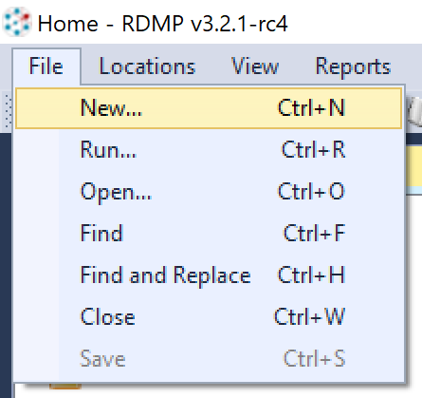
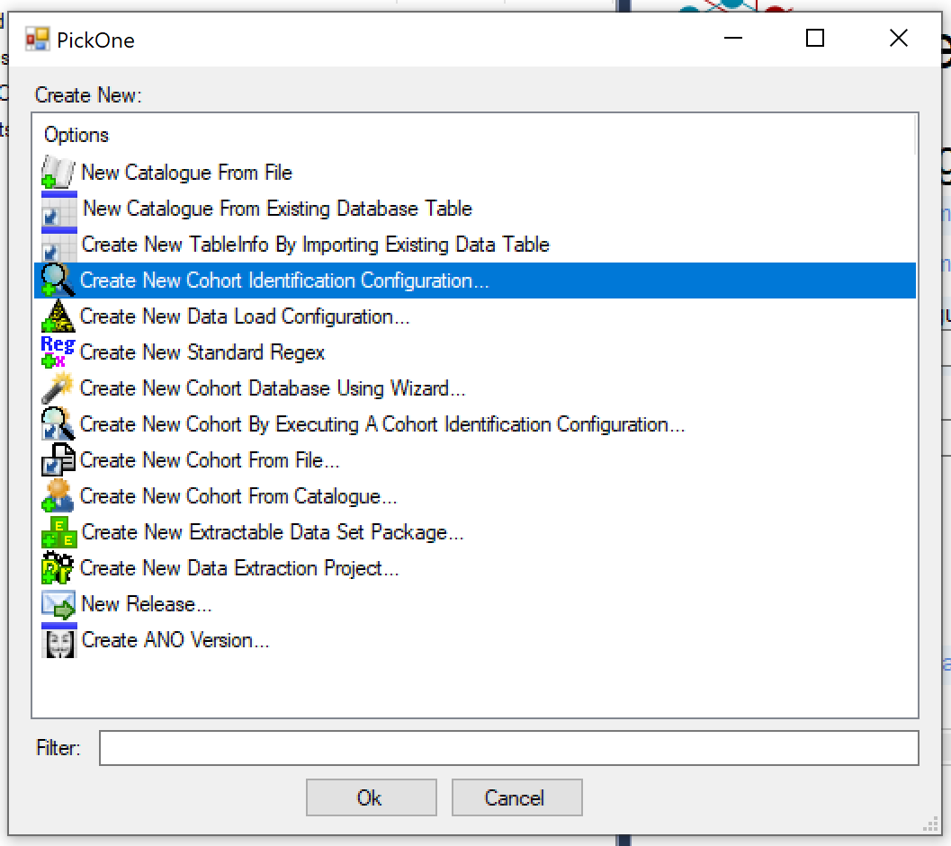
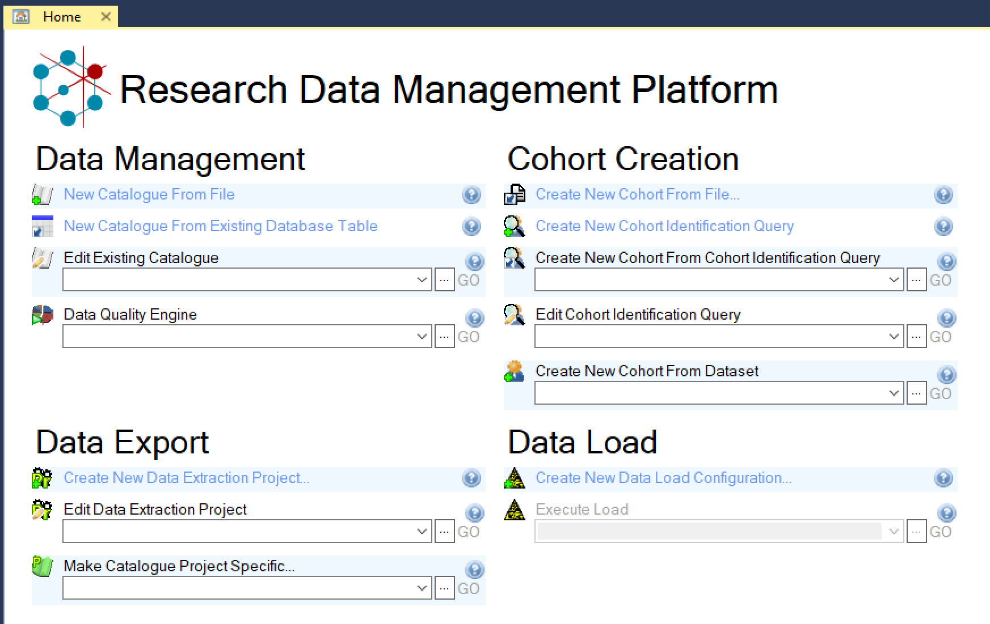

Slide 2
Cohort Generation
Cohort Manager

Slide 3
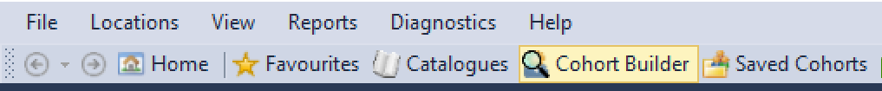
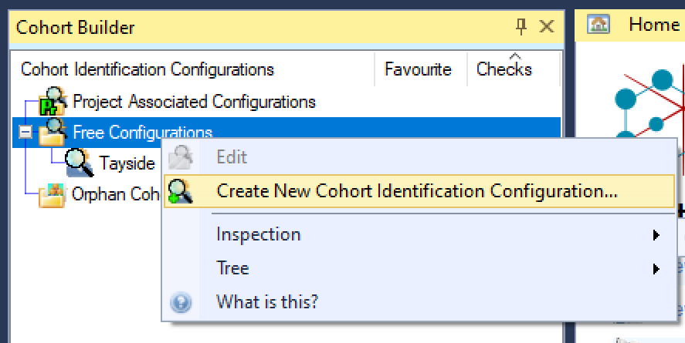
How to open the Cohort Builder
From the Home Screen:
From the File menu:
From the Cohort Builder context menu:

Slide 4
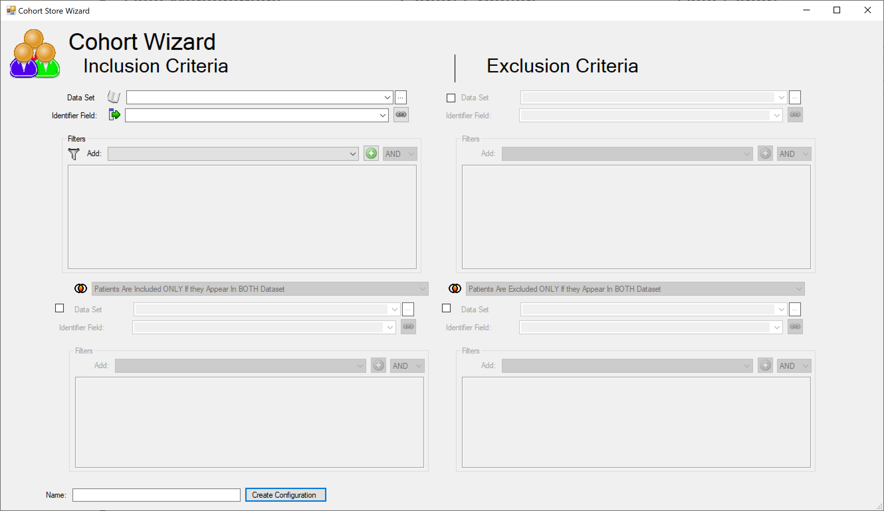
The wizard

Slide 5
The wizard
“I want all patients who have been prescribed Diazepam¹ for the first time after 2000² and who are still alive today³”

Slide 6
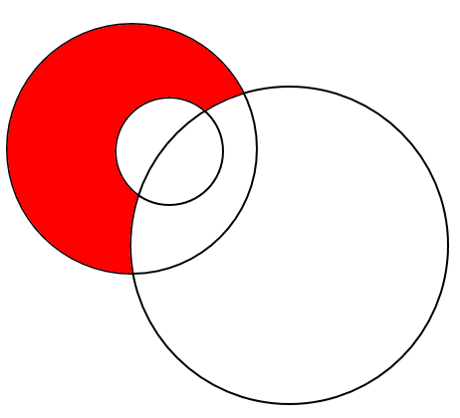
Set 2
People who collected diazepam prescriptions before 2000
Set 1
People who have ever had Diazepam prescriptions
Set 1 EXCEPT Set 2 EXCEPT Set 3
People who were prescribed diazepam for the FIRST time after 2000 and are alive today
Set 3
People who are dead
Set 3 EXCEPT Set 1
People who are dead and have never been prescribed Diazepam
Set 2 EXCEPT Set 3
People who were prescribed diazepam before 2000 and are still alive
Set 2 INTERSECT Set 3
People who were prescribed diazepam before 2000 and are now dead
Set 3 INTERSECT Set 1 EXCEPT Set 2
People who were prescribed diazepam for the first time after 2000 and are now dead

Slide 7

Physical Diagram - Simple Case (1 data server)
Database Server
Database 1
Database 2
Query 1
Query 2
Q1+Q2
RDMP Software
Inclusion Criteria (UNION)
Query 1
People on diabetic drugs
Query 2
People with a diabetic hospital admission
User Account with read access to server

Slide 8
Physical Diagram – Complex Case (2 servers)
Caching Server
Database Server
Database Server
Cache Database
Database 1
Database 2
Query 1
Query 2
Query 1
Query 2
RDMP Software
UNION Q1+Q2
UNION Q1+Q2
RDMP Software
Cached identifiers only
User Account with:
read access to database1
write access to cache
User Account with:
read access to database2
write access to cache

Slide 9
Complex Case 2 - Restrictions
All users:
Share access to the same ‘query building configuration’
Cannot execute queries for which they do not have access to the underlying database/server
Can execute queries which have cached results
Cannot modify any queries which are cached*
Cache only stores identifiers
Added benefit
Queries can run on a ‘substitution layer’ or any magic number strategy
There can be multiple cache databases for different projects if required
Cached queries have SQL executed stored and versioned such that any change invalidates the cached identifier list. In future we can add read-only decorations to the UI too if we want to prevent users accidentally invalidating cached results

Slide 10
Define starting dataset(s)
Select distinct chi from Biochemistry
Biochemistry
List of unique chis
Select distinct chi from Biochemistry
Biochemistry
List of unique chis
Select distinct chi from Demography
Demography
List of unique chis

Slide 11
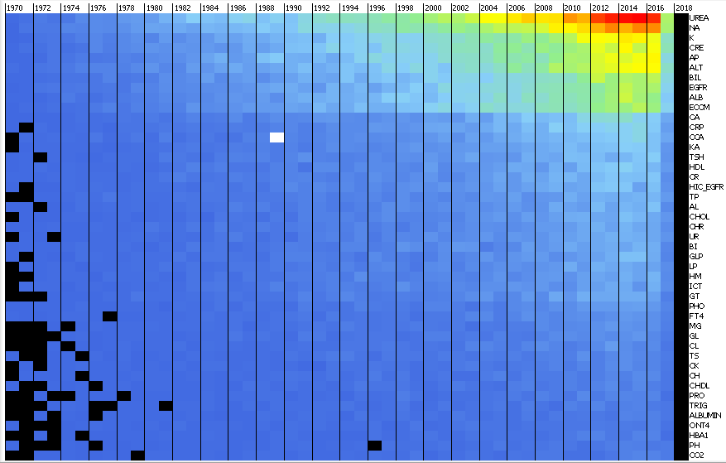
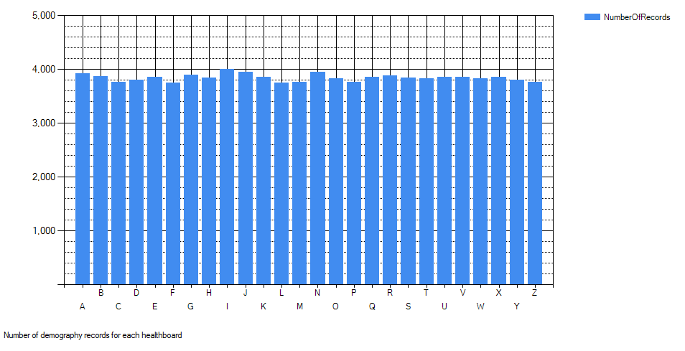
Create a simple graph for the dataset(s)
Biochemistry
Demography

Slide 12
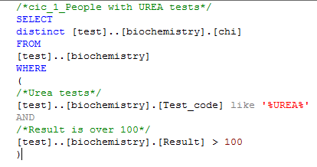
Add filters and rename set
Biochemistry
People with UREA
Tests over 100
List of unique chis
Biochemistry
People with
Sodium tests
People who have
Ever Been residents
Of Fife

Slide 13
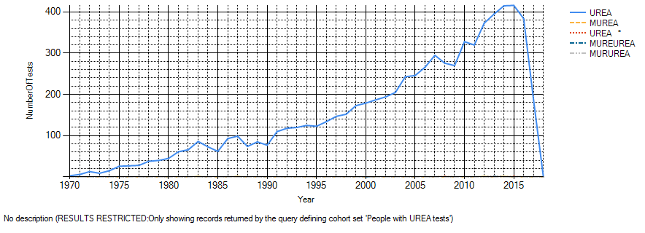
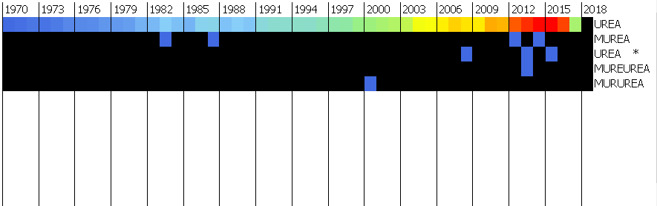
Check each set(s) by combining with existing graph(s)
Biochemistry
People with UREA
Tests over 100
Count = 7104

Slide 14
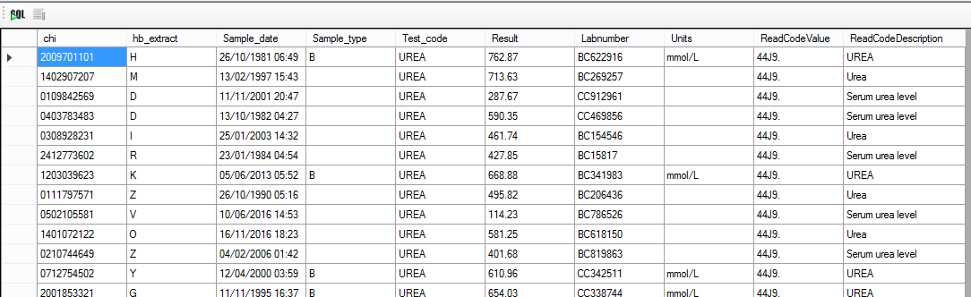
Check each set(s) by viewing sample of matched records
Biochemistry
People with UREA
Tests over 100
Count = 7104

Slide 15
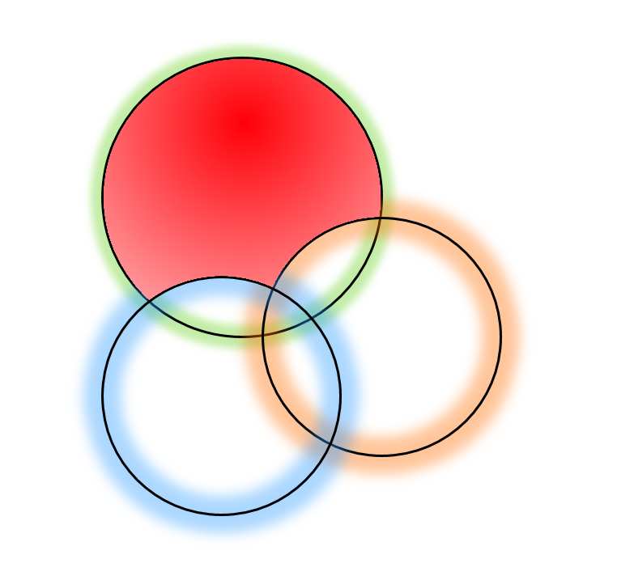
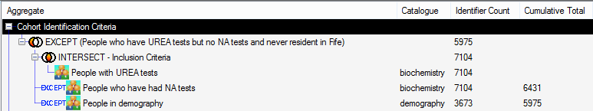
Combine sets to answer final question
Biochemistry
People with UREA
Tests over 100
People who have a UREA test over 100
Who have never had a Sodium (NA) test
And have never been resident in Fife
5,975 Patients
Biochemistry
People with
Sodium tests
People who have
Ever Been residents
Of Fife

Slide 16
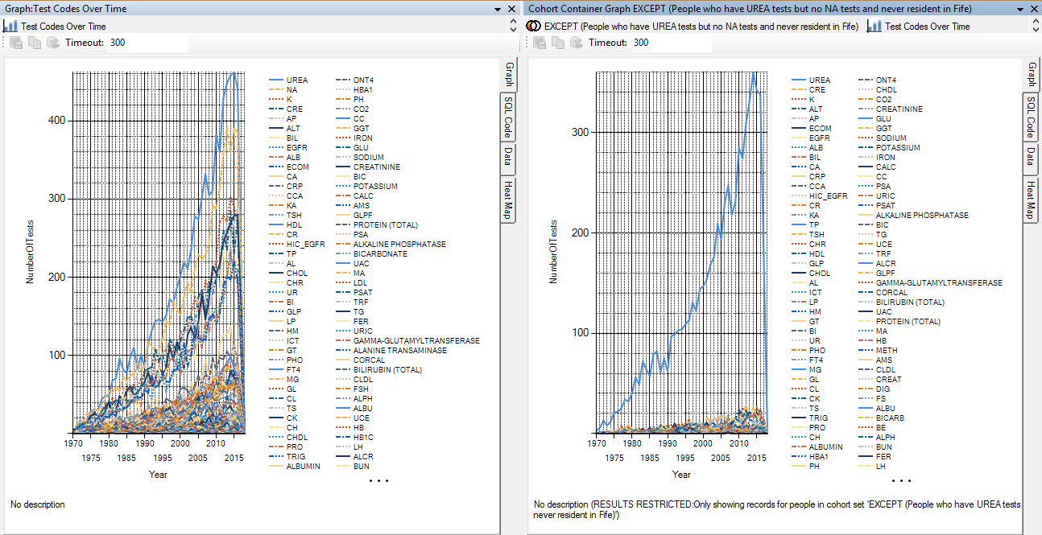
Run Graphs on Final Matched Patients
All Biochemistry Records
Biochemistry records of patients in final cohort

Slide 17
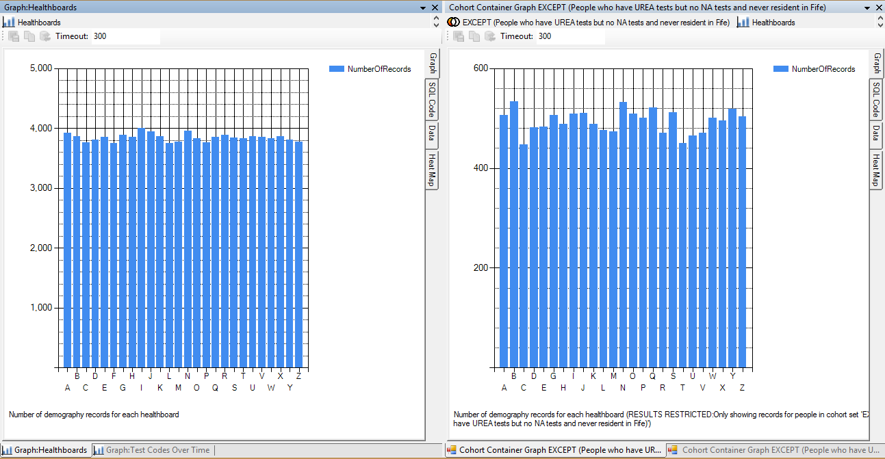
Run Graphs on Final Matched Patients
All Demography Records
Demography records of patients in final cohort

Slide 18
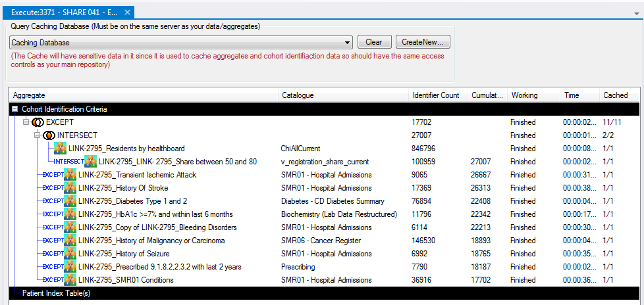
DLS Example

