Slide 1
HDS - Design Review

Slide 2
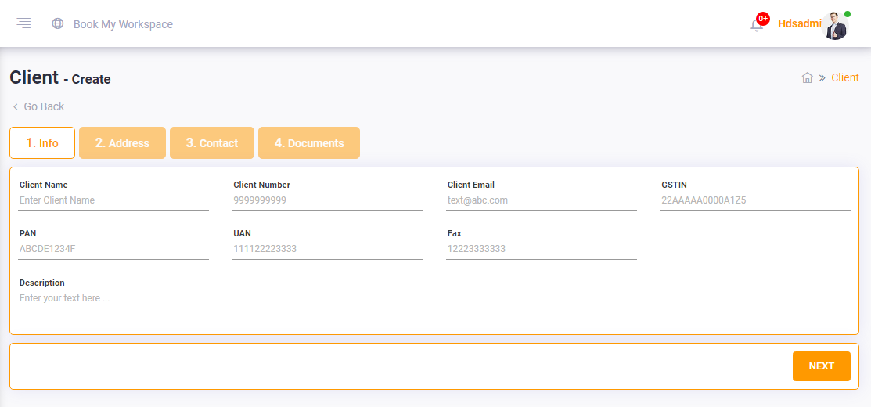
Phase-2
Assumptions:
Superadmin will onboard operators.
SuperAdmin will collect all the details first and fill in the form.
Operator knows why these info is required.
Onboard Operators
Design Comments
Form has not been designed based on how the user will come into the platform.
Customer signup entry points need to be considered
Description field needs guidance on filling. Why is it needed?
User’s motivation to fill the form is not addressed
There is no sense of progression for the user.

Slide 3
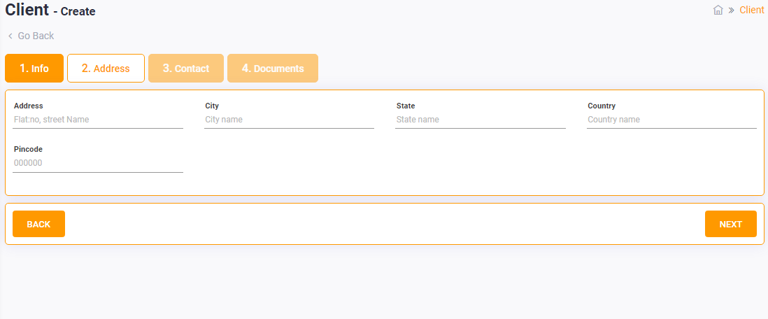
Phase-2
Assumptions:
Superadmin will onboard operators.
SuperAdmin will collect all the details first and fill in the form.
Operator knows why these info is required.
Onboard Operators
Design Comments:
Address details are not autofilled based on any user attributes in Info
Address details are manually expected to be filled which could be time consuming.

Slide 4
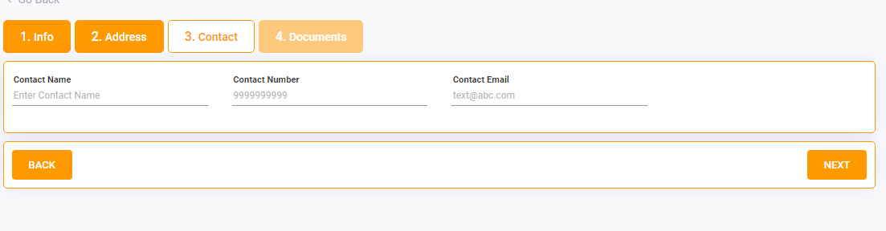
Phase-2
Assumptions:
Contact Name will be different from Client Name
Client knows that contact name would be different from client name
Onboard Operators
Design Comments:
Contact details can be embedded via login so that email address and number can be curated and this section is unnecessary.

Slide 5
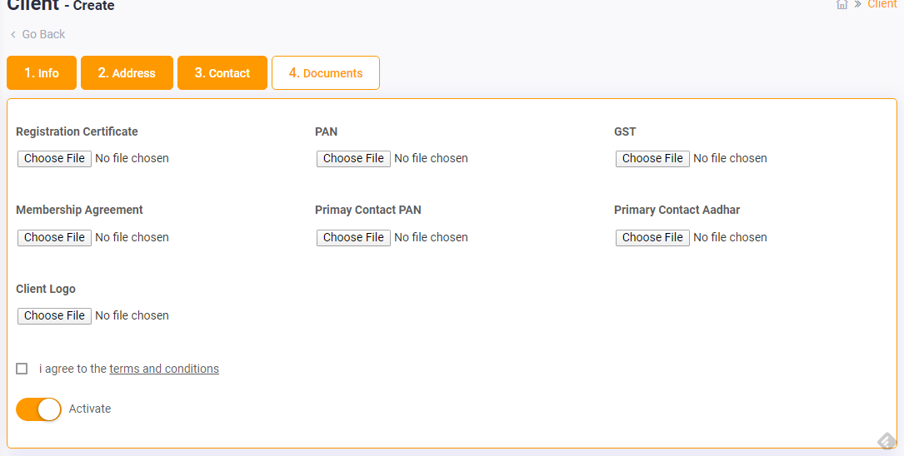
Phase-2
Assumptions:
Client knows why these documents are required
Client feels secure about sharing this documents
Onboard Operators
Design Comments:
Forms are put together without understanding of what user will be required
Why would activate be required?

