Slide 1

Feasibility Study and
Implementation of EV Conversions for Motorcycles in Sri Lanka
E/19/169
JAYAWARDHANA HDSM

Slide 2




SUPERVISORS
Supervisor
Ms. Lekha Bakmeedeniya Univesity of Peradeniya
Co - Supervisor
Eng. Tharanga Wickramarathna Project Manager
Ceylon Electricity Board

Slide 3
TABLE OF CONTENTS
01
02
03
04
05
06
07
08
09
INTRODUCTION
OBJECTIVES
SCOPE OF WORK
METHODOLOGY
EXPECTED OUTCOMES
TIMELINE
SIGNIFICANCE OF PROJECT
CHALLENGES AND MITIGATIONS
CONCLUSION
Notes:
Let’s move on to the key details

Slide 4


INTRODUCTION
Importance of the transportation sector in Sri Lanka
Challenges with internal combustion engine (ICE) vehicles:
Environmental pollution
Economic burden from fuel imports
Opportunity for electric vehicle (EV) conversions
Focus on motorcycles for greater impact

Slide 5
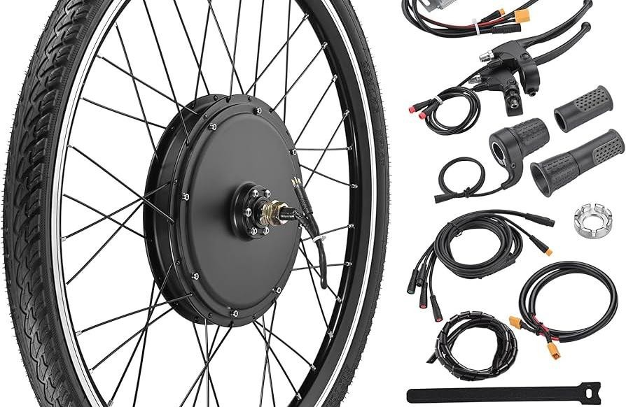
OBJECTIVES
Technical Feasibility
Assess the potential for EV conversions
Identify suitable components (motors, batteries, controllers)
Design Optimization
Ensure a balance between weight, speed, and efficiency
Adapt designs for local conditions
Financial Feasibility
Estimate conversion costs and savings on fuel and maintenance
Determine the payback period
Recommendations
Policy suggestions
Scaling up with renewable energy integration

Slide 6


SCOPE OF
WORK
Survey specifications of motorcycles in Sri Lanka
Analyze fuel and maintenance costs
of ICE vehicles
Test and identify suitable conversion kits
Develop and test prototypes under real-world conditions
Provide recommendations for scaling up EV adoption

Slide 7

METHODOLOGY
Data Collection:
Literature reviews, surveys via Google Forms, and direct driver interviews
Technical Analysis:
Select popular motorcycle models, Evaluate BLDC motors, lithium-ion batteries, and controllers
Financial Feasibility:
Calculate costs and assess savings over time
Pilot Testing:
Monitor prototypes for performance metrics (speed, range, charging)
Notes:
Financial analysis to access conversion costs and savings

Slide 8


EXPECTED OUTCOMES
A feasible conversion plan for motorcycles to EVs
An optimized prototype design
Financial model for cost-benefit analysis
Policy recommendations for scaling EV adoption
Integration of renewable energy in the charging infrastructure

Slide 9


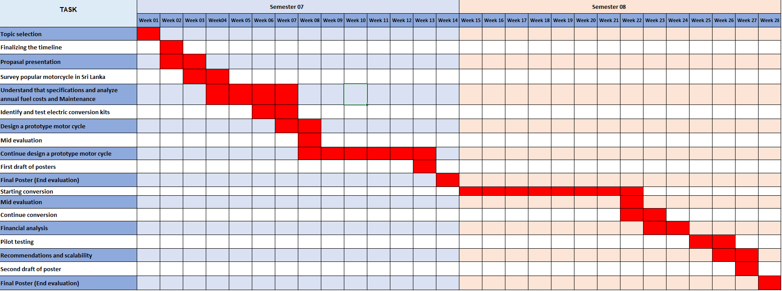
TIMELINE

Slide 10
SIGNIFICANCE OF THE PROJECT
Environmental Benefits:
Reduces emissions and urban air pollution.
Economic Impact:
Cuts fuel import costs and saves foreign exchange.
Lowers user operating costs (fuel and maintenance).
Sustainability:
Encourages renewable energy integration for EV charging.
Technological Advancement:
Fosters EV technology adoption and local innovation.
Policy and Awareness:
Supports government policy development.
Raises public awareness on EV benefits.

Slide 11


CHALLENGES
& MITIGATIONS
Technical:
Limited kit compatibility → Adapt and
test.
Weight and space issues → Use lightweight materials.
Safety concerns → Conduct rigorous testing.
Financial:
High kit cost → Highlight savings, seek incentives.
Renewable energy cost → Start small- scale, partner with providers.

Slide 12


CONCLUSION
Addressing challenges in Sri Lanka's transportation sector.
Providing a sustainable and cost-effective EV
conversion solution.
Delivering actionable insights into technical and financial viability.
Contributing to a greener and more sustainable
future.
Notes:
In conclusion,this project addresses critical challenges in sri lankas transportation sector by promoting EV conversions.By integrating rene.energy and providing cost-effective sol,it contri

Slide 13



THANK
YOU!!!

