Slide 1
Bearcat Game
Hayden Dennis
Notes:
Hi my name is Hayden Dennis
Presenting project plan

Slide 2
Team Name: 10x devs
Member(s):
Hayden Dennis
Industry Advisor: Austin Coontz
Notes:
TrustedSec – Security Consultant

Slide 3
Abstract
Bearcat/Binturong game is a designed to be a free accessible game for students to study questions using competition. A key goal is make the solution freeware so anyone can host it for free. The plan is for the game application to provide options for generating card packs via LLM.
Notes:
Goal was to make an LLM powered game
Most existing games are brainrot (subway surfer, temple run ect.) and usually paid.
Decided multiplayer was the best way to make it fun because fun game mechanics are difficult and competition is inherently fun.

Slide 4
User stories
As a student, I want to be able to review and study in the form of a game to effectively cover materials in a small group.
As a student, I want to be able to automatically generate flashcards via LLM in order to rapidly review material.
As a teacher, I want a game to review materials to engage with students during classroom review sessions.

Slide 5
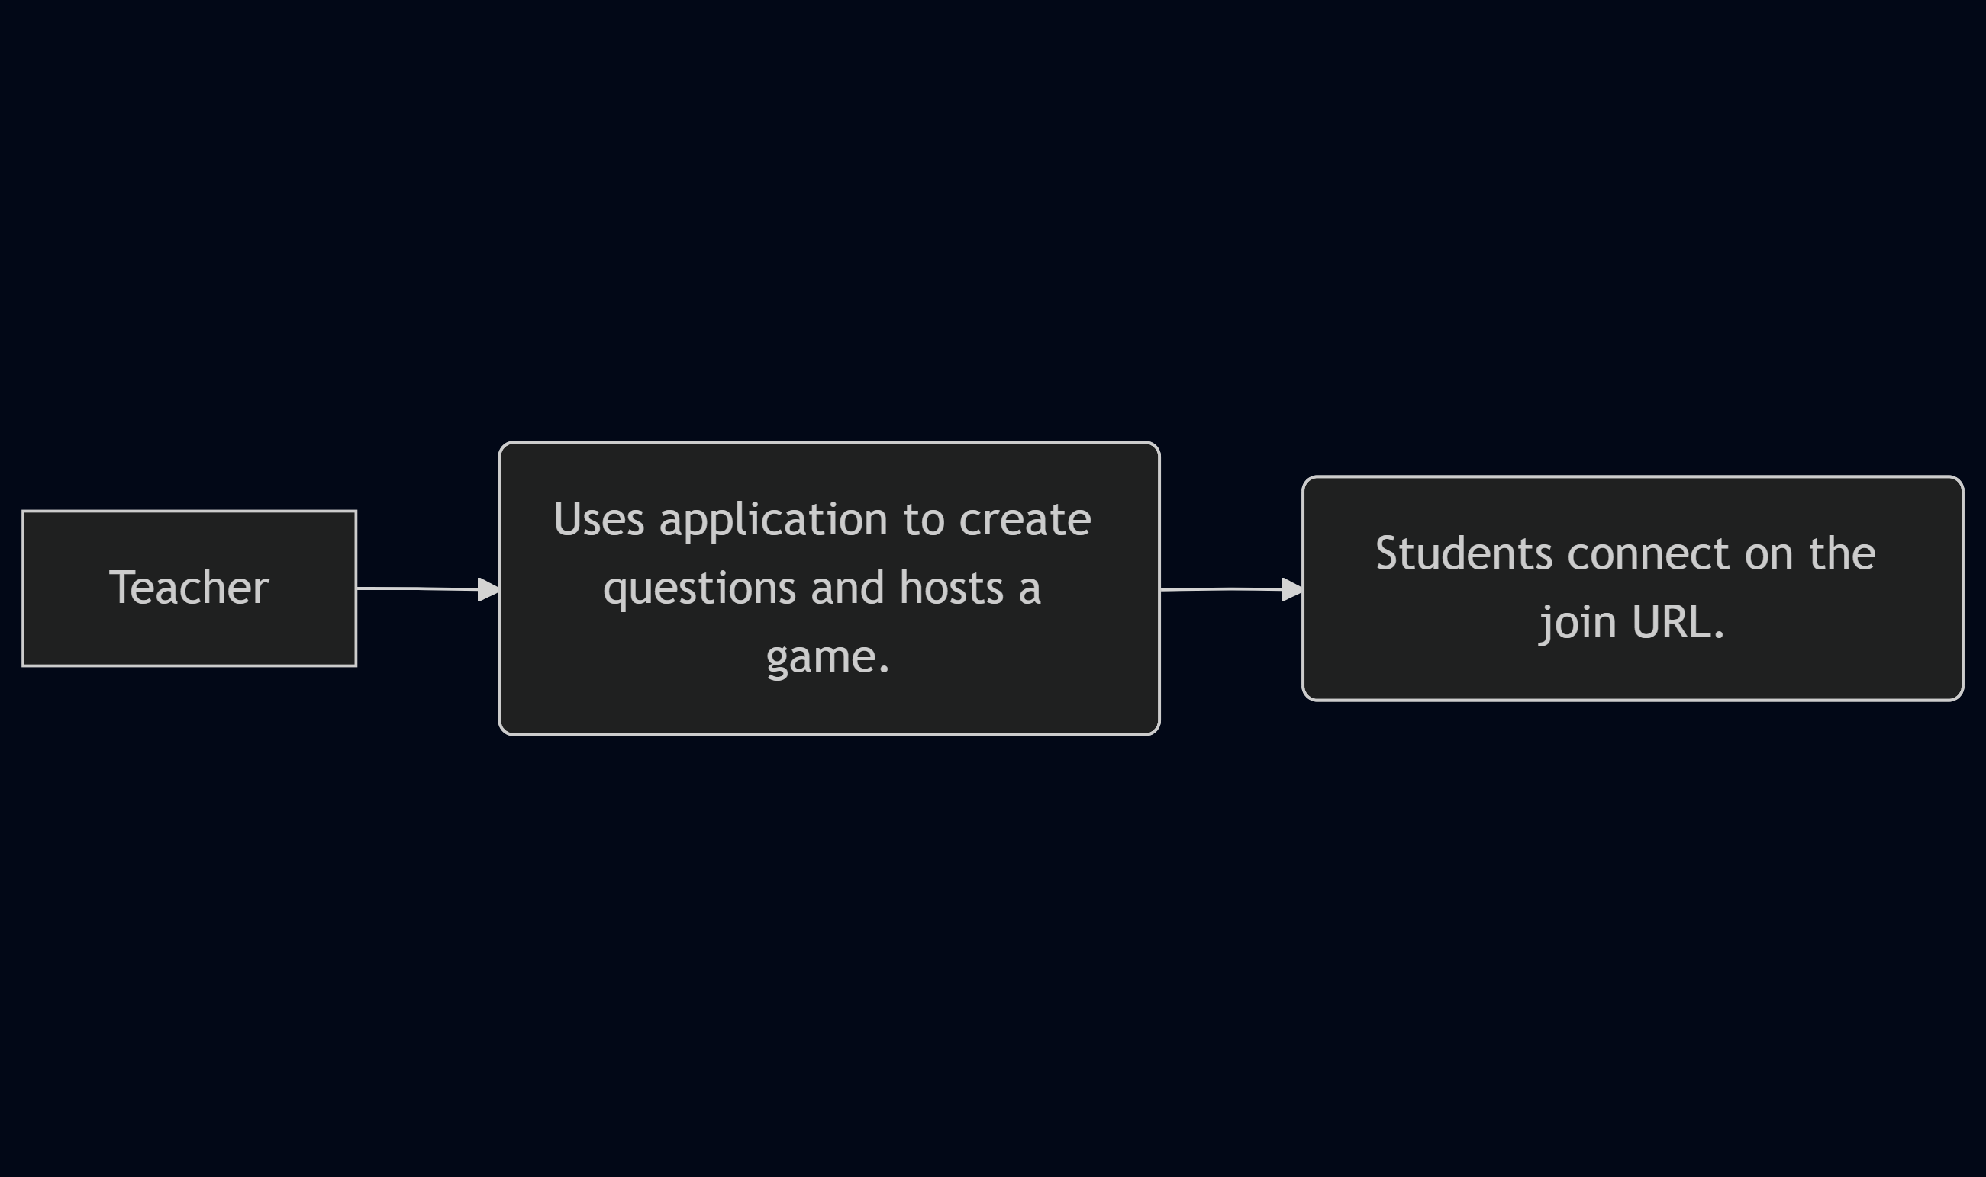
D0
Notes:
Hardbox is the user and soft boxes are actions. This shows the perspective of just the teacher.

Slide 6
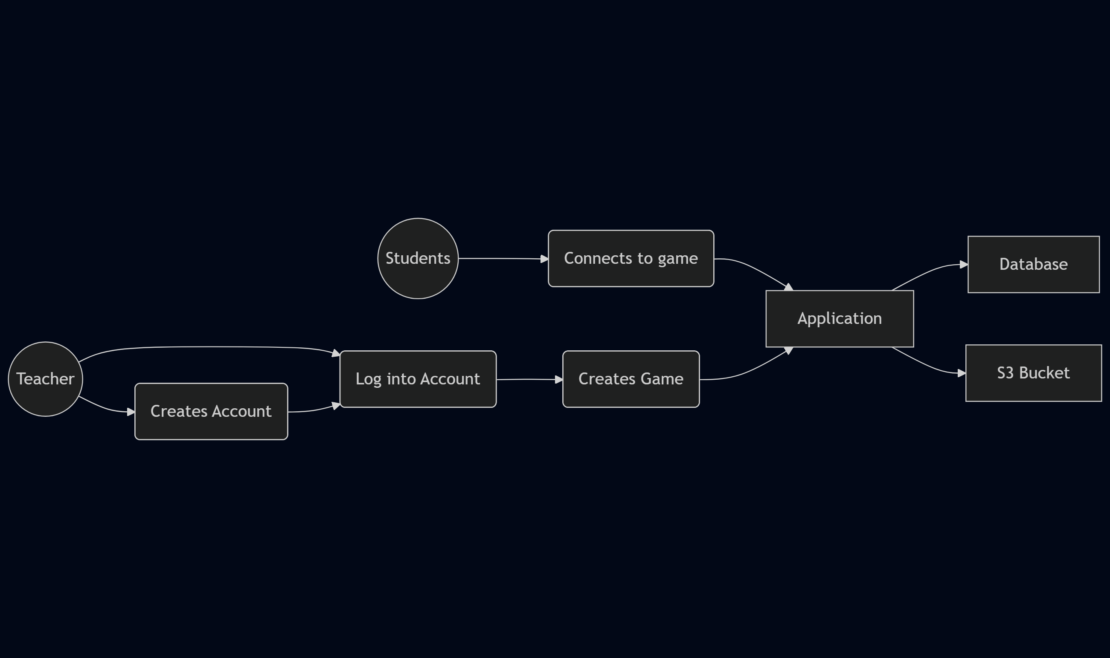
D1
Notes:
Circles are clients, squares are services, soft rectangles are actions

Slide 7
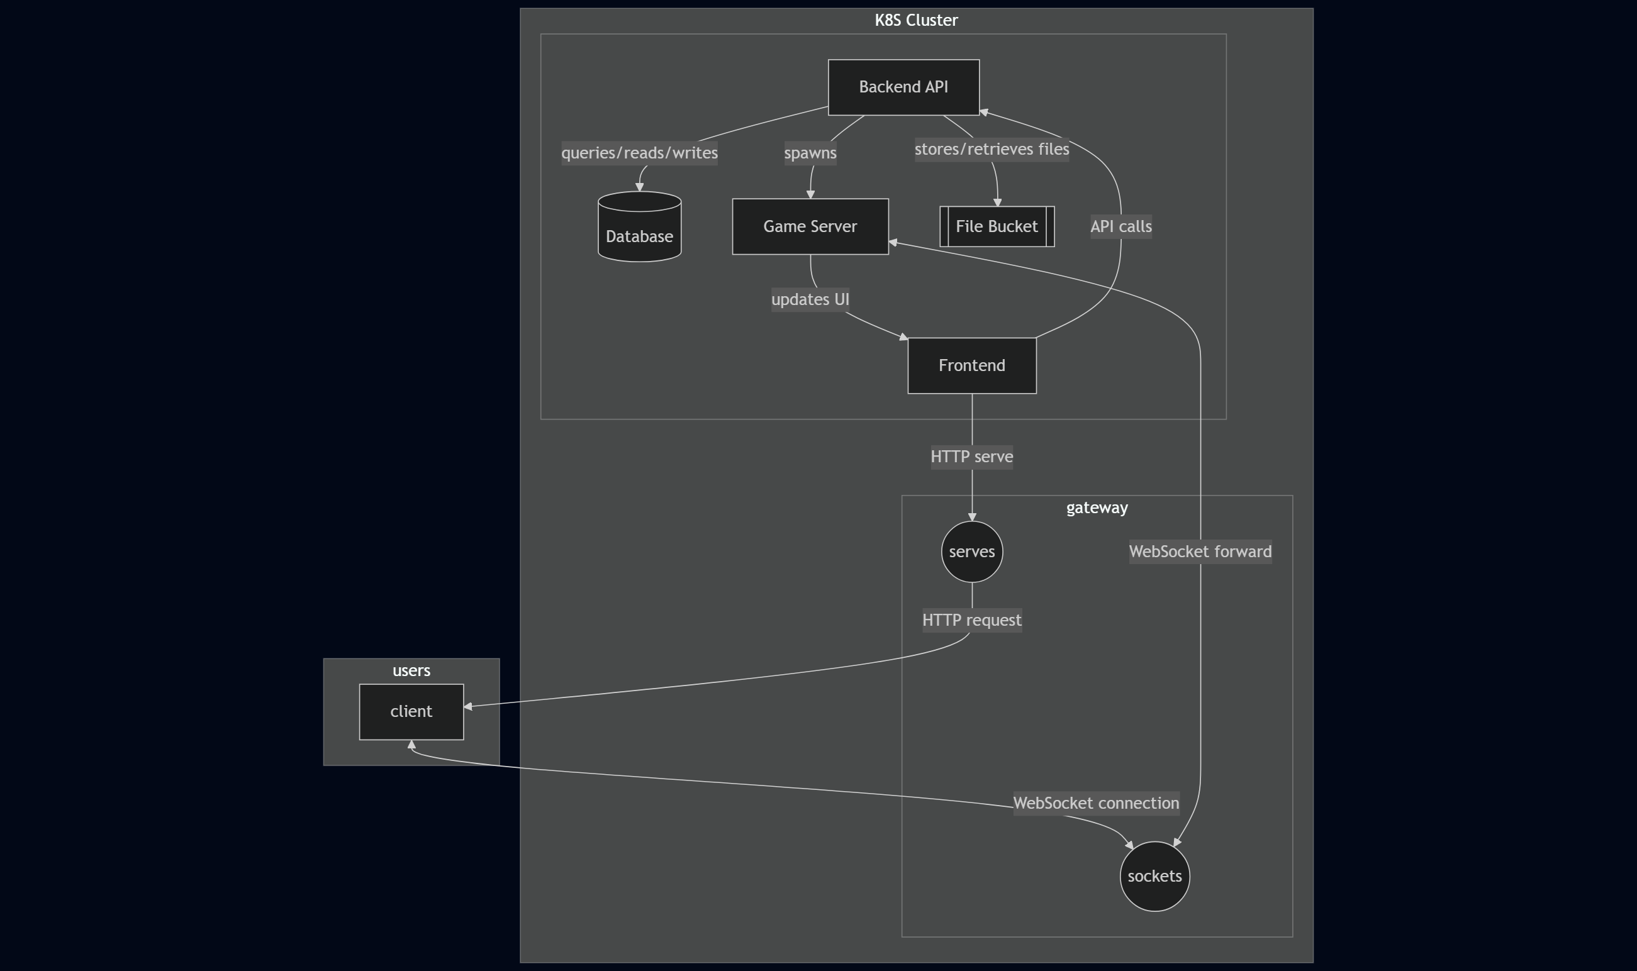
D3
Notes:
Rectangles are machines
Circles are different application layer commincation protocols that are used for a live game
Arrows are labelled indicating the actions being taken.

Slide 8
Project constraints
Economic:
Hosting costs – primarily LLM inference
Anything spent on assets
Security
Account file uploads
Legal
Students, privacy

Slide 9
Current State
Service hosting for development/debug
API:
Endpoint for inferencing sglang service (in-progress).
Endpoints for CRUD operations.
Type definitions for db, ORM.
Client:
Pages: Login, Files, Account
Session

Slide 10
Notes:
Future: preventative auth rules

Slide 11
Notes:
Still need to add button and modal for LLM generation

Slide 12
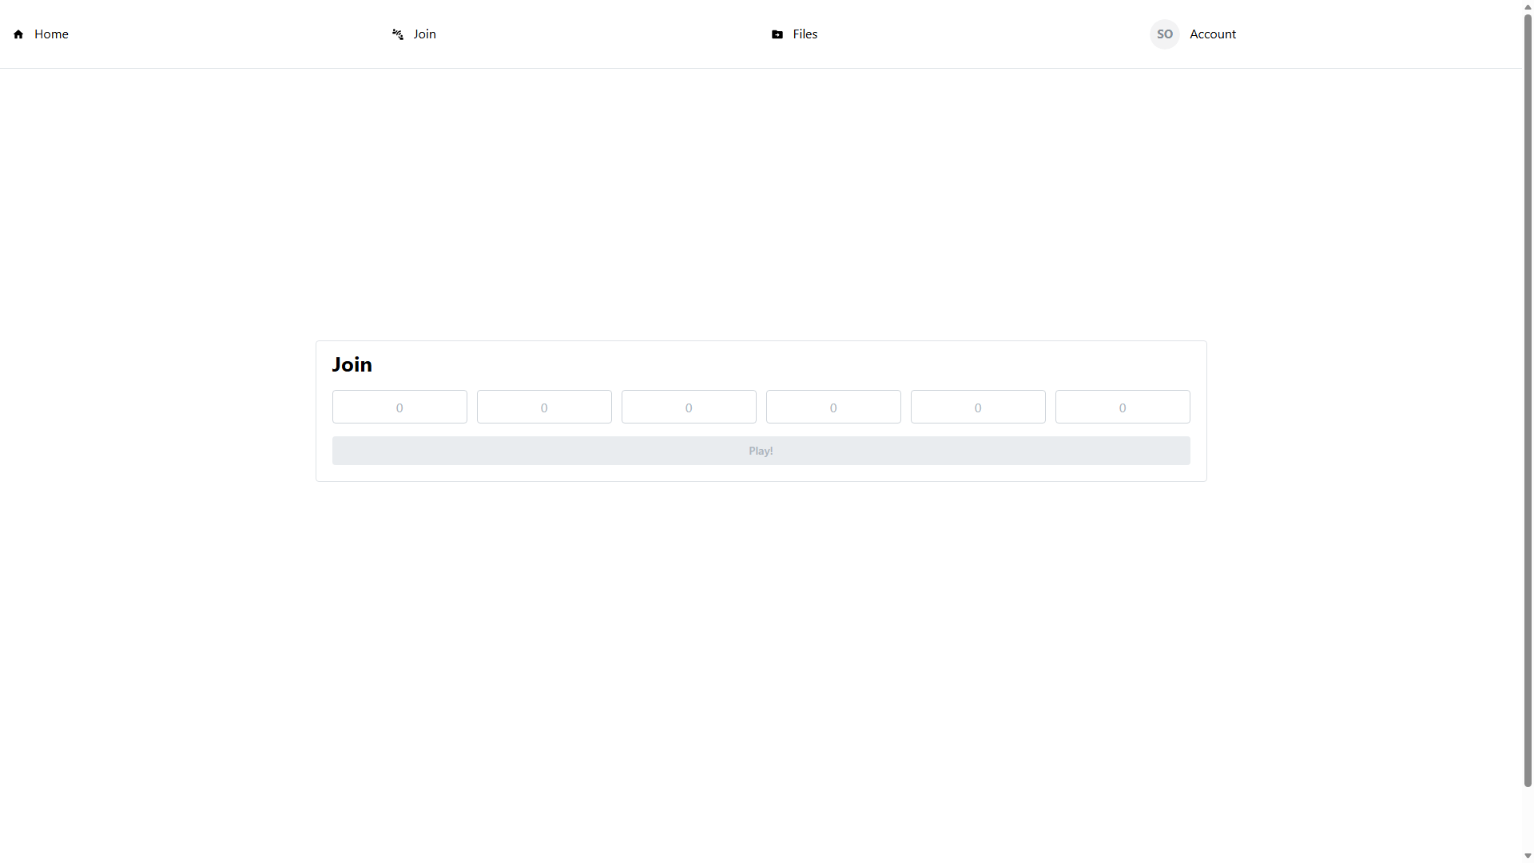

Slide 13
End of term expectations
API:
Helm (Kubernetes) integration
Testing suite
Alternative services/configuration:
Larger model for sglang.
Postgres (instead of sqlite).
Non-AWS based file storage – either Redis or Postgres(BYTEA col).
Text extraction step for pdfs needs to not be repeated.
Client
Testing (both client unit testing and E2E.
Home (about) page.
Game (essentially untouched):
Assets
Rending
Input
Scripting actual gameplay
Deployment

Slide 14
End of term expectations
API:
Helm (Kubernetes) integration
Testing suite
Alternative services/configuration:
Larger model for sglang.
Postgres (instead of sqlite).
Non-AWS based file storage – either Redis or Postgres(BYTEA col).
Text extraction step for pdfs needs to not be repeated.
Client
Testing (both client unit testing and E2E.
Home (about) page.
Game (essentially untouched):
Assets
Rending
Input
Scripting actual gameplay
Deployment
Notes:
Yellow highlight is everything not necessarily needed for MVP.
7 / 18 milestones are done; Another is mostly done.
Most of remaining work will be the game itself and then debugging the integration of the application.
All the web-based stuff is completed.

