Slide 1
Bearcat Game
Hayden Dennis
Notes:
Hi my name is Hayden Dennis
Presenting project plan

Slide 2
Team Name: 10x devs
Member(s):
Hayden Dennis
Industry Advisor: Austin Coontz
Notes:
TrustedSec – Security Consultant

Slide 3
Goals
Build a FOSS project to help students study materials effectively. The key points I focused on while designing and building were to make the game be fun and be able to use questions from anki.
Notes:
Goal was to make an LLM powered game
Most existing games are brainrot (subway surfer, temple run ect.) and usually paid.
Decided multiplayer was the best way to make it fun because fun game mechanics are difficult and competition is inherently fun.

Slide 4
Merits
Used structured decoding to produce the format to build an anki table
Implemented a hand rolled anki binary file generation based on the file specification
Rolled my own auth

Slide 5
Broader Impacts
This project has the potential to assist students in their learning . Additionally, this project can assist students in creating small study groups to cover material.

Slide 6
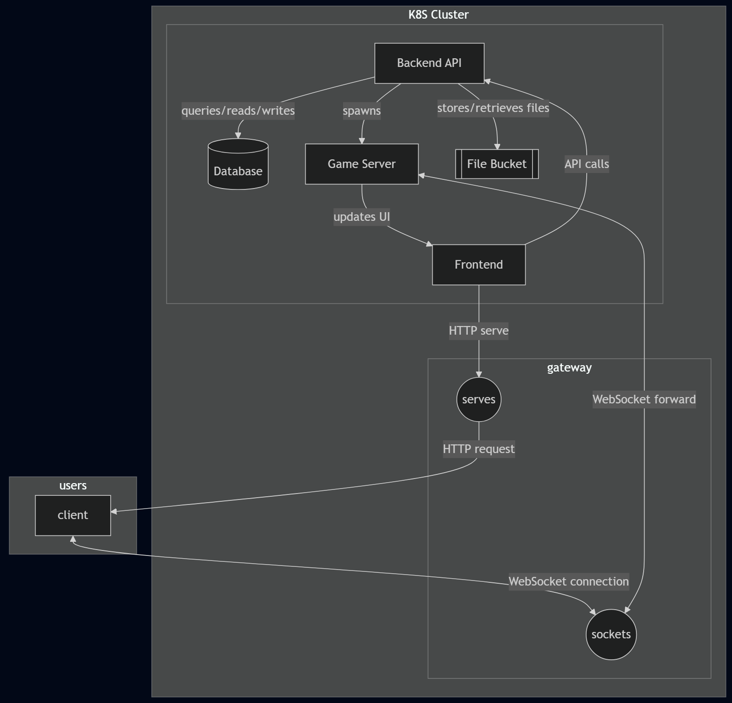
Design
API:
Exposes API calls
Spawns and manages game servers
Frontend:
Fetches and embeds game client
UI for files/accounts
Game Server:
Core game server responsible for serving experience to player.
Notes:
Rectangles are machines
Circles are different application layer commincation protocols that are used for a live game
Arrows are labelled indicating the actions being taken.

Slide 7
Technologies
API:
FastAPI – async python
SQLModel - ORM
Sqlite3
Frontend:
Dash - async python
Testing
Pytest
syrupy
Game Server:
ThreeJS typescript
Integration:
Docker/kubernetes
Helm
Nginx
Sglang

Slide 8
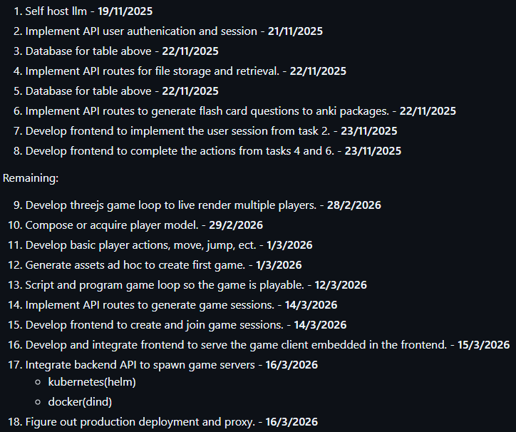
Results

Slide 9
Notes:
Future: preventative auth rules

Slide 10
Notes:
Still need to add button and modal for LLM generation

Slide 11
