Slide 1

Network Programming in Python
Python 网络编程
讲师: 胡伟通
School of Cyberspace
Hangzhou Dianzi University
2024-2025 Academic Year – 1st Semester
October 2024

Slide 2
「 Week 07 」
UDP - User Datagram Protocol

Slide 3

About this course
2.0 Transport layer protocol
2.1 Port Numbers
2.2 Socket
2.3 Binding to Interfaces
2.4 UDP Fragmentation
2.5 Socket Options
2.6 Broadcast

Slide 4
2.0 Transport layer protocol
Application Layer
e.g. ftp
Application Layer
Transport Layer
e.g. TCP, UDP
Transport Layer
Network Layer
e.g. IP
Network Layer
Link Layer
Ethernet
Link Layer

Slide 5
2.0 Transport layer protocol
Transport layer protocol: support packet transmission to the correct machine
https://www.jianshu.com/p/387018d663ad
Q: What should I do if two applications want to maintain a single session?
A: The protocol above the IP layer requires two additional features:
Multiplexing
Reliable transmission

Slide 6
2.0 Transport layer protocol
User datagram protocol
（UDP）
Two important agreements
Transmission control protocol
（TCP）
https://erlerobotics.gitbooks.io/erle-robotics-python-gitbook-free/udp_and_tcp/index.html

Slide 7
2.0 Transport layer protocol
When to use TCP ? 1. You need to make sure that the transmitted data arrives accurately and remains intact. 2. You need to send a lot of data instead of simply requesting and returning. 3. You can tolerate the time it takes to establish a connection.（ low efficiency ）
When to use UDP? 1. You don't care if the packets you send arrive accurately, or you can handle them yourself. (unstable)
2. You just want to get a simple request and return. 3. You need to establish a connection quickly. (efficient)
4. The amount of data you send is not very large. UDP limits each packet to no more than 64KB. Usually, people use less than 1KB when using UDP. (Internet of Things)

Slide 8
2.1 Port Numbers
Port
What is the use of the port? We know that a host with an IP address can provide many services, such as HTTP (World Wide Web Service), FTP (File Transfer), SMTP (Email), etc. These services can be implemented by one IP address. So, how does the host distinguish between different network services? Obviously, you can't rely solely on IP addresses, because the relationship between IP addresses and network services is one-to-many.
In fact, the "IP address + port number" is used to distinguish different services.
It should be noted that the ports are not one-to-one correspondence. For example, when your computer accesses a WWW server as a client, the WWW server uses the "80" port to communicate with your computer, but your computer may use a port like "3457".

Slide 9
2.1 Port Numbers
File
File
I/O
Logic
I/O
Logic
Process
Process
Read
Write
Read
Write
Port Number
Port Number
Network
Protocal
Terminal A
IP address
Terminal B
IP address

Slide 10
2.1 Port Numbers
The port is to distinguish which process !
For example：
house adress IP; room number: port.
The port can have 65,536 (2 to the 16th power)! Since there are so many, the operating system numbers ports for unified management. This is the port number.
Server
Client
Request
192. 168. 1. 9: 53
192.168.1.30: 44137
Response

Slide 11
2.1 Port Numbers
Port classification
Well-known port （0~1023）：
Port 80 is assigned to the HTTP service. Port 21 is assigned to the FTP service.
E.g. telephone 110/119/120
Dynamic ports (ranging from 1024 to 65535). It is generally not a fixed allocation of a service. Dynamic allocation means that when a system process or application process requires network communication, it requests a port from the host, and the host allocates one of the available port numbers for its use. When this process is closed, the occupied port number is also released.
Port scanning with nmap.

Slide 12
Naming and Addressing
Domain name
Identify a host (domain management in Alibaba Cloud)
Variable length string(eg：www.hdu.edu.cn)
Is mapped to one or more IP addresses
IP Address
Expressed in dotted decimal notation (eg: 10.0.0.1)
32 bits (IPv4). Not a number! Often converted to 32 bits for use (eg some companies store the client's IP address in the database section)
Port Number
Identify the process on a host
16 bits

Slide 13
Programming: Query the port number of the domain name service
>> import socket
>> socket.getservbyname("domain")
53

Slide 14

2.2 Socket basic concepts
Notes:
电源插座；窝，穴；牙槽

Slide 15
Issues that need resolving
What mechanism can a programmer use when writing a web application?
How to write a web application that sends packets between hosts (clients and servers) ?
Answer: Socket API
IP Network
Client
Server
Notes:
Application Programming Interface

Slide 16
Network API
The operating system provides an application programming interface for web applications (API)
Ideal network interface
Easy to use
Flexible
Independent of any application
Allows the app to use all the features of the network
Standardization
Allow programmers to learn once, use everywhere
The application interface provided for the network is called Socket.（套接字）

Slide 17
2.2 Socket basic concepts
Sockets provide a computer communication mechanism across networks
There are many kinds of Sockets:
DARPA Internet addresses (Internet Sockets)
Unix interprocess communication (Unix Sockets)
CCITT X.25 address
others
Berkeley Sockets are the most popular Internet
Running on Linux, FreeBSD, OS X, Windows

Slide 18
Internet Sockets
Support for streams and datagrams(eg: TCP, UDP, IP)
Similar to UNIX file I/O API (Provide a file descriptor)
Based on C language, single thread
Do not require multithreading
Based on Python, multithreading model
Support multithreading

Slide 19
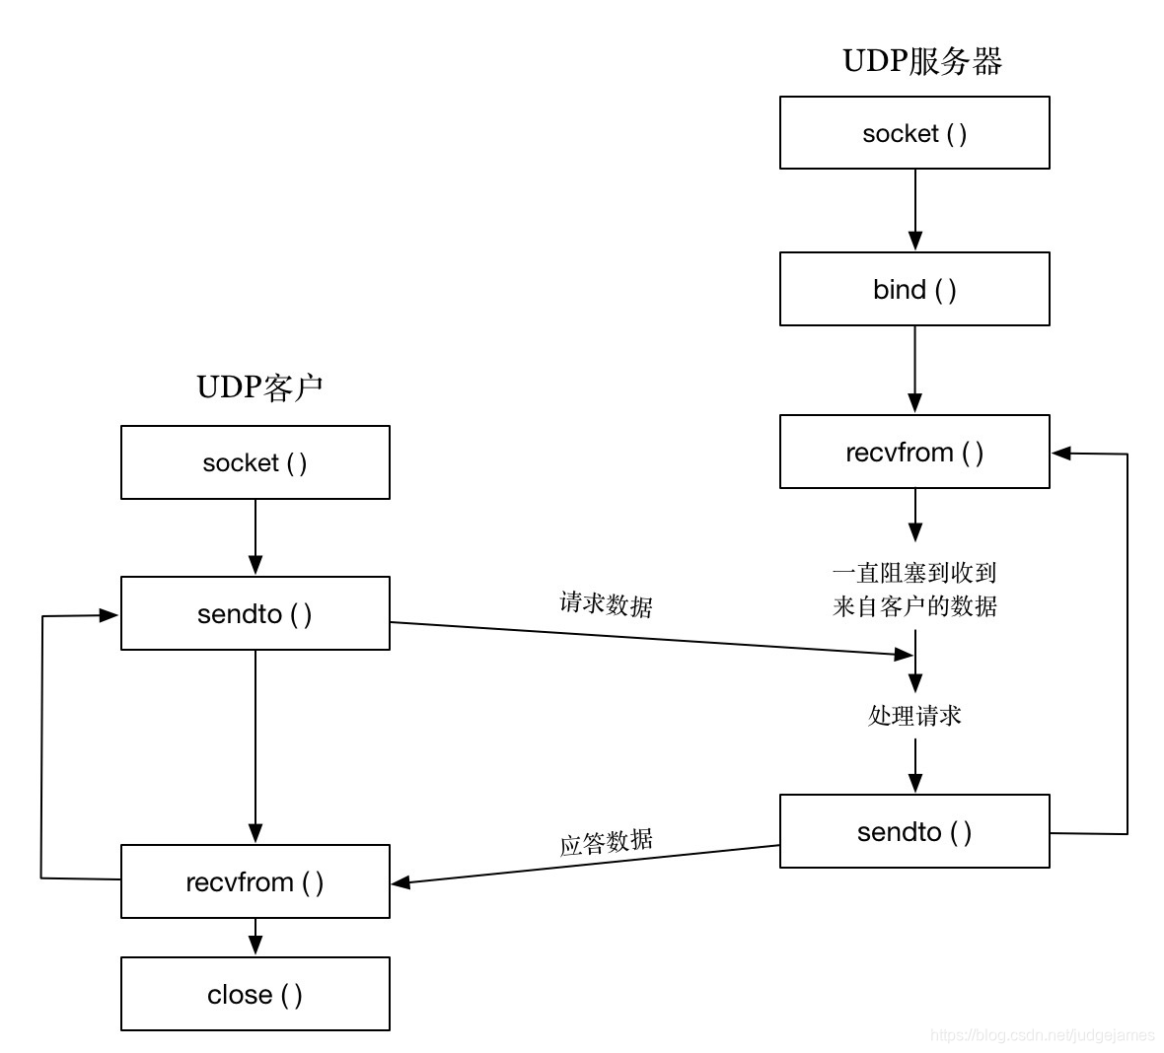
2.2 Socket
Internet of Things scene ！

Slide 20
2.2.1 Promiscuous Clients and Unwelcome Replies
1. Create a server socket;
2. Imitate a slower server (ctrl+z: pause server);
3. The client sends a datagram and hangs waiting for the server to respond;
4. The attacker forged a server response.
sock.sendto(‘FAKE’.encode(‘ascii’),(‘127.0.0.1’, clientport))
5. ctrl+c: No need for the server to run, turn it off.

Slide 21
2.2.1 Promiscuous Clients and Unwelcome Replies
Promiscuous Client：
Regardless of whether the address is correct, the network listening client technology that receives and processes all received packets is called a promiscuous client.
Avoid attacks by fake packets：
1. Write a good excellent encryption algorithm;
2. Design or use a protocol that includes a unique identifier or request ID in the request (the ID range is large enough) ;
3. Verify that the response packet address is the same as the request packet address.

Slide 22
2.2.2 Unreliability, Backoff, Blocking, and Timeouts
How to avoid waiting for a network packet that has actually been lost?
Reference Code:
"udp_remote.py"

Slide 23
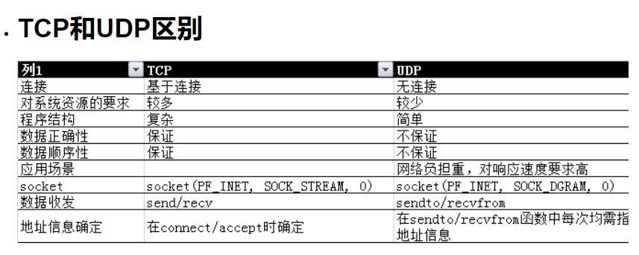
2.2.3 Connecting UDP Sockets
Call connect():

Slide 24
2.2.4 Request IDs: A Good Idea
ID: Use random numbers to resist attack to some extent

Slide 25
2.3 Binding to Interfaces
When using UDP communication (There is a difference between the client and the server), the client does not need to use bind () to bind his own IP and port number, but the server needs to use bind() to bind own IP address and port number.
https://blog.csdn.net/suxinpingtao51/article/details/11809011

Slide 26
2.4 UDP Fragmentation
TCP is stream-oriented and has no boundaries between data streams.
UDP is packet-oriented, with clear boundaries between groups.
UDP sends a packet, the receiver either receives nothing, or the entire packet is successfully received.
TCP is connection-oriented, UDP is connectionless.
Analogous to the relationship between calling and sending a telegram.

Slide 27
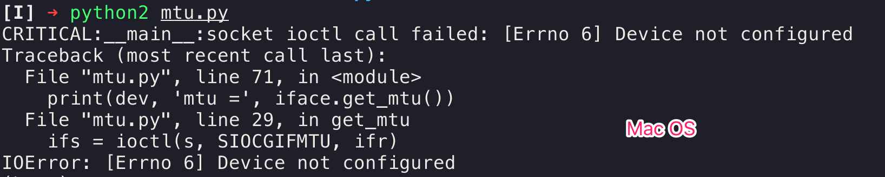
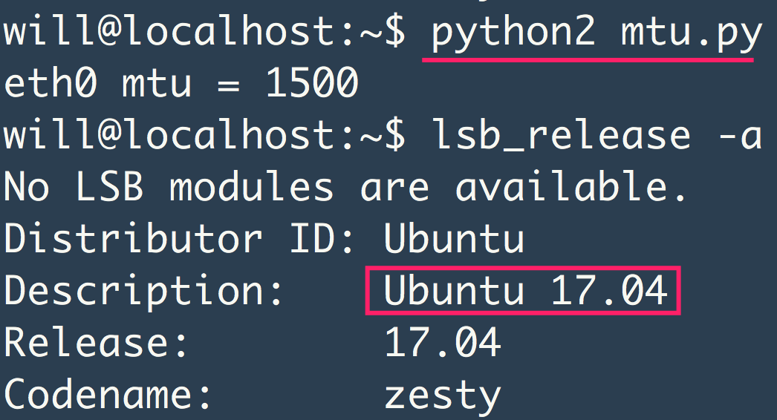
2.4 UDP Fragmentation

Slide 28
2.4 UDP Fragmentation
UDP packets in the program can be up to 64KB.
Ethernet or wireless network card can only process data packets of around 1500B.
Large UDP datagrams are divided into multiple smaller datagrams, but it means that packet loss is prone to occur.
Query the MTU between the local host and the remote host ("Maximum Transmission Unit" or "Maximum Packet Capacity")
Notes:
UDP（User Datagram Protocol）并不像TCP（Transmission Control Protocol）一样提供可靠的数据传输，也没有握手和重传机制。因此，UDP的MTU（最大传输单元）通常由底层网络设备和链路的MTU决定。
MTU是指在不发生分片的情况下，网络可以传输的最大数据包大小。对于以太网，其常见的MTU为1500字节。这意味着，如果使用UDP进行通信，你的数据报大小（包括UDP头部和数据）最好小于或等于1500字节，以确保不发生分片。
然而，实际上，不同的网络设备和链路可能会有不同的MTU值。在某些情况下，为了适应较小的MTU，你可能需要在应用层进行数据分片和重新组装，以确保数据的完整性和可靠性。

Slide 29
2.4 UDP Fragmentation
UDP data is unreliable. Sending a string of digital packets (1, 2, 3) may become (1, 0, 0) when received. When doing UDP connection, you need to do data verification yourself.
UDP data is unordered, issued (1, 2, 3), and may be received in the order of (1, 3, 2). Applications must do their own grouping.
TCP requires extra work because of establishing connections, releasing connections, IP packet check sorting, etc., and is much slower than UDP. TCP is suitable for transmitting data, UDP is suitable for streaming media. (Http3 is based on UDP)
UDP is easier to traverse the router firewall than TCP.

Slide 30
Programming: Send large UDP packets
>> import socket
>> socket.getservbyname("domain")
Notes:
`socket.getservbyname("domain")` 是一个 Python 中的 Socket 模块函数调用，用于获取指定服务（service）的端口号。在这个特定的例子中，"domain" 是服务的名称，函数将返回与该服务关联的标准端口号。
在这里，"domain" 通常对应的是 DNS（Domain Name System）服务。DNS服务通常使用UDP协议在端口53上进行通信。因此，`socket.getservbyname("domain")` 的返回值应该是 53。
这个函数的一般形式是 `socket.getservbyname(servicename[, protocolname])`，其中 `servicename` 是服务的名称，`protocolname` 是协议的名称（可选，默认为 None）。在这个例子中，"domain" 是服务名称，而协议名称使用默认值 None，因为 DNS 通常使用UDP协议。
注意：在某些情况下，可能会因为网络环境的不同而返回不同的端口号。

Slide 31
2.5 Socket Options
Get or set the options associated with a socket：
Options may exist in a multi-layer protocol, and they always appear at the top of the socket layer. When operating socket options, the names of the layers and options that the option is located must be given.
Usage：
value = getsockopt(level, optname);
socket.setsockopt(level, optname, value)
General option：
SO_BROADCAST
SO_DONTROUTE
SO_TYPE

Slide 32
2.6 Broadcast
Only UDP sockets allow broadcast or multicast.
Broadcast UDP：
The difference from unicast UDP is that the IP address is different. The broadcast uses the broadcast address 255.255.255.255 to send the message to each host on the same broadcast network.
It is worth emphasizing that local broadcast information is not forwarded by the router. Of course, this is very easy to understand, because if the router forwards the broadcast information, it will inevitably cause network paralysis. This is why the designers of the IP protocol deliberately did not define an Internet-wide broadcast mechanism. Broadcast addresses are commonly used to communicate status information between players on the same local network in online games, etc.
In fact, as the name suggests, the broadcaster wants to talk to all the people on the LAN, but the broadcast still has to specify the recipient's port number, because it is impossible for all the ports of the recipient to listen to the broadcast.

Slide 33
2.6 Broadcast
Only UDP sockets allow broadcast or multicast.
Multicast:
The hosts of the same service type in the network are logically grouped. When data is transmitted and received, the data is only carried out in the same group. Other hosts that do not join the group cannot send and receive corresponding data.

Slide 34
2.6 Broadcast
Code 2-4：
UDP client and server for broadcast messages on a local LAN.

Slide 35
2.6 Broadcast
When to use UDP?
To implement a protocol that already uses UDP.
Design a time-critical media stream.
To design an application that is suitable for LAN subnet multicast.
Save limited energy of a device.

