Slide 1

Network Programming
网络编程
讲师: 胡伟通
School of Cyberspace
Hangzhou Dianzi University
2024-2025 Academic Year – 1st Semester
October 2024

Slide 2
「 Week 08 」
TCP
(Transmission Control Protocol)

Slide 3

About this course
3.1 How TCP Works
3.2 When to Use TCP
3.3 What TCP Sockets Mean
3.4 A Simple TCP Client and Server
3.5 Binding to Interfaces
3.6 Deadlock
3.7 Closed Connections, Half-Open Connections
3.8 Using TCP Streams Like Files

Slide 4
3.1 How TCP Works
1. The classic definition of TCP comes from RFC 793 in 1981.
2. The following are the basic principles:
Each TCP packet has a serial number;
TCP does not use sequential integers as the sequence number of the packet;
The initial sequence number of TCP is randomly selected;
Communicate without locking steps;
flow control;
If the packet is dropped, TCP assumes that the network is becoming congested.

Slide 5
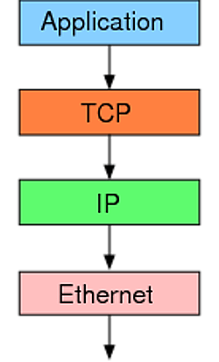
3.1 How TCP Works
The Internet consists of a set of protocols. TCP is just one of them, with its own division of labor.

Slide 6
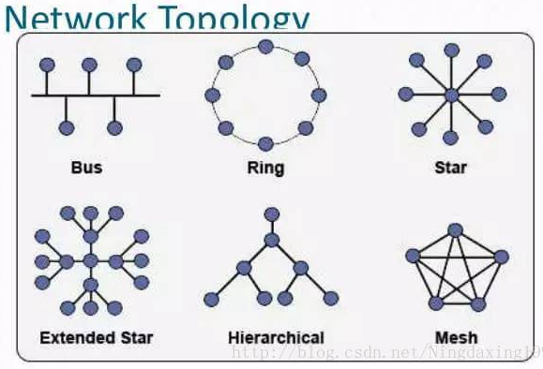
3.1 How TCP Works
The Internet consists of a set of protocols. TCP is just one of them, with its own division of labor.
The lowest layer Ethernet protocol (Ethernet) specifies how electronic signals form packets, and resolves point-to-point communications within the subnet.

Slide 7
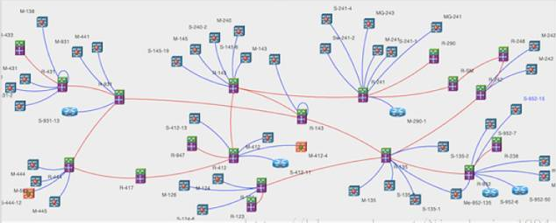
3.1 How TCP Works
The Internet consists of a set of protocols. TCP is just one of them, with its own division of labor.
However, the Ethernet protocol does not address how multiple LANs interoperate, which is addressed by the IP protocol.
The IP protocol defines a set of its own address rules called IP addresses. It implements a routing function that allows A host on one LAN to send messages to B host on another LAN.

Slide 8
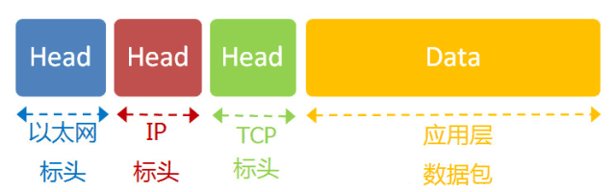
3.1 How TCP Works
The Internet consists of a set of protocols. TCP is just one of them, with its own division of labor.
The IP protocol is just an address protocol and does not guarantee the integrity of the packet. If the router drops packets (for example, if the cache is full and the incoming packets are lost), you need to find out which package was lost and how to resend the packet. This depends on the TCP protocol.
Simply put, the role of the TCP protocol is to ensure the integrity and reliability of data communications and to prevent packet loss.

Slide 9
3.1 How TCP Works
The size of the TCP packet
The size of the Ethernet packet is fixed, initially 1518 bytes, and later increased to 1522 bytes. Among them, 1500 bytes is the payload and 22 bytes is the header.

Slide 10
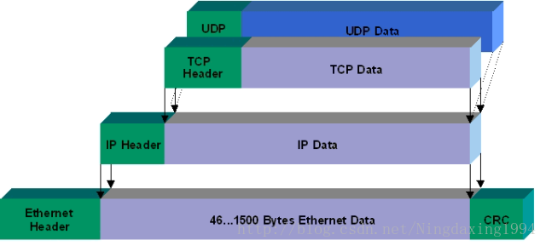
3.1 How TCP Works
The IP packets are in the Ethernet packet and the TCP packets are in the IP packet.
The IP packet is in the payload of the Ethernet packet. It also has its own header information, which requires a minimum of 20 bytes, so the IP packet payload is up to 1480 bytes.
The TCP packet is inside the payload of the IP packet. Its header information also requires a minimum of 20 bytes, so the maximum payload of a TCP packet is 1480 - 20 = 1460 bytes. Since the IP and TCP protocols often have extra header information, the TCP payload is actually around 1400 bytes.

Slide 11
3.2 When to Use TCP
When do you use TCP? 1. You need to ensure that the transmitted data arrives accurately and remains intact. 2. Need to send a lot of data instead of simple request and return. 3. Can tolerate the time spent in establishing a connection. (low efficiency)
When do you use UDP? 1. Don't care if the packets sent arrive accurately, or you can handle them yourself. (unstable) 2. Just want to get a simple request and return. 3. Need to establish a connection quickly. (High efficiency) 4. The amount of data sent is not very large. UDP limits each packet to no more than 64KB. Usually, people use less than 1KB when using UDP. (Internet of Things)

Slide 12
3.2 When to Use TCP
UDP does not need to establish a connection before transmitting data. The remote host does not need to give any confirmation after receiving the UDP message. Although UDP does not provide reliable delivery, it is because of this, it saves a lot of overhead, making it faster. For example, some services that require high real-time performance often use UDP. The corresponding application layer protocols are mainly DNS, TFTP, DHCP, SNMP, NFS, etc.
TCP, which provides a connection-oriented service, must establish a connection before transferring data, and release the connection after the data transfer is completed. Therefore, TCP is a reliable transportation service, but because of this, it inevitably adds a lot of overhead, such as confirmation, flow control, and so on. The corresponding application layer protocols mainly include SMTP, TELNET, HTTP, FTP, and so on.

Slide 13
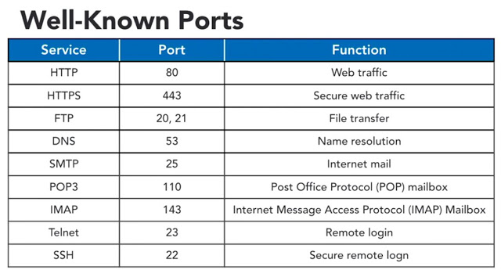
3.2 When to Use TCP
Notes:
演示ftp登录

Slide 14
3.2 When to Use TCP
In order to achieve reliable transmission through IP datagrams, many things need to be considered, such as data corruption, packet loss, duplication, and fragmentation order, etc. TCP uses checksum, serial number, acknowledgment response, retransmission control, connection management, and Mechanisms such as window control to achieve reliability transmission.
Notes:
演示ftp登录

Slide 15
3.2.1 TCP header format
TCP 报文段的首部格式
32 位
位 0 8 16 24 31
源 端 口
目 的 端 口
序 号
20 字节的
固定首部
TCP
首部
确 认 号
数据
偏移
保 留
U
R
G
A
C
K
P
S
H
R
S
T
S
Y
N
F
I
N
窗 口
检 验 和
紧 急 指 针
选 项 （长 度 可 变）
填 充
TCP 报文段
TCP 首部
TCP 数据部分
发送在前
IP 首部
IP数据报的 数据部分

Slide 16
3.2.2 Six flags
URG: Identify whether the emergency pointer is valid.
ACK: Identify whether the serial number is valid.
PSH: Used to prompt the receiving application to immediately read the data from the tcp buffer.
RST: Requires re-establishment of the connection. We refer to the message containing the RST flag as the reset segment.
SYN: Request to establish a connection. We refer to the message containing the SYN identifier as a synchronization segment.
FIN: Notify the peer, the local end will be closed. We will refer to the packet containing the FIN identifier as the end segment.

Slide 17
3.2.3 TCP connection establishment
The process by which TCP establishes a connection is called a handshake.
Handshake requires the exchange of three TCP segments between the client and the server. We name it as three-message handshake.
The use of the three-message handshake is mainly to prevent the failed connection request packet from being suddenly transmitted again, thus generating an error.

Slide 18
3.3 What TCP Sockets Mean
SOCK_STREAM
a.k.a. TCP
reliable delivery
in-order guaranteed
connection-oriented
bidirectional
SOCK_DGRAM
a.k.a. UDP
unreliable delivery
no order guarantees
no notion of “connection” – app indicates dest. for each packet
can send or receive
App
App
D1
3
2
1
socket
Dest.
3
2
D2
1
socket
D3

Slide 19
3.3 What TCP Sockets Mean
socket()
Server
Client
bind()
socket()
listen()
connect()
accept()
write()
[blocked]
read()
read()
[blocked]
[blocked]
write()
When interaction is over, server loops to accept a new connection
Notes:
对比tcp和udp里的connect函数。

Slide 20
3.3 What TCP Sockets Mean
connect()
UDP： Address association inside the operating system
TCP ：Complete three-message handshake and may fail
socket type
passive socket、listening socket
Only used to accept connections
Cannot send and receive data
accept() returns accepted active socket
Identified by two-tuple group( local_ip, local_port)
active socket、connected socket
Can send and receive data( send()、recv() )
Identified by quaternion( local_ip, local_port, remote_ip, remote_port)

Slide 21
3.4 A Simple TCP Client and Server
1、Use one socket per session
2、Address is already occupied
Code list 3-1

Slide 22
3.4.2 Address Already in Use
1、 Set the socket SO_REUSEADDR option;
2、 If there is no such setting, the server restarts with an error message.：
[Errno 98] Address already in use

Slide 23
3.5 Binding to Interfaces
1、 The server side runs with an empty string as the host name;
2、Python bind() tells the operating system what are the network interfaces from which you are willing to receive connections;
3、python tcp_sixteen.py server “”
Special IP: 0.0.0.0 indicates accepting connection requests from any interface.
Notes:
互动回顾一下以前的做法

Slide 24
3.6 Deadlock
1、If both sides of the communication write data, the socket buffer is filled with more and more data, and the data is never read, which is easy to cause deadlock. Eventually, in a certain direction, it is no longer possible to send data through send(), and it may wait for the buffer to be emptied forever, causing blocking.
2、Code list 3-2： TCP server and client that may cause deadlock

Slide 25
3.6 Deadlock
Two ways to avoid deadlocks:
1. The client and server can close blocking through the socket option.
2. The program can process data from multiple inputs simultaneously using a technique. Multiple processes or threads.

Slide 26
3.7 Closed Connections, Half-Open Connections
1、 Data is sent and received via send() and recv(). Some TCP-based protocols mark the data so that the client and server can automatically know when the communication is complete.
2、 The socket method shutdown() can be used to generate a file terminator for a socket in one direction while keeping the connection in the other direction open.

Slide 27
3.8 Using TCP Streams Like Files
1、If you want to pass a socket to a Python module that supports reading and writing ordinary file objects, you can use the makefile() method.
2、This method returns a Python object.
3、 When the caller needs to read and write data, the object will call recv() and send() at the bottom.
Notes:
一种封装方式

