Slide 1
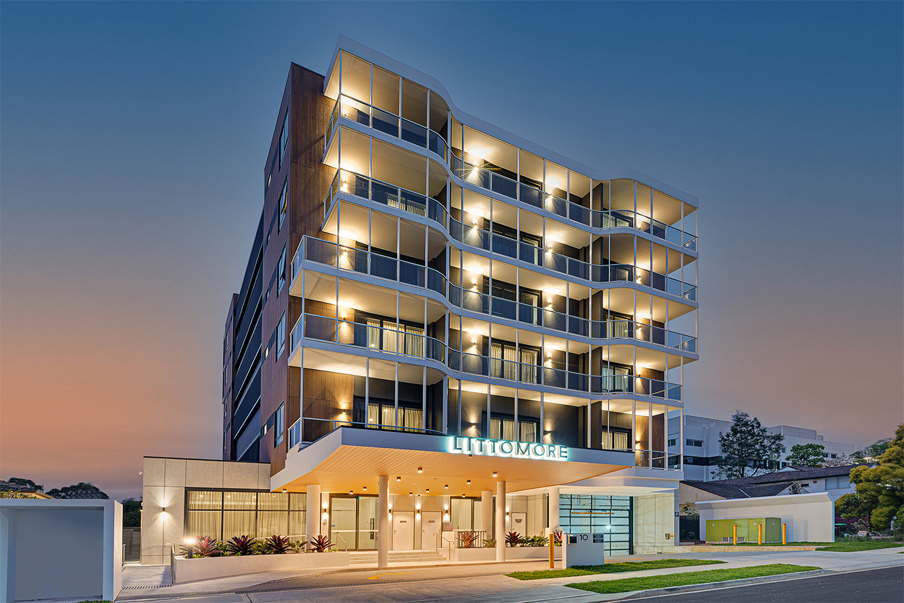

HOTEL BUSINESS PLAN
Presented By :- Hardik Dave
Guided By :- Abhishek Wavhal

Slide 2
Project Summary
This Project was given to Tops by the team with an intention to understand the Business done by Hotel Group.
This Dataset had two hotels City Hotel and Resort Hotel. The data provided was for 3 years 2015 , 2016 and 2017.we also have the revenue and booking details with number of days of stay and booking cancellation, total number of guests including children. It also specifies guests wait period for booking , repetition of guests, their food choices among others. The data also gives us an analysation of countries from which bookings have been done. We also a agent and other channels who also help in business by booking rooms for guests on the resort and city hotel behalf. The data is divided between city hotel and resort hotel. Hence we can make a fair comparison between both. Before visualize any data from the data set We will do the data cleaning as to fill any null values and delete any duplicated values and after that we have to do data wrangling. Also we will do our analysis for both city and resort as individual businesses and in comparison to one another. We will also take help of charts for better analysis.

Slide 3
Problem Statement
This data set contains booking information for a city hotel and resort hotel, and include information such as when the booking was
made, the number of adults, children, and/or babies, and the number of available parking spaces, which agent made the booking, among other
things.
The objective of this project is Explore and analyze the data to discover important factors that govern the bookings. Define Your Business
Objective? Analyze and visualize the data on bookings of City Hotel and Resort Hotel to gain insights on the different factors that affect the booking and ADR.

Slide 4
Data Understanding
Hotel – City Hotel or Resort Hotel
Is canceled – If booking cancel-0 or 1​
Lead time - the no.of days between time books their room to arrival hotel​
Arrival date year – year of arrival date​
Arrival date of month - month of arrival date ​
Arrival date week number – week no.of year for arrival date​
Stays in weekend nights - no. of weekend nights (Saturday or Sunday) spend by guest at hotel​
Stays in week nights – no. of week night (Mon to Fri) spend by guest at hotel​
Adults – No.of adults among guest​
Children – no.of children among guest​
Babies – no.of babies among guest​
Meal – type of meal booked by guest​
Country – country of guest​
Market segment – grouping into categories based on their booking patterns​
Distribution channel name – name of booking distribution channel​
Is repeated guest – if the booking was from repeated by guest(1) or not(0)​
Previous cancellations – no.of previous booking that were canceled by the cust.. Prior to the customer booking​
Previous booking not canceled – no.of previous booking that were not canceled by the cust.. Prior to the customer booking ​
Reserve room type – code of room type reserved​
​Deposit type – type of deposits made by the guest​
Agent – id of the agent who made the booking ​
Company – id of the company that made the booking ​
Days in waiting list – no of. Days the booking on the waiting list ​
Customer type – type of the customer, assuming one of four categories ​
ADR – (average daily rate) dividing the sum of lodging transaction by the total no.of staying night ​
Required car parking spaces – no.of car parking spaces required by the customer ​
Total of specials request – no. of special request made by the customer ​
Reservation request – reservation status ​
Reservations request date – date of last reservation status updated ​
Assigned room type – code of room type assigned ​
Booking changes – no.of changes made to the booking​

Slide 5
Data Cleaning Process
Import Data in Power bi
Go to Transform Data
Select all data and remove error
Select all data and remove duplicates
Remove company column because no of null value
NULL Replace By Other in Agent Column
NULL Replace By Other In Company Column
arrival_date_year, arrival_date_month, arrival_date_day_of_month are merge and create new column Arrival Date.
Data Load and Close

Slide 6
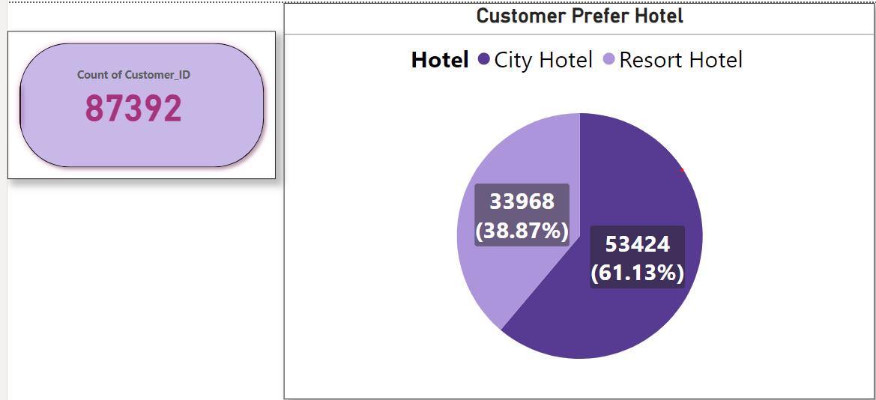
1. Which Hotel Prefer By Customer?
Why did pick Pie Chart?
I used pie chart to check and understand the hotel type is resort or city is simple way of visualizing.
2. What is the insights found from the chart?
Based on the above observations, I found that 61.13% preferred city hotel and 38.87% prefer to book a resort hotel.
3. Business Impact?

Slide 7
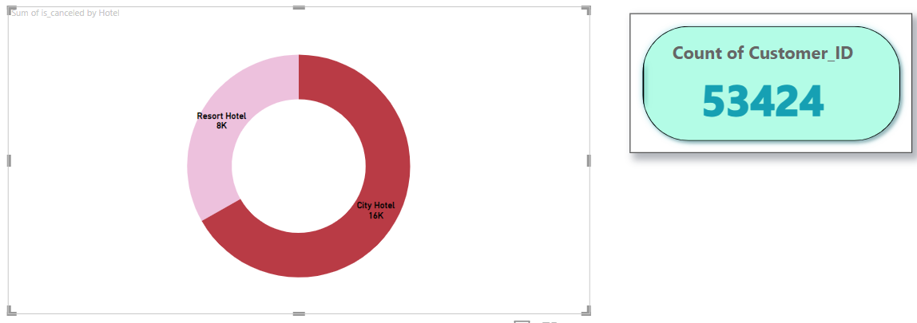
1.How much booking cancel in which hotel?
Why Choose this chart?
Only 2 category easily understand
More Booking cancelled in city hotel compare with resort hotel

Slide 8
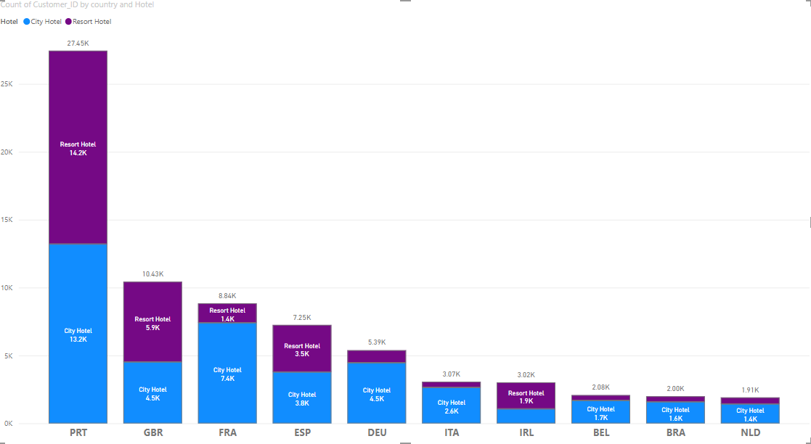
Hotel booking country wise?
I choose this chart because show the booking of Top 10 Country in which type of hotel.

Slide 9
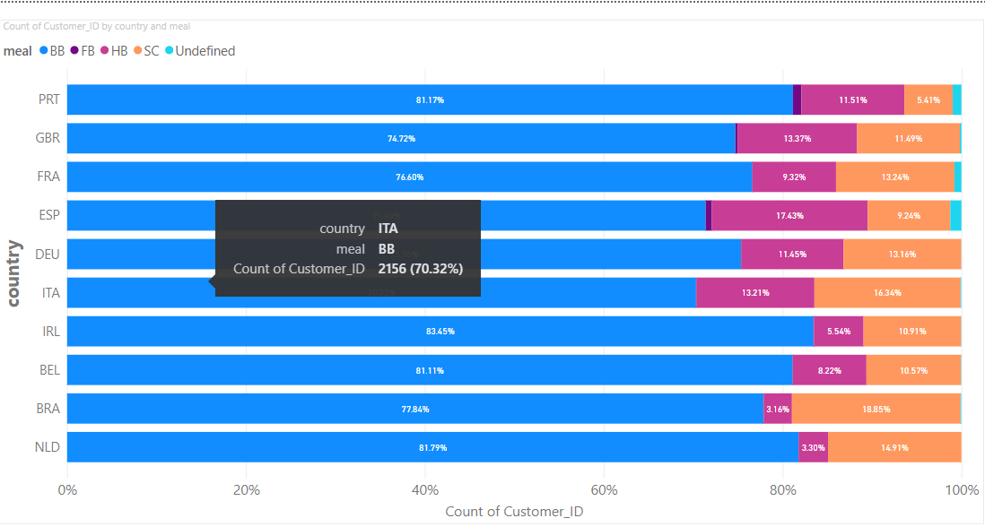
1. Meal prefer country wise?

Slide 10
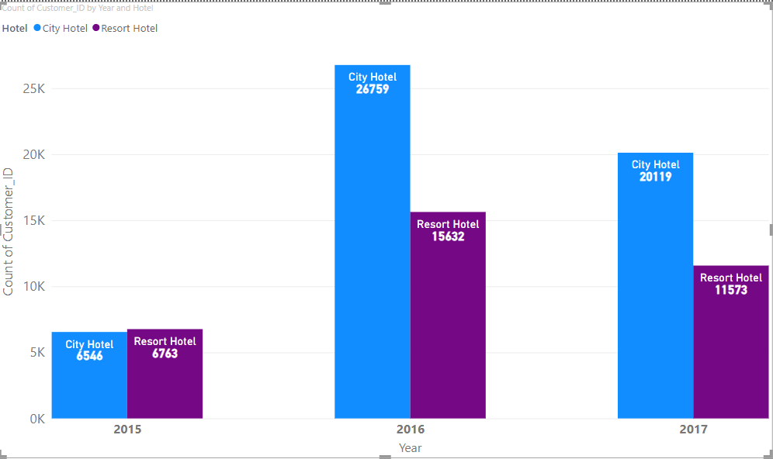
1. How much booking in which year?

Slide 11
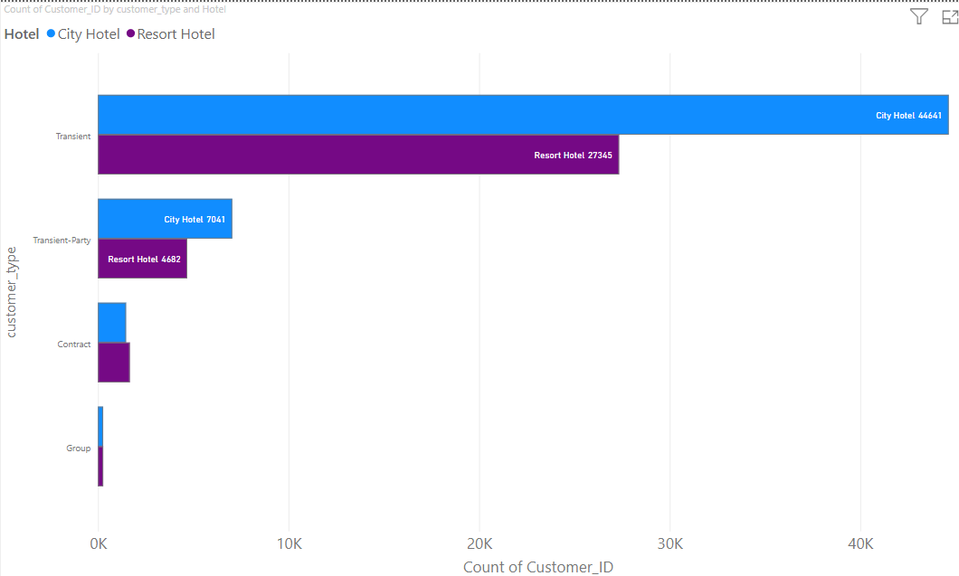
1. Which type of customer prefer which hotel?

Slide 12
Thank You

