Slide 1
Process N particles in one go
Hans Dembinski, MPIK Heidelberg

Slide 2
Overview
See https://gitlab.ikp.kit.edu/AirShowerPhysics/corsika/issues/224
Instead of processing one particle in a Monte-Carlo step, process N particles at once in a Monte-Carlo step
Possible because Monte-Carlo steps for all particles independent
Apply ProcessA to particle range, apply ProcessB to particle range, ...
Benefits
Faster processing
Allows processes to do local optimizations which are otherwise impossible
Allows us to create and modify ProcessList at run-time without performance hit

Slide 3
Current main loop vs proposed main loop
Particle&
ParticleSpan
P
P
P
P
P
P
Process A
Process A
Stack
Process B
Stack
Process B
Process C
Process C

Slide 4
Benefits of processing N particles
CPUs faster when doing same operation on multiple data
Reduced CPU cache misses
Can use SIMD instructions
Pipelining
Allows encapsulated process optimization
Process can internally use optimizations which balance one-time cost against reduced cost per particle
Run multiple threads
Compute on the GPU
Allocate buffers for intermediate results
Can use ProcessList constructed at run-time instead of static list
Configure std::vector<std::variant<ProcessA, ProcessB, ProcessC, ...>> at run-time
Runtime Lookup cost is negligible compared to time spend in process body

Slide 5
Syntactic cost is small
Many calculations with Eigen::Arrays look as if they were numbers (like in Python with Numpy arrays)
Can always fall back in process to iteration over one particle a time

Slide 6
Particle
Size of Particle must be multiple of RealType for Eigen
Particle should be trivial for best copy performance
#include <type_traits>
struct Particle {
float& px() { return px_; }
float& py() { return py_; }
float& pz() { return pz_; }
float& e() { return e_; }
// "private" variables
float px_, py_, pz_, e_;
};
static_assert(std::is_trivial<Particle>::value);
Trivial struct: no public/private sections, only POD members, no virtual methods

Slide 7
ParticleSpan
#include <Eigen/Core>
#include <vector>
class ParticleSpan {
public:
using iterator = Particle*;
using ArrayView = Eigen::Map<
Eigen::Array<float, Eigen::Dynamic, 1>,
Eigen::Unaligned,
Eigen::InnerStride<(sizeof(Particle) / sizeof(float))>
>;
ParticleSpan(std::vector<Particle>& v)
: begin_(v.data()), end_(v.data() + v.size()) {};
iterator begin() { return begin_; }
iterator end() { return end_; }
std::size_t size() { return end_ - begin_; }
ArrayView px() { return ArrayView(&begin_->px_, size()); }
ArrayView py() { return ArrayView(&begin_->py_, size()); }
ArrayView pz() { return ArrayView(&begin_->pz_, size()); }
ArrayView e() { return ArrayView(&begin_->e_, size()); }
private:
iterator begin_, end_;
};
Any Particle field has a fixed memory offset to the next field
ArrayView can adapt a memory buffer of RealType with regular strides to look like a Eigen::Array
ArrayView is light-weight, it does not own the memory (copy ok)

Slide 8
Energy loss
Templated functions accept Particle and ParticleSpan!
Important: return decltype(auto) instead of auto
Use ADL-friendly call to log for Eigen
template <class T>
decltype(auto) sqr(const T& x) { return x * x; }
template <class T>
decltype(auto) momentum_squared(T& part) {
return sqr(part.px()) + sqr(part.py()) + sqr(part.pz());
}
template <class T>
void do_energy_loss(T& part) {
auto beta_2 = momentum_squared(part) / sqr(part.e());
// compute energy loss, ignoring all constants
using std::log; // allow Eigen to find its own log via ADL
auto energy_loss = log(beta_2 / (1.0 - beta_2)) / beta_2 - 1.0;
part.e() -= energy_loss;
}

Slide 9
Processing
#include <vector>
#include <variant>
std::vector<Particle> stack(1000);
ParticleSpan span(stack);
// Method 1: process one particle at once
for (auto&& p : span)
do_energy_loss(p);
// Method 2: process block of particles at once
do_energy_loss(span);
std::variant<ContinuousEnergyLoss, DummyProcess> process;
process = ContinuousEnergyLoss(); // set at run-time
// Method 1A: process one particle using std::variant
for (auto&& p : span)
visit([&span](auto& proc) { proc(span); }, process);
// Method 2A: process block of particles using std::variant
for (auto _ : state)
visit([&span](auto& proc) { proc(span); }, process);
struct ContinuousEnergyLoss {
template <class T>
void operator()(T& p) const {
do_energy_loss(p);
}
};
struct DummyProcess {
template <class T>
void operator()(T& p) const {}
};

Slide 10
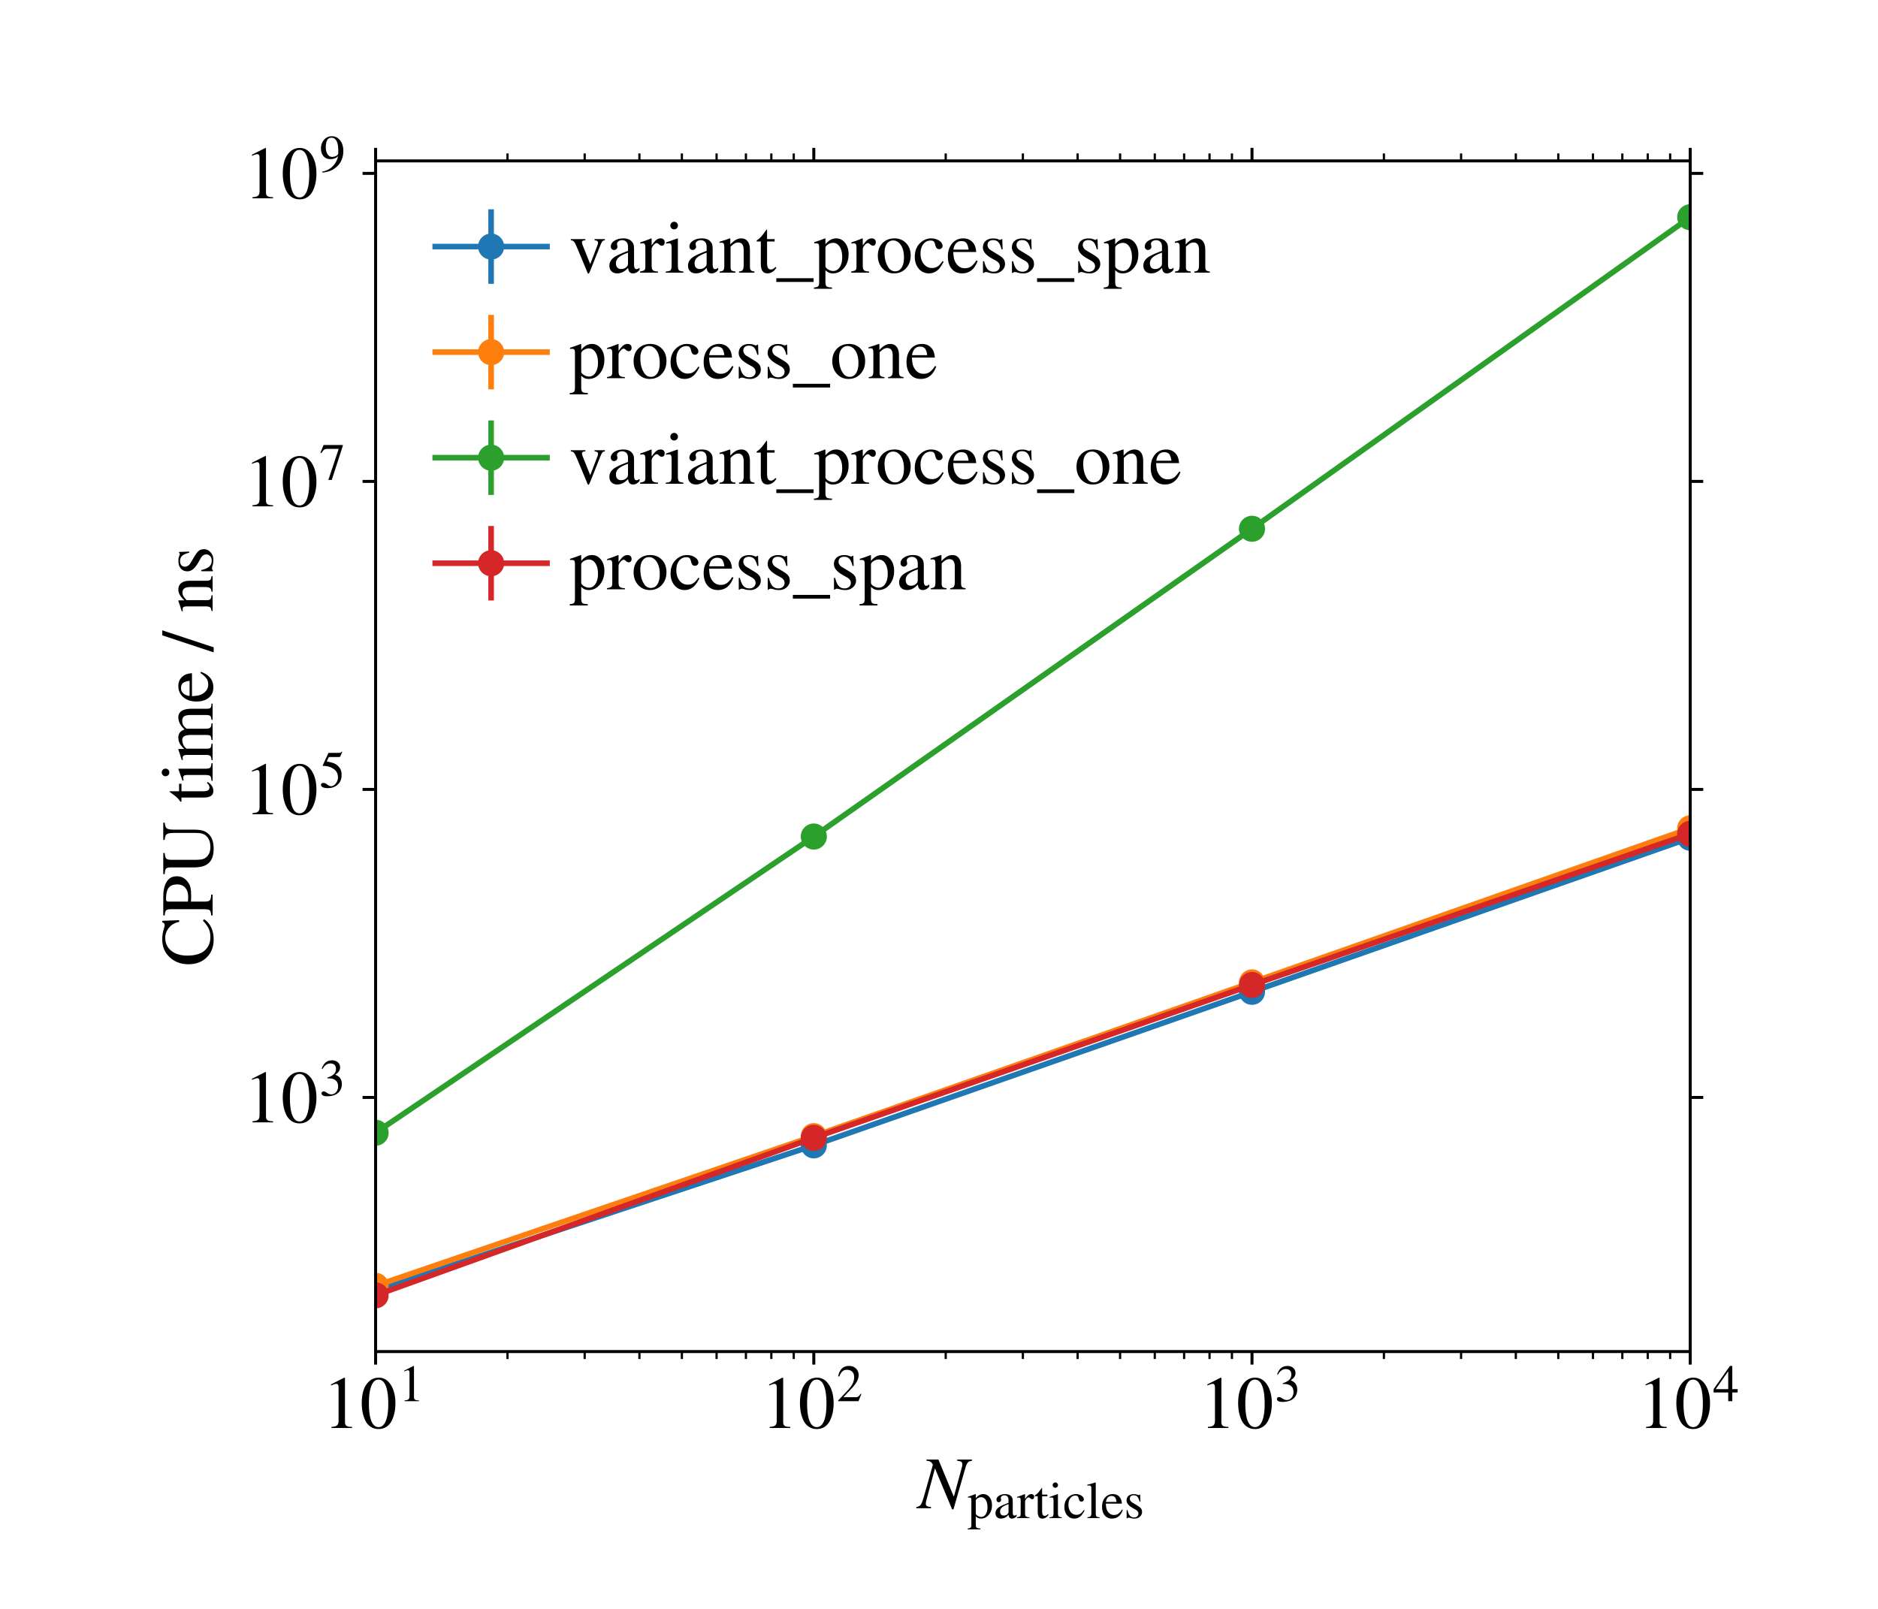
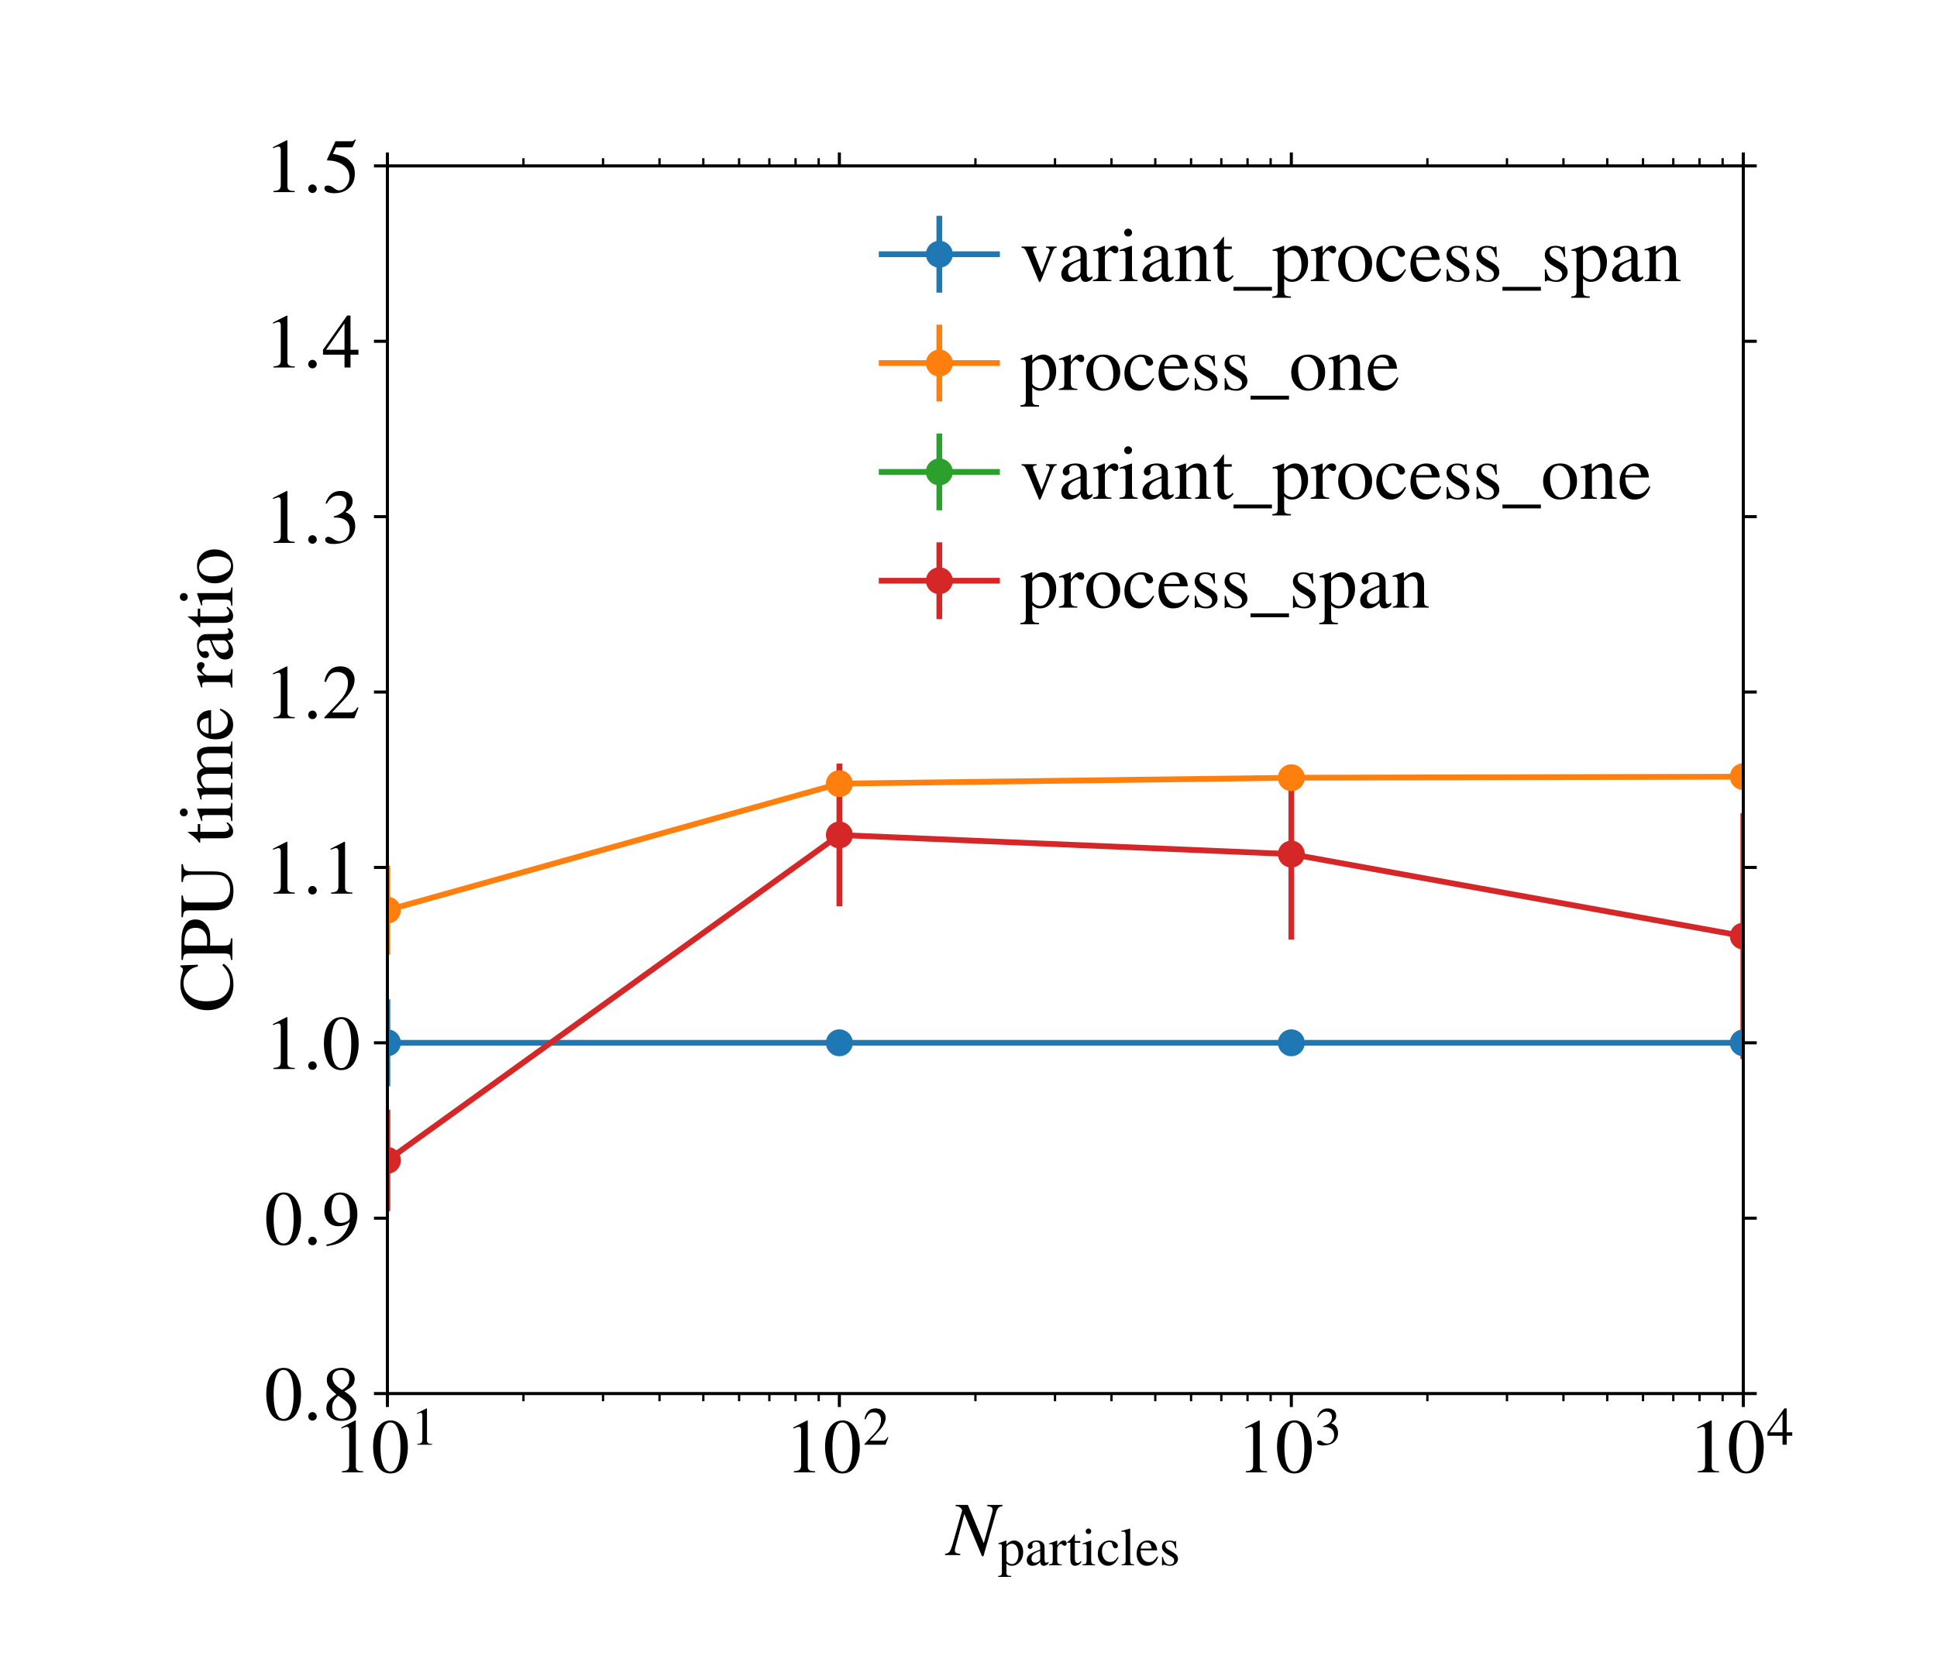
Benchmarks
Highest performance for variant of processes which acts on a ParticleSpan
Higher performance gains seem possible with better use of SIMD
Variant of processes which acts on Particle a time is unacceptably slow

Slide 11
Summary
We should change to the new main loop proposal
No show stoppers
ParticleSpan and Eigen make array computing easy
Enable individual modular optimisations for each process
Speed gains not as much as I had expected, but present
Much simpler ProcessList, configurable at run-time from Python

Slide 12
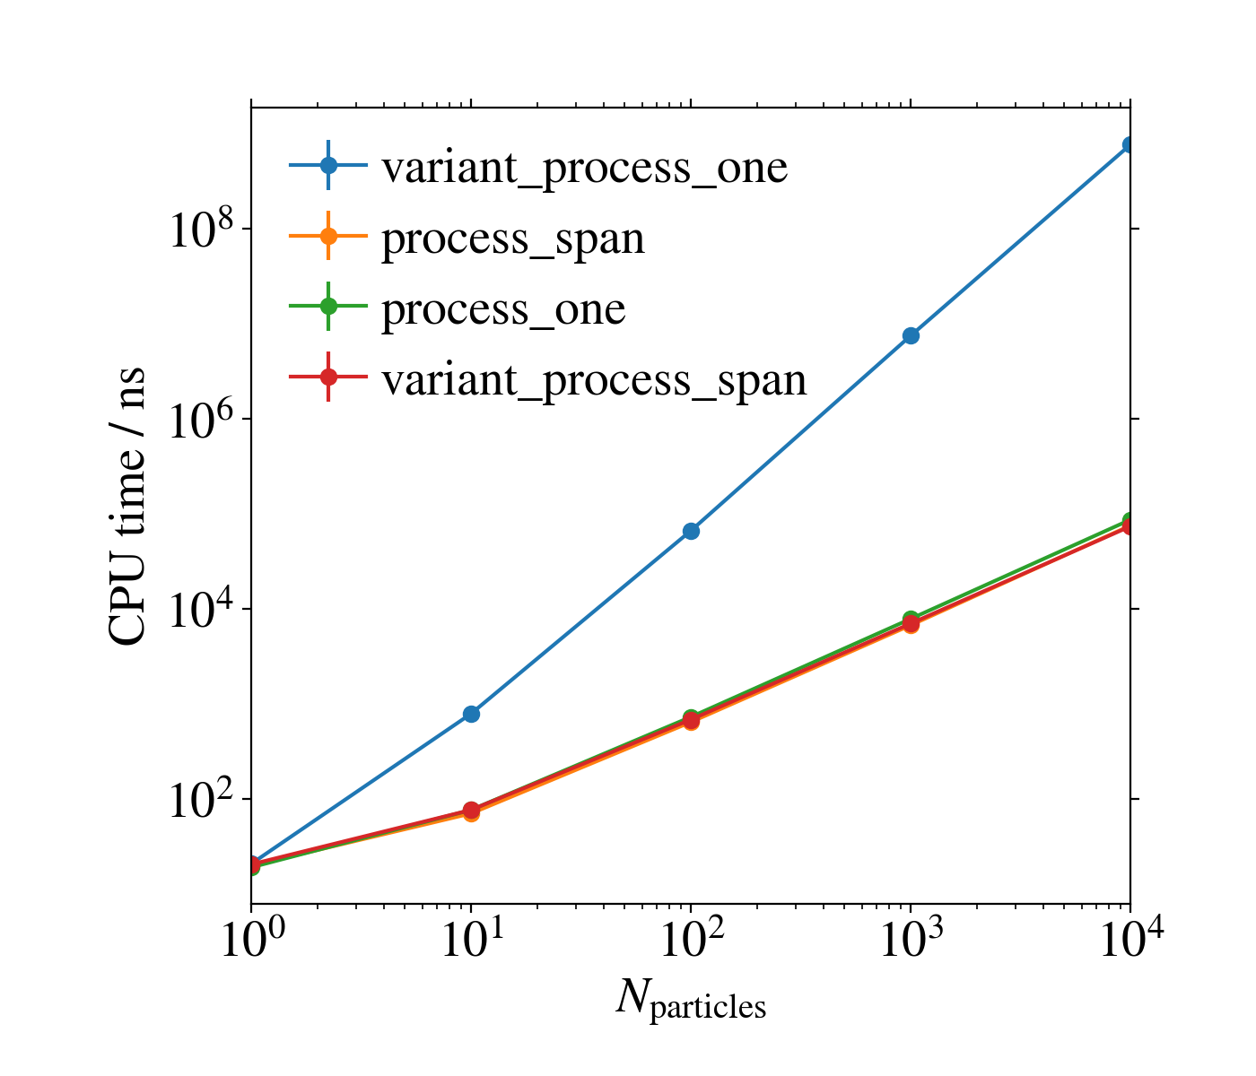
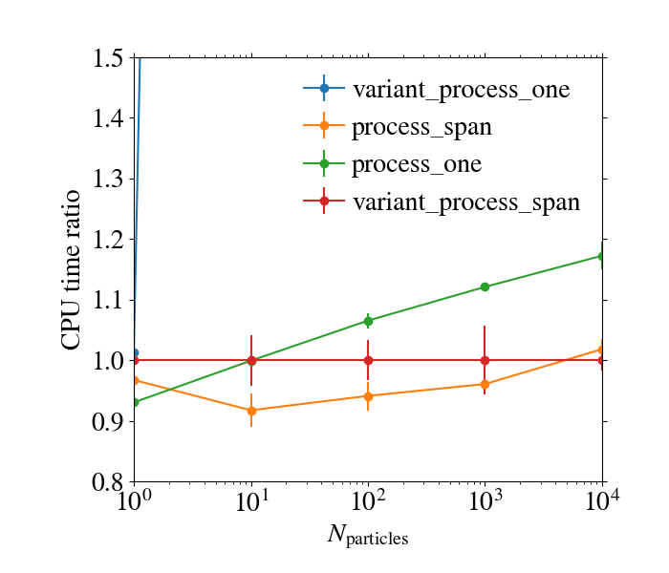
Benchmarks 2 under load, also with 1 particle

Slide 13
Github repo with this demonstrator
https://github.com/HDembinski/corsika_span_demo

