Slide 1


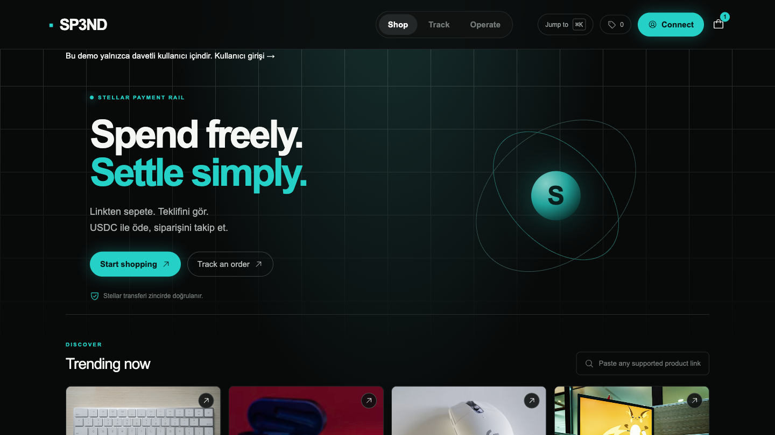
RISE IN × STELLAR PRO HACKATHON · 19–20 SEP 2026
Spend freely.
Settle simply.
One USDC payment on Stellar. Real goods from Amazon Türkiye,
Trendyol, and Hepsiburada — delivered to a Turkish address.
LOCAL COMMERCE
STELLAR USDC
FREIGHTER + SEP-53
Working app in-repo · github.com/HDemir23/SP3ND · sp3nd.shop
Notes:
Açılış: SP3ND, Stellar USDC ile Türkiye'deki gerçek e-ticaret sitelerinden alışveriş. Kart uygulamaya girmez. Tek cüzdan imzası, tek USDC ödemesi, operatör mağazadan satın alır. Jüriye 14 slayt; demo DEMO.md senaryosu.

Slide 2
1 · MEANINGFUL IDEA
USDC sits in wallets. Shopping still needs a card.
THE LOCK
THE COST
THE GAP
Amazon Türkiye, Trendyol, and Hepsiburada do not take Stellar USDC. A holder who wants a real product still has to off-ramp, wire TRY, and check out as a card customer.
Each hop adds FX spread, banking hours, and KYC. Remittances become cash, not the actual goods a family asked for. Crypto-native users bounce before they spend.
Stellar already moves dollars in seconds. Turkey already has dense e-commerce. Nobody connects the two without asking the shopper for a card or a private key.
Use case: local payments + commerce. Not a demo swap. A rail that turns Stellar dollars into a parcel at a Turkish door.
SP3ND · STELLAR PRO HACKATHON 2026 · ISTANBUL
2 / 14
Notes:
Problem: Türkiye'de USDC ile Amazon/Trendyol/HB alışverişi yok. Off-ramp + kart zorunlu. SP3ND bu boşluğu kapatır: zincirde ödeme, kapıda ürün.

Slide 3
1 · WHO BENEFITS
A clear buyer — and a desk that can serve them this week
01
USDC holders in Turkey
02
Diaspora sending goods, not cash
People who already keep dollars on Stellar and want a keyboard, a phone case, or a gift without opening a bank transfer.
A relative abroad pays in USDC. The parcel lands at a Turkish address. Remittance becomes a delivered product.
03
Crypto-native shoppers
04
The operator desk
Paste a product URL, review a 15-minute quote, sign once in Freighter. No card number ever enters the app.
A human merchant-of-record who already has store accounts. They buy, attach real order refs, and ship. The protocol does not scrape cards.
SP3ND · STELLAR PRO HACKATHON 2026 · ISTANBUL
3 / 14
Notes:
Hedef: Türkiye'de USDC tutanlar, yurtdışından mal gönderen diaspora, kart vermek istemeyen kripto kullanıcıları. Operatör = merchant of record.

Slide 4
VALUE PROPOSITION
Paste a link. Pay USDC once. Get the thing.
3 stores
1 transfer
0 cards
15 min
One cart
One USDC total
Keys stay local
Firm quote
Amazon TR, Trendyol, Hepsiburada in a single quote.
Goods + shipping + 1 USDC per unit. No second charge.
Freighter signs. The app never sees a secret or a PAN.
Admin-verified TRY prices, TCMB FX, then a locked USDC amount.
What we refused to fake: auto-buy on merchant sites, escrow we do not yet have, and partial refunds. The operator buys with their own account. The chain only moves USDC.
SP3ND · STELLAR PRO HACKATHON 2026 · ISTANBUL
4 / 14
Notes:
Değer: tek sepet, tek USDC, kart yok, 15 dk teklif. Kapsam dışı: otomatik mağaza satın alma, escrow, kısmi iade. Dürüst MVP.

Slide 5
2 · MVP · USER FLOW
Seven steps judges can click without a script rewrite
1
2
3
4
5
6
7
Sign in
Cart
Address
Quote
Pay
Fulfill
Refund
5-minute Freighter message. Reject it and there is no session.
Three store URLs. Qty + note. Same URL bumps qty. Reload keeps the cart.
Turkish delivery fields. One request copies cart + address into an order.
Admin confirms TRY, FX, shipping. Fee is 1 USDC per unit. 15-minute lock.
Server builds XDR. User signs. Horizon must match the exact payment.
Operator buys per store. Partial, then purchased, then shipped.
Full USDC only, memo R+order. No partial refunds.
Wallet isolation is part of the product, not a footnote.
A second Freighter account must not see the first wallet’s cart, address, or orders. Switching accounts forces a new sign-in. Payment XDR is bound to the session wallet. Chrome extension only has activeTab — it never stores a session.
SP3ND · STELLAR PRO HACKATHON 2026 · ISTANBUL
5 / 14
Notes:
Demo sırası: giriş (reddet=oturum yok) → 3 mağaza sepet → adres → admin teklif → Freighter ödeme → satın alma durumları → tam iade. İkinci cüzdan izolasyonu göster.

Slide 6
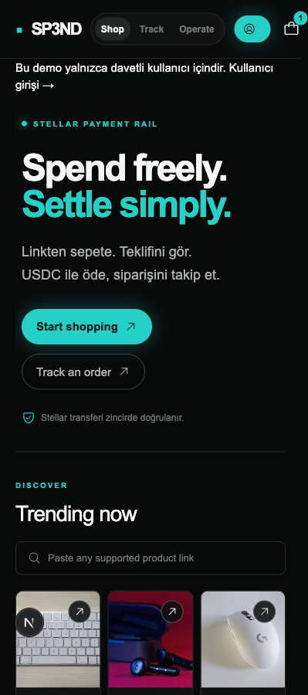
4 · USER EXPERIENCE
A shop a non-crypto relative can finish
Mosaic storefront · paste-a-link cart · Chrome extension · Turkish copy throughout
SP3ND · STELLAR PRO HACKATHON 2026 · ISTANBUL
6 / 14
Notes:
UX: kripto bilmeyen biri de link yapıştırıp teklif görür. Mobil ve masaüstü aynı akış. Extension ürün sayfasından URL taşır, sepete kendi başına eklemez.

Slide 7
PAYMENT MATH
The quote is a formula. The payment is a real USDC operation.
SERVER-SIDE TOTAL
No double pay
USDC = (goods TRY + shipping TRY) / USDTRY
+ 1 USDC × quantity
Network delay keeps watching the same hash. A second payment is not prepared.
Service fee
1 USDC per unit. Client cannot override it.
Refresh-safe
Reload continues polling. Quote/cancel stay locked while an attempt is live.
FX
Admin confirms TCMB USD selling rate (4 dp).
Rounding
Decimal.js, USDC rounded up to 7 dp.
Reject-safe
Lock
15 minutes. Timebounds on the Stellar tx.
If Freighter refuses, the same XDR can be signed again.
XDR
Built on the server. Freighter only signs.
Unlock rule
Paid status
Only after Horizon matches hash, payer, receiver, issuer, amount, memo, time.
After expiry + 60s of Horizon ledger time, the hash is checked, then the lock lifts.
SP3ND · STELLAR PRO HACKATHON 2026 · ISTANBUL
7 / 14
Notes:
Formül: (ürün TRY + kargo TRY) / kur + adet başına 1 USDC. İstemci hizmet bedelini değiştiremez. Ödendi ancak Horizon eşleşmesiyle. Aynı hash izlenir, ikinci ödeme yok.

Slide 8
3 · TECHNICAL DOCUMENTATION
Classic Stellar payments, a Next.js desk, no secrets on the server
CLIENT
APP
DATA
Next.js 16 · Freighter API
Chrome extension (activeTab)
Route handlers · Prisma
Wallet-scoped sessions (8h)
SQLite · cart, orders, memos
Login challenges, payment attempts
STELLAR
AUTH
FX / CATALOG
stellar-sdk · Horizon
USDC payment + memo + timebounds
SEP-53 message signing
SHA-256 + Ed25519, one-time nonce
TCMB USD selling rate
Amazon TR fetch · Rainforest fallback
OPERATOR
MERCHANTS
Admin quotes, store-by-store purchase refs, shipping, full refund (R + memo)
Amazon Türkiye · Trendyol · Hepsiburada — bought with the operator’s own account, never the app’s
SP3ND · STELLAR PRO HACKATHON 2026 · ISTANBUL
8 / 14
Notes:
Mimari (Mermaid):
flowchart LR
U[Chrome + Freighter] --> A[Next.js]
E[Extension] --> A
A --> DB[(SQLite)]
A --> H[Horizon]
A --> FX[TCMB + catalog]
H --> USDC[Circle USDC]
OP[Admin] --> M[Amazon TR / Trendyol / HB]
Soroban yok: klasik payment. Escrow yol haritasında.

Slide 9
3 · ECOSYSTEM FIT
Stellar is the checkout, not a badge on the footer
Freighter
Wallet connect, message sign-in, and the USDC payment signature. Nothing is custodied.
SEP-53
Documented signed-message format. Origin + wallet + nonce + 5-minute expiry. Atomic one-time use.
Circle USDC
Testnet issuer GBBD47…FLA5 · Mainnet issuer GA5ZSEJY…KZVN. Trustlines checked on both sides.
Horizon + SDK
@stellar/stellar-sdk builds the XDR, submits, and verifies the exact payment operation.
Memo + bounds
Order memo on the payment. maxTime = quote expiry. Replay and overpay are rejected.
Skills / docs
Stellar signing docs, SEP-53, Freighter API, Horizon. TR Mock Anchor is next — not a mocked SEP-6 today.
SP3ND · STELLAR PRO HACKATHON 2026 · ISTANBUL
9 / 14
Notes:
Stellar çekirdekte: Freighter, SEP-53, Circle USDC, Horizon doğrulama. Anchor henüz yok — bunu bir sonraki slaytta açık söyle. Sahte SEP-6 göstermiyoruz.

Slide 10
2 · TECHNICAL IMPLEMENTATION
Not mocked. Not hardcoded. Deliberately scoped.
Real Horizon path
What is out of scope
npm run test:testnet funds Friendbot accounts, opens trustlines, issues demo USDC, and drives the HTTP API against live testnet.
No Soroban contract in this MVP. No SEP-6 deposit. No automatic merchant purchase. No partial refund. No card vault.
Unit + API tests
Why that is a feature
npm test uses temp SQLite and a fake Horizon. npm run test:api signs two wallets and asserts isolation, then deletes its rows.
A broken escrow or a scraped store login would fail the demo. A signed USDC payment and a human desk will not.
Idempotent checkout
Passkeys / smart wallets
Wallet-bound checkout key returns the same order on retry. Cart lines unique on wallet + URL + notes.
Treated as a bonus, as the brief asks. Freighter is the supported signer today.
SP3ND · STELLAR PRO HACKATHON 2026 · ISTANBUL
10 / 14
Notes:
Dürüstlük: Soroban/Anchor yok. Testnet script gerçek Horizon kullanır. Otomatik testler gerçek mağaza siparişi veya mainnet ödeme sayılmaz — DEMO.md'de yazıyor.

Slide 11
5 · TRACTION & CONTINUITY
Ship the desk, then put TRY on-ramp and escrow on-chain
NOW
NEXT 90 DAYS
SCF / INSTAAWARDS
Freighter login + USDC pay
TR Mock Anchor (SEP-6 / 10 / 38)
Licensed TRY anchor partner
3-store cart, TR address
TRY deposit → USDC in-app
More TR merchants
Admin quote / buy / ship / refund
Soroban escrow: release on fulfill
Diaspora GTM in EU/UK/DE
Chrome extension
Live small mainnet orders
Passkey smart wallets
Intended next step: Stellar Community Fund, with InstaAwards as the fast path if the live desk proves a handful of real parcels.
SP3ND · STELLAR PRO HACKATHON 2026 · ISTANBUL
11 / 14
Notes:
Devam: SCF. 90 gün: TR Mock Anchor (SEP-6/10/38) + Soroban escrow. Bugün çalışan şey: klasik USDC ödeme + operatör masası. Mainnet alıcı cüzdanı .env MAINNET_RECEIVER.

Slide 12
LIVE DEMO
The acceptance script — same order as DEMO.md
1
Sign in
Chrome + Freighter. Sign the 5-minute message. Reject it once so judges see no session.
2
Cart
Amazon TR, Hepsiburada, Trendyol — one each. Qty + color/size note. Repeat URL bumps qty. Reload. Extension fetch + confirm.
3
Address
Fill a Turkish address. One quote request. Order shows three merchants + the address.
4
Quote
Admin: name, unit TRY, USDTRY, per-store shipping. Fee = 1 USDC/unit. User sees breakdown + 15:00.
5
Pay
Freighter: wallet, network, receiver, amount. Sign a small real payment. Explorer link. Same hash if delayed.
6
Fulfill
Operator buys on store accounts. Attach real refs. Partial then purchased, then partial/full shipped.
7
Refund
If needed: full refund only. Send R+memo from the desk wallet. Panel verifies the hash.
SP3ND · STELLAR PRO HACKATHON 2026 · ISTANBUL
12 / 14
Notes:
Canlı demo bu sırayla. Cüzdan yoksa ödeme/satın alma kabulü bekler — slayt 13. İkinci cüzdanla izolasyonu unutma.

Slide 13
6 · PRESENTATION & DOCS
Everything a judge needs to run, click, and score
GitHub
github.com/HDemir23/SP3ND
Public site
www.sp3nd.shop
Local app
localhost:3000 after npm ci && npm run setup && npm run dev
Admin
/login?role=admin · password from .env
Extension
/extension · or chrome://extensions load unpacked
Verify
npm test · npm run typecheck · npm run test:api · npm run test:testnet
SP3ND · STELLAR PRO HACKATHON 2026 · ISTANBUL
13 / 14
Notes:
Jüri kurulumu README'de. APP_ORIGIN tam olarak http://localhost:3000 olmalı. MAINNET_RECEIVER boşsa teklif/ödeme yapılandırma hatası verir. Otomatik test ≠ gerçek ödeme.

Slide 14
Spend freely.
Settle simply.
Stellar already moves the dollar. SP3ND spends it at a Turkish door.
Repo
Site
Next
github.com/HDemir23/SP3ND
sp3nd.shop
SCF · Anchor · escrow
Thank you · questions
Notes:
Kapanış: Stellar doları taşıyor, SP3ND onu kapıya götürüyor. Sorular. Demo’ya geç.

