Slide 1
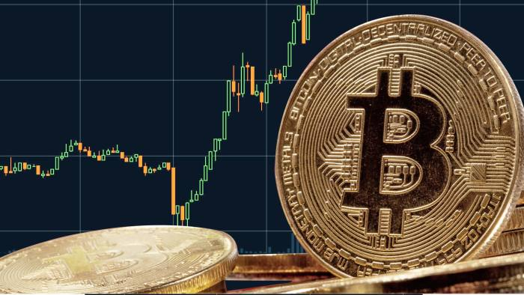
Bitcoin Dashboard App
Heather Dietrich
March 2021
U of T Data Analytics Bootcamp

Slide 2
Introduction
Bitcoin Dashboard App will track the following:
Daily closing price
% Change in Price (day over day)
Volume (24hr)
Bitcoin performance over time
Market Capitalization ($USD)
Market News
Facebook Prophet is applied to forecast the future price of Bitcoin and provide additional insight into trends on price

Slide 3



Data Sources

Slide 4
ETL Process
Extract:
Data was extracted from the web using API calls and web scraping
Languages used: Python (APIs & BeautifulSoup)
Transform:
Extracted data was transformed using pandas
Languages used: Python (Pandas & NumPY)
Load:
Data was loaded into PosgreSQL Database using SQL Alchemy.
ETL through Google Colab
Facebook Prophet machine learning model was created as part of ETL process with 30 day predictions loaded to database for visualization on front-end application.

Slide 5

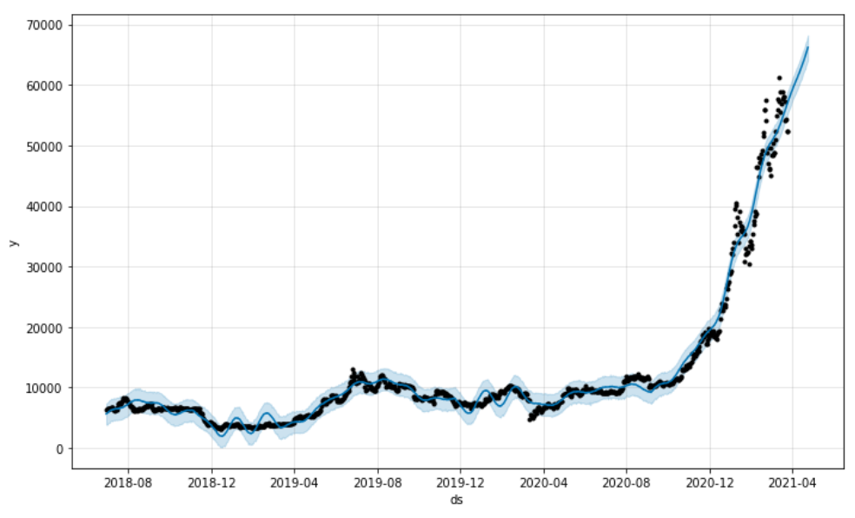



Machine Learning – Facebook Prophet

Slide 6

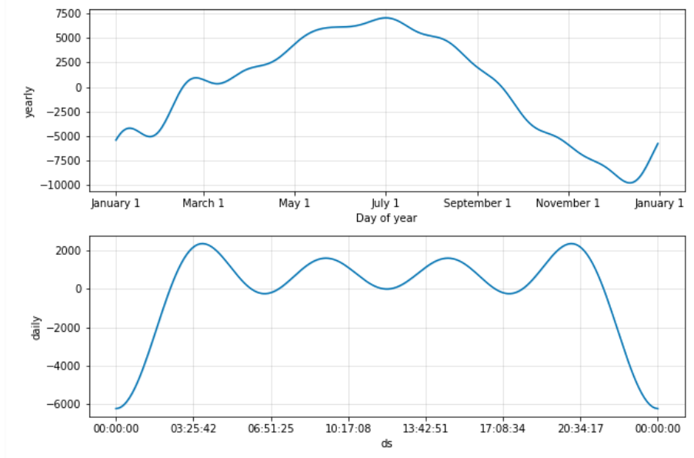
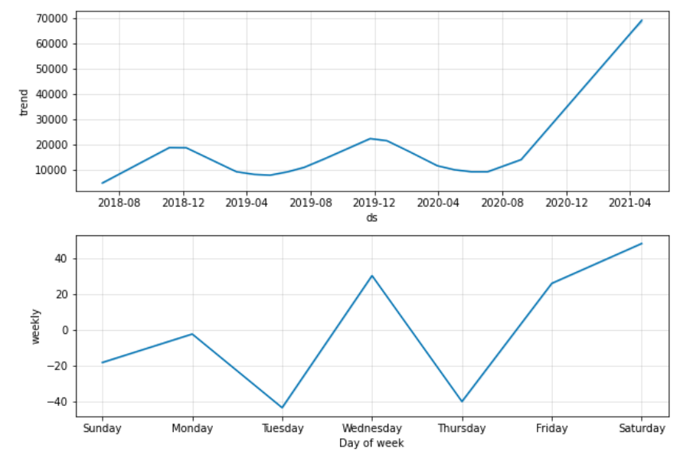
Machine Learning – Facebook Prophet

Slide 7
Infrastructure
Data was selected from database using SQLAlchemy and output in json format to python Flask app routes
Visualizations were created in JavaScript pulling input data from Flask app routes and outputs were sent to HTML.
Dashboard page format was built off of Bootstrap Made template.
App was deployed to Heroku through GitHub

Slide 8
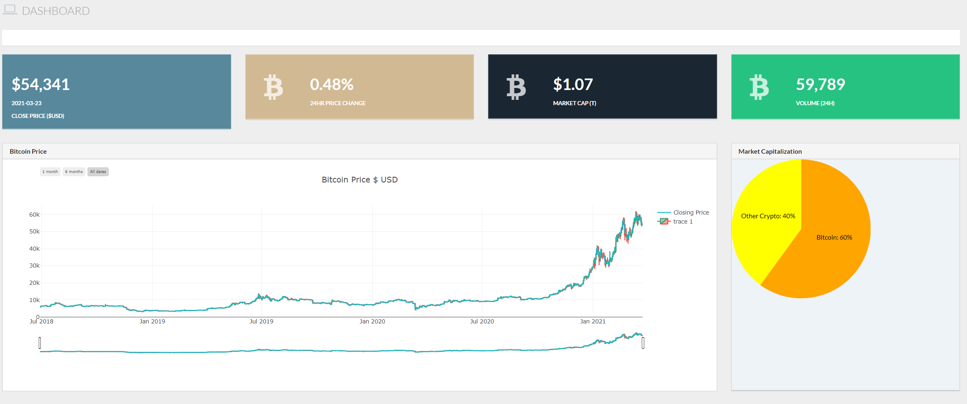
Visualization – Financial Overview

Slide 9
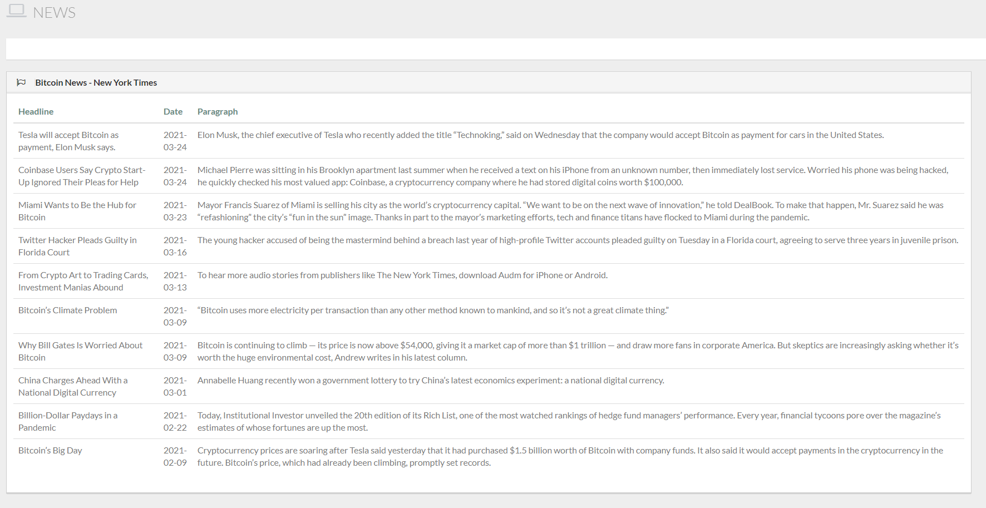
Visualization – Market News

Slide 10
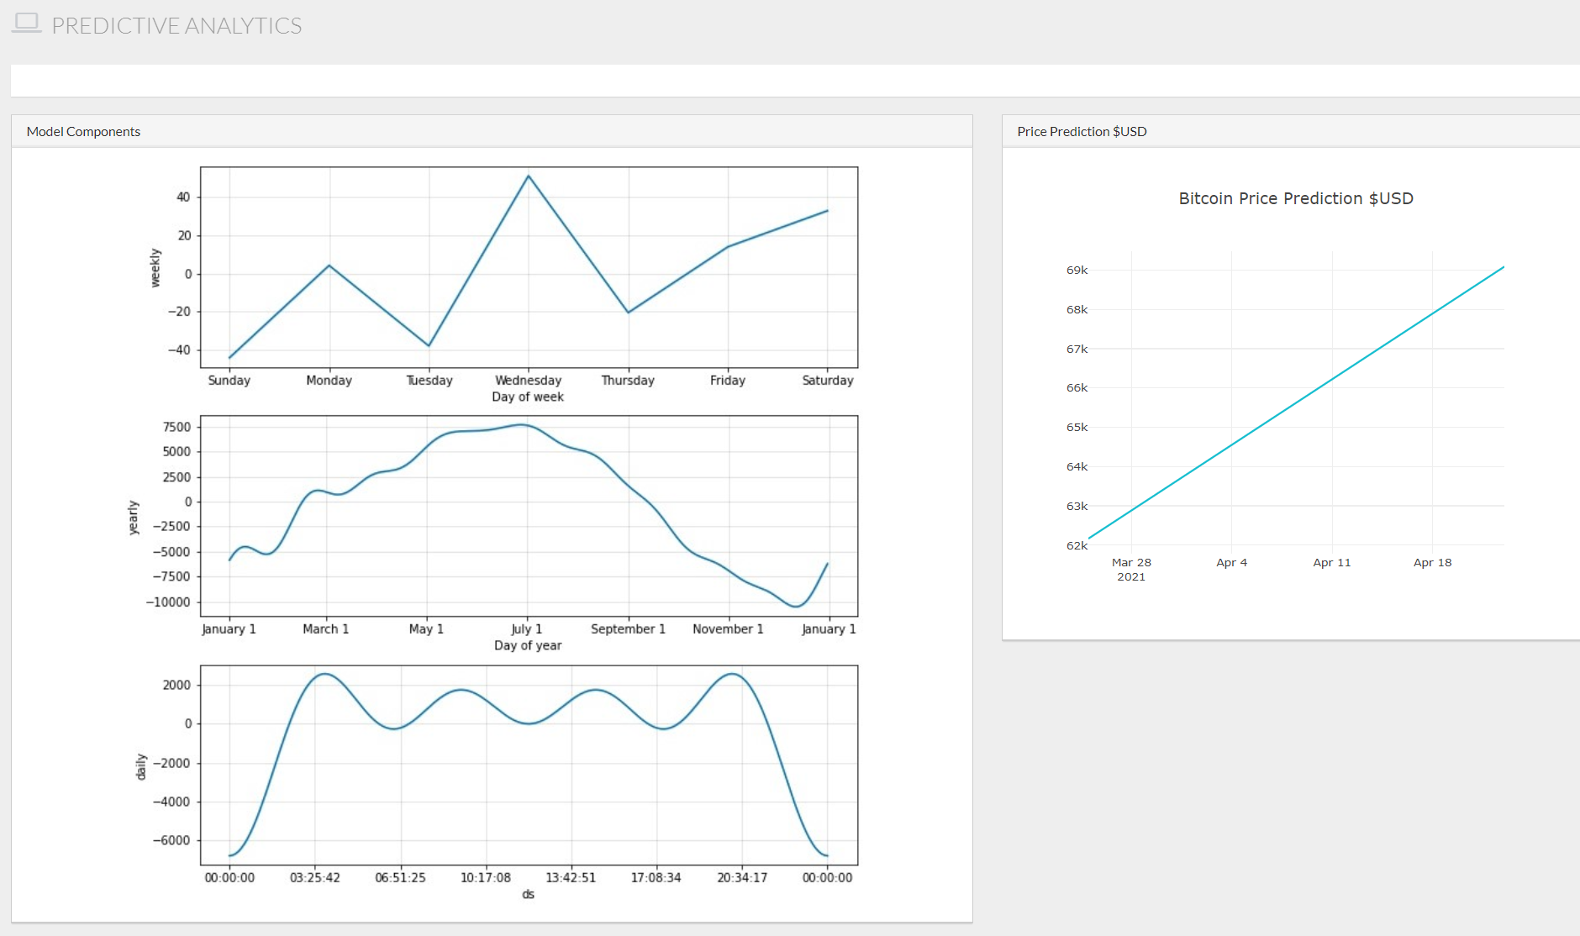
Visualization – Predictive Analytics

Slide 11
Challenges
ETL process through Google Colab created challenges for automating
Difficulty visualizing Facebook Prophet plots and components on front end application
Uncertainty in forecasting Bitcoin price due to extreme volatility (Accuracy of price predictions)

Slide 12
Post Mortem
ETL process could be automated daily through Heroku to maintain most up-to-date data on a scheduled basis (daily).
Application could continue to be optimized for mobile
Application could be scaled to include live data (currently includes daily data) with paid access
Additional crypto-currencies could be included within the dashboard to show comparisons.

Slide 13

Questions?

