Slide 1
Performance Comparison of Sorting Algorithms
Steven Simmermon & Harrison Downs

Slide 2
Introduction
Algorithms used by computers are often categorized by their theoretical time complexities, which is represented by big O notation.
How will the expected performance be reflected in a real-life execution of the code?
Insertion Sort - O(n²)
Merge Sort - O(nlog(n))
Quick Sort - O(nlog(n))
Counting Sort - O(n)
Notes:
Comparing execution times to understand performance and big O notation
Each one has a theoretical time complexity
Testing whether or not this is reflected in real results

Slide 3
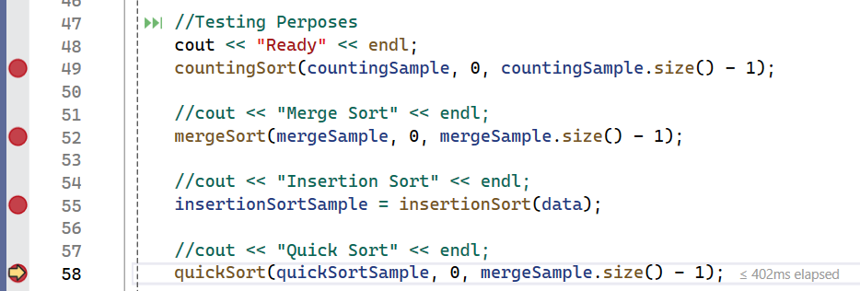
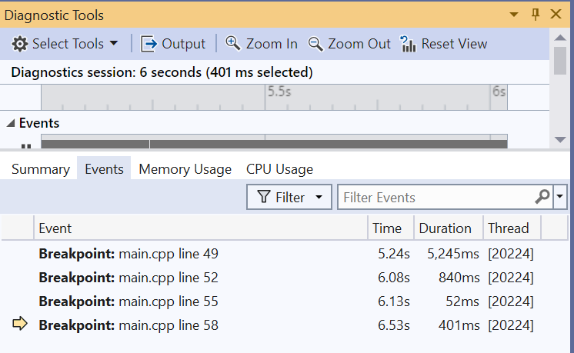
Methodology
Function
Breakpoints
Diagnostic Tools
Events

Slide 4
Sample Size
1,000 | 10,000 | 50,000 | 100,000 | 250,000 | 500,000
Read Sample Function
Go through each sample size 5 times and take the average

Slide 5
Data & Graphs
All time measured in Milliseconds

Slide 6
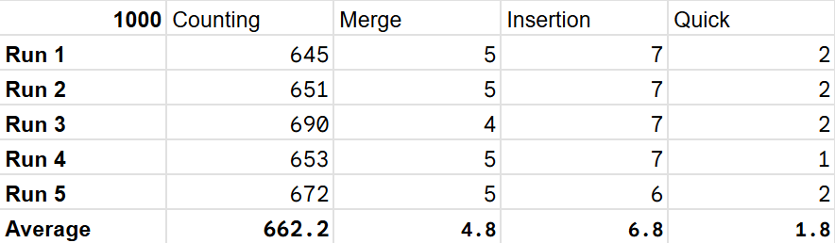
1,000 Data

Slide 7
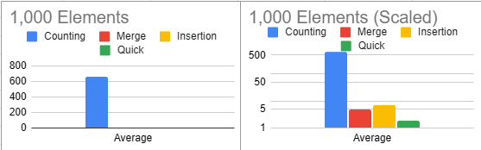
1,000 Graph

Slide 8
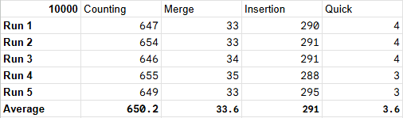
10,000 Data

Slide 9
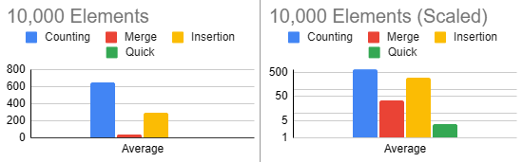
10,000 Graph

Slide 10
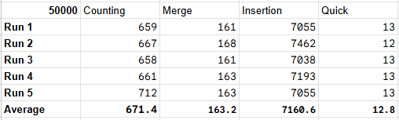
50,000 Data

Slide 11
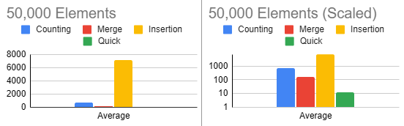
50,000 Graph

Slide 12
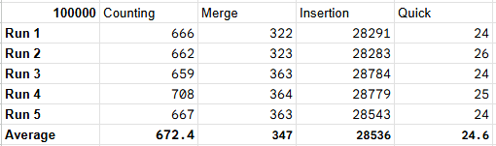
100,000 Data

Slide 13
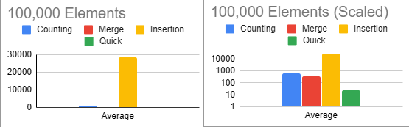
100,000 Graph

Slide 14
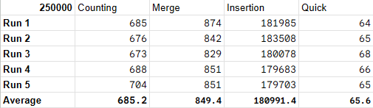
250,000 Data

Slide 15
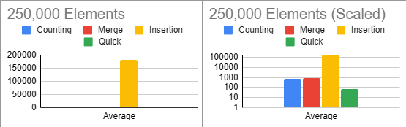
250,000 Graph

Slide 16
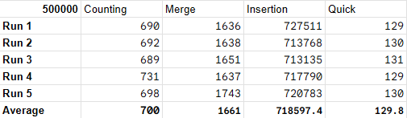
500,000 Data

Slide 17
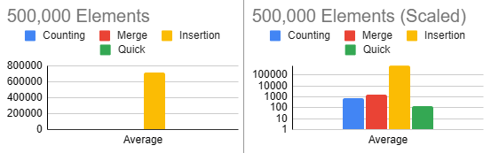
500,000 Graph

Slide 18
Line Graphs
For each Sort

Slide 19
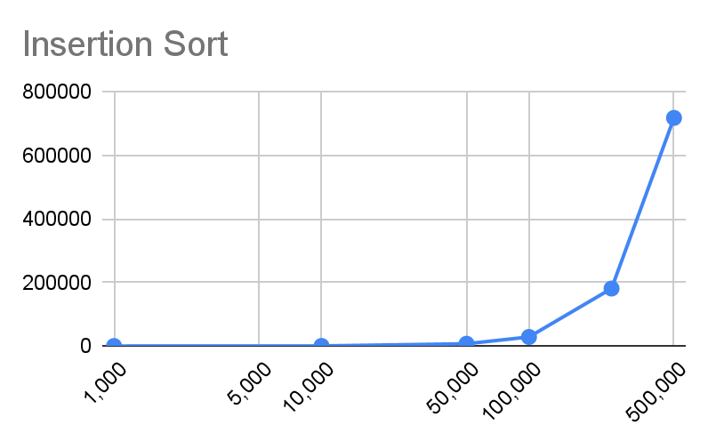
Insertion Sort
O(n²)
Average Time(ms) | 6.8 | 291 | 7160.6 | 28536 | 180991.4 | 718597.4
Elements | 1,000 | 10,000 | 50,000 | 100,000 | 250,000 | 500,000

Slide 20
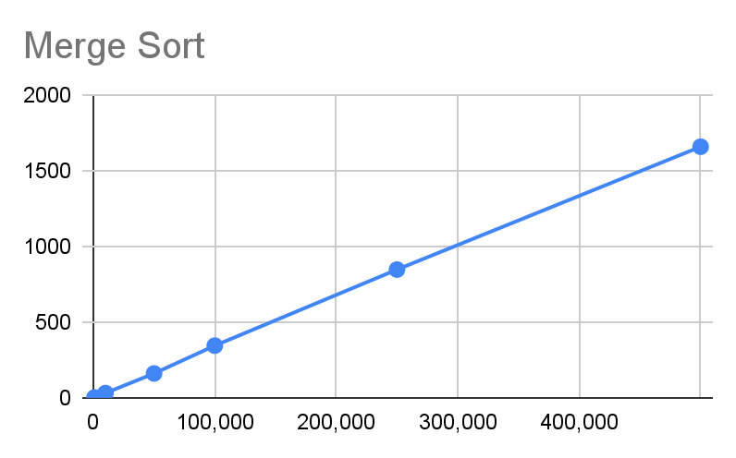
Merge Sort
O(nLog(n))
Average Time(ms) | 4.8 | 33.6 | 163.2 | 347 | 849.4 | 1661
Elements | 1,000 | 10,000 | 50,000 | 100,000 | 250,000 | 500,000

Slide 21
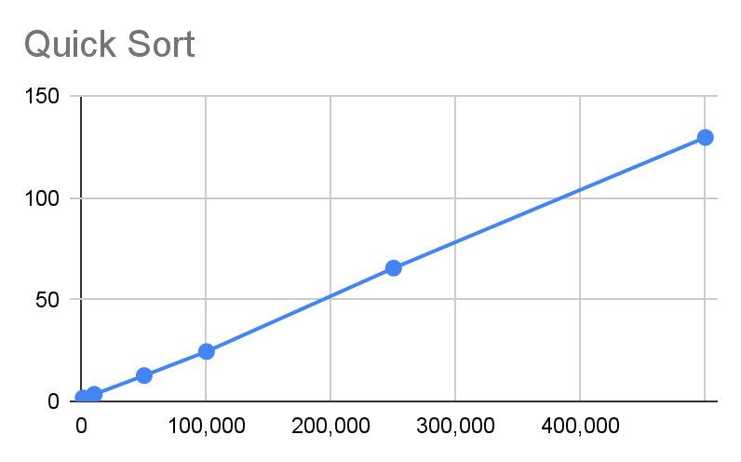
Quick Sort
O(nLog(n))
Average Time(ms) | 1.8 | 3.6 | 12.8 | 24.6 | 65.6 | 129.8
Elements | 1,000 | 10,000 | 50,000 | 100,000 | 250,000 | 500,000

Slide 22
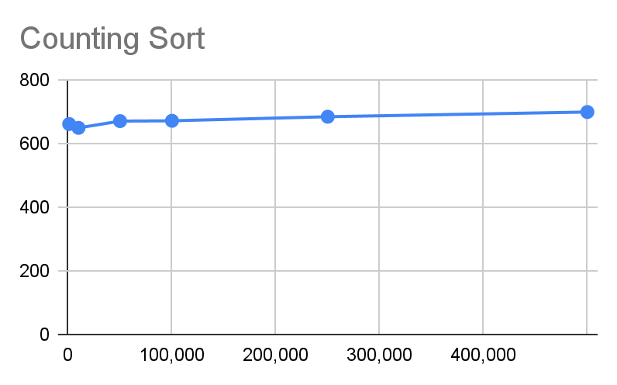
Count Sort
O(n)
Actual: O(1)
Average Time(ms) | 662.2 | 650.2 | 671.4 | 672.4 | 685.2 | 700
Elements | 1,000 | 10,000 | 50,000 | 100,000 | 250,000 | 500,000

Slide 23
Analysis

Slide 24
Insertion Sort
Met expected performance: O(n²)
Acceptable for small data sets (n <= 10,000)
Not viable for any larger data sets
Average Elapsed ms | Items Sorted
Algorithm | 1,000 | 10,000 | 50,000 | 100,000 | 250,000 | 500,000
Counting Sort | 662.2 | 650.2 | 671.4 | 672.4 | 685.2 | 700
Insertion Sort | 6.8 | 291 | 7,160.6 | 28,536 | 180,991.4 | 718,051
Merge Sort | 4.8 | 33.6 | 163.2 | 347 | 849.4 | 1,661
Quick Sort | 1.8 | 3.6 | 12.8 | 24.6 | 65.6 | 129.75
Notes:
10k items, 291 ms comparable

Slide 25
Merge Sort & Quick Sort
Met expected performance: O(nlog(n))
Efficiently processes data sets of all sizes
Quick sort consistently outperformed merge sort
Average Elapsed ms | Items Sorted
Algorithm | 1,000 | 10,000 | 50,000 | 100,000 | 250,000 | 500,000
Counting Sort | 662.2 | 650.2 | 671.4 | 672.4 | 685.2 | 700
Insertion Sort | 6.8 | 291 | 7,160.6 | 28,536 | 180,991.4 | 718,051
Merge Sort | 4.8 | 33.6 | 163.2 | 347 | 849.4 | 1,661
Quick Sort | 1.8 | 3.6 | 12.8 | 24.6 | 65.6 | 129.75
Notes:
Similarity in recursively splitting the list
Quick sort’s swaps are more deliberate, Merge’s are more arbitrary

Slide 26
Counting Sort
Did NOT meet expected performance: O(n);
Actual performance suggests O(1)
Sharply outperformed the other algorithms with large data sets
In a situation that requires large amounts of data AND the max/min values are know, the counting sort is the superior choice.
Average Elapsed ms | Items Sorted
Algorithm | 1,000 | 10,000 | 50,000 | 100,000 | 250,000 | 500,000
Counting Sort | 662.2 | 650.2 | 671.4 | 672.4 | 685.2 | 700
Insertion Sort | 6.8 | 291 | 7,160.6 | 28,536 | 180,991.4 | 718,051
Merge Sort | 4.8 | 33.6 | 163.2 | 347 | 849.4 | 1,661
Quick Sort | 1.8 | 3.6 | 12.8 | 24.6 | 65.6 | 129.75

Slide 27
Conclusion
Notes:
Insertion is easiest to implement; acceptable in basic situations
Merge and quick are efficient and dynamic; quick is even better
Counting needs more research

