Slide 1

Large Language Models and Control Mechanisms Improve Text Readability of Biomedical Abstracts
Zihao Li*, Samuel Belkadi*, Nicolo Micheletti*,
Lifeng Han, Matthew Shardlow, Goran Nenadic
Paper: https://arxiv.org/pdf/2309.13202.pdf
Code/Model (2be uploaded): https://github.com/HECTA-UoM/PLABA-MU

Slide 2
Table of Content
Task Introduction with Examples and Figures
Methodologies and Workflow Pipeline
Models applied
Automatic Evaluation
Human Evaluation
Summary inc. Interesting findings and Resources to share

Slide 3
Introduction
with Methodology

Slide 4
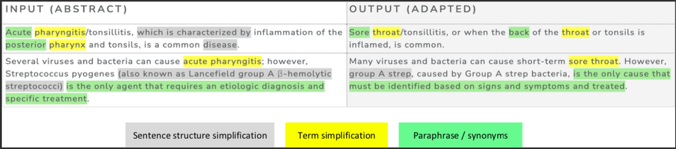
Task: Plain Language Adaptation of Biomedical Abstracts
Aim: To improve public health literacy, better healthcare outcomes, better usage of health system Read our related work on surveys of ‘low health literacy’ related to ‘poor health outcomes’

Slide 5
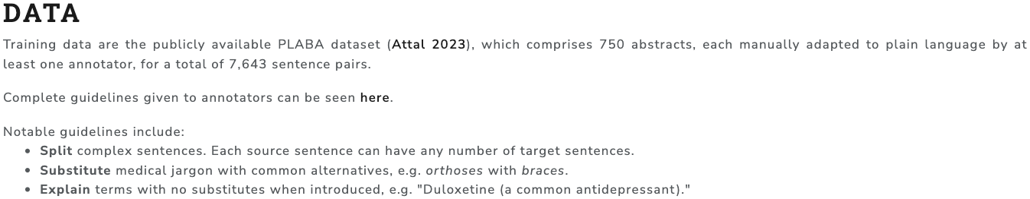
Originated from PLABA2023 at TAC2023
https://bionlp.nlm.nih.gov/plaba2023/

Slide 6
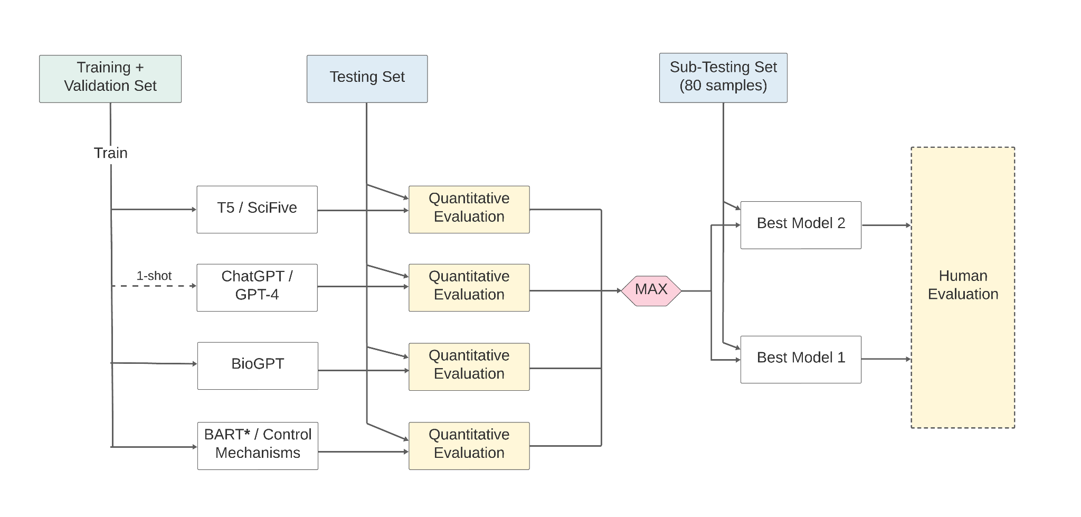
Methodology

Slide 7

Models applied

Slide 8
Model Investigations
We apply domain fine-tuning and prompt-based learning (PBL) on:
Encoder-decoder models (T5, SciFive)
Decoder-only GPT models (GPT-3.5 and GPT-4) from OpenAI and BioGPT
Control-token Mechanisms on BART-based models

Slide 9
GPTs (BioGPT)
LLM specifically designed for medical text generation.
Built upon GPT-3 but specifically trained to understand medical language, terminology, and concepts.
Follows the Transformer model backbone and is pre-trained on 15 million PubMed abstracts.
Has demonstrated a high level of accuracy and has great potential for applications in medicine.
While One-Shot prompt-based learning is applied to ChatGPT and GPT-4 without additional training using the PLABA dataset, BioGPT is fine-tuned on the training and validation set

Slide 10
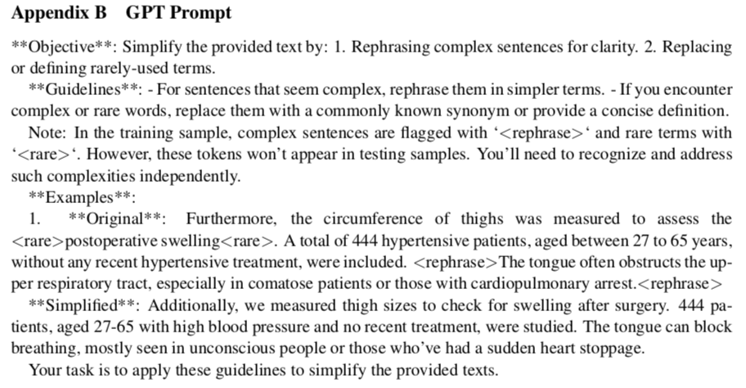
GPTs (ChatGPT prompting)

Slide 11
T5 and SciFive
T5 uses the Transformer Architecture proposed in Attention-is-all-you-need (2017)
They both are designed for sequence-to-sequence tasks (inc. summarization, QA, Classification and Translation)
We use the prompt “Summarize:”
They use the same vocabulary, sentence piece tokenizer, and loss function
T5 vs SciFive:
T5 is pre-trained on the Common Crawl Corpus (750GB of clean English data)
SciFive is pre-trained on the Common Crawl Corpus + Biomedical domain

Slide 12
BART (w. Wikilarge, w. Control Mechanism)
In addition to the single token masking strategy applied in BERT, BART provides various masking strategies, including deletion, span masking, permutation, and rotation of sentences.
BART provides both leftward and rightward context in the encoders.
We continuously train BART on Wikilarge training set (Zhang and Lapata), 2017. Then apply transfer learning on the PLABA dataset.

Slide 13
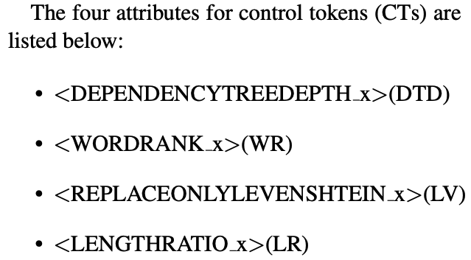
They represent:
the syntactic complexity,
the lexical complexity,
the inverse similarity of input and output at the letter level, and
the length ratio of input and output respectively.

Slide 14
After fine-tuning, we find the optimal value of CTs.
Following a similar process in MUSS, we applied Nevergrad on the validation set to find the static optimal discrete value for DTD, WR, and LV.
As for the LR, we applied the control token predictor to maximise the performance with the flexible value.
The predictor is also trained on Wikilarge to predict the potential optimal value for LR.

Slide 15
PLABA Data Setup
This data set is extracted from PubMed search results
using 75 healthcare-related questions that MedlinePlus users asked.
includes 750 biomedical article Abstracts manually simplified into 921 adaptations with 7,643 sentence pairs in total.
We divided the PLABA data into Train, Validation, and Test sets, aiming for an 8:1:1 ratio.
there are only a few 1-to-0 sentence pairs, which might cause a negative effect in training the simplification models. Thus we eliminated them.
In addition, to better leverage the SARI score, we picked sentences with multi-references for validation and testing purposes.
Ended up with the following sentence pair numbers according to the source sentences (5757, 814, 814)

Slide 16

Automatic Evaluation

Slide 17
Metrics
N-gram overlap metrics (evaluate simplification quality to reference):
BLEU: precision-focused (n-gram overlap with reference)
ROUGE: recall-focused (n-gram overlap with reference)
SARI: considers both precision and recall + output-to-reference length ratio
Trained metric (evaluate meaning preservation after simplification)
BERTScore: evaluate the semantic similarity between generated and reference texts using BERT embeddings

Slide 18
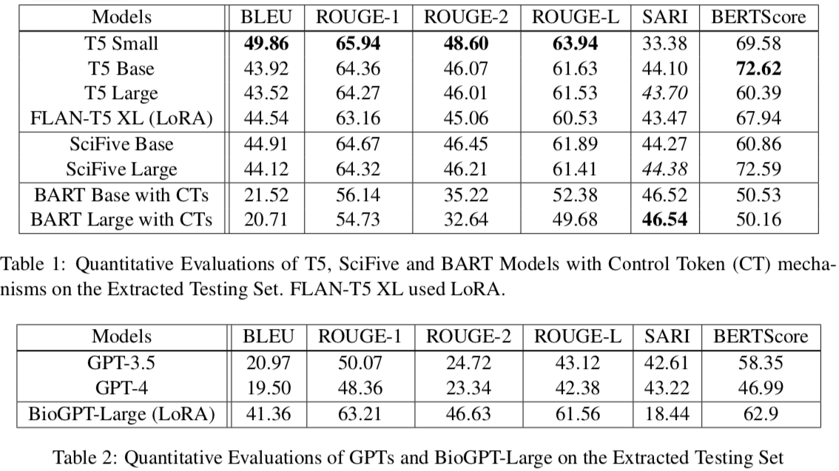
Results

Slide 19
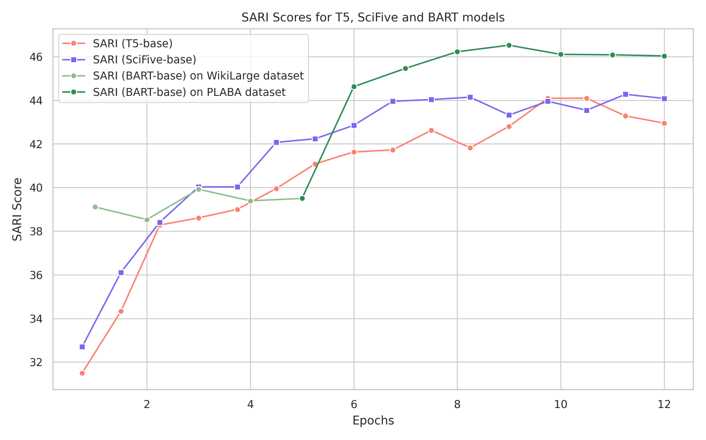
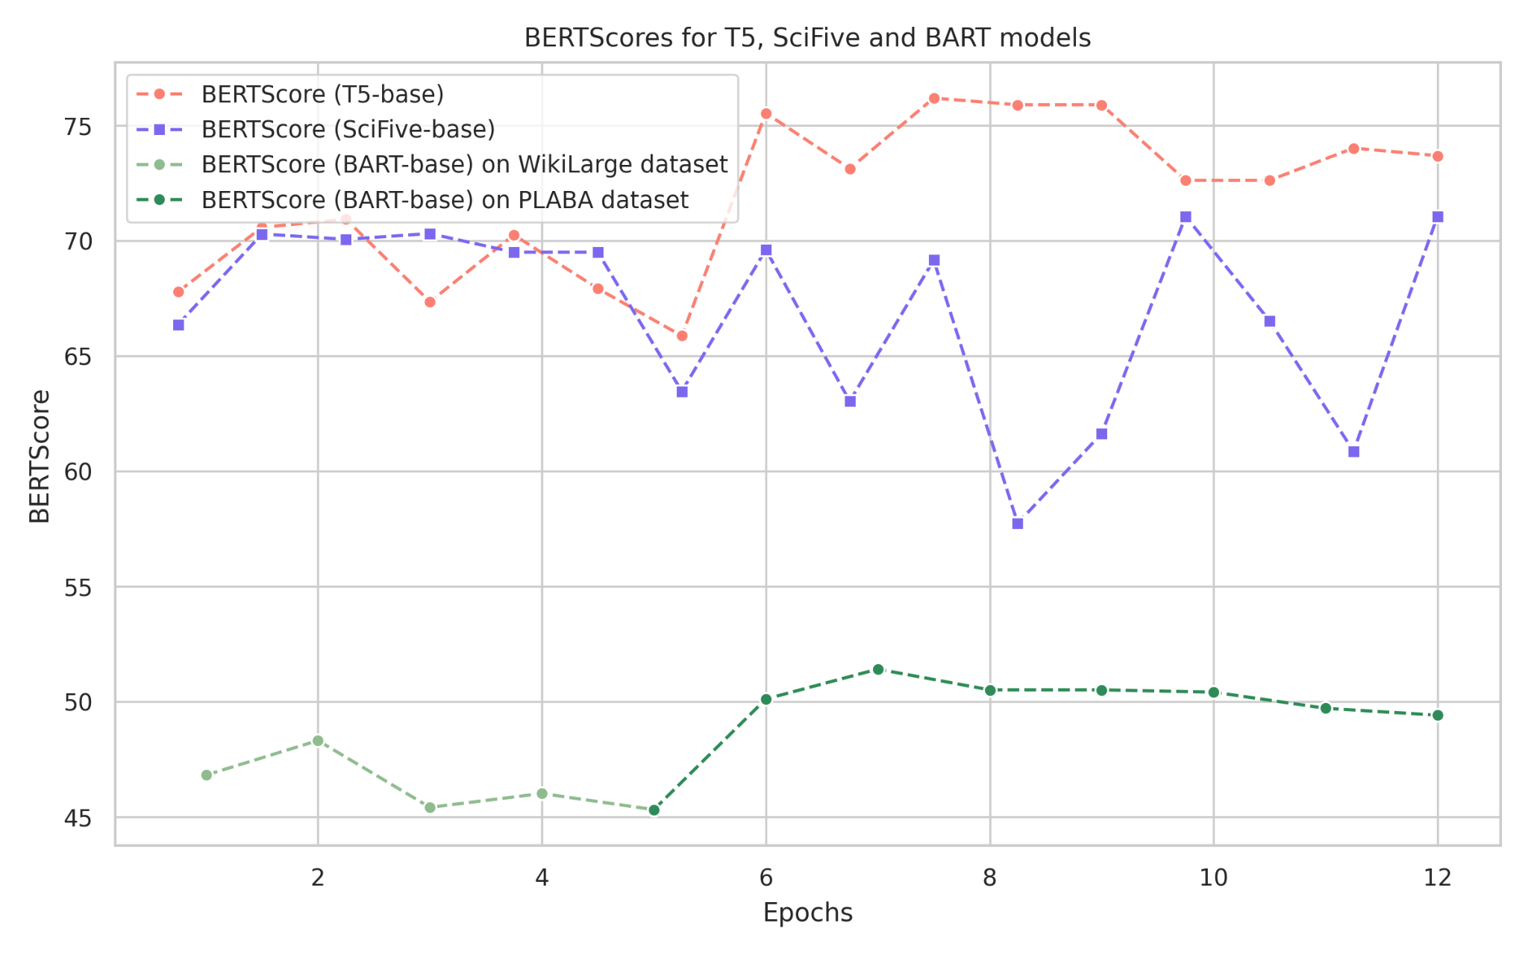
SARI and BERTScores

Slide 20
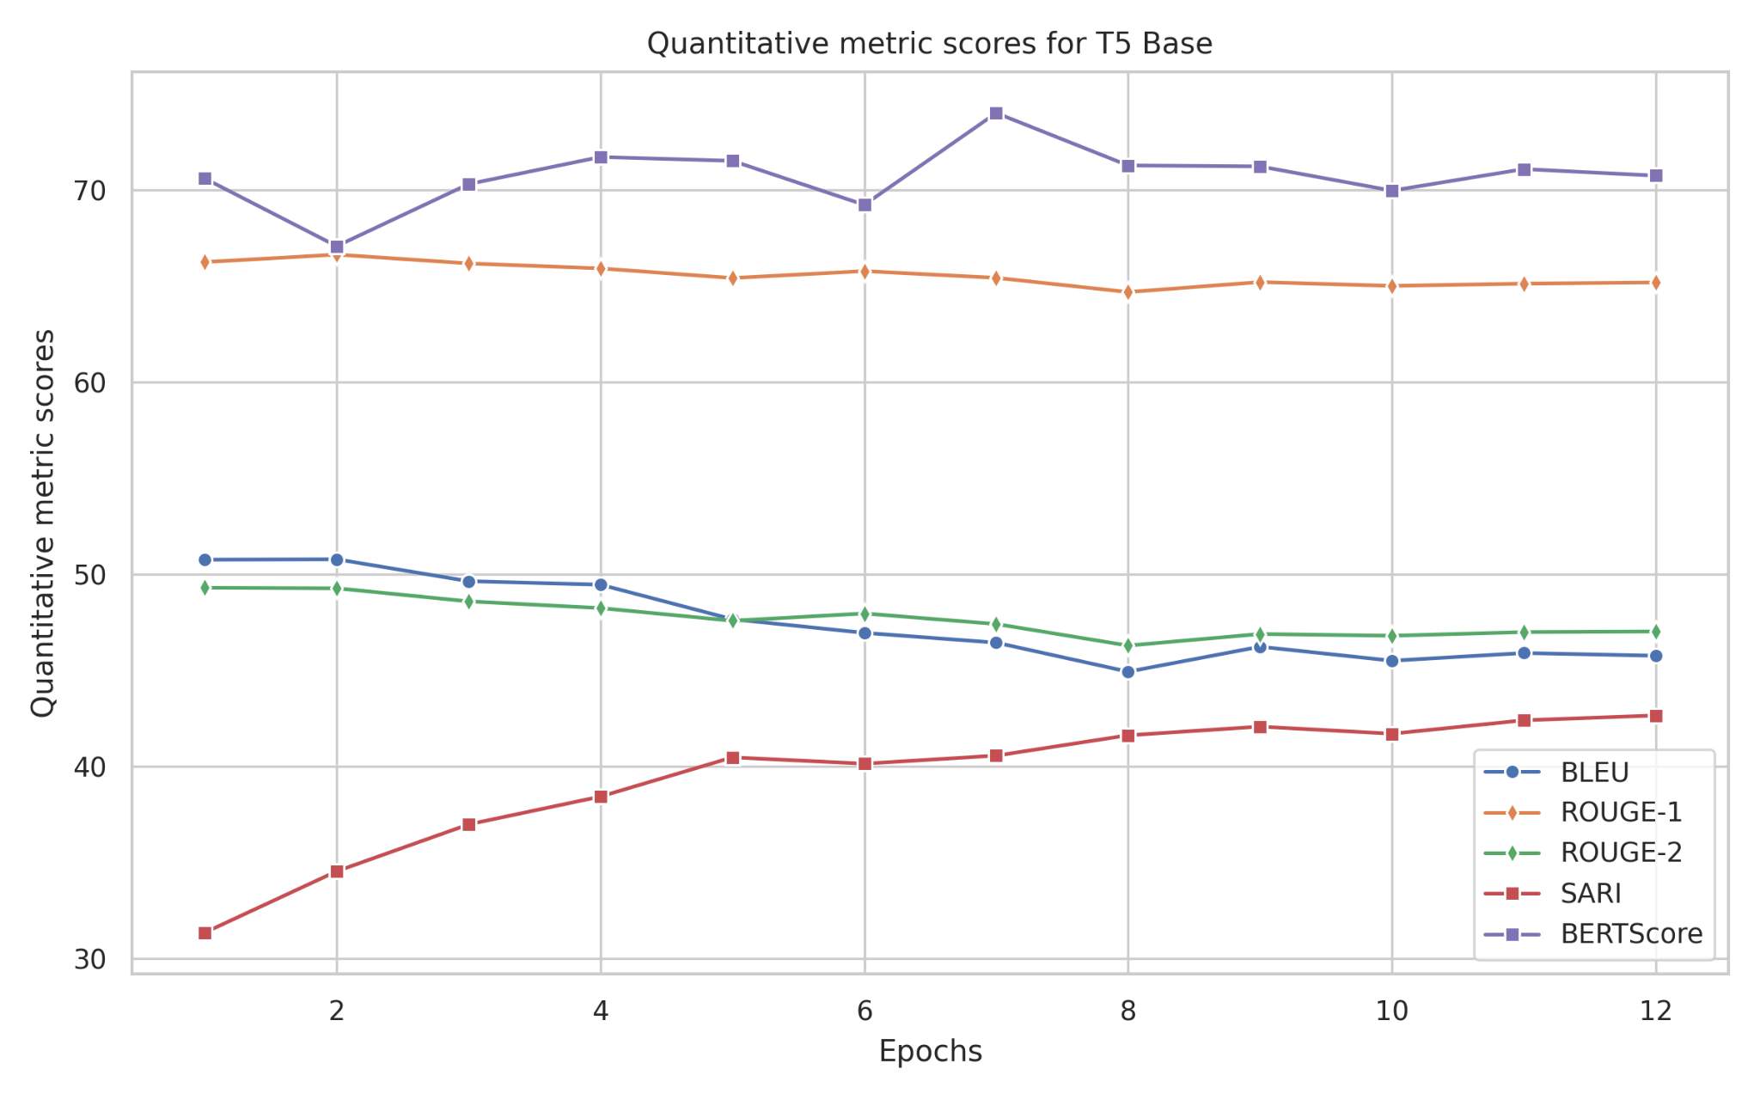
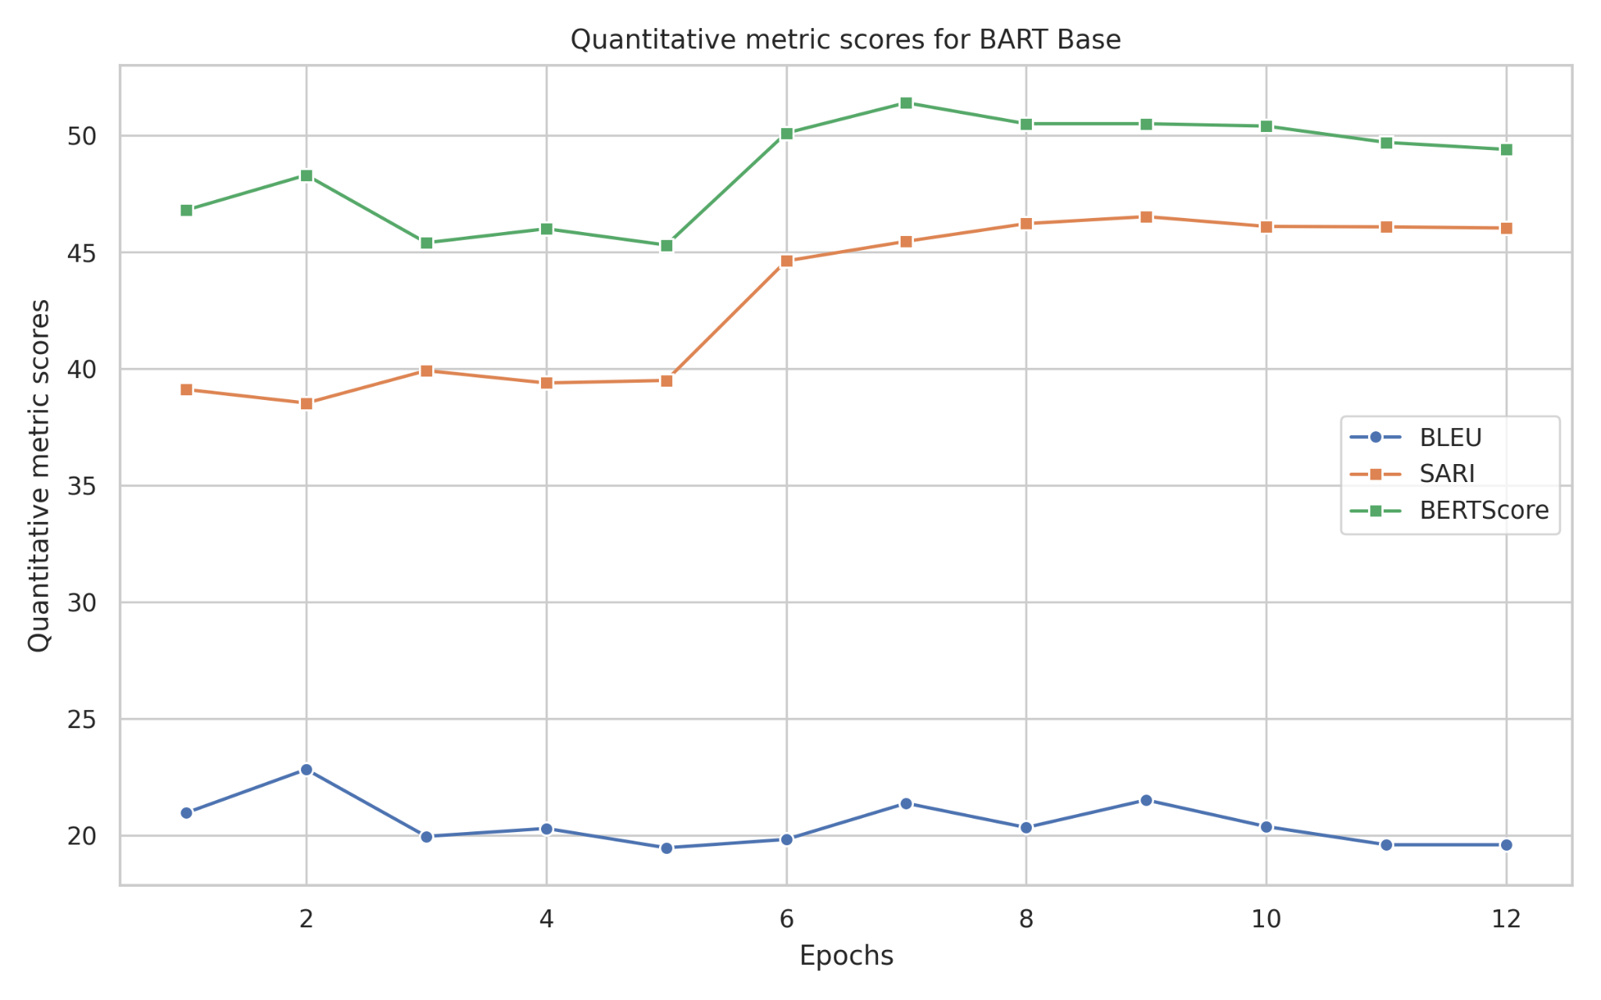
BLEU and ROUGE scores

Slide 21

Human Evaluation

Slide 22
Models Selected
T5-Base model has the highest BERTScore (72.62) and also a relatively higher SARI score (44.10), we chose it as one of the candidates for human evaluation.
The other candidate is fine-tuned BART Large with CT Mechanisms, which has the highest SARI score (46.54) among all evaluated models.
Note that, SciFive Large has results close to the ones of T5 Base. In this case, we selected the smaller model for human evaluation.

Slide 23
Human Evaluation Setup
We randomly sampled 80 sentences from the test set split and evaluated the corresponding outputs of BART-large with CTs and T5-base anonymously.
In the Evaluation Form, we randomly assigned the order of the two systems' outputs and put them beside the input sentence.
Based on the comparison of input and output sentences, the annotators need to answer two questions.
Each annotator evaluated 40 sentence pairs with 50% overlaps to make sure every sentence was evaluated twice by different annotators.

Slide 24
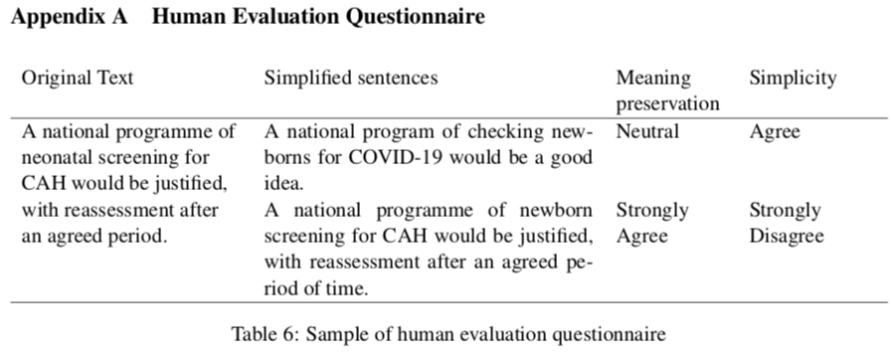

Slide 25
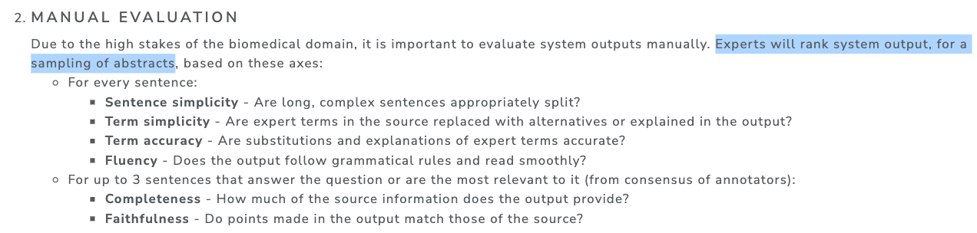
vs. PLABA2023 Official

Slide 26
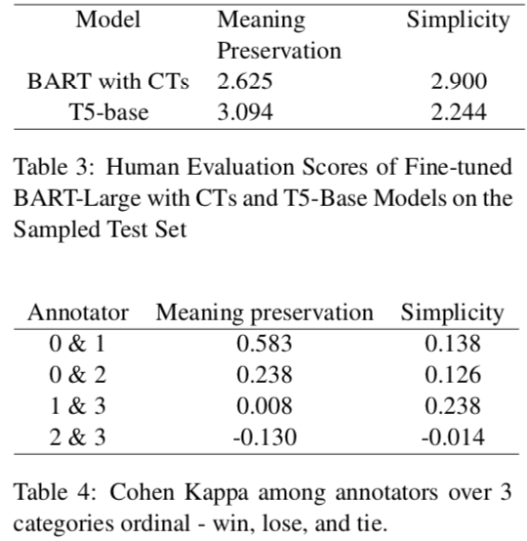
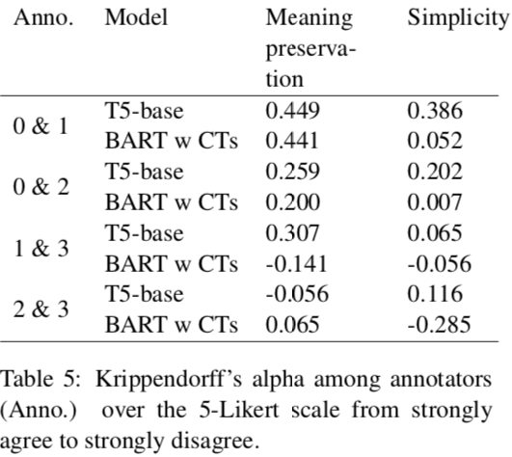
Human Evaluation Scores & Krippendorff’s Alpha

Slide 27
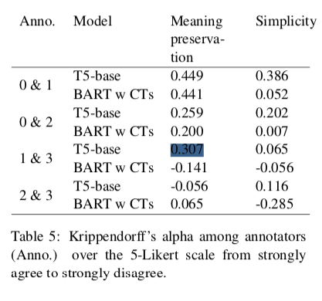
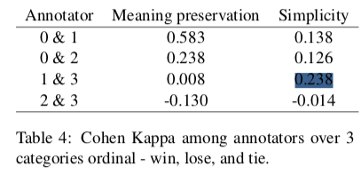
Discussion on findings (1)
Two Agreement Metrics do not always agree with each other

Slide 28
Discussion on findings (2)
How to deal with the judgement on two models when one almost copied the full text from the source while the other did simplification but with introduced errors?
Source:
“A national programme of neonatal screening for CAH would be justified, with reassessment after an agreed period”
BART-w-CTs model:
“A national program of checking newborns for COVID-19 would be a good idea.”
However, ``CAH'' means ``Congenital adrenal hyperplasia'' instead of ``COVID-19’’
The T5-base model:
“A national programme of newborn screening for CAH would be justified, with reassessment after an agreed period of time.”
Almost copied the same source text

Slide 29
Discussion on findings (3)
Abbreviation caused interpretation inaccuracy. This can be a common issue in the PLABA task.
Source:
“A total of 157 consecutive patients underwent TKA (n = 18) or UKA (n = 139)”
BART-w-CTs model:
“A total of 157 consecutive patients underwent knee replacement or knee replacement.”
The T5-base model:
“A total of 157 patients had either knee replacement or knee replacement surgery.”
Both these two models produced repeated phrases “knee replacement or knee replacement'' due to a lack of meaningful understanding of "TKA: total knee arthroplasty'' and “UKA: Unicompartmental knee arthroplasty’’.

Slide 30
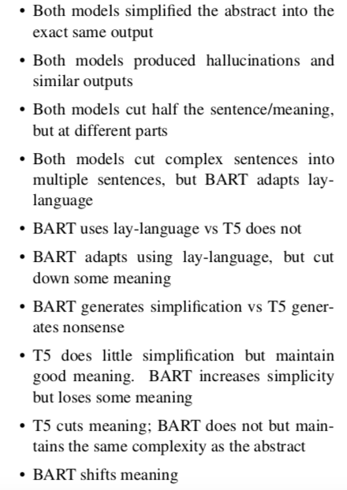
Discussion on findings (4)
We list a few more interesting generations made by both models.

Slide 31
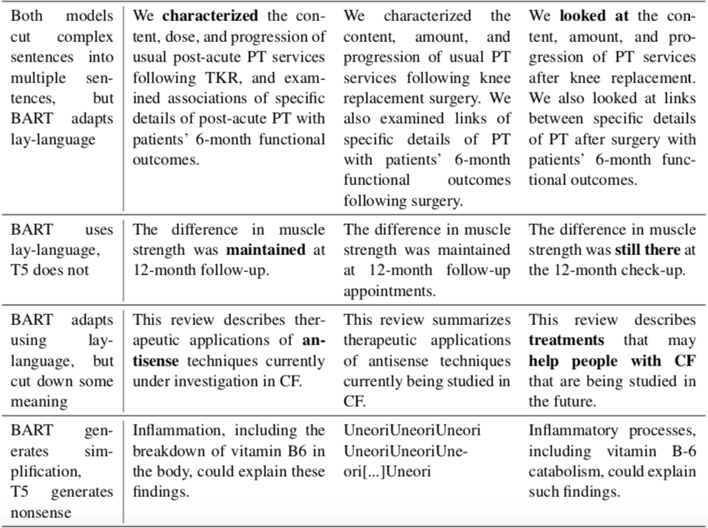

Slide 32
Conclusion
T5 prioritises meaning preservation, while BART tends to favour more substantial simplifications.
Automatic Evaluations: BART achieves the highest SARI score quantifying generation quality to reference, but lags behind T5 in BERTScore, which measures meaning preservation.
Human Evaluations: BART achieves higher Simplicity, T5 higher Meaning Preservation.

Slide 33
Future Work
More efficient training methods to be explored: prefix, adapter, + … (in paper)
Human eval: how to address the current low IAA Alternative biomedical text simplification datasets.

