Slide 1

A Mini Project On Skin Cancer Detection Using Convolutional Neural Networks by T. Heema Sree (21N81A6770) P. Navya Sri (21N81A6782) K.Vamshidhar (21N81A67B3) Under the Supervision of Mr.Raghavendra M I M.Tech Assistant Professor
Department of CSE-DataScience
Sphoorthy Engineering College
(Approved by AICTE &Affiliated to JNTUH )
Nadergul , SaroorNagar Mandal , Hyderbad – 501510
Academic Year : 2024-2025

Slide 2
Abstract
Skin cancer, particularly melanoma, has a high mortality rate when detected at advanced stages, making early and accurate diagnosis essential. This study presents a deep learning-based system for automated skin cancer detection using dermascopic images. A convolutional neural network (CNN) was developed to classify skin lesions into benign and malignant categories, utilizing a large, publicly available dataset. Key preprocessing steps, including lesion segmentation, image enhancement, and data augmentation, were applied to improve the model’s accuracy and robustness. Transfer learning was incorporated to address the challenge of limited annotated data, allowing the model to leverage pre-trained weights from large-scale image classification tasks. The proposed model achieved superior performance in terms of accuracy, sensitivity, and specificity when compared to traditional diagnostic methods and existing machine learning approaches. This automated system significantly reduces the time required for diagnosis, assisting dermatologists in early detection and minimizing the risk of human error. Moreover, it offers a scalable solution for regions with limited access to dermatological expertise, enabling remote and cost-effective skin cancer screening. The study demonstrates the potential of AI-driven technologies to revolutionize skin cancer detection, ultimately contributing to improved patient outcomes through timely interventions.
Keywords: Skin cancer detection , Melanoma diagnosis, Deep learning, Convolutional neural network (CNN).

Slide 3
INTRODUCTION
Skin cancer is one of the most common types of cancer all over the world. The most common cause is excessive exposure of the skin to UV rays from the sun . Fair-skinned, sun-sensitive people have a higher rate of UV exposure than dark-skinned people who are less sensitive to the sun . There are various types of skin cancer. Among them, melanoma skin cancer is the most common and dangerous type of cancer. It involves an abnormal proliferation of pigment cells in the skin. It is a common life-threatening disease in humans. It brightens the skin and can quickly spread to other areas body . Therefore, early detection of melanoma is essential. Invasive melanoma accounts for approximately 1% of all skin cancer cases but contributes to most skin cancer deaths. The incidence of melanoma skin cancer has increased rapidly over the past 30 years. In 2021, it was estimated that 100,350 new cases of melanoma were diagnosed in the United States, ultimately resulting in about 6,850 deaths .
Skin cancer is a significant public health issue, and early detection is paramount for successful treatment. Traditional diagnosis often relies on visual examination by dermatologists, which can be subjective and time-consuming. This project investigates the application of Convolutional Neural Networks (CNNs) to automate the process of skin cancer detection. By leveraging the power of deep learning, we aim to develop a model that can accurately classify skin lesions as benign or malignant based on [Image type - e.g., dermoscopic images, clinical photographs]. Our CNN architecture will learn intricate patterns and features within the images, enabling more objective and potentially more accurate diagnoses. This project has the potential to assist dermatologists in their clinical practice, improve diagnostic efficiency, and enhance patient outcomes.

Slide 4
LITERATURE SURVEY
1. Skin Cancer Detection utilizing Deep Learning: Classification of Skin Lesion Images using a Vision Transformer
Publisher by : Carolin Flosdorf, Justin Engelker, Igor Keller, Nicolas Mohr. Published Date: 2024
This project aims to improve skin cancer detection using Vision Transformers (ViTs), a deep-learning architecture. By comparing ViT models with traditional models such as CNNs, decision trees, and k-nearest neighbors, the study aims to enhance the accuracy of classifying different skin lesions, particularly melanoma. The research highlights the potential of ViTs to offer faster and more accurate diagnoses, especially in healthcare settings with limited access to dermatologists​.
2.Skin Cancer Images Classification using Transfer Learning Techniques
Publisher by : MdSirajul Islam & Sanjeev Panta. Published Date: 18 Jun 2024
This project focuses on using transfer learning techniques to classify skin cancer images as benign or malignant. It aims to improve the performance of skin cancer detection by fine-tuning pre-trained deep learning models like ResNet-50, MobileNet, and InceptionV3. The goal is to achieve higher accuracy, precision, and recall for early detection of skin cancer, particularly melanoma, using a publicly available dataset​.

Slide 5
3.SKIN CANCER
Publisher by : Apple Bodemer, Publisher Date: 2014, updated 2020.
The main objective of this project is to provide an overview of skin cancer, its types (melanoma and nonmelanoma), risk factors, prevention strategies, and treatment options. It emphasizes the importance of early detection and preventive measures, such as minimizing UV exposure, practicing regular skin self-examinations, and adopting a healthy diet rich in plant-based foods and antioxidants. The paper also explores the potential benefits of various natural compounds, vitamins, and botanicals like omega-3 fatty acids, beta-carotene, green tea, and curcumin in the prevention and management of skin cancer​.

Slide 6
EXISTING SYSTEM
Previous research demonstrates how convolutional neural networks (CNNs) can help effectively through both automation and an accuracy that is comparable to the human level. However, despite the progress in previous decades, the precision is still limited, leading to substantial misclassifications that have a serious impact on people’s health. Hence, we employ a Vision Transformer (ViT) that has been developed in recent years based on the idea of a self-attention mechanism, specifically two configurations of a pre-trained ViT.
Previously published papers of year 2024 and 2020 was taken as the reference and observed that, there approaches have given good results . But all they worked on the improvement of the patient outcome based on historical data and other worked on implementing various techniques. The work performed by previous users was not that satisfactory. We have found where the area where the actual problems occurred and mentioned them below as disadvantages.
Lack of real time applications testing
Computational complexity and Training time
Overfitting on small

Slide 7
PROPOSED SYSTEM
The proposed system leverages Convolutional Neural Networks (CNNs) to classify skin cancer images into two categories: benign and malignant. The system aims to provide an automated, accurate, and efficient solution to assist dermatologists in early skin cancer detection, potentially saving lives through timely diagnosis.
Dataset Preparation
The dataset is structured into separate directories for training and validation, with images categorized by labels (e.g., benign and malignant). Data preprocessing includes:
Rescaling: Images are normalized to pixel values between 0 and 1.
Data Augmentation: Techniques such as rotation, zooming, shifting, and flipping are applied to enhance model generalization and reduce overfitting.
Model Details
Input size: 128x128 pixels with 3 color channels (RGB).
Layers:
3 convolutional layers with 32, 64, and 128 filters respectively.
3 max-pooling layers for spatial reduction.
A dense layer with 128 neurons and ReLU activation.
A final dense layer with 1 neuron and sigmoid activation for binary classification.
Loss Function: Binary Cross-Entropy
Optimizer: Adam
Metrics: Accuracy

Slide 8
SYSTEM REQUIREMENTS
To ensure smooth execution, the following hardware and software configurations are recommended:
Hardware
Processor: Intel i5/i7 or AMD Ryzen 5/7 (or better)
RAM: At least 8 GB (16 GB recommended for large datasets)
GPU: NVIDIA GPU with CUDA support (e.g., GTX 1050 or better) for faster training (Optional but recommended)
Storage: 20 GB or more free space to store datasets and models
Software
Operating System: Windows, macOS, or Linux
Python: Version 3.8 or higher

Slide 9
LIBRARIES
The following Python libraries are necessary for this project:
TensorFlow
NumPy
Matplotlib
scikit-learn
Pandas

Slide 10
System Architecture
The proposed system for skin cancer detection using CNN involves a modular architecture for efficient and accurate image classification. It begins with Data Acquisition, where skin lesion images are preprocessed by resizing, normalizing, and augmenting for better generalization. The Model Training Layer uses a CNN with convolutional, pooling, and fully connected layers to extract features and classify images into benign or malignant categories. Training is optimized using binary cross-entropy loss and the Adam optimizer.
The Evaluation Layer validates the model’s performance through metrics like accuracy, precision, recall, F1-score, and a confusion matrix. Post-training, the system is deployed via a standalone application, web interface, or API service, allowing users to upload images and receive real-time classification results.
This architecture is modular, scalable, and flexible, supporting real-world clinical applications while facilitating improvements through user feedback and additional data integration. It automates early diagnosis, enhancing accuracy and efficiency in skin cancer detection.

Slide 11
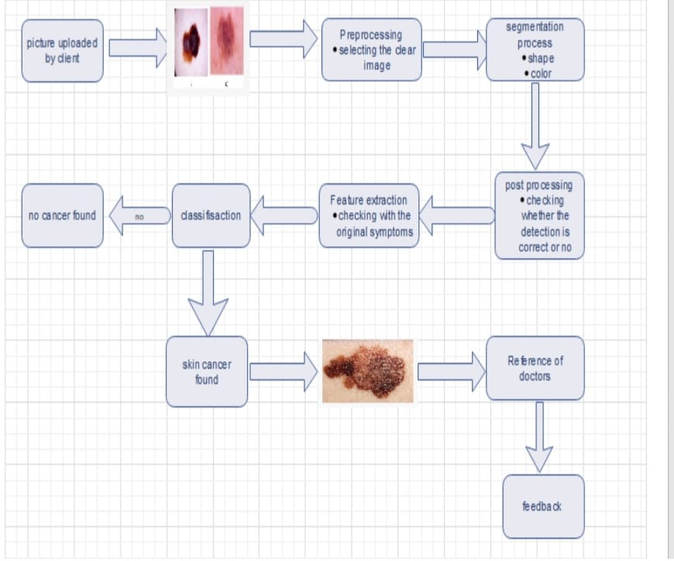
SYSTEM DESIGN

Slide 12
METHODOLOGY
The skin cancer detection project utilizes multiple methodologies to ensure an accurate and efficient classification system. Data preprocessing is a critical initial step, involving resizing images to a uniform size, normalizing pixel values for computational efficiency, and applying data augmentation techniques such as rotation, flipping, and zooming to enhance the diversity and robustness of the training dataset. The core of the system is a Convolutional Neural Network (CNN), designed to extract spatial features from images using convolutional and pooling layers. Batch normalization is employed to stabilize training, while dropout layers mitigate overfitting. The model is trained using the Adam optimizer and binary cross-entropy loss to minimize classification errors. Performance evaluation includes metrics such as accuracy, precision, recall, F1-score, and confusion matrices to validate the model's generalization capabilities. The system supports multiple deployment methodologies, including standalone applications, web interfaces, or APIs, making it versatile for real-world clinical use.

Slide 13
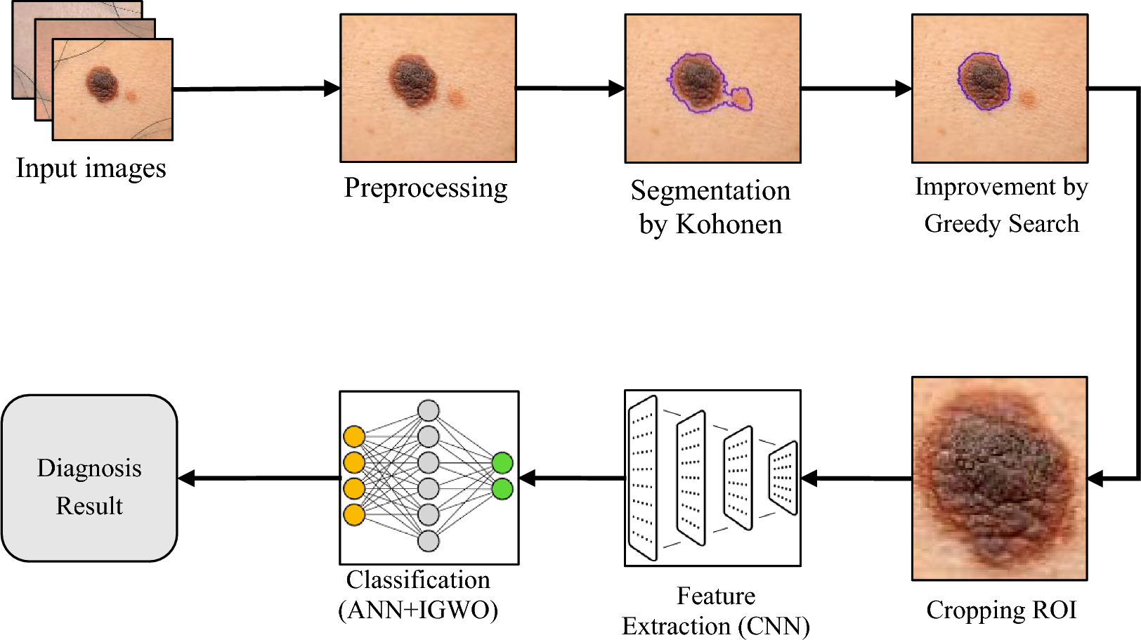
METHODOLOGY

Slide 14
Workflow
The methodology used in skin cancer detection with images typically involves the use of image processing, machine learning (ML), and deep learning (DL) techniques.
⁠ 1.⁠Data Collection and Preprocessing
Purpose: To gather and prepare skin lesion images for further analysis.
Data Collection: Obtain images from publicly available datasets (e.g., ISIC, HAM10000) or medical institutions.
Image Preprocessing:
Resizing images to a uniform size.
Removing noise and artifacts.
Normalizing pixel values.
Data augmentation
2.⁠ ⁠Image Segmentation
To isolate the lesion from the surrounding healthy skin

Slide 15
Workflow
3.⁠ ⁠Feature Extraction
To identify key features such as color, texture, shape, and size from the segmented images.
4.⁠ ⁠Classification
To classify the lesion into benign or malignant.
5.⁠ ⁠Evaluation and Validation
To assess the model's performance.
6.⁠ ⁠Post-Processing and Decision Making
To provide an interpretable diagnosis to clinicians and patients.

Slide 16
EVALUATION
1.⁠ ⁠Clinical Examination by Dermatologists
Method: Visual inspection of skin lesions.
Accuracy: Varies based on dermatologist experience (accuracy ranges from 60-80%).
Benefit: quick, and inexpensive.
2.⁠ ⁠Dermoscopy
Method: A handheld device magnifies and illuminates skin lesions for a more detailed view.
Accuracy: Increases diagnostic accuracy to 75-90%.
Benefit: Improves identification of malignant lesions compared to naked-eye examination.

Slide 17
EVALUATION
3.⁠ ⁠Digital Skin Imaging
Method: High-resolution images of skin lesions are captured and analyzed by dermatologists remotely.
Accuracy: Comparable to in-person examination.
Benefit: Increases access to specialists, especially in remote areas.
4.⁠ ⁠Artificial Intelligence (AI) in Skin Cancer Detection
Method: AI models analyze images of skin lesions to detect potential malignancies.
Accuracy: Some AI models have achieved accuracy levels comparable to dermatologists (90-95%).
Benefit: Rapid analysis, cost-effective, can screen large populations.

Slide 18
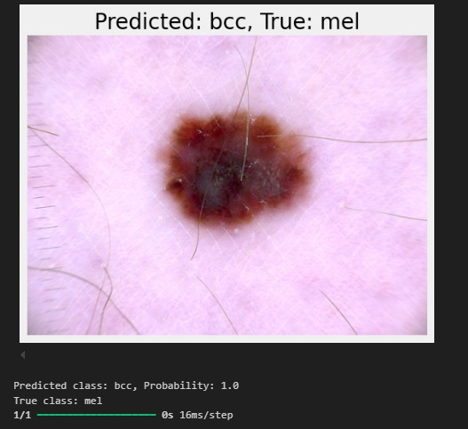
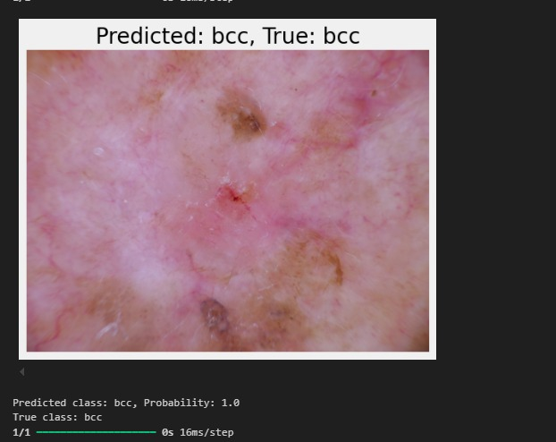

Slide 19
FUTURE ENCHANCEMENT
The detection of skin cancer is continuously evolving with advancements in technology. Below are some potential future enhancements that can improve accuracy, accessibility, and patient outcomes.
Real-time Clinical Integration: In the future, skin cancer classification models could be integrated into real-time diagnostic tools used in clinics. This could involve mobile apps for patients or systems for dermatologists to instantly classify skin lesions, providing quicker diagnoses and enabling early intervention. Continuous improvements in hardware and computational efficiency could make this feasible even for resource-limited environments.
Improved Pre-trained Models: As medical imaging datasets grow and become more accessible, we can expect pre-trained models specifically designed for medical domains, including dermatology. Instead of using general-purpose models like ImageNet, future models could be pre-trained on large-scale medical image datasets, leading to better domain-specific feature extraction and performance.
The future of transfer learning in skin cancer classification lies in improving model accuracy, enhancing data availability and diversity, increasing transparency, and integrating these models into real-world clinical workflows. With continued advancements, transfer learning-based models have the potential to revolutionize early skin cancer detection and improve patient outcomes.

Slide 20
CONCLUSION
Skin cancer detection methods have evolved significantly, moving from traditional clinical examinations to advanced technologies such as dermoscopy, AI-powered diagnostics, and digital imaging. Despite the current advancements, there is still room for improvement to enhance accuracy, accessibility, and early detection.
Future innovations like wearable technology, genetic testing, AI models, and non-invasive biopsy methods will revolutionize skin cancer detection by providing more personalized, precise, and efficient diagnostic solutions. These advancements will reduce the burden on healthcare systems, improve patient outcomes, and increase survival rates by enabling early intervention.
The implementation of a skin cancer detection system using Convolutional Neural Networks (CNNs) demonstrates the potential of deep learning in revolutionizing medical diagnostics. By leveraging advanced image processing techniques and robust CNN architectures, the system effectively classifies skin lesions as benign or malignant with significant accuracy. The integration of data preprocessing methods, including normalization and augmentation, ensures that the model generalizes well to diverse and unseen datasets. Metrics such as precision, recall, F1-score, and confusion matrices validate the system’s reliability, providing a comprehensive evaluation of its performance.

Slide 21


