Slide 1
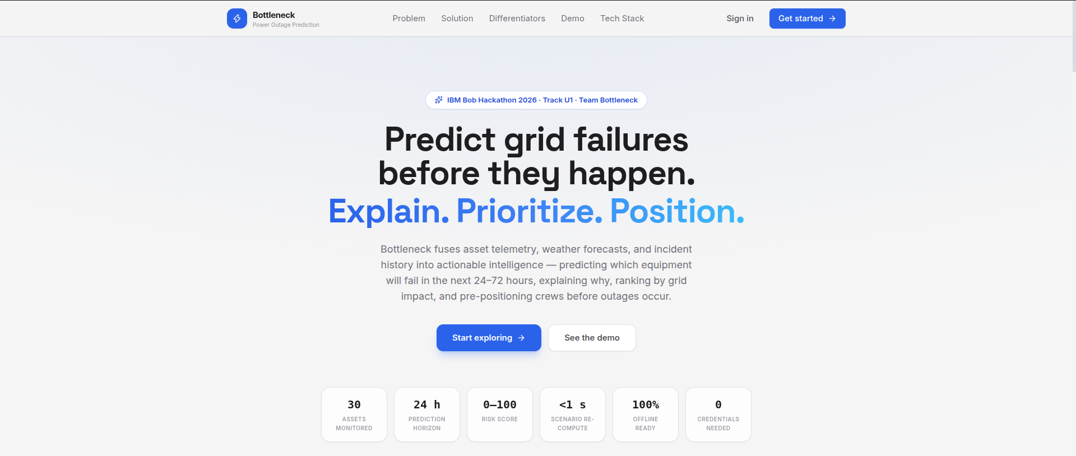
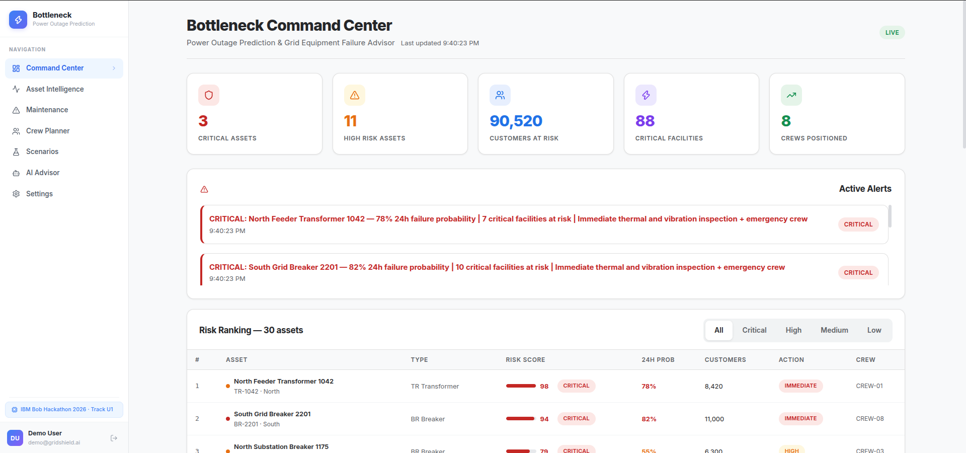
⚡
TEAM BOTTLENECK
IBM Bob Hackathon 2026 · Track U1
Bottleneck AI
Power Outage Prediction &
Grid Equipment Failure Advisor
Predict which grid equipment fails in the next 24–72 hours, explain why, rank it by real operational impact, and put the right crew on site before the lights go out.
THE TEAM
UK
DV
HM
KP
Live product — marketing site + operator command center
Urval Kheni
Dhruvin Vaghasiya
Heet Mehta
Krish Patel
Team Lead
Engineer
Engineer
Engineer
Notes:
Bottleneck AI by Team Bottleneck — Heet Mehta (lead), Dhruvin Vaghasiya, Urval Kheni, Krish Patel. IBM Bob Hackathon 2026, Track U1.

Slide 2
⚡
Bottleneck AI
THE PROBLEM
Utilities lose billions to failures they never saw coming
Transformer failure is the #1 cause of outages — and today it is discovered only after the power is already gone.
$0.5B+
1.4B
5–8h
#1
Lost annually to preventable equipment failures
People dependent on India's grid
Average urban outage duration
Transformers as outage root cause
1
Maintenance is reactive
2
Existing tools predict probability only
Crews are sent on fixed calendars to low-risk assets while critical transformers degrade silently in the field.
They answer "will it fail?" but never "does it matter?" — ignoring how many customers and critical facilities go dark.
The result: unnecessary outages, delayed restoration, and life-safety risk for hospitals, emergency services, and water treatment plants.
02
Notes:
Failures are found too late because nothing connects condition, weather, and downstream impact.

Slide 3
⚡
Bottleneck AI
ROOT CAUSE
Three gaps keep operators one step behind
Every one of them is a data problem before it is an engineering problem.
01
Siloed data
02
No downstream-impact awareness
03
Reactive dispatch
Telemetry, weather forecasts, and incident history live in separate systems that never meet. No unified view of risk exists anywhere in the control room.
Nothing answers the only question that matters to a dispatcher: if this asset fails, who actually loses power — and is a hospital on that feeder?
Crews roll out after the outage starts. Nobody is pre-positioned near the assets most likely to fail in the next few hours.
Our thesis
Fix the three gaps at once — fuse the data, score real grid impact, and dispatch on that score — and prevention becomes an operational routine instead of a research project.
03
Notes:
Root cause: data silos, missing impact model, and reactive dispatch.

Slide 4
⚡
Bottleneck AI
THE SOLUTION
PREDICT → EXPLAIN → PRIORITIZE → POSITION
One platform: telemetry + weather + incident history → ranked decisions → crew on site before the outage.
PREDICT
01
EXPLAIN
02
PRIORITIZE
03
POSITION
04
XGBoost forecasts 24h / 72h failure probability for every transformer, feeder, and breaker.
→
A grounded AI copilot surfaces the exact drivers behind every score — never invented values.
→
A composite 0–100 risk score ranks work by operational consequence, not probability alone.
→
The crew planner matches specialty and distance, dispatching teams before the failure lands.
INPUTS
ENGINE
OUTPUT
Asset telemetry · weather forecasts · incident history · grid topology
→
Failure probability → composite 0–100 risk → ranked maintenance queue
→
The right crew, at the right asset, before the outage occurs
04
Notes:
A complete decision-support loop from raw sensor data to crew dispatch, explainable at every step.

Slide 5
⚡
Bottleneck AI
KEY DIFFERENTIATOR
We score consequence, not just probability
Everyone else stops at "this might fail." We answer "and here is what it costs you."
Risk = Probability × Grid Impact × Weather × Criticality × (1 − Redundancy)
★
Impact-aware ranking
⚑
Crew matching in 2 clicks
◎
Explainable end to end
Maintenance is ordered by customers affected and critical facilities at risk — 8,420 customers and 7 facilities put TR-1042 at Priority #1.
Teams are ranked by specialty match plus haversine distance and ETA, then assigned straight from the asset map.
Every 0–100 score decomposes into failure probability, grid impact, weather exposure, criticality, and redundancy.
WORKED EXAMPLE · TR-1042
78% probability × 54% grid impact × 78% weather × 92% criticality × 70% lack of redundancy → risk 98/100, Priority #1
05
Notes:
The composite risk score is the core differentiator — probability alone misranks the work.

Slide 6
⚡
Bottleneck AI
ARCHITECTURE
Built as a swappable, always-bootable stack
A stable FailurePrediction contract means the ML can change without touching anything downstream.
FRONTEND
React 18 + Vite
Command Center · Asset Intelligence map · Maintenance · Crew Planner · Scenarios · AI Advisor
API
FastAPI · JWT auth
30+ REST endpoints under /api/gs/ — risk engine, planners, scenario simulator, copilot
ML
XGBoost in models/bottleneck/
GRIDSHIELD_USE_REAL_ML=1 → real models; deterministic mock predictor as fallback
DATA
SQLite (dev) / PostgreSQL (prod)
Asset fleet, telemetry history, incidents, crew roster, weather cache
Swap the ML predictor and the frontend, risk engine, and planners need zero changes — the deck demo always boots, credentials or not.
06
Notes:
Layered architecture with a stable prediction contract at the seam.

Slide 7
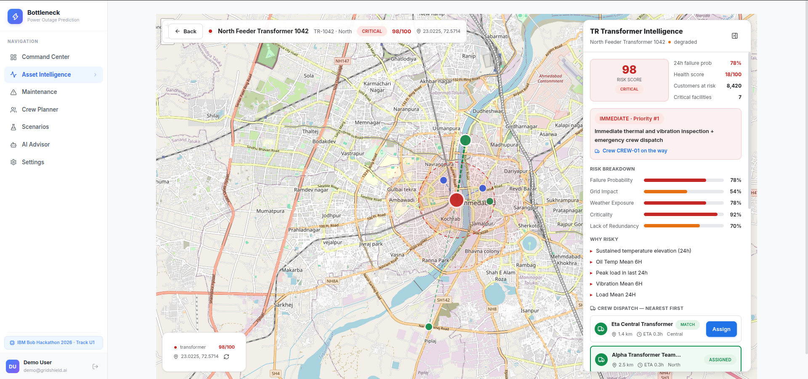
⚡
Bottleneck AI
ASSET INTELLIGENCE
The whole grid, coloured by risk
Full-screen map with risk-coloured markers, safety zones, crew depots, and live dispatch lines.
98
/100 RISK SCORE
CRITICAL · degraded
78% 24h failure probability · health 18/100 · 17 years old
Risk breakdown: probability 78% · grid impact 54% · weather 78% · criticality 92% · lack of redundancy 70%
Why risky: sustained temperature elevation, oil temp, peak load, vibration mean, load mean — all from real telemetry
8,420 customers and 7 critical facilities downstream
Nearest crews ranked by ETA — Alpha Transformer Team assigned at 2.5 km
Hero asset — North Feeder Transformer 1042 (TR-1042)
07
Notes:
Drill into any asset for its full risk decomposition and nearest crews.

Slide 8
⚡
Bottleneck AI
COMMAND CENTER
One screen the control room can run the shift on
Live KPIs, active critical alerts, and a ranked risk table across all 30 assets.
3
Critical assets
11
High-risk assets
90,520
Customers at risk
8
Crews positioned
CRITICAL: TR-1042 — 78% 24h failure probability | 7 critical facilities at risk | immediate thermal and vibration inspection + emergency crew
08
Notes:
TR-1042 sits at Priority #1 with an immediate action recommendation.

Slide 9
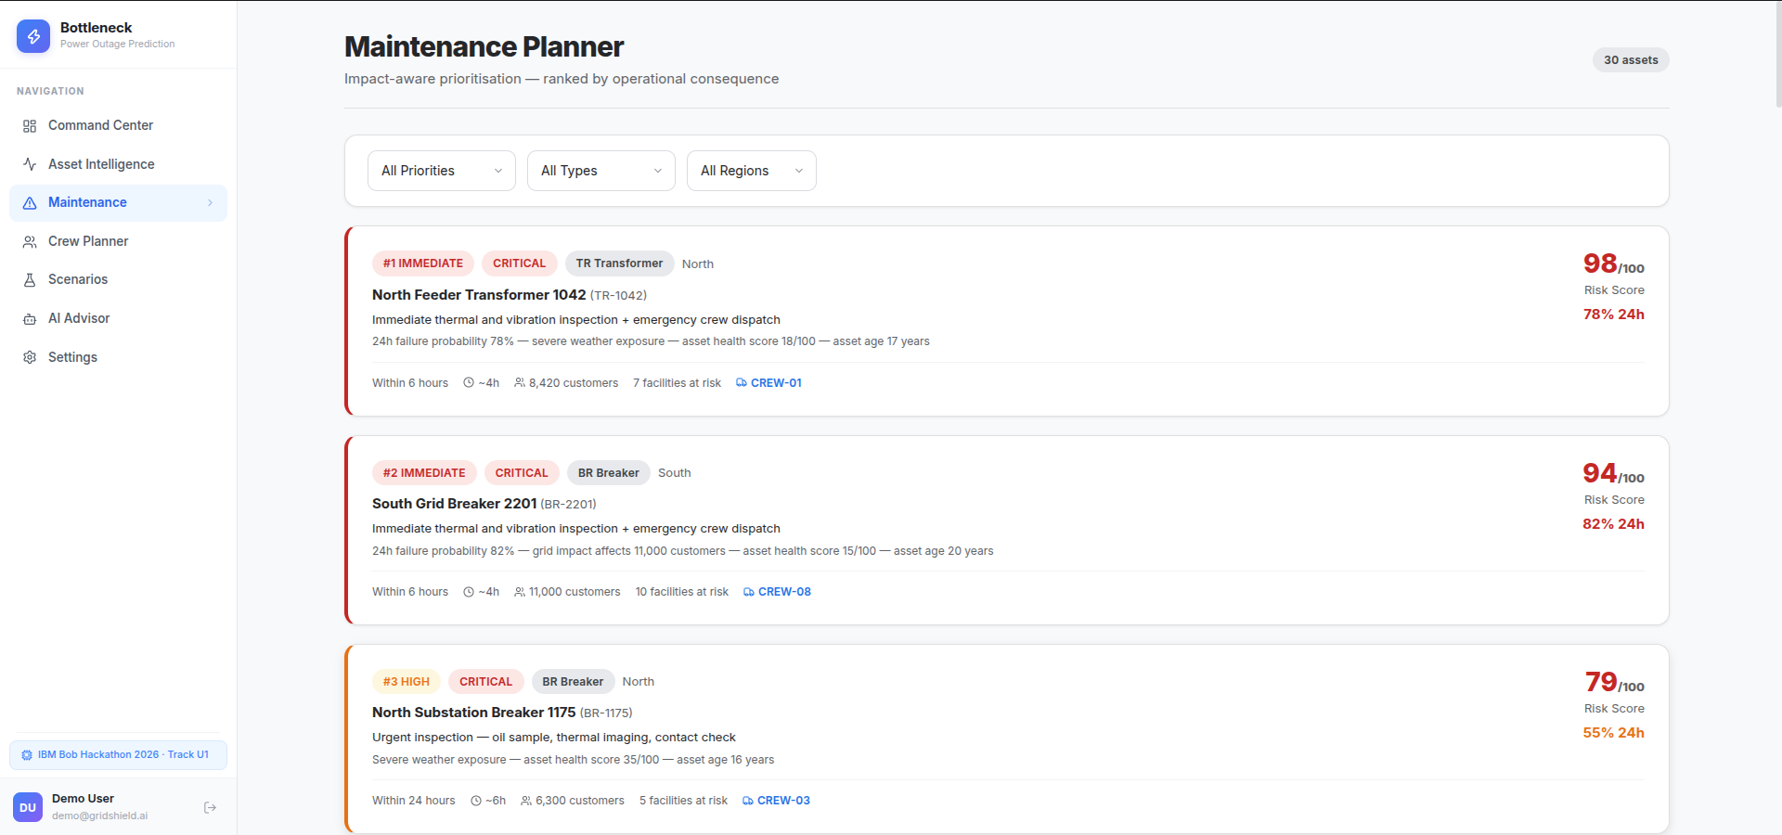
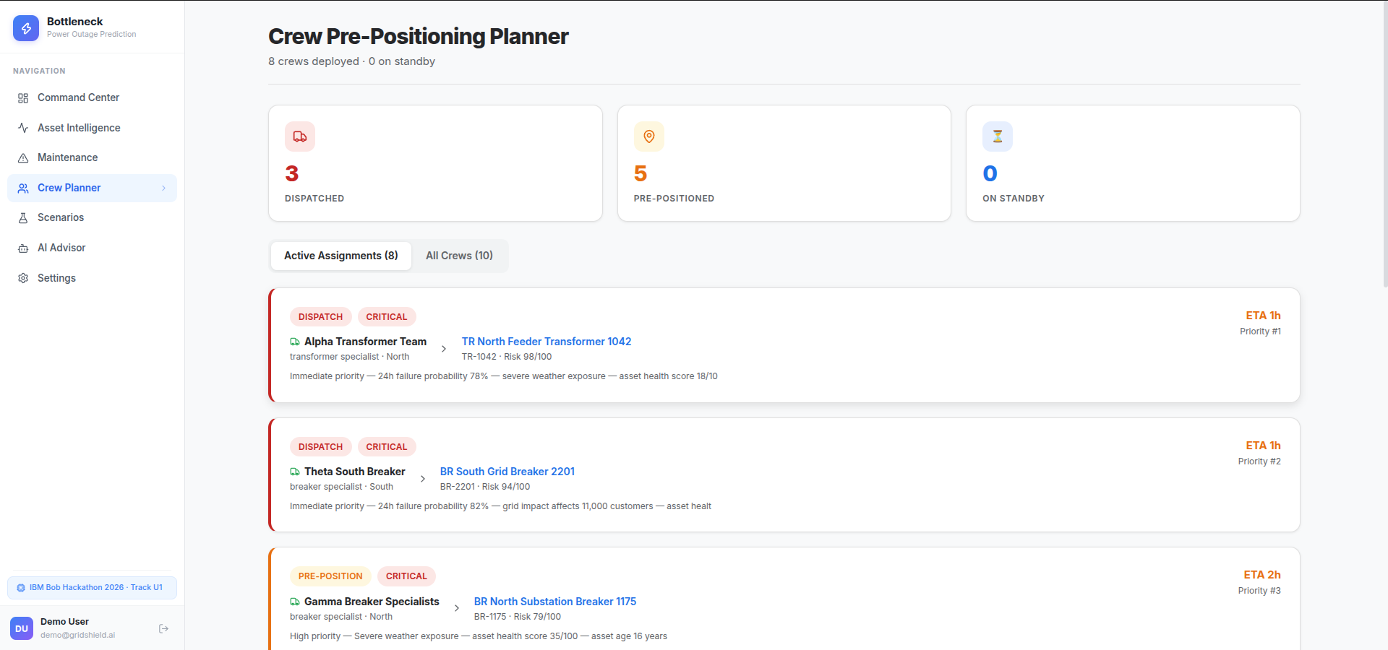
⚡
Bottleneck AI
MAINTENANCE & CREWS
From ranked work to a crew already on the road
Impact-aware prioritisation feeds straight into specialty-matched, distance-ranked pre-positioning.
MAINTENANCE PLANNER
CREW PRE-POSITIONING PLANNER
Ranked by consequence
Matched, not nearest-only
Positioned before impact
#1 TR-1042 at risk 98 — within 6h, 8,420 customers, 7 facilities
Specialty match + haversine distance + ETA, assignable in 2 clicks
3 dispatched, 5 pre-positioned, ETA 1–2h across 8 active assignments
09
Notes:
Maintenance ranking and crew planning are two views of one risk score.

Slide 10
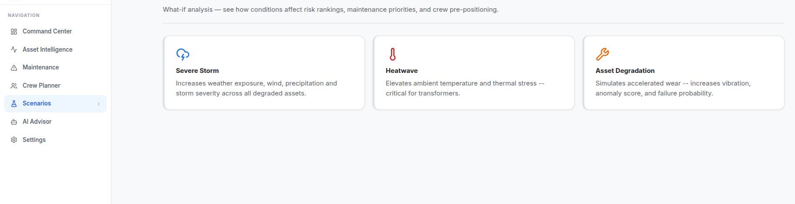
⚡
Bottleneck AI
SCENARIO SIMULATOR
What-if analysis that repositions crews in under a second
Severe storm, heatwave, and accelerated asset degradation — the full pipeline re-runs live.
BEFORE
AFTER SEVERE STORM
TR-1042 risk 94 · CREW-07 on standby · TR-2108 outside the top 5
TR-1042 risk 98 · CREW-07 reassigned to pre-position · TR-2108 enters the top 5
Full prediction → risk → maintenance → crew pipeline updates in under 1 second.
10
Notes:
Scenario simulation proves the loop is live, not a static report.

Slide 11
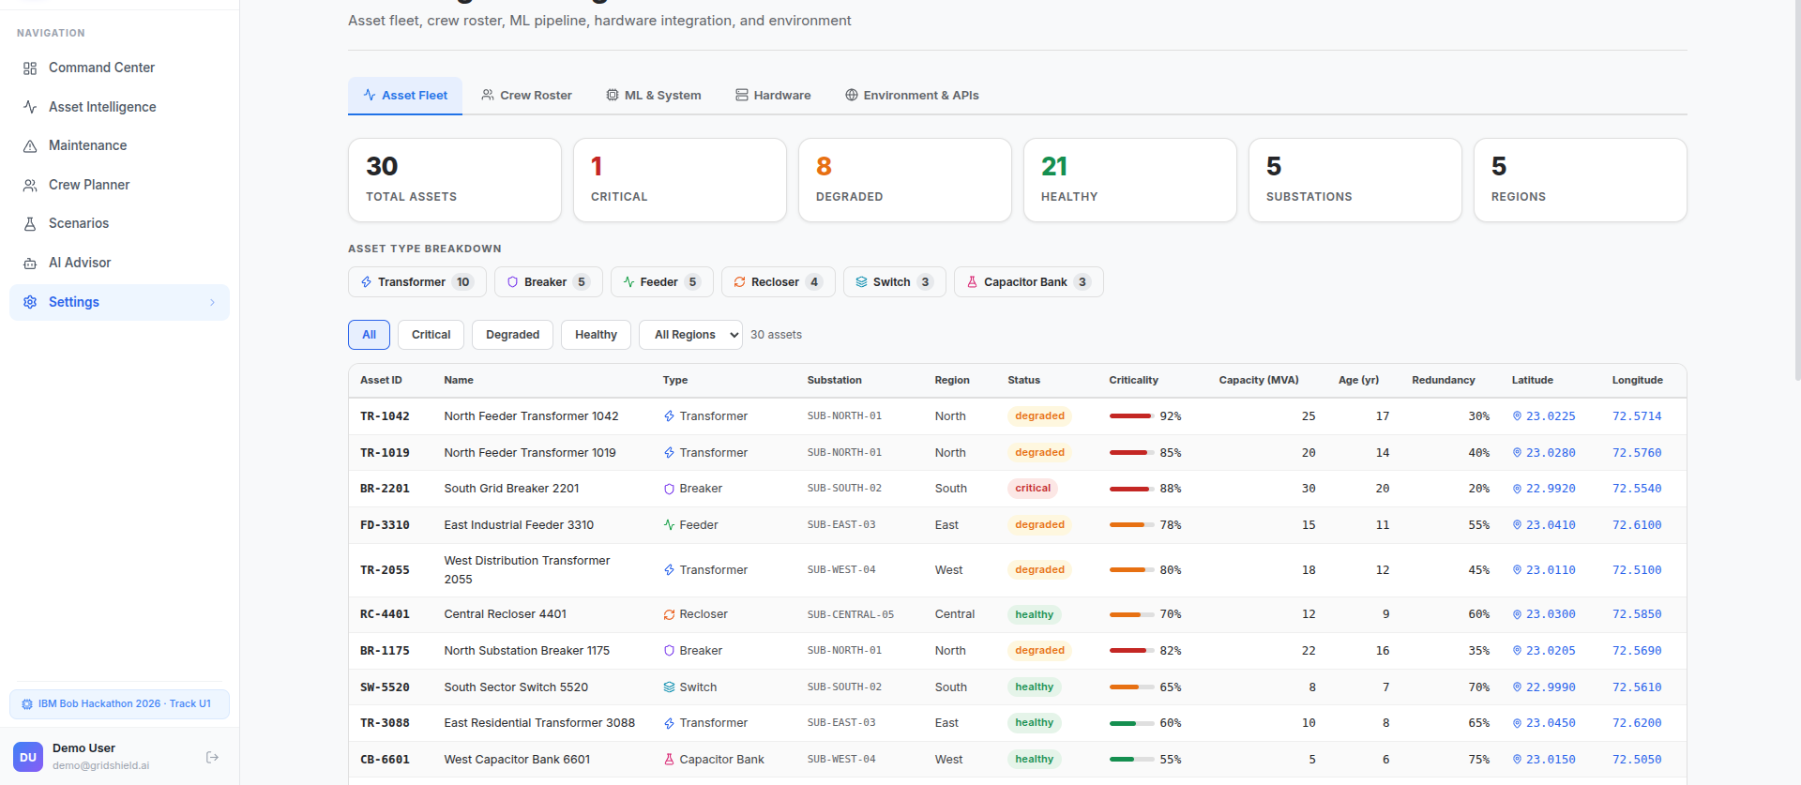
⚡
Bottleneck AI
ML INTEGRATION
The ML Pipeline: real models or mock, same contract
Swap the predictor behind a single environment flag — nothing downstream notices.
GRIDSHIELD_USE_REAL_ML=1
Models missing or flag off
FailurePrediction
Real XGBoost models load from models/bottleneck/
Deterministic mock predictor keeps the demo reproducible
→
One stable contract — zero UI, risk-engine, or planner changes
RETRAINING PIPELINE
SETTINGS & CONFIGURATION · 30-ASSET FLEET
1
generate_training_data
↓
2
train_models
↓
3
evaluate
11
Notes:
The ML seam keeps the demo bootable with or without trained models.

Slide 12
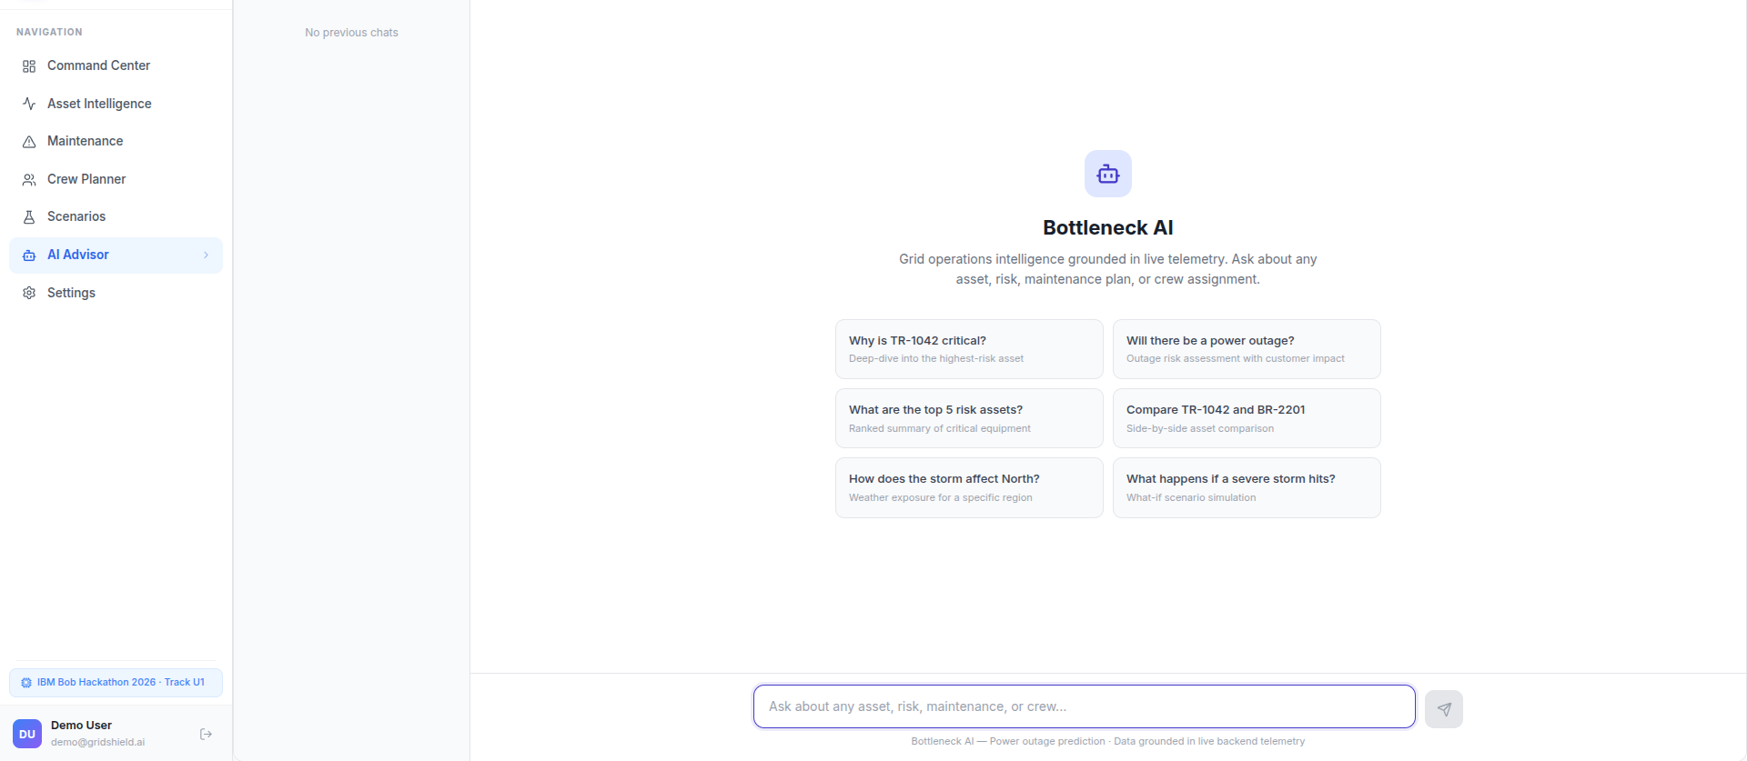
⚡
Bottleneck AI
AI COPILOT
Every answer grounded in live backend telemetry
The copilot never invents a sensor value — it cites the data the risk engine actually used.
“Why is TR-1042 critical?”
Anomalous temperature sustained over the last 24h
Severe weather exposure across the North region
8,420 customers and 7 critical facilities downstream
Health score 18/100 on a 17-year-old asset
Nearest matched crew: Alpha Transformer Team, 2.5 km
No hallucination by construction: the copilot answers only from backend records — risk breakdowns, telemetry, incidents, and crew state.
12
Notes:
Grounding is what makes the explanation trustworthy to an operator.

Slide 13
⚡
Bottleneck AI
HARDWARE INTEGRATION
Future Enhancement : Ready for the substation, not just the laptop
Protocol documentation and register maps ship with test and sync endpoints for each standard.
MB
D3
61
MQ
UA
Modbus
DNP3
IEC 61850
MQTT
OPC-UA
Register maps + test endpoint
Outstation point mapping
Logical node integration
Telemetry topic subscribe
Node browse + sync
NEW · Assignment e-mail notifications
When a crew is assigned, Bottleneck delivers an SMTP notification straight to the crew mailbox with the asset ID, GPS coordinates, distance from the depot, and ETA — so the dispatch leaves the platform and reaches a person.
Protocol docs included
Test endpoints per protocol
Zero credentials to demo
Every integration ships with its register map and a documented sync path
Connectivity can be validated before a single field device is wired in
The offline path runs on deterministic synthetic telemetry
13
Notes:
Hardware readiness plus SMTP dispatch notifications close the loop to the field.

Slide 14
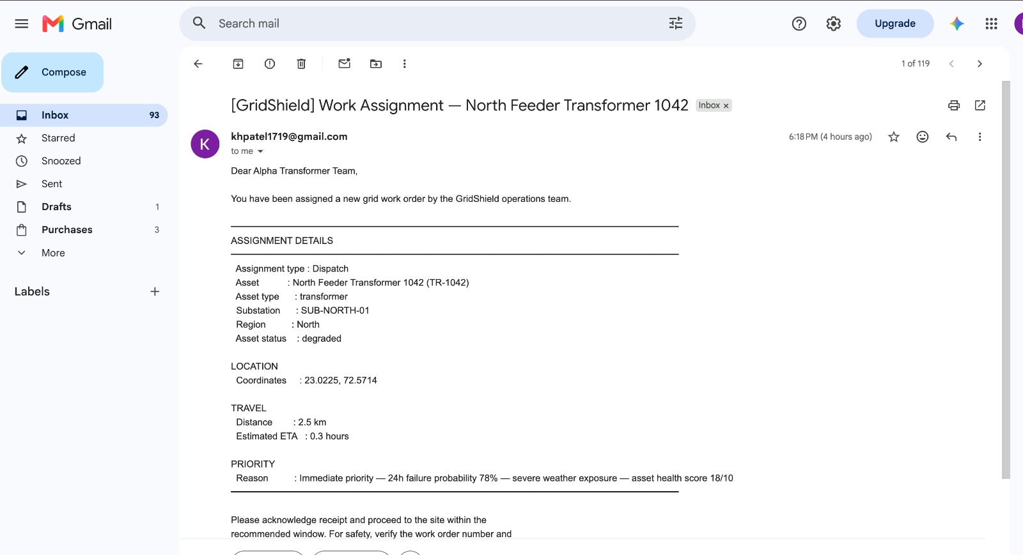
⚡
Bottleneck AI
Worker Assignment : Ready for the work
14

Slide 15
⚡
Bottleneck AI
IBM BOB & ROADMAP
Built with IBM Bob, and built to keep going
Bob was our primary AI coding agent across every phase — the full log lives in docs/BOB_ENGINEERING_LOG.md.
ROADMAP
IBM Bob as the engineering partner
Real SCADA / IoT telemetry
Scaffolding the FastAPI service and the React 18 client
Designing the composite risk engine and the crew-matching logic
Wiring the XGBoost seam and the deterministic mock fallback
Debugging, refactoring, and documenting all 30+ endpoints
Replace synthetic feeds with live substation data
OAuth2 / OIDC
Enterprise identity in place of demo JWT auth
Live weather feed
Continuous forecast ingestion for weather exposure
Deployment
Containerised delivery via Docker and Railway
30 assets monitored · 24h & 72h horizon · 0–100 risk score · <1s scenario re-compute · 100% offline-ready · 0 credentials needed
15
Notes:
Bob log is in docs/BOB_ENGINEERING_LOG.md. Roadmap moves from synthetic to live infrastructure.

Slide 16
⚡
Bottleneck AI
Built with IBM Bob, and built to keep going
bob-task-281127d7cc0558dbf1e8d055ae7122a7-2026-09-14_session2.md
bob-task-741d5570544a9fcb1d82546884caa0f7-2026-09-15.md
bob-task-4b1a939007c0b58d20364adbb6fe86d3-2026-09-15.md
bob-task-8623d7cee9b04b382641eacf5e9f8a84-2026-09-14.md
bob-task-53d856f17d662470228af0840d49f409-2026-09-14.md
bob-task-df828133b60a5549332a6a36dccce1ae-2026-09-14_heet.md
bob-task-6197ff02640b6a6f4f6a4fd8b7f2d4f7-2026-09-15.md
16
Notes:
Hardware readiness plus SMTP dispatch notifications close the loop to the field.

Slide 17
Thank You
Bottleneck AI — predict the failure, explain the risk, position the crew.
Team Bottleneck · IBM Bob Hackathon 2026 · Track U1
UK
DV
HM
KP
Urval Kheni
Dhruvin Vaghasiya
Heet Mehta
Krish Patel
Team Lead
Engineer
Engineer
Engineer
Questions welcome
Notes:
Close and open the floor for questions.

