Slide 1
Mainstreaming Metadata into Research Workflows to advance Reproducibility and Open Geographic Information Science
Joseph Holler (Middlebury College) and Peter Kedron (Arizona State University)
Conference: FOSS4G 2022, Firenze
Funding: National Science Foundation BCS-2049837
Publication: https://doi.org/10.5194/isprs-archives-XLVIII-4-W1-2022-201-2022
GitHub: github.com/HEGSRR/foss4g-2022-metadata
OSF: osf.io/52j8s/
Notes:
Thank you!
The title of my talk today is Mainstreaming Metadata into Research Workflows to advance Reproducibility and Open Geographic Information Science.
I am Joseph Holler from Middlebury College and this work was completed with the collaboration of Peter Kedron at Arizona State University with the support of a National Science Foundation grant for improving reproducibility and replicability in the geographic sciences.
These slides and the associated paper are available in the ISPRS archives, on GitHub, and on OSF.

Slide 2


Motivation for Metadata
Enhance the reproducibility of geographic research
Increase the pace and credibility of knowledge production in the geographic sciences
Facilitate more efficient & open research life cycles
Notes:
We need some motivation for a 20 minute talk about metadata!
I am motivated because I have reluctantly concluded that metadata is required to enhance the reproducibility of geographic research.
I am motivated to work on reproducibility in order to increase the pace and credibility of knowledge production in the geographic sciences.
Furthermore, I am optimistic that integrating metadata into everyday research practices will facilitate more efficient and open research life cycles.
This research is based on experience applying the broad consensus reports by the National Academies on Open Science and Reproducibility and Replicability to the specific challenges in the geographic sciences
So, what is happening in geography?

Slide 3
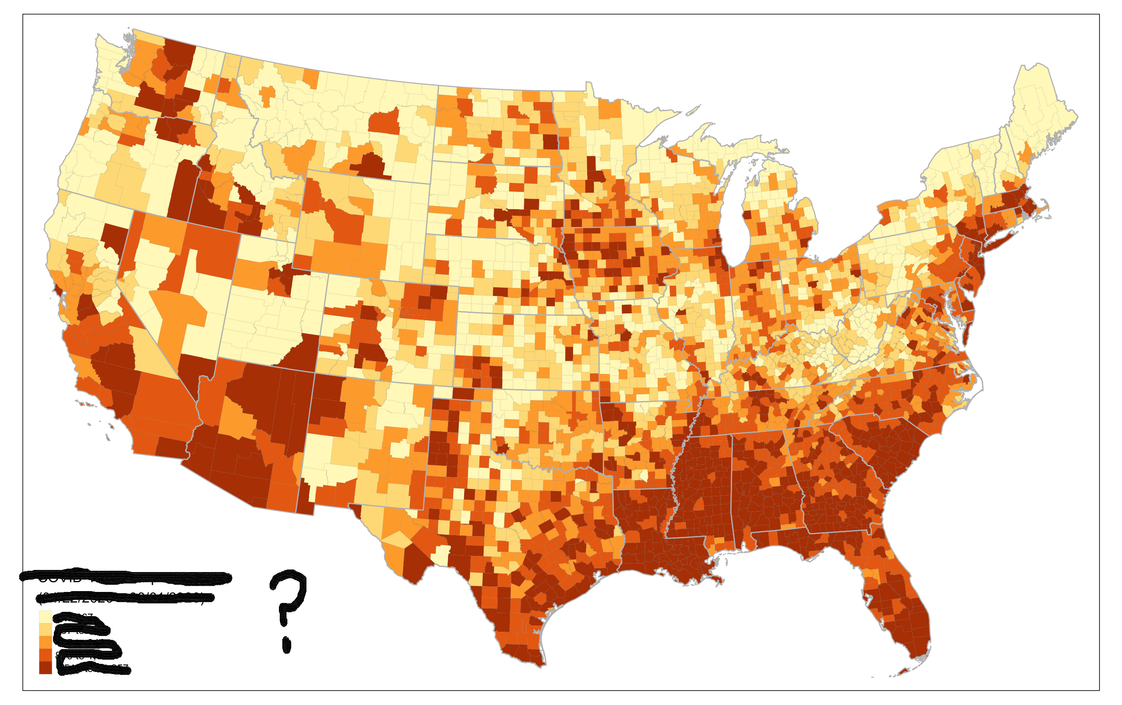
7 Reproduction or Replication Studies
Context
Metadata? No, I have never used that…
I am familiar with “reproducibility”, and my research is reproducible!
github.com/HEGSRR/
RPr-Chakrabory-2021
RPr-Malcomb-2014
RPr-Mollalo-2020
RPr-Vijayan-2020
RPr-Saffary-2020
RPr-Kang-2020
RPl-DiMaggio-2021
Notes:
For some context from our research project,
we have surveyed geographers about their research practices, finding most folks would say, “I am familiar with reproducibility and my research is reproducible”
However, when asked about metadata, most would say, “Metadata, No, I have never used that...”
Providing data or even code alongside a research publication without metadata is like publishing a map with no title or legend… leaving serious questions about the data and its proper use unanswered.
We have reluctantly and painfully come to this conclusion– and the need for this paper– after attempting seven reproduction or replication studies and publishing each as a reproducible research compendium in our GitHub HEGSRR Organization.

Slide 4
Three Points
Researchers use, create, and modify information about their research projects and research data throughout the research life cycle
Open Science and Reproducibility require standardized metadata
We need better open source geospatial software to support metadata-rich research
Notes:
My talk aims to convince you of these three points:
Researchers use, create, and modify information about their research projects and research data throughout the research life cycle
Open Science and Reproducibility require standardized metadata
We need better open source geospatial software to support metadata-rich research
But first, what is reproducibility?

Slide 5
Reproducibility > repeating computations
 | Same Methods | Varied Methods
Same Data | Reproduction (Verification) | Reanalysis
Different Data | (Direct) Replication | Extension
Christensen, Freese and Miguiel (2019)
Notes:
Reproducibility is a core motivation of open science, but it’s more than simply repeating another researcher’s computations as illustrated by this matrix.
In the top left, if we use the same methods and same data to achieve the same results as a prior study, this REPRODUCTION provides a check of the internal validity of the study.
We normally discover uncertainties or deficiencies in the original procedures, leading us to the top-right, where we REANALYZE the same data with varied methods and test the sensitivity of the study to researcher decisions and errors.
If we want to externally validate a study, we drop to the bottom left, where we apply the same methods to new data in a REPLICATION.
Finally, the bottom right is where science makes further progress by EXTENDING previous studies with varied methods and new data.
What is the role of metadata in all of this?

Slide 6
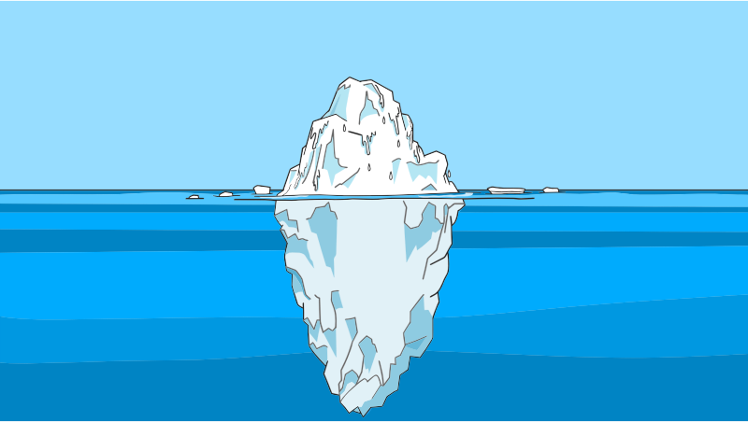
Geospatial Metadata: information about spatial data
Geospatial Data
Metadata
Notes:
Geospatial metadata is information about spatial data.
Drawing on a tired cliché, consider that geospatial data is just the attractive floating island of ice above the ocean surface,
Whereas a mass of contextual information lies beneath, and without which the ice above water is both useless and dangerous.

Slide 7
Metadata for Reproducibility & Open Science
Reproduce
Replicate
Original Research
Social & Ontological Context (Schuurman and Leszcynski 2006, Comber et al 2008)
Provenance metadata is an ethical issue (Tullis and Kar 2021)
FAIR open data (Wilkinson et al 2016)
F indable
A ccessible
I nteroperable
R eusable
5-Star Reproducibility (Wilson et al 2021)
✰ data, code, and license
✰  some metadata & provenance
✰   complete & structured metadata and provenance
✰    international standards for data and metadata
✰     processing environment
Notes:
We can think of metadata as one of the essential cogs allowing the gears of open science to work.
Metadata provides essential social and ontological context for the meaning, interoperability, and appropriate use of data.
For Tulls and Car, provenance metadata is also an ethical issue, particularly with regards to location privacy and data quality of big data for humanitarian response.
In open science, metadata is the key to FAIR open data.
Data becomes findable with project-level metadata including the study’s geographic extent.
Data is accessible when metadata specifies its open license, its access protocols, or when metadata provides as much detail as possible for inaccessible data.
Data is interoperable when metadata adheres to machine-readable international standards
Research data is reusable when metadata provides enough context and detail for re-creation and appropriate re-use
In Wilson’s 5-star guide to reproducible geographic research, metadata distinguishes three out of five stars.
Simply providing code and data with an open license only achieves one star.
Some metadata achieves two stars,
Complete metadata achieves three stars,
And metadata encoded with international standards achieves four stars.
So, what are the metadata standards?

Slide 8
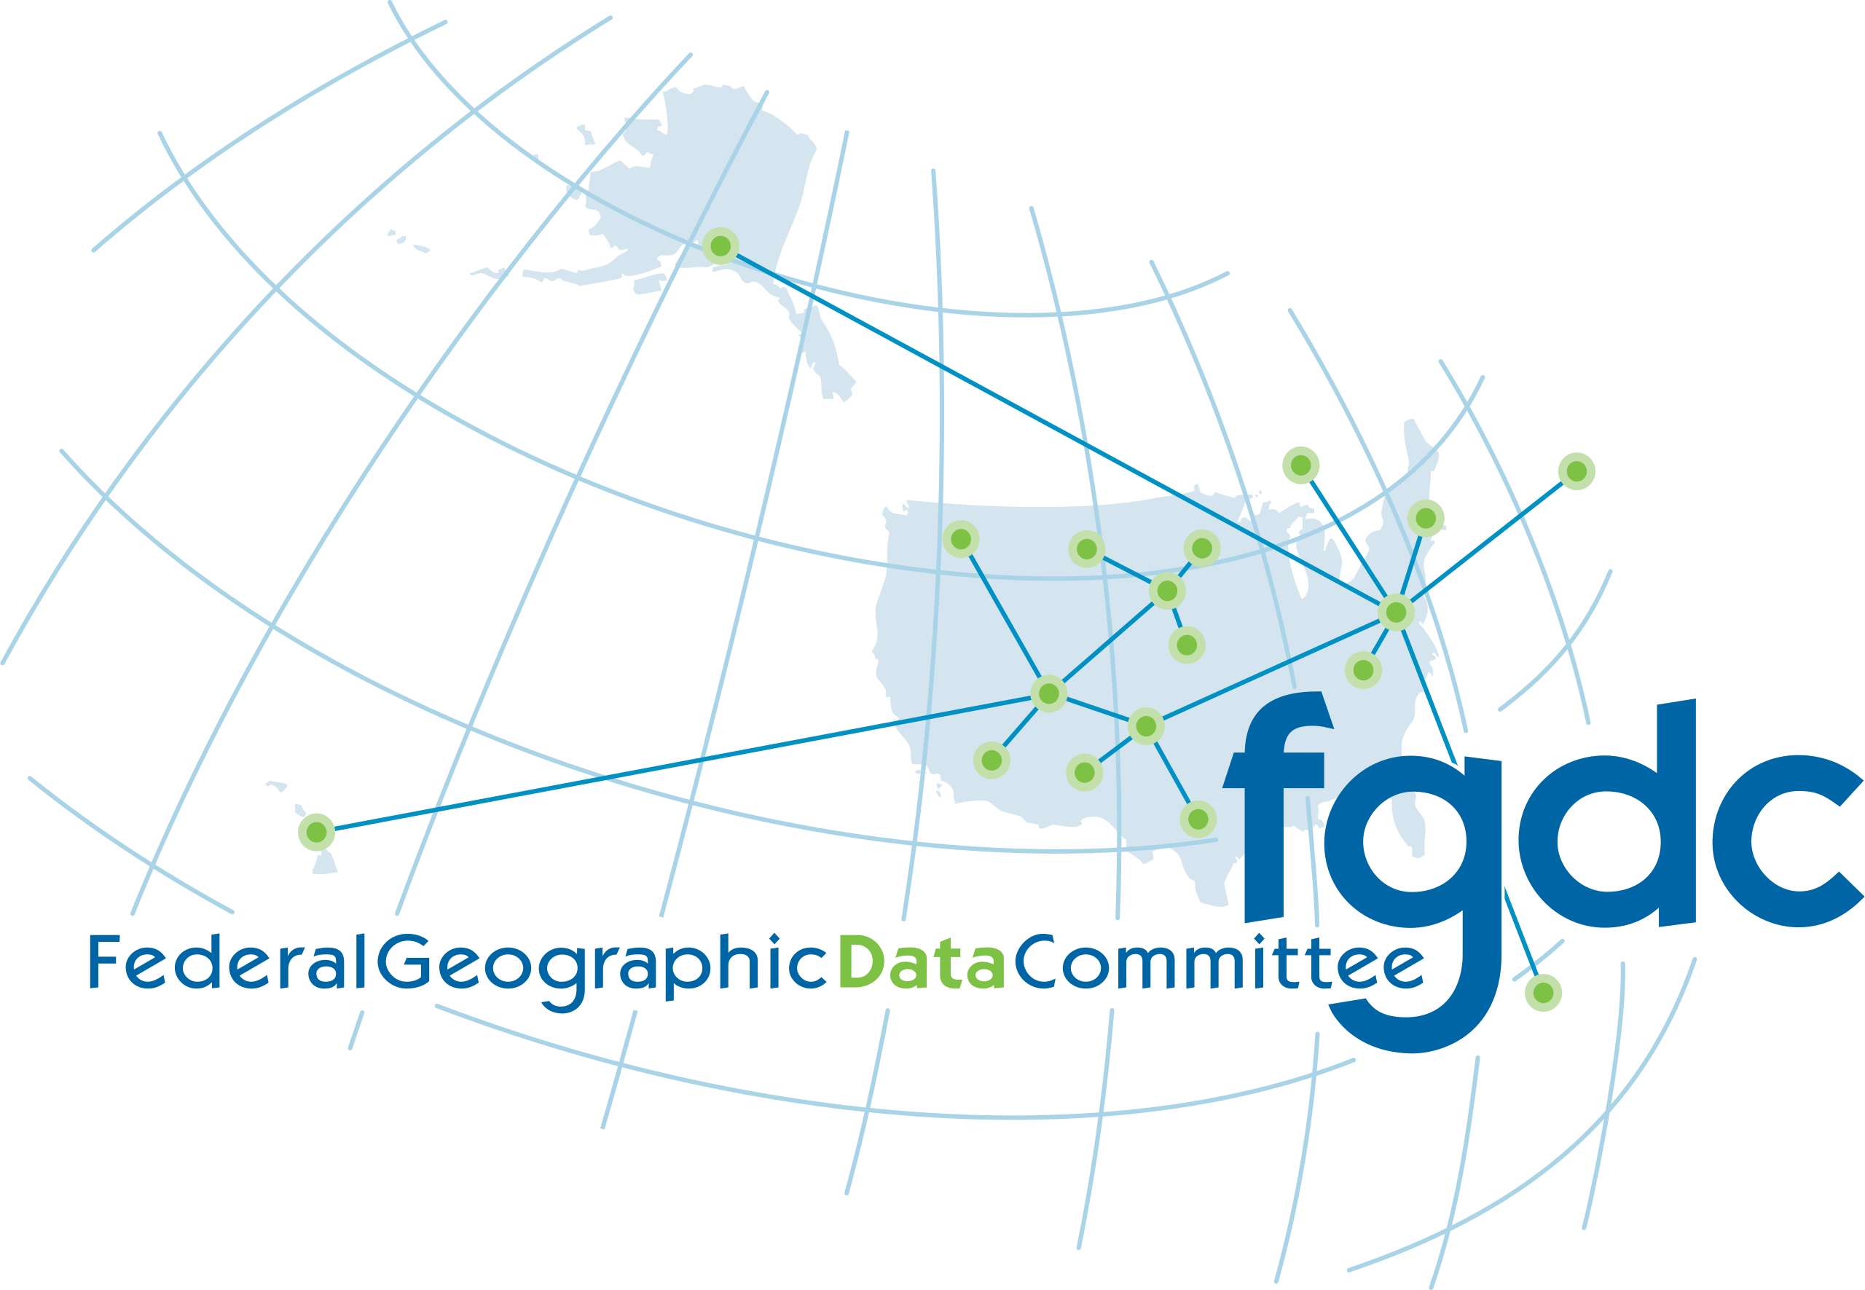




Standards
Spatial Data Infrastructures
FGDC: Federal Geographic Data Committee
INSPIRE: Infrastructure for Spatial Information in Europe
Standards Organizations
ISO: International Organization for Standardization
DCMI: Dublin Core Metadata Initiative
OGC: Open Geospatial Consortium
Notes:
Metadata standards for geographic information may come from either spatial data infrastructures, e.g. the Federal Geographic Data Committee for the United States or the Infrastructure for Spatial Information in Europe.
These data infrastructures developed to enhance data standards interoperability between government agencies
Metadata have also been developed by non-governmental organizations, including the International Organization for Standardization, the Dublin Core Metadata Initiative developed by librarians for managing digital archives, and the Open Geospatial Consortium.
Currently, the FGDC is moving toward using the ISO standard and INSPIRE uses an extension to the ISO standard, making the ISO standards the de-facto choice for geographic data layers.
Meanwhile, The Dublin Core standard is ideally suited for the overall research project.
The OGC has plenty of guidance on open data storage formats, but leaves the metadata standard to the ISO.

Slide 9
Recommended Standards
ISO 19115 | Dublin Core
Dataset name | Title
Abstract, Purpose | Description
Topic Category | Subject Keywords
Unique Identifier | Identifier
Date | Date
Contact / Responsible Parties | ---
Credit, Citation | Contributors, Creator, Publisher
Constraints | Rights
Distribution and Format | Type
Spatial Representation | Type
Extent (spatial & temporal) | Coverage
Spatial Resolution
Temporal Resolution
Content information (attributes, measurements)
Data Quality, Usage
Lineage | Source, Provenance
ISO 19115 for geographic data
Dublin Core for research projects
Geospatial Data
Metadata
Notes:
So, exactly what sorts of information are lurking beneath the waves?
Again, the ISO 19115 and related ISO standards are best for geographic data layers and the Dublin Core standard is best for whole research projects.
I compare the two standards in the table on the right.
The first five rows answer the basic what, why, and when questions of the data, and make your projects findable by using a DOI for the unique identifier and controlled vocabularies for topic/subject keywords.
The next two rows answer the who question about the data: who is responsible for authoring, creating, publishing, maintaining, etc. ?
The next row provides legal issues of constrains and rights. Ideally data will be published with open licenses, without which copyright protection is implied.
From this point on, the ISO 19115 standard provides much more detail for geographic data layers than Dublin Core would, including
The spatial data model, spatial and temporal extents and resolutions, and content information, which is essentially a data dictionary of all the attributes, attribute types, measurements, and even descriptive statistics.
Data quality and proper usage information are only part of the ISO 19115.
The ISO’s lineage feature is robust enough to record step-by-step data transformations, while the Dublin Core standards are more about recording a chain of custody.
How does all of this information fit within a research life cycle? Let’s take a look.

Slide 10
Open Science Research Life Cycle
Provocation
Ideation
Knowledge Generation
Validation
Dissemination
Preservation
Notes:
The National Academy’s Open Science by Design report envisions research life cycle with expanded research opportunities and improved research quality enabled by open science practices in each of six phases.

Slide 11
Open Science Research Life Cycle
Provocation
Ideation
Knowledge Generation
Validation
Dissemination
Preservation
Literature Review → New Idea
Notes:
In the provocation phase, we search for existing literature and new ideas – imagine geographically explicit literature reviews and synthesis studies…

Slide 12
Open Science Research Life Cycle
Provocation
Ideation
Knowledge Generation
Validation
Dissemination
Preservation
Research Planning & Prototyping
Notes:
In the ideation phase, we plan the research, including human subjects protocols, proposals with data management plans, and pre-analysis registrations of study protocols, requiring study of metadata for 2ndary data and creation of metadata for the project and each of its data layers

Slide 13
Open Science Research Life Cycle
Provocation
Ideation
Knowledge Generation
Validation
Dissemination
Preservation
Collect / Generate Data
& Metadata
Notes:
In the knowledge generation phase, we collect and analyze data, ideally in an executable research compendium with a computational notebook or other means of tracking provenance

Slide 14
Open Science Research Life Cycle
Provocation
Ideation
Knowledge Generation
Validation
Dissemination
Preservation
Interpretation, Working Papers & Conferences
Notes:
In the validation phase, we analyze and share preliminary results, which can be aided with OSF / figshare registration

Slide 15
Open Science Research Life Cycle
Provocation
Ideation
Knowledge Generation
Validation
Dissemination
Preservation
Peer Review, Publication
Notes:
In the dissemination phase, we undergo our beloved peer review process, revision, and formal publication.

Slide 16
Open Science Research Life Cycle
Provocation
Ideation
Knowledge Generation
Validation
Dissemination
Preservation
Public Archive with finalized Metadata
Notes:
In the preservation phase, we archive research data and code in an open access repository and finalize project metadata for searching and data-layer metadata for (re)usability

Slide 17
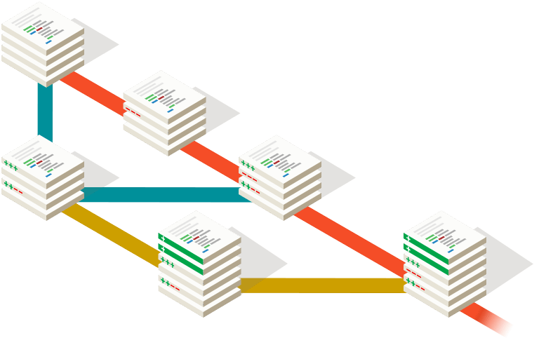
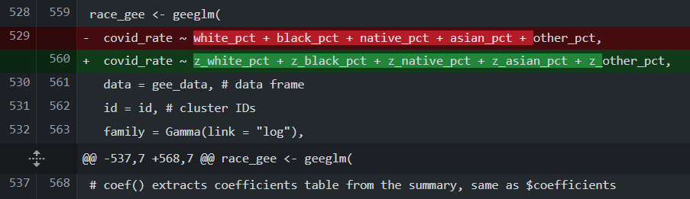
Open Science Research Life Cycle
Provocation
Ideation
Knowledge Generation
Validation
Dissemination
Preservation & Metadata-rich Research Life Cycle
Research Compendium Template
Project with Metadata
Data
Raw
Public
Private
Derived
Public
Private
Metadata
Docs (Reports, Manuscript, Presentation)
Procedures
Code (computational notebook)
Environment
Protocols
Results (figures, maps, tables, model outputs)
Git Repository
Version Tracking
Difference Comparison
Branching
Notes:
If we reimagine this life cycle using a research compendium, we carry a preservation phase enriched with metadata through the whole research life cycle, such that the research is already preserved as the publication hits the press.
The compendium template provides structure for organizing data, metadata, code and procedures, documents and results.
It is managed as a Git repository for version tracking, comparing differences or changes between versions, and branching and merging alternative research designs.
At the provocation phase, our literature review is enabled by project-level metadata, spatially-explicit synthesis / meta-analysis / bibliometric analysis
At Ideation phase, we create project-level metadata,
We research and imagine the data we will use and create and document this in the data\metadata folder.
We use the project- and data-metadata to write proposals
, data management plan, ethics review board, and pre-analysis plan documents. We register the plan(s) on OSF or similar using project-level metadata and OSF to our repository.
At the Knowledge Generation phase, we create the data, update our metadata documents, and enable visualization of any changes to the data portion of our research protocols. Ideally, metadata tools support cataloging data, updating metadata, and building a directory for the compendium.
At the validation phase, we write report documents, visualize unplanned deviations in the research protocol, and provide extraordinarily useful preprints and conference presentations.
At the dissemination phase, reviewers have unprecedented access to the details of our research, changes required by review are tracked, and the research is more findable through project-level metadata and usable through data-level metadata. Sufficient details of embargoed, restricted, or proprietary data are available to simulate, access, or recreate similar data.
At the preservation phase, we realize that we have been preserving the research in a public compendium all along, and ensure we have added a persistent identifier (DOI) to all of our interlinked research products.

Slide 18
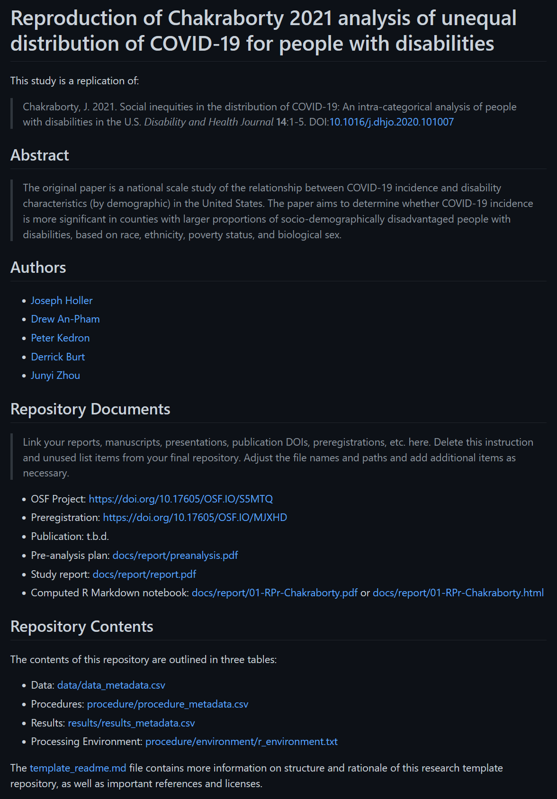
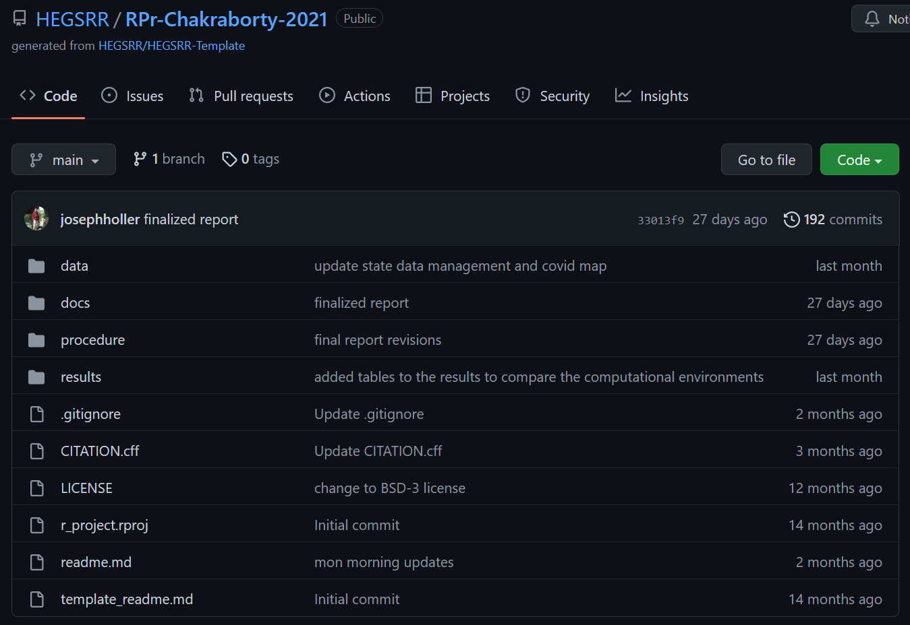
Research Compendium Template in Action

Slide 19
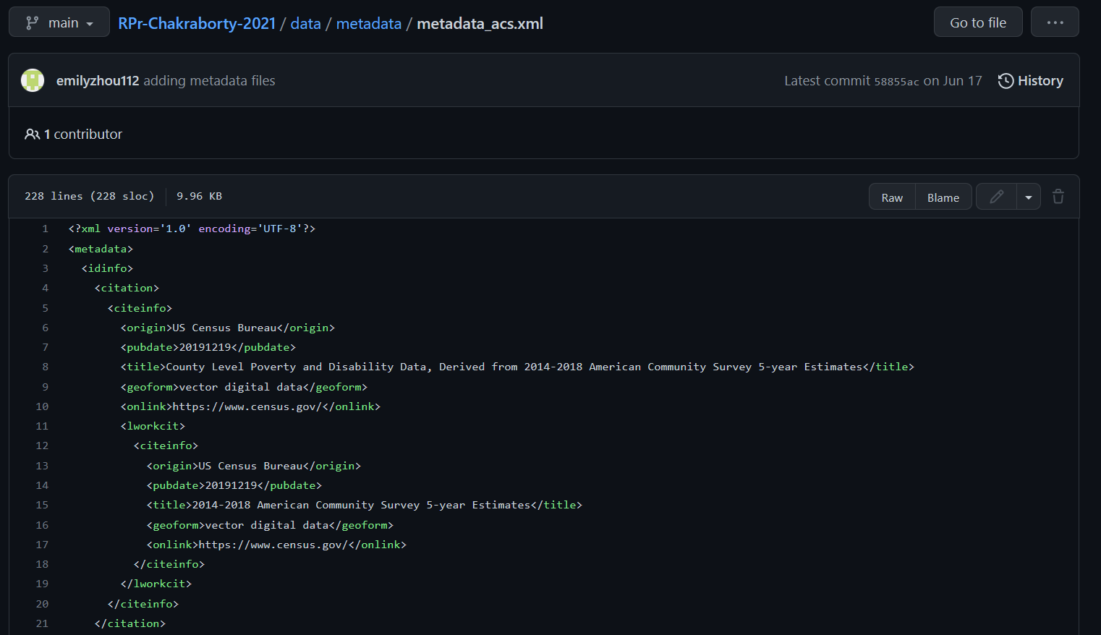
Research Compendium Template in Action: FGDC XML

Slide 20
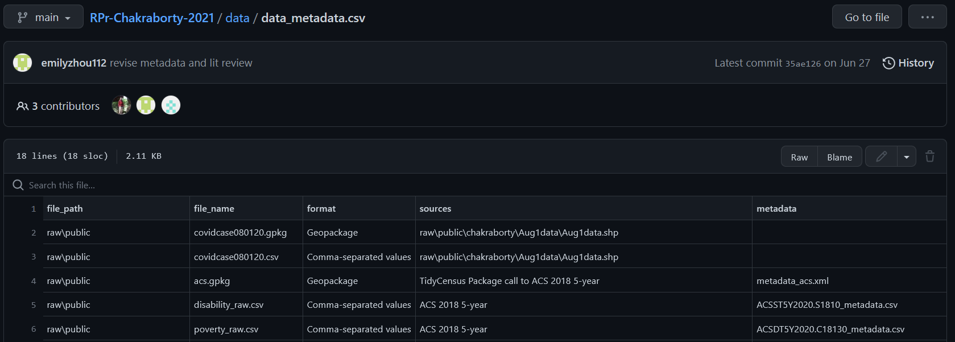
Research Compendium Template in Action: CSV Index

Slide 21










Open Geographic Information Metadata Systems
Must have metadata editing functionality…
3 Desktop GIS: QGIS, GRASS, SAGA
2 Spatial Data Science Packages: R geometa, Python pygeometa
1 Catalogue: GeoNetwork
1 Content Management: GeoNode
2 Metadata Authoring: Metadata Wizard, mdEditor
1 Executable Research Compendium Tools: o2r-meta
Notes:
Given this suite of software tools, what software features do we need?

Slide 22
Metadata Software Needs
Easy to use
Start-up
Graphical user interface
Open Standards
International metadata standards
Standardized encoding
Automation
Cataloguing / searching
Geographic metadata
Attribute metadata
Validation
Provenance

Slide 23
Results of Metadata Software Evaluation

Slide 24
Software | Easy Start | GUI | Standards | Encoding | Catalogue | Auto – Geographic | Auto – Attribute | Validate | Provenance
QGIS | ✓ | ✓ |  | XML | ✓ | ✓ | ✓ | ✓
SAGA | ✓ |  |  |  | ✓ | ✓ | ✓ |  | ✓
GRASS | ✓ | ✓ | ✓ | XML |  | ✓
GeoNetwork |  | ✓ | ✓✓ | XML |  |  |  | ✓
GeoNode |  | ✓ | ✓✓ | XML |  | ✓ | ✓
mdEditor | ✓✓ | ✓ | ✓ | JSON |  |  |  | ✓
Metadata Wizard | ✓✓ | ✓ | ✓ | XML |  | ✓ | ✓ | ✓
Geometa |  |  | ✓ | XML |  |  |  | ✓
PyGeometa |  |  | ✓ | XML, YAML
o2r-meta |  |  |  | XML, JSON | ✓ | ✓ |  | ✓
Notes:
Easy start-up: double check for very fast installation, single check for more complex installation/program, grey check for more difficult procedure to begin project and import data
GUI: check for graphical user interface for editing metadata, grey check if it requires an add-on
Standards: double-checks for supporting Dublin Core and ISO, single check for supporting only one, grey check for supporting only FGDC or requiring add-on
Encoding: XML is the standard, some also use JSON or YAML – this makes it possible for other software to use the data to auto-generate research documents
Catalogue: check for searching and listing geospatial data in a research directory: grey check for doing this only for Raster (SAGA) or only in visual Browser (QGIS)
Automated geographic: automatically extracting geographic metadata – extent, CRS
Automated attribute: automatically extracting layer attributes, types, and perhaps descriptive statistics – grey if only in layer view
Validate: feature to assess completeness of metadata records
Provenance: feature to automatically track analytical steps and record them as layer metadata

Slide 25
Three Points
Easy to use
Start-up
Graphical user interface
Open Standards
International metadata standards
Standardized encoding
Automation
Cataloguing / searching
Geographic metadata
Attribute metadata
Validation
Provenance
Extensible
Researchers use, create, and modify information about their research projects and research data throughout the research life cycle
Open Science and Reproducibility require standardized metadata
We need better open source geospatial software to support metadata-rich research

Slide 26
Questions, corrections, comments, and collaborations welcome!
www.github.com/HEGSRR
osf.io/c5a2r/
josephh@middlebury.edu
Thank You

