Slide 1
Mainstreaming Metadata into Research Workflows to advance Reproducibility and Open Geographic Information Science
Joseph Holler (Middlebury College) and Peter Kedron (Arizona State University)
Conference: FOSS4G 2022, Firenze
Funding: National Science Foundation BCS-2049837
Publication: https://doi.org/10.5194/isprs-archives-XLVIII-4-W1-2022-201-2022
GitHub: github.com/HEGSRR/foss4g-2022-metadata
OSF: osf.io/52j8s/

Slide 2


Motivation
Enhance reproducibility of geographic research
Increase the pace and credibility of knowledge production in geographic science
Facilitate more efficient & open research life cycles

Slide 3
Three Points
Researchers use, create, and modify information about their research projects and research data throughout the research life cycle
Reproducibility and Open Science require standardized metadata
We need better open source geospatial software to support metadata-rich research

Slide 4
Reproducibility and Replicability
 | Same Methods | Varied Methods
Same Data | Reproduction (Verification) | Reanalysis
Different Data | (Direct) Replication | Extension
Christensen, Freese and Miguiel (2019)
Notes:
Reproducibility is a core motivation of open science

Slide 5
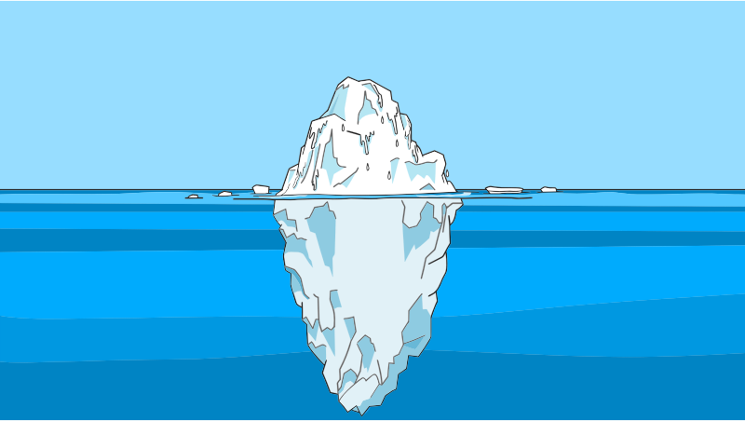
Geospatial Metadata: information about spatial data
Geospatial Data
Metadata
Notes:
Apologies for the iceberg analogy– but if we consider that geospatial data itself is just the glamorous polar bear platform above the ocean surface, a mass of contextual information lies beneath, and without knowledge of this the fraction above water is both useless and dangerous.

Slide 6
Metadata for Reproducibility & Open Science
Social & Ontological Context (Schuurman and Leszcynski 2006, Comber et al 2008)
FAIR open data (Wilkinson et al 2016)
F indable
A ccessible
I nteroperable
R eusable
5-Star Reproducibility (Wilson et al 2021)
✰ data, code, and license
✰  some metadata & provenance
✰   complete & structured metadata and provenance
✰    international standards for data and metadata
✰     processing environment
Reproduce
Replicate
Original Research
Notes:
Metadata are the cogs for research data wheels
Finable: persistent identifier and searchable information
Accessible: license, protocol for access, metadata may stand in for inaccessible original data
Interoperable: metadata standards for machine readability
Reusable: license for direct reuse & sufficient metadata for reanalysis or replication
So… what standards do we have for geographic research & data?

Slide 7





Standards
Spatial Data Infrastructures
FGDC: Federal Geographic Data Committee
INSPIRE: Infrastructure for Spatial Information in Europe
Standards Organizations
ISO: International Organization for Standardization
DCMI: Dublin Core Metadata Initiative
OGC: Open Geospatial Consortium

Slide 8
Standards
ISO 19115 | Dublin Core
Dataset name | Title
Abstract, Purpose | Description
Topic Category | Subject Keywords
Unique Identifier | Identifier
Date | Date
Contact / Responsible Parties | ---
Credit, Citation | Contributors, Creator, Publisher
Constraints | Rights
Distribution and Format | Type
Spatial Representation | Type
Extent (spatial & temporal) | Coverage
Spatial Resolution
Temporal Resolution
Content information (attributes, measurements)
Data Quality, Usage
Lineage | Source, Provenance
ISO 19115 for geographic data
Dublin Core for research projects
Geospatial Data
Metadata

Slide 9
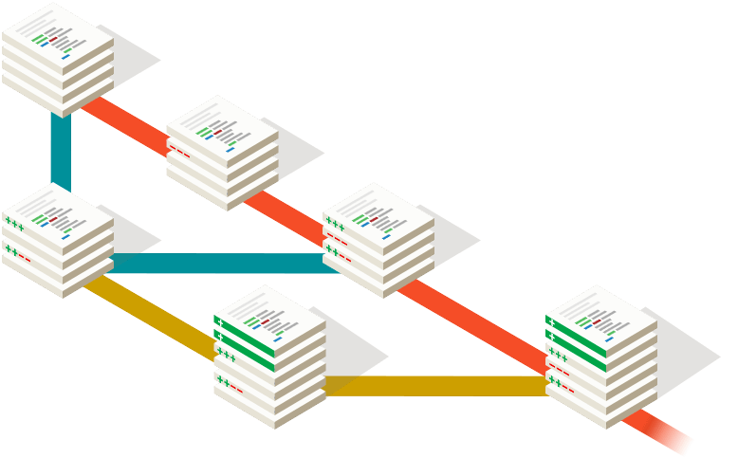
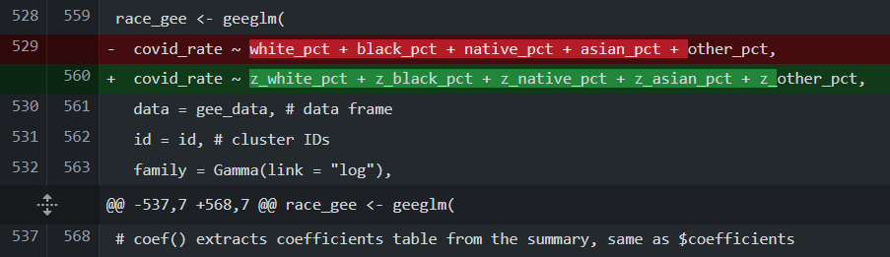
Open Science Research Life Cycle
Provocation
Ideation
Knowledge Generation
Validation
Dissemination
Preservation
Executable Research Compendium
Project & Project Metadata
Data
Raw
Public
Private
Derived
Public
Private
Metadata
Procedures
Code (computational notebook)
Environment
Protocols
Documents (Reports, Manuscript, Presentation)
Git Repository
Version Tracking
Difference Comparison
Notes:
Provocation: we search for existing literature and new ideas – imagine geographically explicit literature reviews and synthesis studies…
Ideation: plan the research, including human subjects protocols, proposals with data management plans, and pre-analysis registrations of study protocols, requiring study of metadata for 2ndary data and creation of metadata for the project and each of its data layers
Knowledge generation: collect and analyze data, ideally in an executable research compendium with a computational notebook or other means of tracking provenance
Validation: analyze and share preliminary results, which can be aided with OSF / figshare registration
Dissemination: Peer review, revision and publication – scientific papers insufficiently communicate research methods for review
Preservation: Archiving in an open access repository /w project-level metadata for searching and data metadata for (re)usability
Given this framework, what
geospatial software help manage metadata through the open science research life cycle framework?

Slide 10










Open Geographic Information Metadata Systems
3 Desktop GIS: QGIS, GRASS, SAGA
2 Spatial Data Science Packages: R geometa, Python pygeometa
1 Catalogue: GeoNetwork
1 Content Management: GeoNode
2 Metadata Authoring: Metadata Wizard, mdEditor
1 Executable Research Compendium Tools: o2r-meta
Notes:
Given this suite of software tools, what software features do we need?

Slide 11
Metadata Software Needs
Easy to use
Start-up
Graphical user interface
Open Standards
International metadata standards
Standardized encoding
Automation
Cataloguing / searching
Geographic metadata
Attribute metadata
Validation
Provenance

Slide 12
Results of Software Evaluation

Slide 13
Software | Easy Start | GUI | Standards | Encoding | Catalogue | Auto – Geographic | Auto – Attribute | Validate | Provenance
QGIS | ✓ | ✓ |  | XML | ✓ | ✓ | ✓ | ✓
SAGA | ✓ |  |  |  | ✓ | ✓ | ✓ |  | ✓
GRASS | ✓ | ✓ | ✓ | XML |  | ✓
GeoNetwork |  | ✓ | ✓✓ | XML |  |  |  | ✓
GeoNode |  | ✓ | ✓✓ | XML |  | ✓ | ✓
mdEditor | ✓✓ | ✓ | ✓ | JSON |  |  |  | ✓
Metadata Wizard | ✓✓ | ✓ | ✓ | XML |  | ✓ | ✓ | ✓
Geometa |  |  | ✓ | XML |  |  |  | ✓
PyGeometa |  |  | ✓ | XML, YAML
o2r-meta |  |  |  | XML, JSON | ✓ | ✓ |  | ✓
Notes:
Easy start-up: double check for very fast installation, single check for more complex installation/program, grey check for more difficult procedure to begin project and import data
GUI: check for graphical user interface for editing metdata, grey check if it requires an add-on
Standards: double-checks for supporting Dublin Core and ISO, single check for supporting only one, grey check for supporting only FGDC or requiring add-on
Encoding: XML is the standard, some also use JSON or YAML – this makes it possible for other software to use the data to auto-generate research documents
Catalogue: check for searching and listing geospatial data in a research directory: grey check for doing this only for Raster (SAGA) or only in visual Browser (QGIS)
Automated geographic: automatically extracting geographic metadata – extent, CRS
Automated attribute: automatically extracting layer attributes, types, and perhaps descriptive statistics – grey if only in layer view
Validate: feature to assess completeness of metadata records
Provenance: feature to automatically track analytical steps and record them as layer metadata

Slide 14
Three Points
Easy to use
Start-up
Graphical user interface
Open Standards
International metadata standards
Standardized encoding
Automation
Cataloguing / searching
Geographic metadata
Attribute metadata
Validation
Provenance
Researchers use, create, and modify information about their research projects and research data throughout the research life cycle
Reproducibility and Open Science require standardized metadata
We need better open source geospatial software to support metadata-rich research

Slide 15
Three Points
Researchers use, create, and modify information about their research projects and research data throughout the research life cycle
Reproducibility and Open Science require standardized metadata
We need better open source geospatial software to support metadata-rich research

