Slide 1
Practicing and Teaching Reproducibility and Replicability in the Human-Environment and Geographical Sciences
Joseph Holler – Middlebury College
Peter Kedron – Arizona State University
Emily Zhou – Middlebury College

Slide 2
Support
NSF BCS-2049837 Transforming Theory-Building and STEM Education Through Reproductions and Replications in the Geographical Sciences
Geospatial Software Institute COVID-19 Fellows University of Illinois Urbana-Champaign National Science Foundation OAC-1743184

Slide 3
Introductions
Name
Institution
Experience with open source GIS in your research or teaching?
Experience with reproducibility in geographic sciences?

Slide 4

Defining R&R
Reproducibility: Obtaining consistent results using the same input data, computational steps, methods and code, and conditions of analysis
Replicability: Obtaining consistent results using the same input data, computational steps, methods and code, and conditions of analysis

Slide 5
Practicing R&R
Reproducible research practices in original studies
Designing, implementing, and publishing reproduction studies and replication studies in geography

Slide 6
Teaching R&R
Teaching competencies for doing reproducible research
Reproduction and replication studies with students in…
Methods courses
Independent or small groups
Research assistantships
Teaching geographic concepts and methods through reproduction and replication studies

Slide 7
Research Objectives
Assess reproducible research practices in the geographical sciences and identify barriers to reproducibility.
Assess the credibility and generalizability of recent high-impact HEGS research by conducting reproductions and replications.
Establish and evaluate a pedagogy that uses reproductions and replications to improve student learning and STEM competencies.
Notes:
Survey is out!
Seven reproduction studies
Two replication studies
Undergraduate Open Source GIScience course; Graduate spatial statistics course; Graduate reading group; Seven ind. studies / RAs

Slide 8
Seminar Objectives
Conceptual / Theoretical Overview:
R&R in Human-Environment and Geographical Sciences
Technical:
Research compendium in Git / GitHub
Planning and registering a reproduction study
Computational notebook in RStudio / R Markdown
Practical:
Ability to read, access, and execute research compendia
Share ideas & experience for research & teaching R&R
Resources for (self)teaching

Slide 9
Reproducibility & Replicability in the Geographical Sciences
Illustrated with COVID-19 Pandemic Research

Slide 10
Science
Science builds explanatory structures, tells stories which are scrupulously tested to see if they are stories about real life. -Medawar 1967
Science is about finding the most reliable way of thinking at the present level of knowledge. -Rovelli 2014

Slide 11
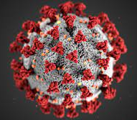
Science under stress: COVID-19
Reproducibility Crisis
Reproducibility rules @ Environmental Protection Agency & Office of Budget Administration
Knowledge evolving rapidly
Open access preprint repositories medRxiv, bioRxiv
Accelerated peer review and publishing process
Retractions from hasty science?
Hydroxychloroquine, Surgisphere, The Lancet & New England Journal of Medicine
An alarming retraction rate for scientific publications on Coronavirus Disease (Yeo-Teh and Tang 2021)
Crisis of public trust?

Slide 12
(how) do we trust science?
Community with self-corrective mechanisms
Peer Review
Debate / test alternative hypotheses – Kuhn’s paradigm shifts
Internal validity
External validity
Reliability
Credibility

Slide 13
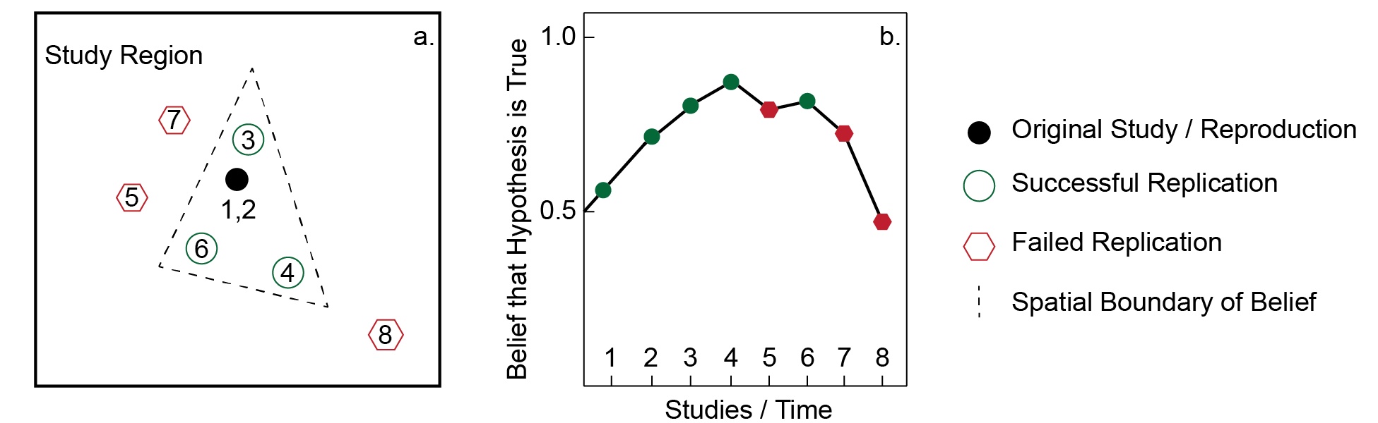
Spatial heterogeneity & scientific discovery

Slide 14
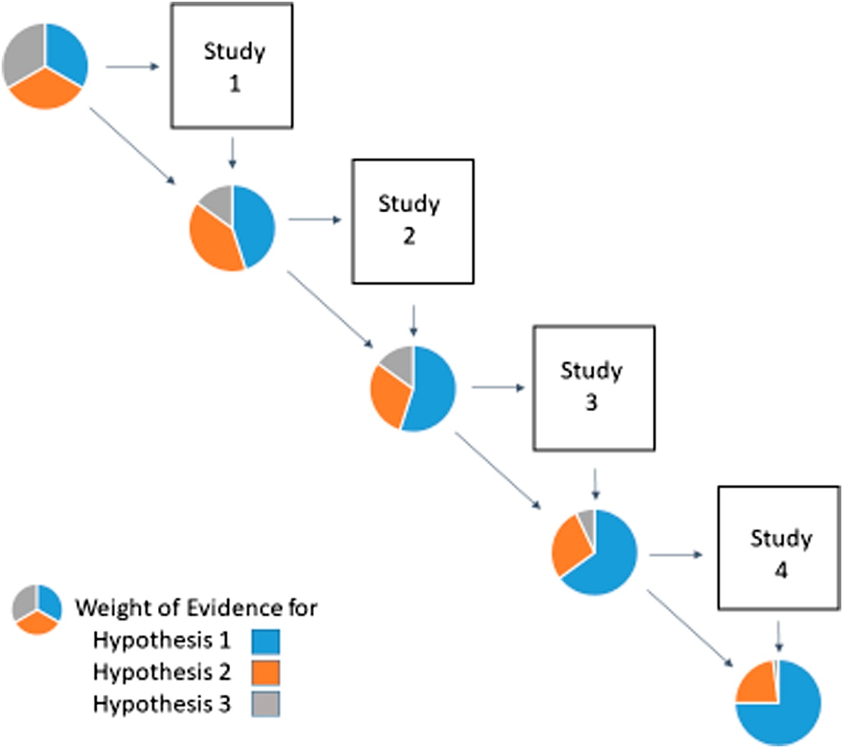
Accumulation of Evidence
Nichols, J. D., M. K. Oli, W. L. Kendall, and G. Scott Boomer. 2021. A better approach for dealing with reproducibility and replicability in science. Proceedings of the National Academy of Sciences of the United States of America 118 (7):1–5.

Slide 15
Defining R&R
 | Same Methods | Varied Methods
Same Data | Reproduction (Verification) | Reanalysis
Different Data | (Direct) Replication | Extension
Modified from Christensen, Freese and Miguel (2019, Table 9.1 pg 159)

Slide 16

Discuss
Reproducibility takes work to achieve… (as if publishing research is not work enough)
Why should we try? What are our individual and collective motivations?

Slide 17
Adjusting Learning Goals
Software-specific methods & extensions? No…
Learn and practice competencies for:
Reading published research
Research planning / design
Learning new (open source) software
Comparing results / assessing error and uncertainty
Reporting findings

Slide 18
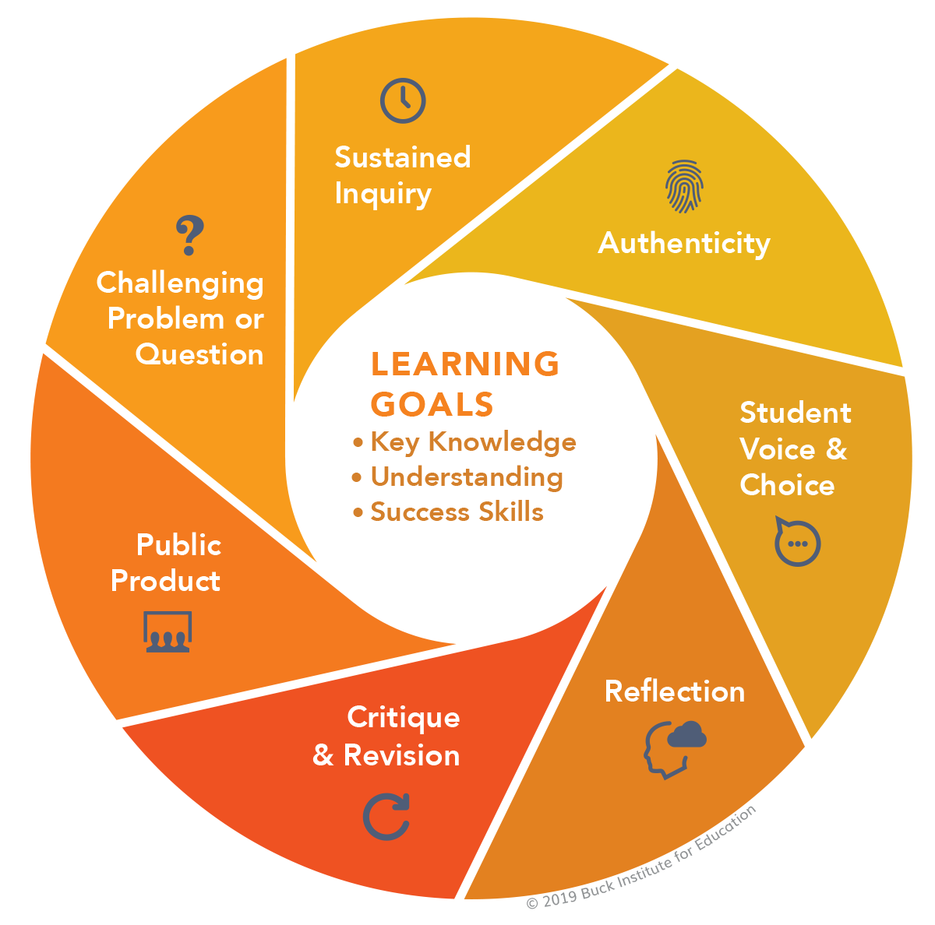
Project-Based Learning
Reproduction studies as project-based learning
Refocus learning goals on competencies
Improved engagement
Retain diversity in STEM
PBL Gold Standard: https://www.pblworks.org/what-is-pbl/gold-standard-project-design

Slide 19
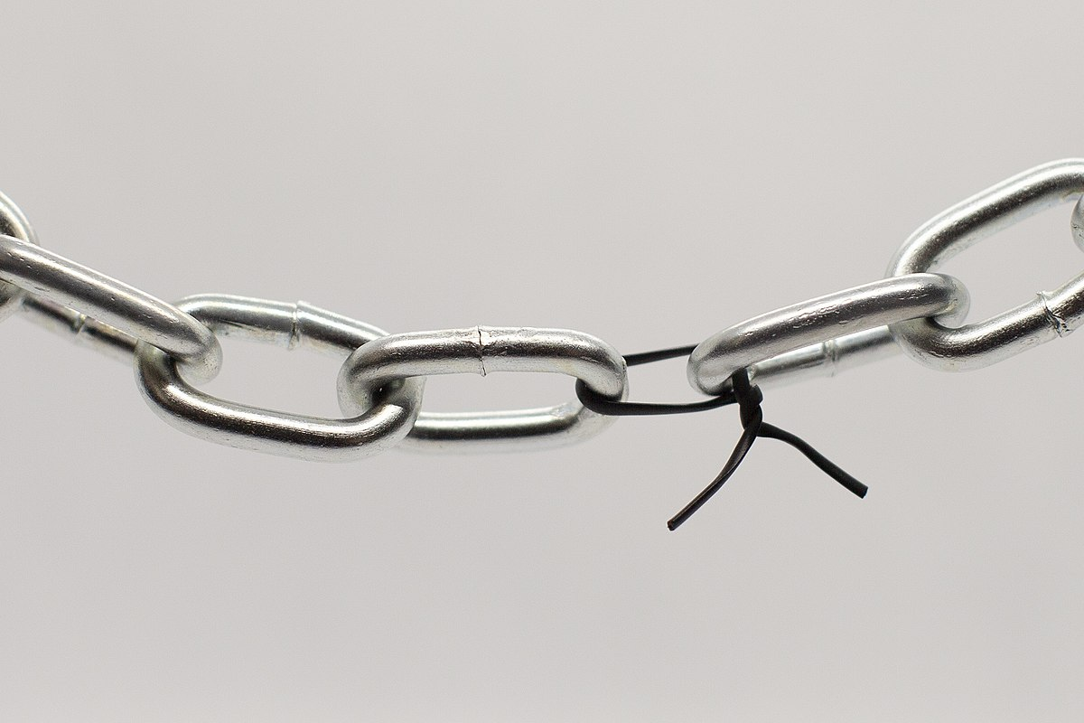
Many necessary conditions for Reproducibility

Slide 20
Improving R&R
Preregister research plan
Data
raw, preprocessed, and results
Code
computational notebook
legibility
Processing environment
Open source software
Specify or containerize environment
Metadata
Open Licenses
Persistent identifier (e.g. DOI, ORCID)
FAIR (findable, accessible, interoperable, reusable) principles
Version Tracking, living papers

Slide 21
State of the Research
Curriculum: https://gis4dev.github.io
Survey of Reproducibility Practices in Geography
Three COVID-19 Spatial Statistics Studies @ ASU
Vijayan
Spatial Bayesian COVID-19 Study @ ASU
Annals of Epidemiology

Slide 22







Infrastructure
Git, GitHub, Markdown & Jekyll
Template Repository
OSF / Figshare
Python Jupyter Notebooks / R Markdown
Docker, o2r.info
Cyberinfrastructure, e.g. CyberGISX
Data repository with access based on ethics review
R&R publishing guidelines / article types / exemplar studies
Notes:
Github & Git: Version tracking, collaborative platforms for projects & coding, website rendering & serving with Jekyll
Open Science Foundation – register preanalysis plans, reports, preprints, data, code, GitHub integration
Python Jupyter Notebooks; R Rmarkdown – computational notebooks, computing languages of data science with robust spatial extensions
Docker – containerize the computational environment
Cyberinfrastructure – shared high-performance computing environment for running Jupyter notebooks

Slide 23
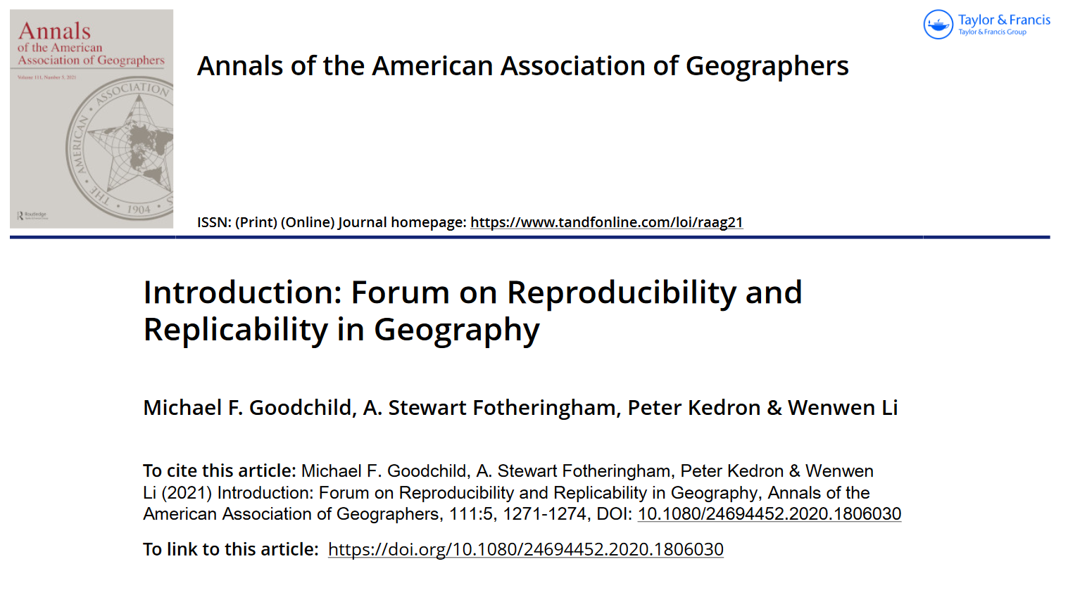


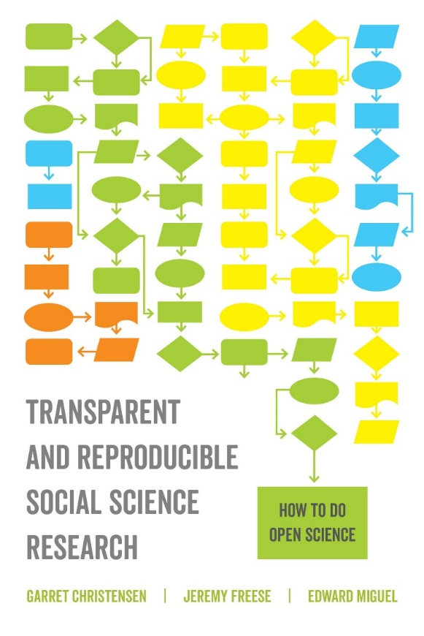
Literature

Slide 24
R&R in Geography
o2r: Konkol, Kray, Nüst, Pebesma
computational reproducibility
docker containers for executable research compendia
Wilson et al 5-star guide
1: Public repository & open license
2: Metadata & provenance
3: Complete, well structured metadata in open format
4. Geospatial standards for data and metadata (FGDC, ISO, OGC)
5. Processing Environment
Tullis & Kar
tensions between provenance, privacy, and data quality
Wainwright; Sui and Kedron
Epistemology and Reproducibility

Slide 25
Vision for R&R in Geography
Studies are preregistered, conducted with open source software, published with permissible licenses, and attached to executable compendia
Reproduction and replication studies are encouraged and published by preeminent journals
Students learn contemporary methods and classic theories through reproductions and replications
Students conduct and publish reproductions and replications

Slide 26
Git & GitHub

Slide 27
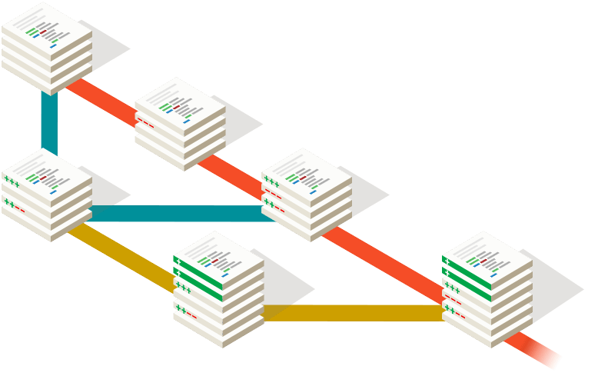
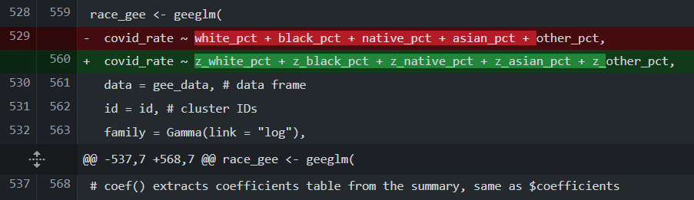
Challenges
Many versions of a research project over time
Complex project management, especially with alternative possible solutions
Collaborating with peers, research assistants
Tracking contributions to the research
Publishing / disseminating research compendium

Slide 28
Git & GitHub Features
GitHub is a software company implementing open source Git and hosting open repositories for free
Clone → copy personal or public repository to your computer
Fork → copy repository to your GitHub account, maintaining relationship to original repository
Commit → save a batch of changes to the repository
Fetch → query remote repository for committed changes
Pull → adopt committed changes from remote repository
Push → upload committed changes to GitHub.com repository
Pull Request → send batch of proposed changes to main repository/branch
Branch

Slide 29
GitHub Features
Markdown pages, including readme
LICENSE file
.CFF citation file
Jekyll integration for rendering webpages
Overleaf integration for authoring LaTeX papers
Issues, Discussions, and Wikis
Release versions, e.g. pre-analysis, preprint, submission, peer review, publishing
Private and Public Repositories, Organizations and Teams help manage access
GitHub Educators / Campus Advisors access free services

Slide 30
Tips & Tricks
One sentence on each new line
Commit frequently with intention: Git can “undo”

Slide 31
Template for R&R Research in HEGS

Slide 32
(Executable) Research Compendium
Computational Notebook: Narrative and Code
Data
Processing Environment
Metadata
License
Compile: Markdown → LaTeX → Publication & Website

Slide 33
Challenges
Challenge | Solution
Large files > 100mb not supported by Git Sensitive / proprietary / private data | .gitignore file set up to ignore private folders
Processing environment | Use R / Python to save environment; Repositories can be cloned into cyberinfrastructure platforms or docker containers
Re-usability

Slide 34
Pre-analysis Planning and Registration

Slide 35

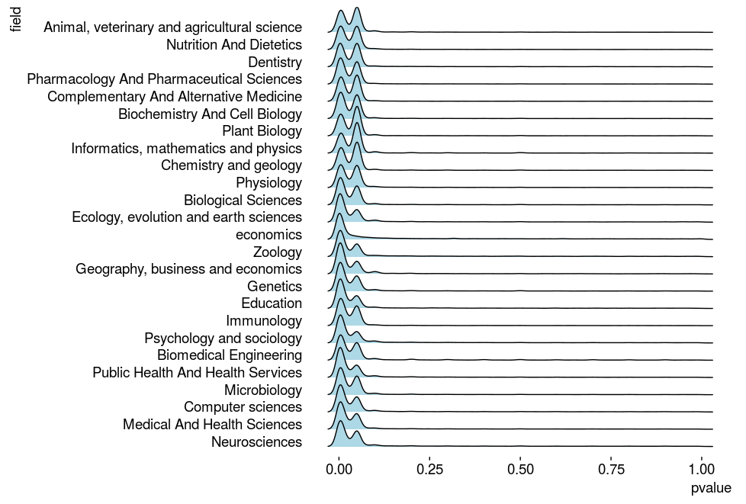

Pre-analysis Planning & Registration
Challenge: P-hacking, Research File Drawer

Slide 36
Pre-analysis Planning
Challenge: Reading scientific papers and translating into sufficiently detailed methods

Slide 37
Close & Critical Reading
Close reading of paper, highlighting
Data Sources / Inputs
Methodology and Data Processing / Methods / Tools
Intermediary and Final Results / Outputs
Workflow Diagram
Circular data layers
Rectangular processes

Slide 38
Discuss after Workflow & Preanalysis
What have we learned about Chakraborty’s analysis that we did not know based on reading the paper?
Why should we try? What are our individual and collective motivations?

Slide 39
OSF Registration
Holler, J., Kedron, P., An-Pham, D., Burt, D., & Zhou, J. (2022, June 2). Reproduction of Chakraborty 2021 Distribution of COVID-19 and intra-categorical analysis of people with disabilities.
https://doi.org/10.17605/OSF.IO/S5MTQ

Slide 40
OSF Registration
Log in with ORCID
Create a project (public or private)
Contributors
Link to GitHub repository (Add-ons → GitHub)
https://help.osf.io/article/211-connect-github-to-a-project
Go to Registrations → New Registration
Title
Description (abstract)
Contributors, Category: Procedure, License (BSD 3-Clause)
Will be archived & cannot be revised/retracted. Will appear under “registrations”
You may embargo the registration
Generate DOI for any public OSF project or project component

Slide 41
The Spatial Scan Statistic: SaTScan & SpatialEpi

Slide 42

SaTScan
Free
Not open source
Requires three input files and many parameters
https://www.satscan.org
Reproducible?
Requires manual use of multiple programs or…
Requires separate installation of SaTScan and system-specific commands from within R
SaTScan™ is a trademark of Martin Kulldorff. The SaTScan™ software was developed under the joint auspices of (i) Martin Kulldorff, (ii) the National Cancer Institute, and (iii) the New York City Department of Health and Mental Hygiene.

Slide 43
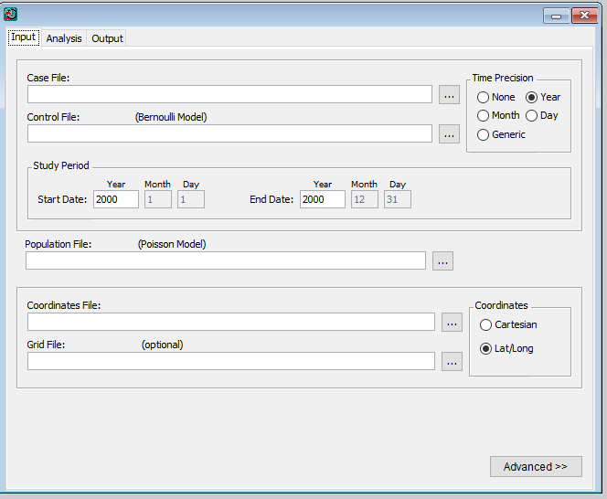
SaTScan Input

Slide 44
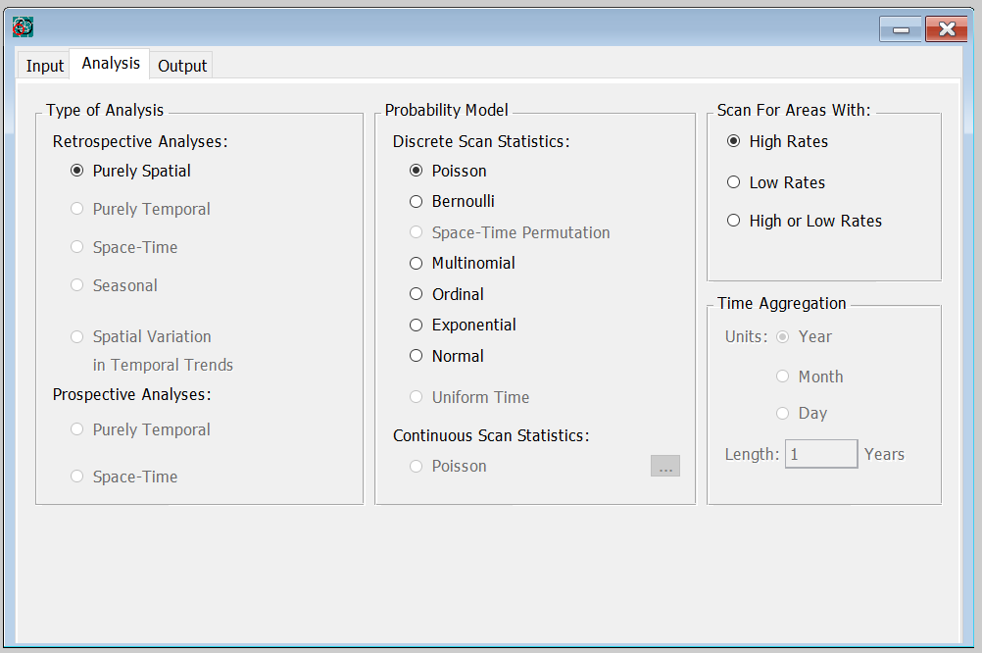
SaTScan Analysis

Slide 45
SaTScan Advanced Options
Check data for temporal extent
Check data for geographic extent
Define non-Euclidean spatial neighbors
Use network space

Slide 46
Discuss after Reproduction
What have we learned about Chakraborty’s analysis that we did not know based on the paper?
Why should we try? What are our individual and collective motivations?

Slide 47
RStudio
Graphic interface for R language
Panels:
Console
Source (code)
Environment (variables, data tables)
Files
Plots
Packages
Help

Slide 48
R / R Markdown Practices
open project in root directory of compendium to begin
load and install packages automatically
record the processing environment
use the here package for relative path names
write code in Rmarkdown or R scripts, not the console!
save API keys, passwords in local environment or scratch directory that is not version-tracked
discrete code chunks that view & check results
save important inputs and results as individual objects in .rds files: Do not rely on the .RData file or objects stored in the environment
save figures with code, not manually
tidyverse style guide & helper functions for legible code

Slide 49
Appreciation
National Science Foundation
UCGIS
Peter Kedron
Research Assistants & Independent Studies: Kufre Udoh, Derrick Burt, Sarah Bardin, Drew An-Pham, Emily Zhou, Maddie Tango

