Slide 1
Practicing and Teaching Reproducibility and Replicability in the Human-Environment and Geographical Sciences
Joseph Holler – Middlebury College
Peter Kedron – Arizona State University
Emily Zhou – Middlebury College

Slide 2
Support
NSF BCS-2049837 Transforming Theory-Building and STEM Education Through Reproductions and Replications in the Geographical Sciences
Geospatial Software Institute COVID-19 Fellows University of Illinois Urbana-Champaign National Science Foundation OAC-1743184

Slide 3
Defining R&R
 | Same Methods | Varied Methods
Same Data | Reproduction | Reanalysis
Different Data | Replication | Extension
Table modified from Christensen, Freese and Miguel (2019)

Slide 4
Defining R&R

Slide 5
Practicing R&R in HEGS
Reproducible research practices
Open science principles
Designing, implementing, and publishing reproduction studies and replication studies in geography

Slide 6
Teaching R&R in HEGS
Teaching competencies for doing reproducible research
Reproduction and replication studies with students in…
Methods courses
Independent or small groups
Research assistantships
Teaching geographic concepts and methods through reproduction and replication studies

Slide 7
Teaching R&R in HEGS
Software-specific methods & extensions? No…
Learn and practice competencies for:
Reading published research
Research planning / design
Learning new (open source) software
Comparing results / assessing error and uncertainty
Reporting findings

Slide 8
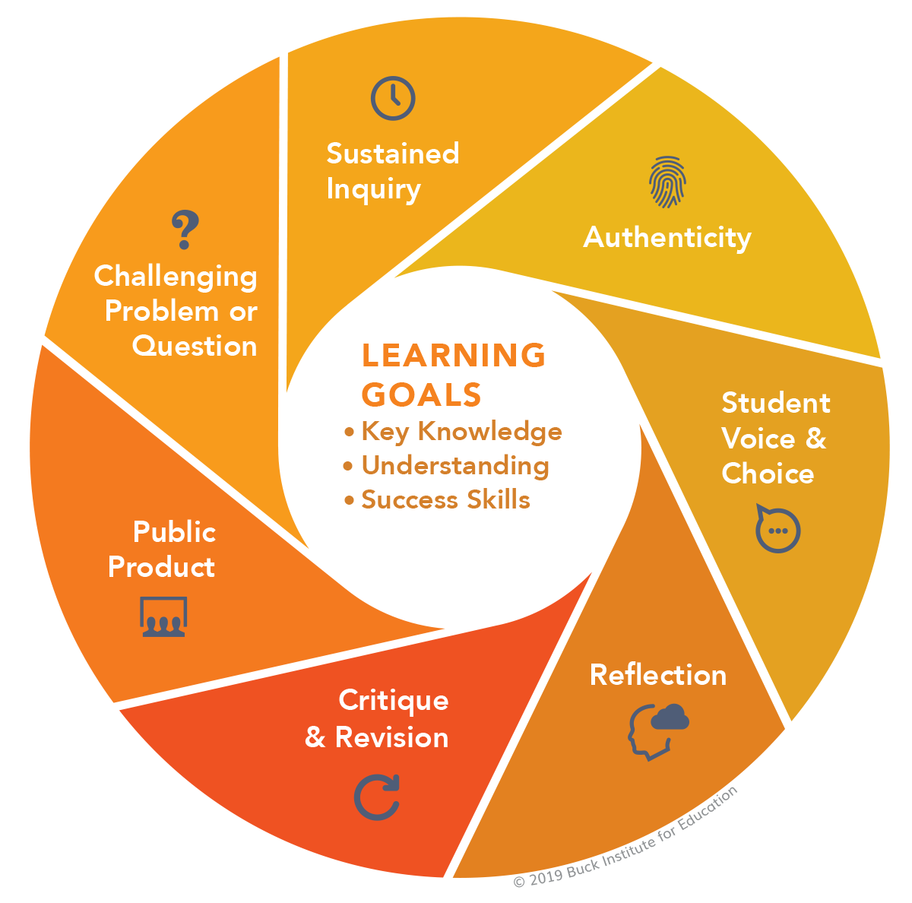
Teaching R&R in HEGS
Reproduction studies as project-based learning
Refocus learning goals on competencies
Improved engagement
Retain diversity in STEM

Slide 9
State of the Research
Annals of Epidemiology

Slide 10
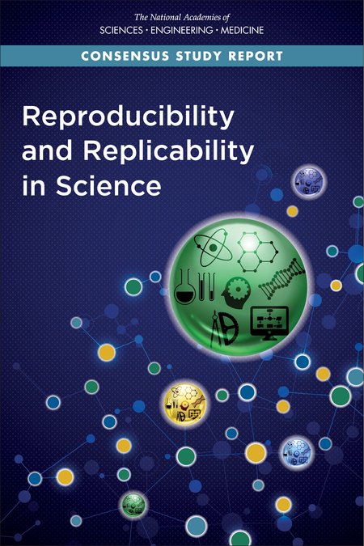
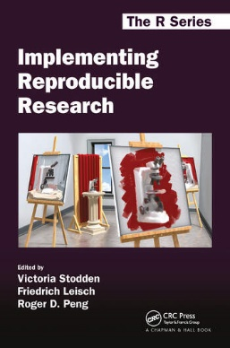
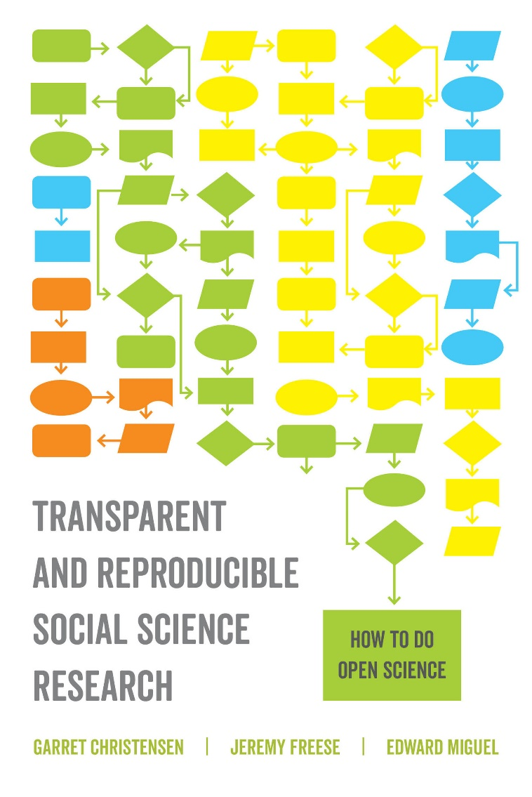
Reading R&R

Slide 11
Improving R&R
Preregister research plan
Data
raw, preprocessed, and results
metadata
Code
computational notebook
legibility
Processing environment
Open source software
Specify or containerize environment
Publish with open license & persistent identifier (e.g. DOI)

