Slide 1


Krishna School of Emerging
Technology & Applied Research
Department : INFORMATION TECHNOLOGY
Semester: 7th SEM
Capstone Project – I (Subject_Code)
Title: HEART FAILURE PREDICTION
Prepared by: HELEE RAO,AAYUSHI PATEL,BANSRI RAULJI
Internal Guide: MRS. NANDINI CHAUDHARY
Enrollment No : 2101202015,2101202001,210120200
Designation :

Slide 2
Presentation Outline
Introduction of the Research domain
Literature Review
Comparative Analysis
Identified Research Gap
Problem Statement
Objectives of the work
Proposed Methodology
Implementation Work (Details of Design, Working and Processes)
Result and Applications
Conclusion and Future Scope
Timeline Chart
References
Enrollment No:

Slide 3
Introduction of the Research domain
Heart failure (HF) is a leading cause of mortality and hospitalization worldwide, making early prediction of adverse events crucial for improving patient outcomes. In our study, we have developed and implemented various machine learning models and algorithms to predict heart failure outcomes using comprehensive physiological data from the eICU Collaborative Research Database (eICU-CRD). By leveraging advanced algorithms like LASSO regression, logistic regression, random forest, and CatBoost, we aim to identify the key risk factors and accurately predict hospital mortality in patients with heart failure. LASSO, a regularization technique, helps in selecting the most important features, while logistic regression and random forest offer robust classification techniques to predict heart failure events.In addition, we enhanced the performance of our models through hyperparameter optimization (HPO) and validated them using metrics such as the area under the receiver operating characteristic (ROC) curve, demonstrating their predictive accuracy. We further employed Shapley Additive Explanations (SHAP) to interpret the impact of individual features on the model predictions and used decision curve analysis (DCA) to assess the clinical utility of the models. Our approach combines multiple machine learning models, fine-tuning methods, and evaluation metrics to create a comprehensive and explainable heart failure prediction system.
Enrollment No:

Slide 4
Literature Review
Sr. No. | Paper Title | Publication | Year
1. | Predicting Mortality in Intensive Care Unit Patients With Heart Failure Using an Interpretable Machine Learning Model: Retrospective Cohort Study | Journal of Medical Internet Research | 2022
Objective:- To develop an interpretable model to predict mortality risk in ICU patients with heart failure and identify key prognostic factors.
Research outcomes:-The XGBoost model demonstrated the highest predictive performance for mortality risk among heart failure (HF) patients in the ICU, with an AUC of 0.824. This indicates that the model can effectively different bet. patients who will survive and those at risk of mortality during their ICU stay.support vector machine (SVM) model having the lowest performance (AUC = 0.701). decision curve analysis showed that the net benefit of the XGBoost model was superior at threshold probabilities ranging from 10% to 28%, meaning that the XGBoost model would lead to better clinical decision-making in this range of risk thresholds.SHapley Additive exPlanation (SHAP) method was used to interpret the XGBoost model,top 20 predictors were identified, with blood urea nitrogen being recognized as the most important predictor for heart failure mortality in ICU patients.The findings indicate that the integration of machine learning models like XGBoost, combined with interpretable frameworks like SHAPhelps optimize treatment plans and allocate ICU resources more effectively for heart failure patients.
Enrollment No:

Slide 5
Literature Review(Cont..)
Sr. No. | Paper Title | Publication | Year
2. | Development and validation of a prediction model based on machine learning algorithms for predicting the risk of heart failure in middle-aged and older US people with prediabetes or diabetes | Clinical cardiology | 2023
Objective:- To develop and validate a machine learning-based prediction model for assessing the risk of heart failure in patients with prediabetes or diabetes.
Research outcomes:-Random Forest (RF) model exhibited the best prediction performance with an AUC of 0.978, demonstrating a high level of accuracy in predicting HF risk.Multivariate logistic regression analysis identified several independent predictors of HF risk:Age: Older individuals are at higher risk.Poverty-to-income ratio: Lower income is associated with increased HF risk.Myocardial infarction condition: A history of heart attack is a significant predictor.Coronary heart disease condition: A history of coronary artery disease increases HF risk.Chest pain condition: A symptom linked with underlying heart issues, contributing to HF.Glucose-lowering medication use: The use of medications to control blood sugar is a predictor of HF in this population.The high predictive accuracy of the RF model suggests it could be integrated into clinical practice to help healthcare providers make informed decisions regarding patient care and preventive measures for those at high risk of HF.
Enrollment No:

Slide 6
Literature Review(Cont..)
Sr. No. | Paper Title | Publication | Year
3. | MACHINE LEARNING IN HEART FAILURE DIAGNOSIS , PREEDICTION, AND PROGNOSIS REVIEW | Article in Annals of Medicine and Surgery | 2024
Objective:- The paper explores the use of machine learning (ML) techniques for diagnosing, predicting, and managing heart failure (HF) across different patient populations, focusing on both traditional and emerging HF classifications.
Research outcomes:-ML techniques like Convolutional Neural Networks (CNNs), Long Short-Term Memory (LSTM), Support Vector Machines (SVMs), and XGBoost for heart failure diagnosis and prognosis. CNN achieved an AUC of 0.92, showing its robustness. The research emphasizes the need for more accurate models beyond logistic regression to handle the complexity of heart failure data, particularly for improved risk assessment and management.
Enrollment No:

Slide 7
Literature Review(Cont..)
Sr. No. | Paper Title | Publication | Year
4. | Heart Failure Prediction with Machine Learning: A Comparative Study | Journal of Physics: Conference series | 2021
Objective:- The objective was to improve mortality risk prediction in heart failure patients by utilizing machine learning to analyze diverse patient data, thus enhancing the accuracy beyond traditional statistical methods.
Research outcomes:-The researchers created the MARKER-HF model, which uses a decision tree method to analyze patient data more thoroughly than traditional models. The model performed well, achieving high accuracy (AUC of 0.88) in predicting patient outcomes. It was tested on different groups, showing similarly strong results. This approach helps better assess patient risk by accounting for complex interactions that traditional methods often miss.The dataset used included 5,822 patients.
Enrollment No:

Slide 8
Literature Review(Cont..)
Sr. No. | Paper Title | Publication | Year
5. | Deep learning prediction of survival in patients with heart failure using chest radiographs | International Journal of Cardiovascular Imaging | 2024
Objective:- To develop and validate a deep learning model using chest radiographs to predict survival in heart failure patients, and to compare its performance with traditional clinical and imaging survival prediction models.
Research outcomes:-For model performance, the DLSPCXR model had an AUC of 0.757 for 5-year survival, showing better prediction capabilities compared to traditional Cox models. However, DLSPinteg surpassed all other models with an AUC of 0.826, indicating it was the optimal approach. Kaplan-Meier analysis further validated these findings, showing that key clinical features significantly impacted survival, especially among patients with higher levels of NT-ProBNP and elevated cardiothoracic ratios in X-rays.The study concluded that deep learning applications using chest radiographs, when combined with selected clinical metrics, offer a powerful tool for survival prediction in heart failure patients, outperforming traditional imaging or clinical Cox models
Enrollment No:

Slide 9
Literature Review(Cont..)
Sr. No. | Paper Title | Publication | Year
6. | An Explainable Transformer-Based Deep Learning Model for the Prediction of Incident Heart Failure | IEEE Journal of Biomedical and Health Informatics | 2022
Objective:- To develop an accurate and explainable deep learning model for predicting the incidence of heart failure using electronic health records.
Research outcomes:-The model achieved an (AUC) of 0.93, indicating excellent performance in distinguishing between patients who will develop heart failure and those who will not.The area under the precision-recall curve (PR-AUC) was 0.69, suggesting that the model also performed well in identifying true positive cases of heart failure.The core method used was a Transformer-based deep learning model. Transformers, originally designed for natural language processing tasks, are known for their ability to handle sequential data. In this case, the model was adapted to process longitudinal patient data from electronic health records (EHRs), including diagnoses and medications.This method involves systematically removing specific features (such as diagnoses, medications, or temporal data) to assess their impact on model performance. The analysis helps identify which features are critical for predicting heart failure.This is a technique used to explain the model's predictions by perturbing (modifying) the input features and observing how these changes affect the model’s output.
Enrollment No:

Slide 10
Comparative Analysis
Table 1: Comparative Analysis Table
Sr No. | Paper Title | Model/Method | Finding/Findings
1. | Predicting Mortality in Intensive Care Unit Patients With Heart Failure Using an Interpretable Machine Learning Model: Retrospective Cohort Study | Extreme Gradient Boosting (XGBoost) model SHapley Additive exPlanation (SHAP) method for model interpretation Retrospective cohort study design using the eICU Collaborative Research Database (eICU-CRD) | The XGBoost model achieved an area under the curve (AUC) of 0.824, indicating high predictive performance for in-hospital mortality among heart failure patients. The average blood urea nitrogen level was identified as the most important predictor of mortality.
2. | Development and validation of a prediction model based on machine learning algorithms for predicting the risk of heart failure in middle-aged and older US people with prediabetes or diabetes | Machine learning algorithms, specifically Random Forest (RF) and others,Univariate and multivariable logistic regression analysis to identify independent risk factors,Receiver Operating Characteristic (ROC) curves, calibration curves, decision curve analysis, and Bootstrap resampling for performance evaluation | The independent predictors of heart failure included age, poverty-to-income ratio, myocardial infarction history, coronary heart disease, chest pain, and glucose-lowering medication use,The Random Forest model demonstrated the best predictive performance with an AUC of 0.978.
Enrollment No:

Slide 11
Comparative Analysis (Cont.)
Table 2: Comparative Analysis Table
Sr No. | Paper Title | Model and Dataset | Finding/Findings
3. | MACHINE LEARNING IN HEART FAILURE DIAGNOSIS , PREEDICTION, AND PROGNOSIS REVIEW | Convolutional Neural Networks (CNNs),Long Short-Term Memory (LSTM)and Support Vector Machines (SVMs) and XGBoost | CNNs Used to differentiate HF patients based on ECG signals.LSTM Applied to predict risk in heart failure with reduced ejection fraction patients.SVMs & XGBoost Utilized for mortality prediction and ICU outcomes.
4. | Heart Failure Prediction with Machine Learning: A Comparative Study | MARKER-HF model, utilizing a boosted decision tree algorithm | The model achieved an AUC of 0.88 in its initial cohort and demonstrated strong external validation with AUCs of 0.84 and 0.81 in separate populations.
Enrollment No:

Slide 12
Comparative Analysis (Cont.)
Table 2: Comparative Analysis Table
Sr No. | Paper Title | Model and Dataset | Finding/Findings
5. | Deep learning prediction of survival in patients with heart failure using chest radiographs | Deep Learning Survival Prediction Model using Chest X-ray (DLSPCXR) Multivariate Cox Analysis.Development of integrated models like DLSPinteg combining clinical parameters with deep learning outputs. Time-Dependent Area Under the Curve | DLSPCXR performed better at predicting 5-year survival in patients with heart failure compared to the imaging Cox model in the validation cohort (AUC: 0.757 vs. 0.561). The integrated DLSPinteg model (combining clinical parameters and DLSPCXR) was the most optimal, outperforming both clinical and imaging Cox models, as well as DLSPCXR alone (AUC: 0.826).
6. | An Explainable Transformer-Based Deep Learning Model for the Prediction of Incident Heart Failure | A Transformer-based deep learning model is a type of neural network architecture,it has self-attention mechanism. it takes patient's longitudinal health record—diagnoses, medications, hospital encounters, and their timing—and make accurate predictions about future events by learning patterns in the data. The self-attention mechanism is particularly helpful because it allows the model to focus on important parts of a patient's medical history while ignoring less relevant information. | The model achieved an area under the receiver operating characteristic curve (AUC) of 0.93 and an area under the precision-recall curve (AUC) of 0.69.,Medication was identified as a significant predictor, with calendar year being more crucial than chronological age. ,New risk factors related to HF were identified, enhancing existing knowledge and addressing gaps in traditional expert-driven models.
Enrollment No:

Slide 13
Identified Research Gap
1. XGBOOST model performed with SHAP model lack interpretability , You get the prediction, but figuring out exactly how the model arrived at that prediction can be difficult.
2.Random forest along with logistic regression makes an effective predictive model for heart failure risk specifically in middle-aged and older individuals with prediabetes or diabetes. There is a need for more interpretative methods to explain how specific features contribute to predictions, enhancing clinicians' and patients' trust in the model.The study identifies risk factors but does not evaluate how different interventions (lifestyle modifications, medication adherence) may impact heart failure risk.
3.Convolutional Neural Networks (CNNs),Long Short-Term Memory (LSTM)and Support Vector Machines (SVMs) and XGBoost:There is a gap in integrating multi-omics data (genomics(dna), proteomics(protiens), metabolomics(metabloic state) and other non-clinical data (e.g., social determinants of health) into predictive models for heart failure.
4. Future research could focus on specific patient populations, such as those with particular comorbidities (e.g., chronic kidney disease, diabetes). The study emphasizes the advantages of the MARKER-HF model but may not provide a comprehensive comparison with other existing heart failure prediction models.the study mentions a boosted decision tree algorithm, which may still present interpretability challenges.
5.Future research could compare the predictive power of deep learning models using other imaging modalities, such as echocardiograms or cardiac MRIs. a gap in incorporating multi-omics data.(DLSPCXR).
6. The study focuses on electronic health records, potentially overlooking valuable biological data from multi-omics sources (genomics, proteomics, metabolomics).The identification of medication as a significant predictor raises questions about the influence of specific types of medications or treatment regimens.TRANSFORMER-BASED DL MODEL.
Enrollment No:

Slide 14
PROBLEM STATEMENT
Despite advancements in predictive modeling for heart failure using machine learning and deep learning techniques, existing models often lack generalizability and comprehensive integration of diverse data sources. This research aims to develop a robust predictive framework that combines boosted decision trees, convolutional neural networks (CNNs), and transformer-based models,XGBOOST leveraging multi-omics data, electronic health records to accurately predict incident heart failure and survival outcomes in diverse patient populations. By enhancing model explainability and validation across multiple cohorts, this study seeks to address critical gaps in current methodologies and improve clinical decision-making for heart failure management.
Enrollment No:

Slide 15
OBJECTIVES OF WORK
MODEL DEVELOPMENT:Develop an integrated predictive framework combining boosted decision trees, convolutional neural networks (CNNs), and transformer-based models to predict incident heart failure and survival outcomes.
Data Integration:Leverage diverse data sources, including multi-omics data, electronic health records, and chest radiographs, to enhance the model’s accuracy and comprehensiveness.
Feature Importance and Explainability:Implement advanced explainability techniques (e.g., SHAP, LIME) to provide insights into feature contributions, improving the interpretability of the predictive model for clinical application.
Generalizability Assessment:Evaluate the model’s performance across diverse patient populations and multiple geographical regions to ensure robustness and generalizability of the findings.
Use data collected over time to look at how heart failure risk factors change and how these changes affect the model's ability to predict heart failure accurately.
Test the combined model in actual hospitals and clinics to see how well it works in helping doctors make better decisions and improve patient care.
Look for and confirm new factors that can increase the risk of developing heart failure or affect how it progresses, to improve our knowledge of the condition
Enrollment No:

Slide 16
PROPOSED METHODOLOGY
To implement an XGBoost model and interpret its predictions using SHAP (SHapley Additive exPlanations) .For XGBoost, which is a complex, non-linear ensemble model, SHAP computes how much each feature value pushes the prediction from the average (or baseline) prediction, helping to reveal the model’s inner workings.SHAP may reveal that higher age (positive SHAP value) increases the likelihood of heart failure, while a high income (negative SHAP value) decreases it. SHAP can show how a combination of high blood pressure and age might synergistically increase heart failure risk more than either feature alone.This interpretability can help clinicians understand the reason behind the prediction, making it easier to use the model’s insights for informed clinical decisions.
Enrollment No:

Slide 17
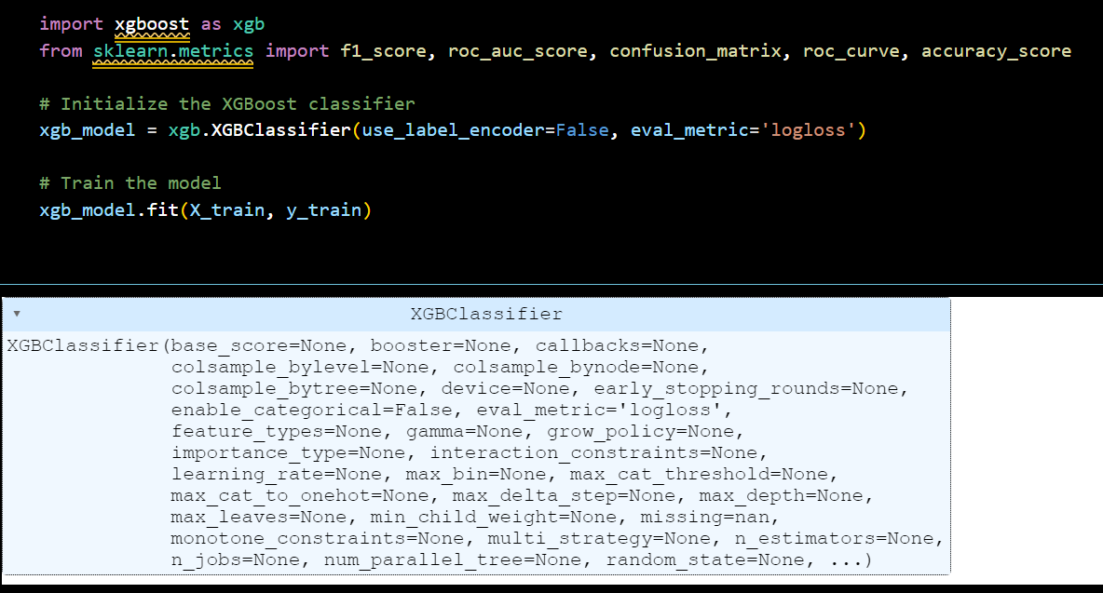
IMPLEMENTATION WORK
Enrollment No:

Slide 18
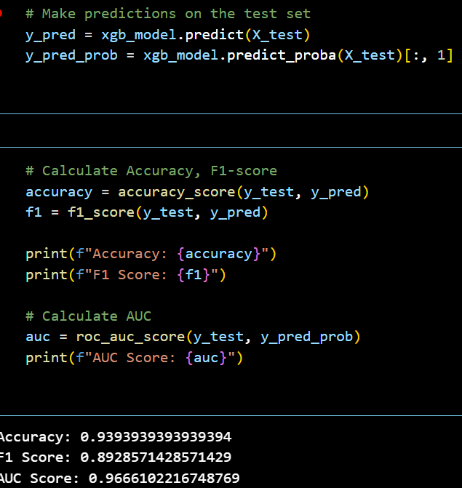
IMPLEMENTATION
Enrollment No:

Slide 19
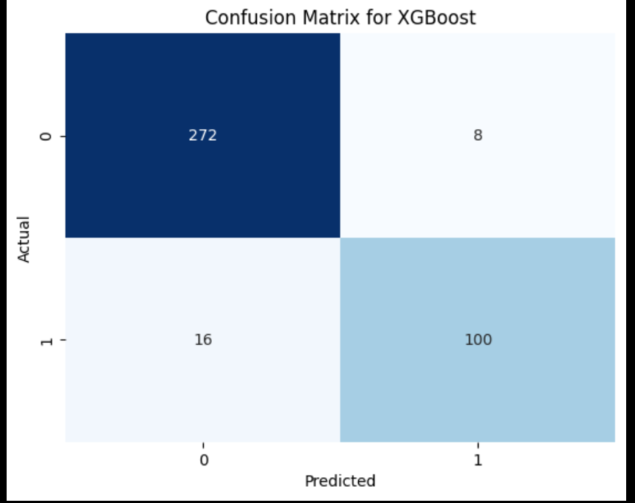
IMPLEMENTATION
Enrollment No:

Slide 20
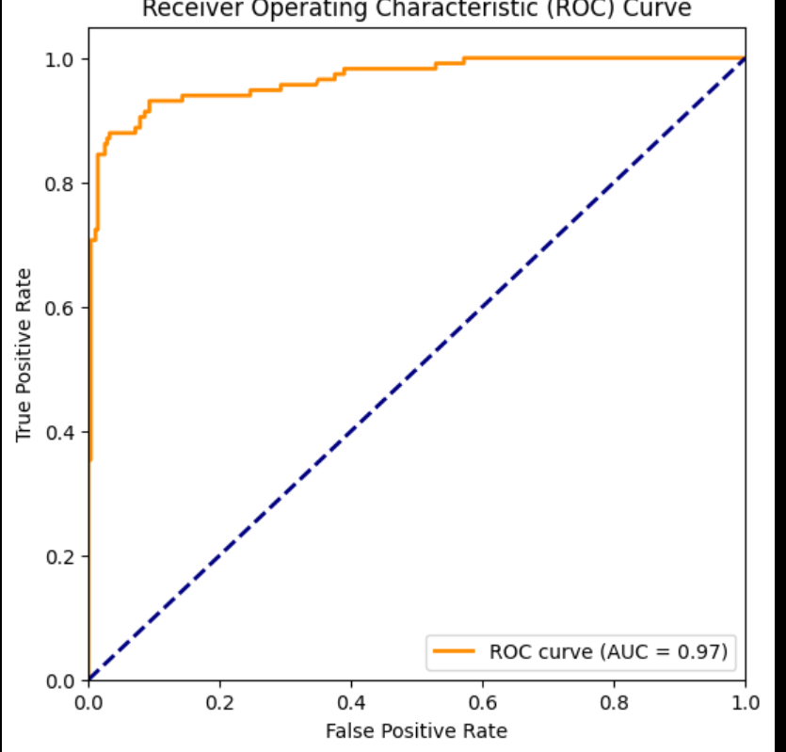
IMPLEMENTATION
Enrollment No:

Slide 21
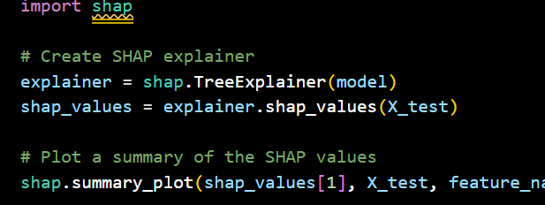
IMPLEMENTATION
Enrollment No:

Slide 22
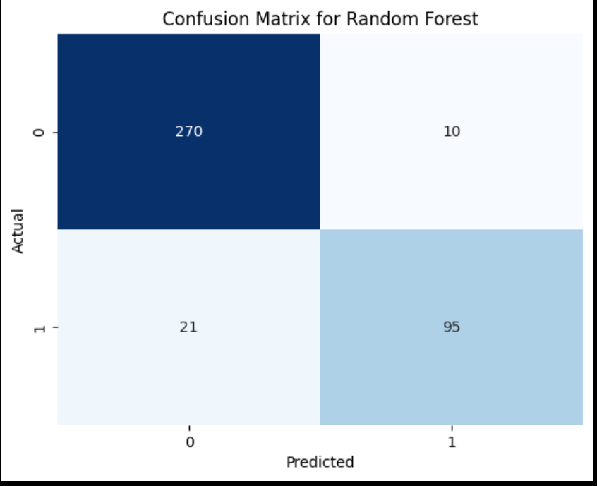
IMPLEMENTATION
Enrollment No:

Slide 23
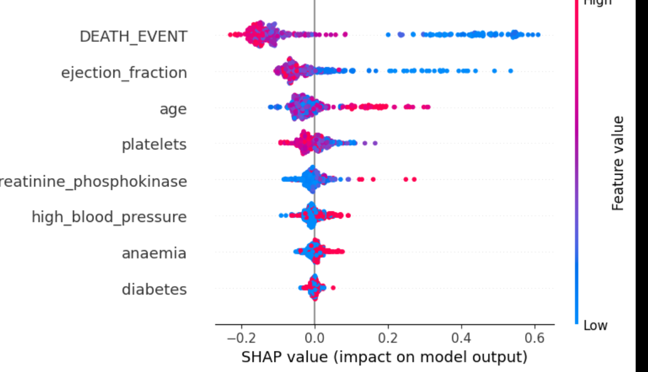
IMPLEMENTATION
Enrollment No:

Slide 24
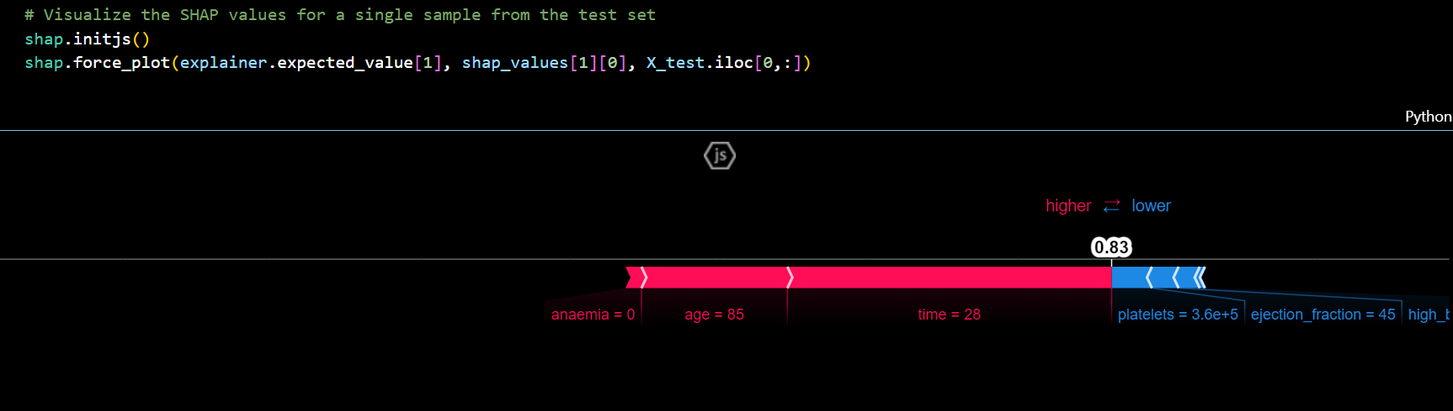
IMPLEMENTATION
Enrollment No:

Slide 25
RESULTS AND APPLICATIONS
XGBOOST: ACCURACY-0.939
F1 SCORE-0.892
ROC CURVE-0.97
AUC-0.966
CONFUSION MATRIX-[[272 8]
[ 16 100]]
SHAP: ACCURACY-0.921
F1 SCORE-0.859
ROC CURVE-0.97
AUC-0.967
CONFUSION MATRIX-[[270 10]
[ 21 95]]
IN COMPARISION , XGBOOST PERFORMS HIGH ACCURACY HEART FAILURE PREDICTION THAN OTHER DEEP LEARNING MODELS .
THE SECOND MOST PREFFERED ACCURACY RUNNING MODEL INCLUDES SHAP MODEL.
WE USED XGBOOST FOR BETTER ACCURACY AND SHAP TO TRAIN AND EXPERIMENT WITH THE DATASET IN ORDER TO GET VARIOUS OUTPUTS TO KNOW HOW HF PREDICTION WORKS.
Enrollment No:

Slide 26
RESULT AND APPLICATIONS
The model can identify patients at high risk of heart failure before symptoms become severe
Hospitals and clinics can use this model to create a high-risk watchlist, allowing healthcare providers to prioritize monitoring and resources for those at greatest risk.
SHAP values provide insights into the factors driving each patient’s risk, allowing clinicians to create tailored treatment plans.
For example, if the model indicates that high blood pressure is a significant contributor to an individual's heart failure risk, targeted interventions like antihypertensive medications and lifestyle adjustments can be emphasized.
For patients who have already experienced heart failure, the model can help predict the likelihood of rehospitalization by identifying high-risk cases.
SHAP-driven explanations of individual risk factors can be shared with patients to educate them on how their lifestyle or health metrics contribute to heart failure risk.
Enrollment No:

Slide 27
CONCLUSION AND FUTURE SCOPE
The heart failure prediction model built with XGBoost and interpreted through SHAP offers a powerful, interpretable solution for assessing heart failure risk among patients. By integrating advanced machine learning with interpretability tools, the model not only provides accurate predictions but also makes these predictions understandable for clinicians. The SHAP explanations reveal critical risk factors at both the global and individual levels, which helps in personalizing treatment plans, prioritizing patients at higher risk, and guiding proactive interventions. Overall, this model represents a significant advancement in predictive healthcare, showing potential to improve patient outcomes, optimize resource allocation, and reduce healthcare costs associated with heart failure.
Enrollment No:

Slide 28
CONCLUSION AND FUTURE SCOPE
Integrating data from genomics, proteomics, and metabolomics could enhance model accuracy by capturing deeper biological insights, allowing for even more personalized risk assessment and interventions.
Testing the model in diverse clinical settings and across broader populations will help validate its effectiveness and generalizability.
Embedding the model into EHR systems can facilitate real-time risk assessments, enabling continuous monitoring of patients’ heart failure risk as new data (e.g., lab results, clinical notes) becomes available.
Deploying a simplified version of the model in mobile apps or web tools could engage patients directly, helping them understand their own risk factors and manage lifestyle changes.
Insights from this model could inform public health policies and preventative health programs targeting prevalent heart failure risk factors, helping reduce the overall disease burden in the community.
Enrollment No:

Slide 29
METHODS TESTED
1. Random Forest
An ensemble learning method that builds multiple decision trees and combines their predictions for more robust results. It’s commonly used for classification tasks, offering good accuracy, interpretability, and resistance to overfitting.
2. Logistic Regression
A statistical model for binary classification, which estimates the probability of a binary outcome based on input features. In heart failure prediction, it’s useful for identifying the likelihood of heart failure presence but may struggle with nonlinear relationships in complex data.
3. SHAP (SHapley Additive exPlanations)
An interpretability method that assigns feature importance values by calculating the contribution of each feature to individual predictions. In heart failure prediction, SHAP helps clarify the impact of each risk factor in models like XGBoost or Random Forest.
4. XGBoost (Extreme Gradient Boosting)
A boosting algorithm that builds an ensemble of weak learners (decision trees) to enhance model accuracy and handle structured data effectively. It’s fast, powerful, and often used for high-performance predictive models, including heart failure risk.
5. MARKER-HF Model
A specific model for heart failure prediction using boosted decision trees. It addresses the complexity of patient interactions to predict mortality risk, validating across multiple cohorts to ensure robustness.
6. Transformer-Based Model
A deep learning model designed to capture sequential dependencies in data. Transformers excel in processing sequential data, like electronic health records (EHR), for heart failure prediction by leveraging temporal patterns over time.
7. SVM (Support Vector Machine)
A supervised learning algorithm that finds a hyperplane to separate classes. In heart failure prediction, SVM is often used when data is linearly separable but may be less effective for highly complex or large datasets.
8. Neural Network
A model composed of interconnected layers mimicking the human brain. In heart failure prediction, neural networks capture complex relationships but often require more data and tuning to achieve optimal performance.
9. LSTM (Long Short-Term Memory)
A type of recurrent neural network (RNN) suited for time-series data, LSTMs capture long-term dependencies. For heart failure, LSTMs process patient data over time, predicting outcomes based on historical health records.
10. Deep Learning Survival Prediction Model using Chest X-ray (DLSPCXR)
A deep learning model that predicts heart failure survival using chest X-rays. By combining image data with clinical factors, DLSPCXR provides a novel, non-invasive prediction of heart failure prognosis, outperforming traditional imaging-based Cox models.
Enrollment No:

