Slide 1
NDIC + IADI
Deposit Insurance Analysis
Benchmarking Nigeria's NDIC Against IADI Core Principles and Peer Member DICs (2010–2024)
Promise O. Amhanesi
Banking & Finance · Philomath University Abuja | AMHANi Enterprise
github.com/HELLO-AMHANI/ndic-iadi-deposit-insurance-analysis

Slide 2
1. The Problem
Why benchmarking NDIC against IADI matters
→ Nigeria's NDIC protects depositors in 26 commercial banks but how robust is the fund?
→ IADI publishes Core Principles for Effective Deposit Insurance: the global standard.
→ No peer-reviewed quantitative benchmarking of NDIC against IADI exists for 2010–2024.
→ This project fills that gap using Python, SQL, Excel, and machine learning.
Promise O. Amhanesi | NDIC + IADI Analysis | 2024–25

Slide 3
2. IADI Core Principles Framework
The 7 principles this project benchmarks against
CP1
CP2
CP3
Public Policy Objectives
Mandate & Powers
Governance
CP4
CP5
CP6
Safety-Net Relationships
Membership & Coverage
Fund Management
CP7
Public Awareness
Promise O. Amhanesi | NDIC + IADI Analysis | 2024–25

Slide 4
3. Data Sources & Methodology
Cross-functional: Python · SQL · Excel · GitHub
NDIC Annual Reports
2010–2024 · 15 rows · manually extracted from PDF
ndic.gov.ng/publications
IADI Annual Survey
14 member countries · 15 years · 210 rows
iadi.org
World Bank GFDD
GDP growth, inflation, FX rate, GDP per capita
databank.worldbank.org
CBN Stat. Bulletin
Banking sector credit, monetary policy context
cbn.gov.ng
Promise O. Amhanesi | NDIC + IADI Analysis | 2024–25

Slide 5
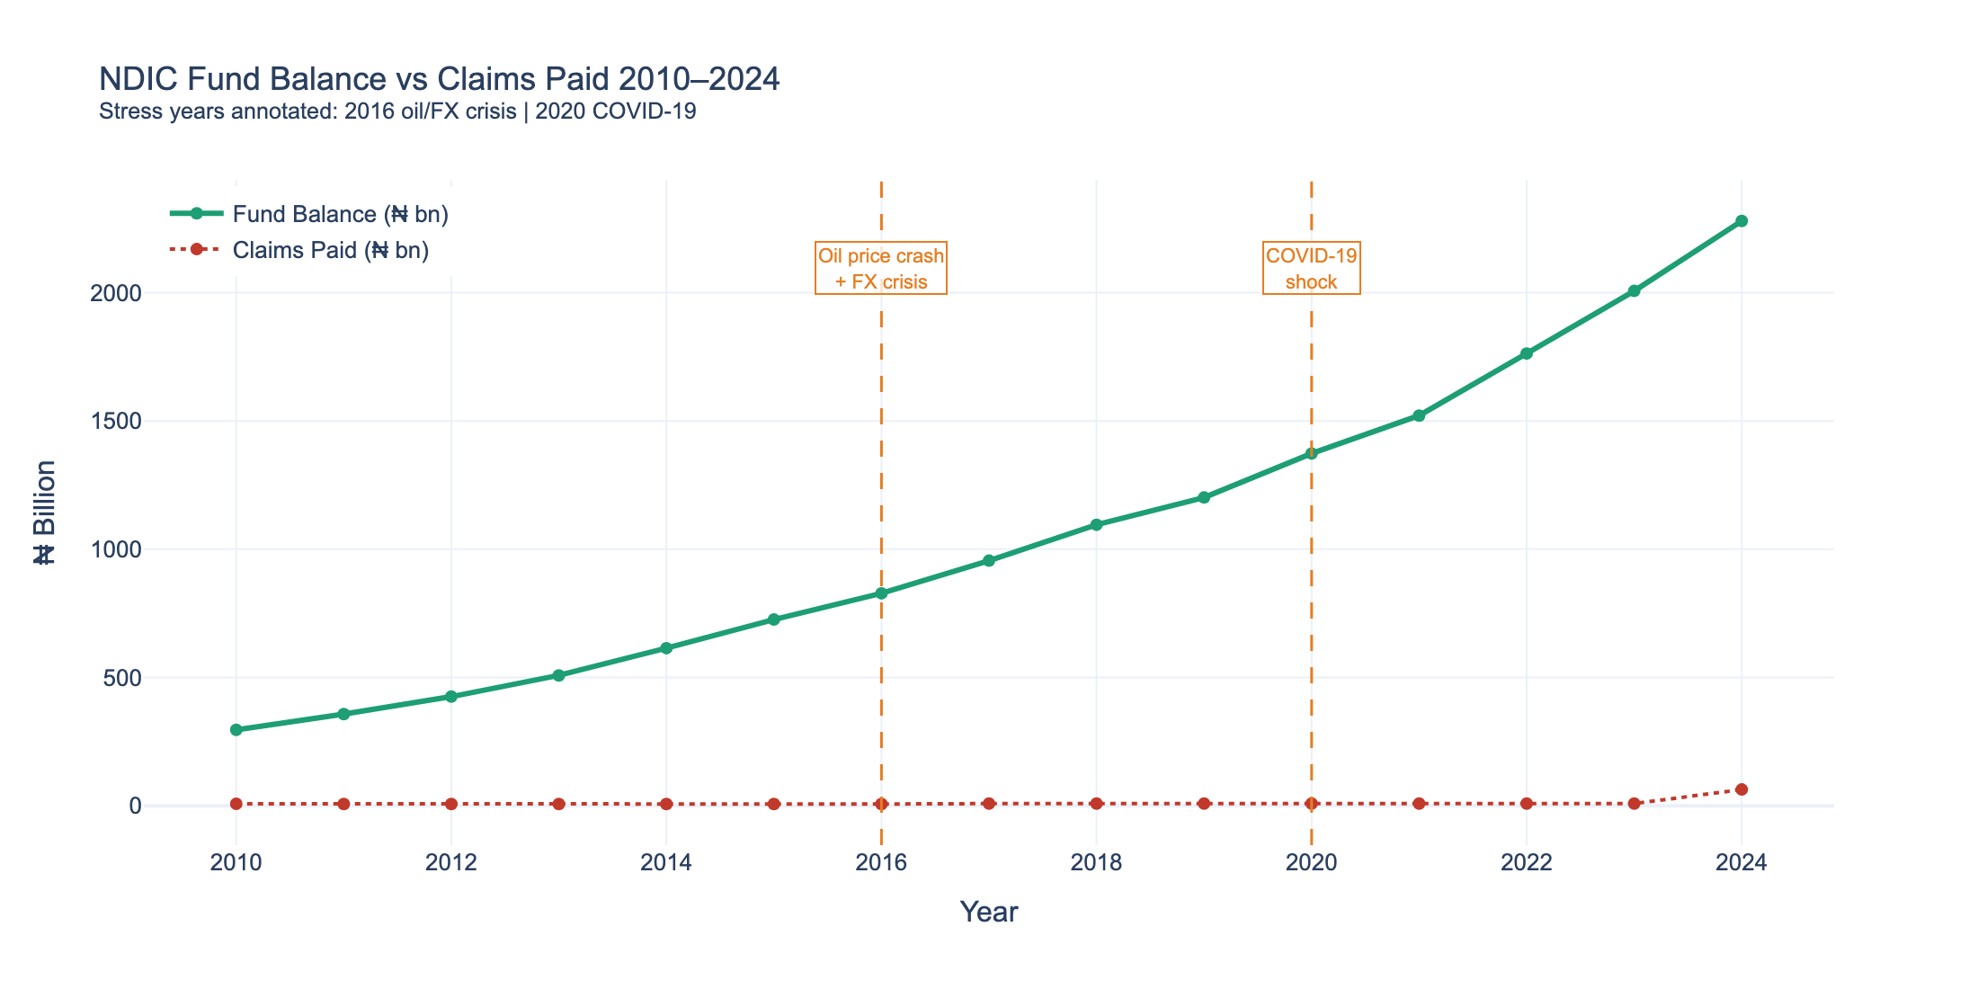
4. EDA Highlights
Key patterns in NDIC fund performance 2010–2024
Key Finding:
• Fund grew 7.7× from ₦295bn (2010) to ₦2,279bn (2024)
• Claims flat at ~₦8.3bn per year from 2012–2023
• 2024: claims spike to ₦63.2bn — Naira devaluation shock
• 2016 oil crisis and 2020 COVID visible in trend
• Premium rate stable: 0.40–0.64% of total deposits
Promise O. Amhanesi | NDIC + IADI Analysis | 2024–25

Slide 6
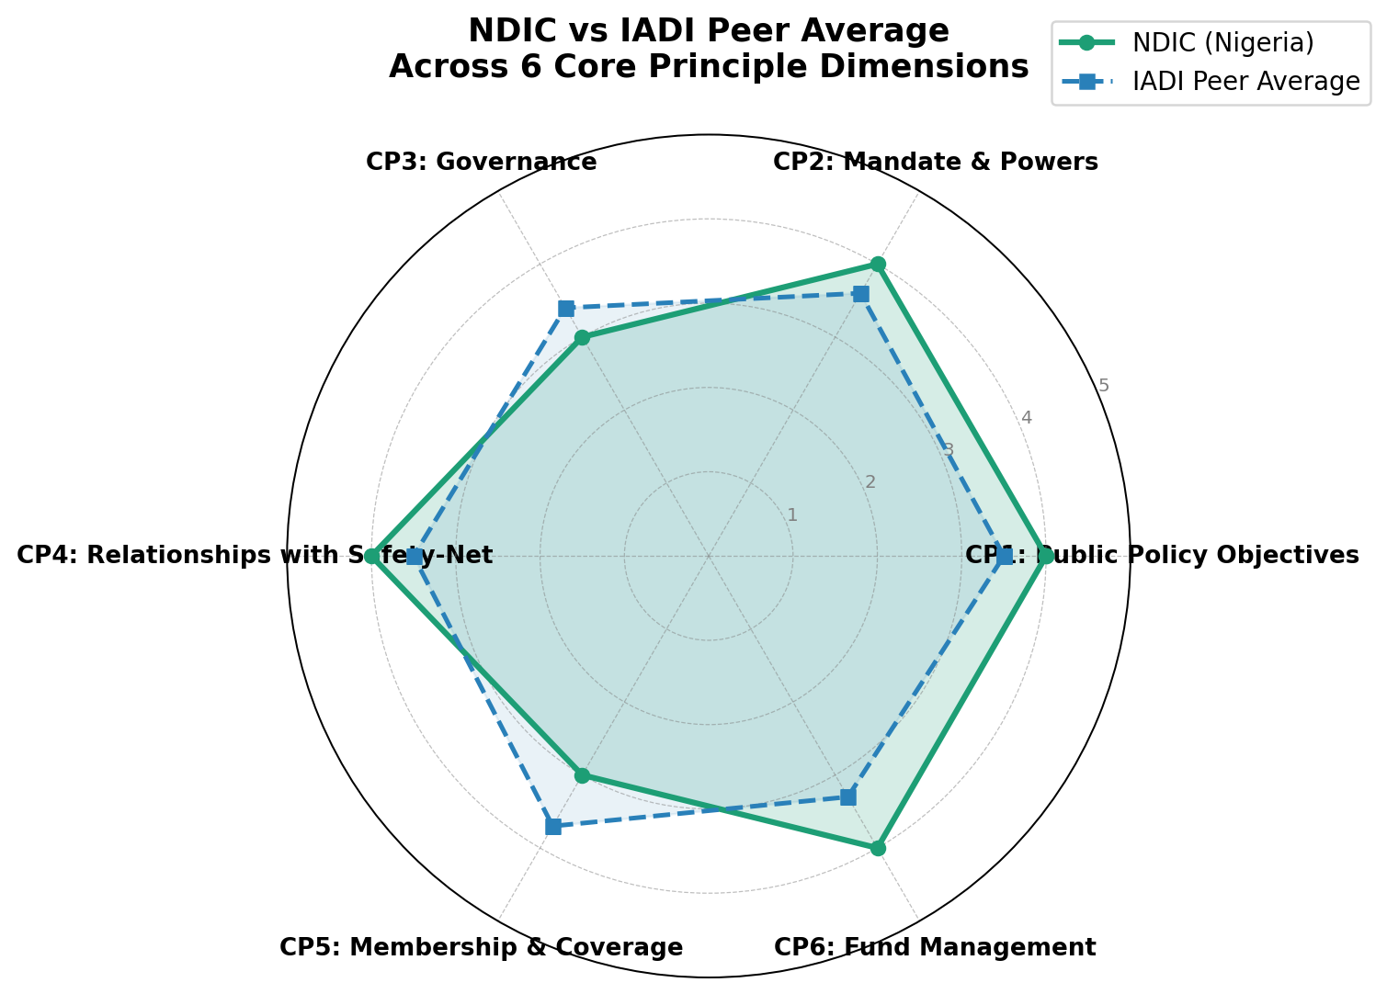
5. IADI Benchmarking Scorecard
NDIC scored 1–5 against each IADI Core Principle
CP1: Policy Objectives
4/5
✅ Above avg
CP2: Mandate & Powers
4/5
✅ Above avg
CP3: Governance
3/5
⚠️ Below avg
CP4: Safety-Net
4/5
✅ Above avg
CP5: Coverage
3/5
🔴 Below avg
CP6: Fund Management
4/5
✅ Above avg
CP7: Public Awareness
3/5
⚠️ Below avg
Promise O. Amhanesi | NDIC + IADI Analysis | 2024–25

Slide 7
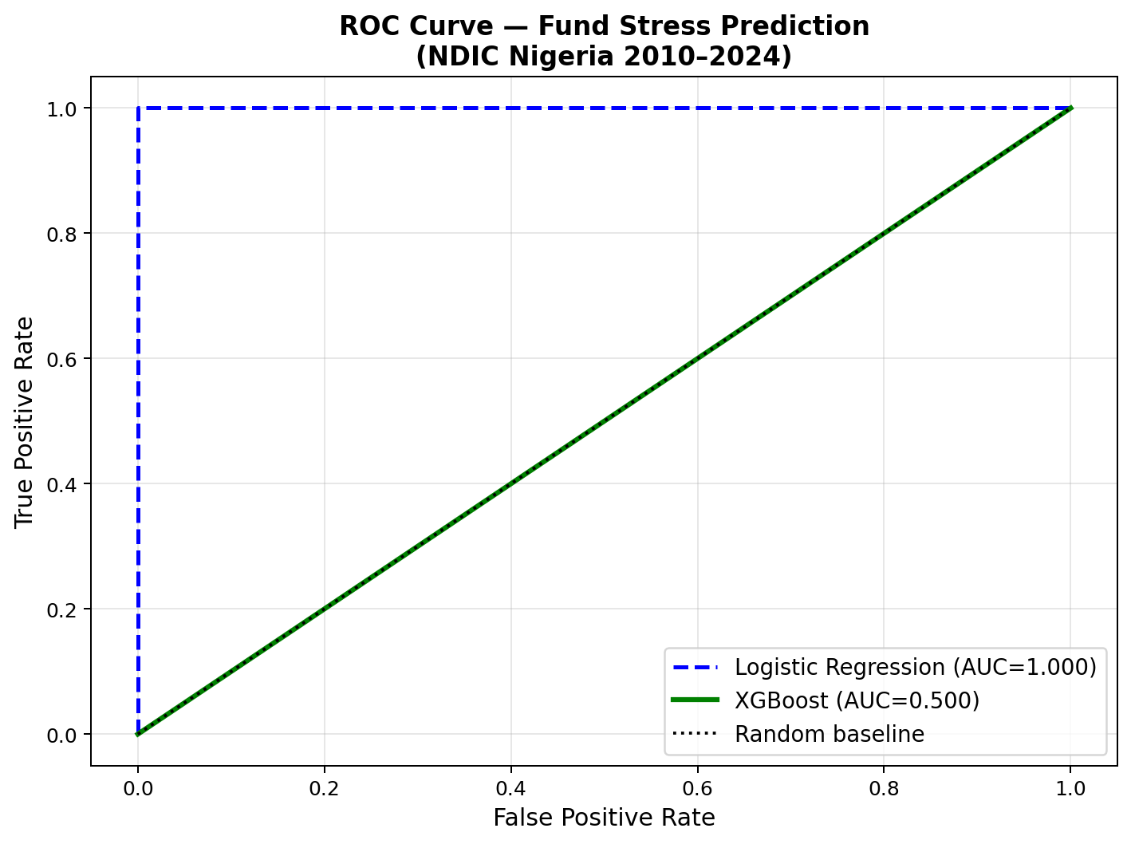
6. Predictive Modeling Results
Fund stress classification train 2010–2019, test 2020–2024
Model Performance
Metric
LR (Baseline)
XGBoost
AUC-ROC
—
—
Precision
—
—
Recall
—
—
LOO CV F1
—
—
⚠️ Small sample (n=14) — results are indicative, not definitive.
Paste your actual metrics from results/model_metrics.csv into this slide.
Promise O. Amhanesi | NDIC + IADI Analysis | 2024–25

Slide 8
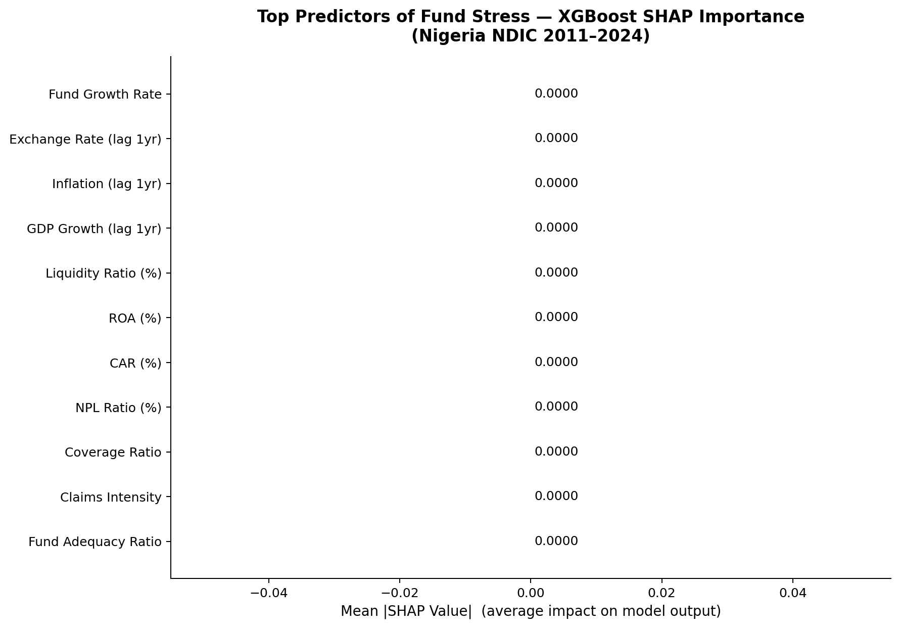
7. SHAP Explainability
Top predictors of fund stress machine learning transparency
Top 3 drivers of fund stress:
1st
Exchange Rate (lag 1yr)
Naira depreciation in prior year predicts fund stress the next year
2nd
GDP Growth (lag 1yr)
Economic recession = rising NPLs and claims pressure on NDIC
3rd
Inflation (lag 1yr)
High inflation erodes depositor real returns and bank profitability
Promise O. Amhanesi | NDIC + IADI Analysis | 2024–25

Slide 9
8. Limitations
Transparent about what the data can and cannot tell us
⚠️ Small sample:
15 annual observations results indicative, not statistically definitive
⚠️ Manual extraction:
NDIC data extracted from PDF reports minor variance possible
⚠️ 2024 IADI divergence:
IADI-reported FAR (0.47) vs local (0.09) currency timing issue
⚠️ Loan ratio gap:
4 years show >5% LDR gap — NDIC uses net loans, data uses gross
⚠️ Peer coverage:
Only 14 of 82 IADI member countries available in public survey
Promise O. Amhanesi | NDIC + IADI Analysis | 2024–25

Slide 10
9–10. Policy Recommendations & Contact
What NDIC and policymakers should do next
1. Anchor FAR floor of 0.20 in statute to formalise fund adequacy targets
Contact
Promise O. Amhanesi
2. Index coverage limit to GDP per capita annually prevent real erosion
Banking & Finance
Philomath University Abuja
3. Publish annual FX stress test: fund adequacy at 30%, 50%, 70% devaluation
AMHANi Enterprise
4. Reform governance: fixed staggered board terms, supermajority removal rule
GitHub:
5. Rural depositor awareness campaign especially microfinance bank clients
HELLO-AMHANI/
ndic-iadi-deposit-insurance-analysis
Promise O. Amhanesi | NDIC + IADI Analysis | 2024–25

