Slide 1
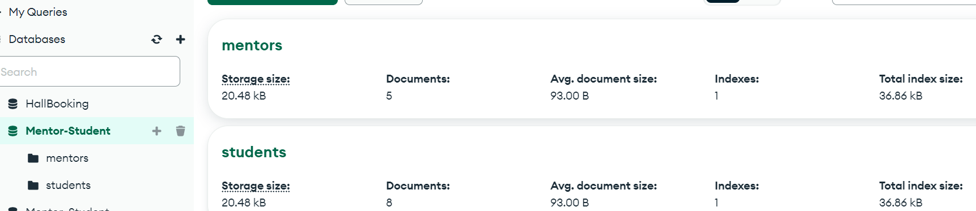
Npm run dev→ Mentor-Student DB Created→ Collection Names mentors, students

Slide 2
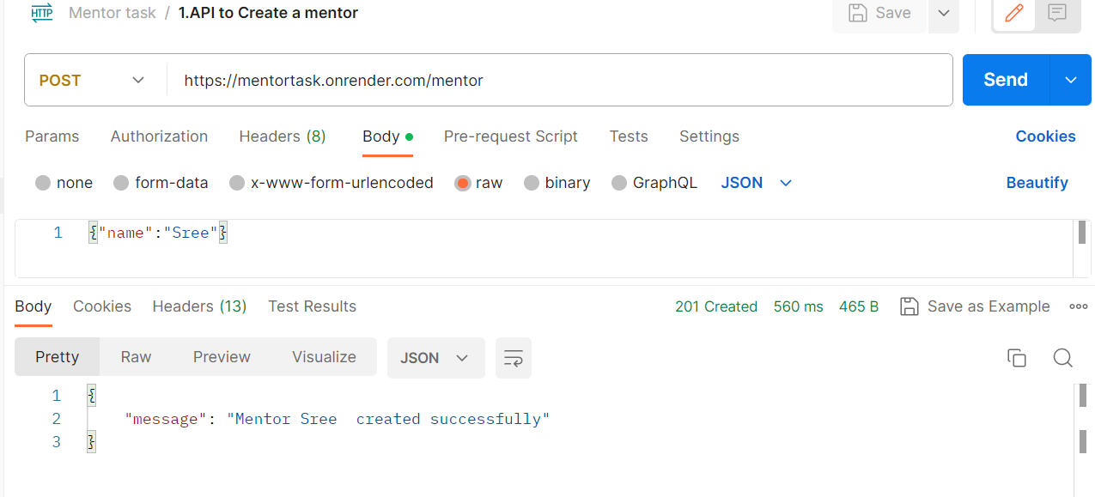
1.Create mentor

Slide 3
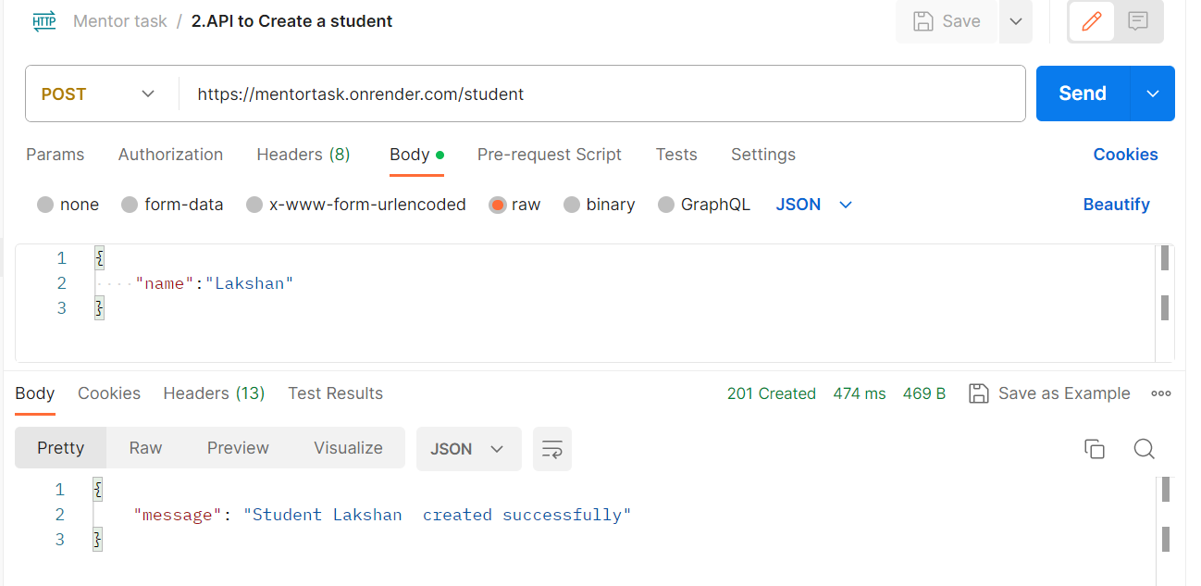
2.Create a student

Slide 4
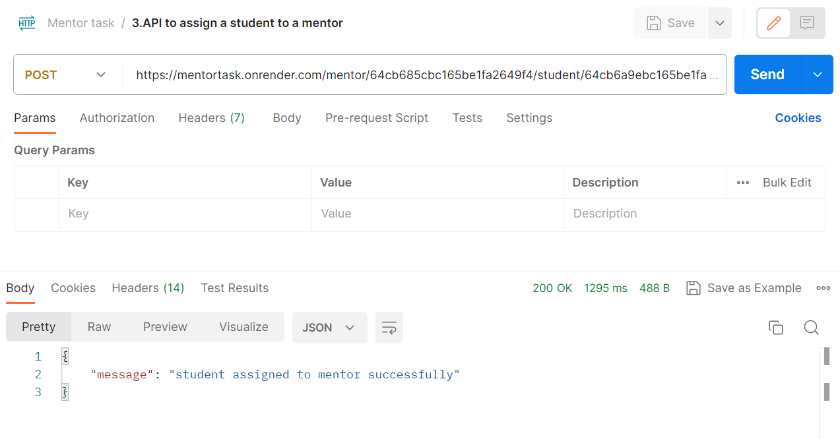
3.API to assign a student to a mentor

Slide 5
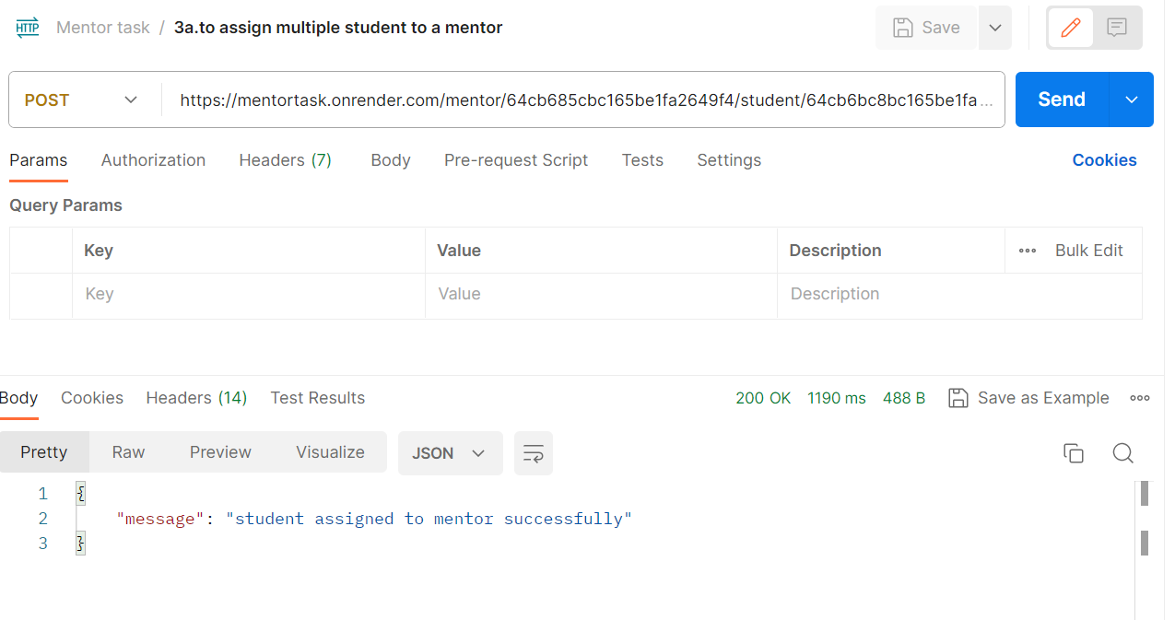
3a.Assign multiple students to one mentor

Slide 6
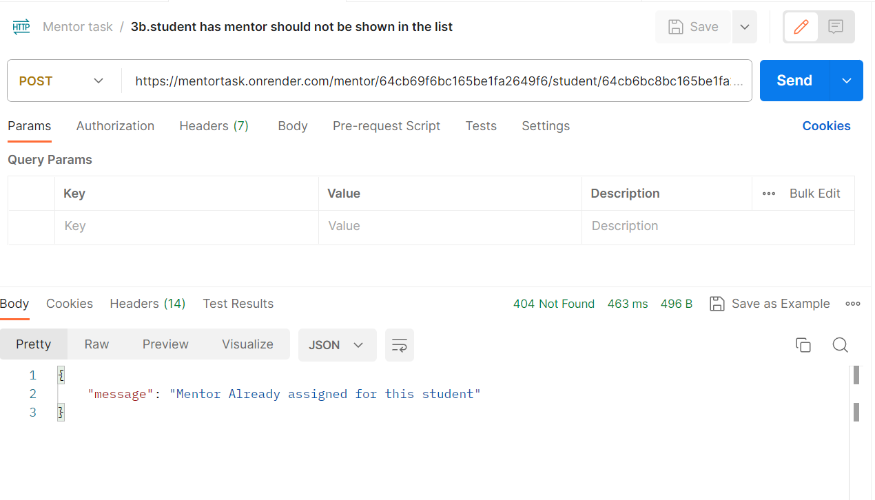
3b.student has mentor should not be shown in the list

Slide 7
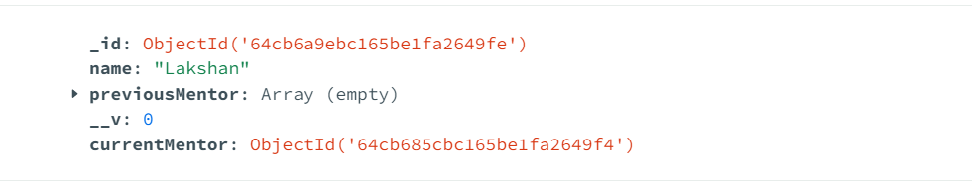
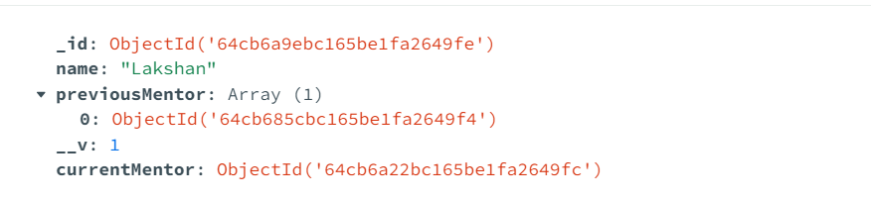
4. Mentor re-assignment put request: https://mentortask.onrender.com/mentor/64cb6a22bc165be1fa2649fc/student/64cb6a9ebc165be1fa2649fe

Slide 8
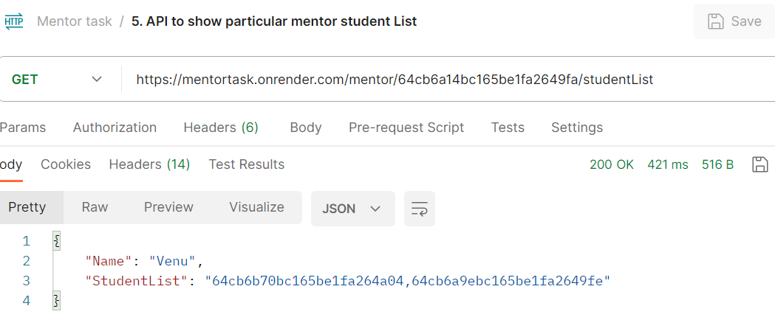
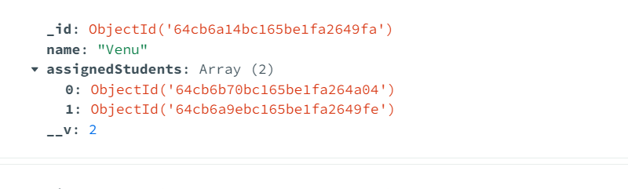
5.Particular mentor student list

Slide 9
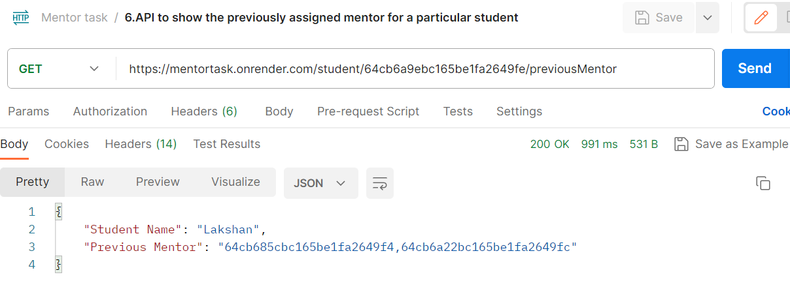
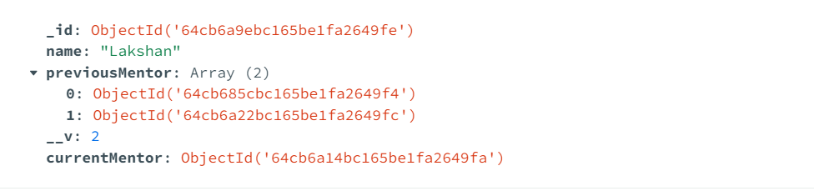
6.Show previously assigned mentor for a particular student

