Slide 1

Car Market Trends Analysis
AICTE STU ID : __________
Hemant Arora

Slide 2

Problem Statement
Convert the Car Dekho records into actionable market insights.
Analyze vehicle manufacturing years, prices, mileage and ownership patterns.
Identify missing data, vehicle variety, most-listed models and transaction characteristics.
Measure depreciation and identify brands/models with stronger resale retention.
Separate two-wheelers from cars and compare their age, pricing and resale behavior.
Answer all 25 case-study questions using reproducible Python analysis.
Car Market Trends Analysis • Car Dekho Dataset • 2

Slide 3
Project Description
End-to-end exploratory data analysis of the supplied 301-record dataset.
Records
Columns
Years
Missing values
301
9
2003–2018
0
Dataset fields: Car_Name, Year, Selling_Price, Present_Price, Kms_Driven, Fuel_Type, Seller_Type, Transmission and Owner.
Derived measures: depreciation = Present Price − Selling Price; retention = Selling Price ÷ Present Price.
Vehicle type is inferred from the model names present in the dataset: 202 cars and 99 two-wheelers.
Two exact duplicate rows are present; they are reported as a data-quality observation rather than silently removed.
Car Market Trends Analysis • Car Dekho Dataset • 3

Slide 4

Who Are the End Users?
How these insights can support decisions.
Buyers
Dealers
Estimate fair resale value and understand depreciation.
Spot high-demand models and pricing opportunities.
Sellers
Analysts
Assess how age, mileage and model influence resale.
Explore market mix, trends and outliers.
Car Market Trends Analysis • Car Dekho Dataset • 4

Slide 5
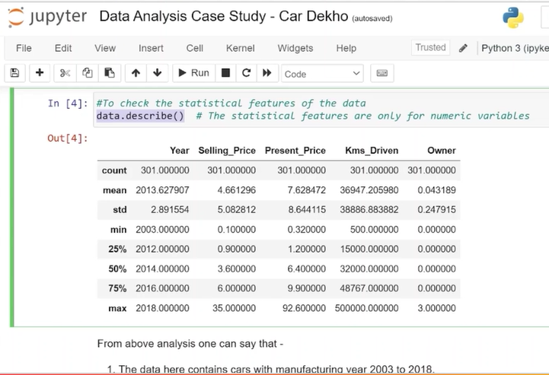

Technology Used
Tools and analytical steps used in the case study.
Python 3 / Jupyter Notebook — interactive analysis and presentation of results.
Pandas — CSV ingestion, cleaning, filtering, grouping and descriptive statistics.
NumPy — numerical calculations and derived metrics.
Matplotlib — visualizations for trends, distributions and relationships.
Workflow: Load → Inspect → Validate → Transform → Analyze → Visualize → Interpret.
Car Market Trends Analysis • Car Dekho Dataset • 5

Slide 6
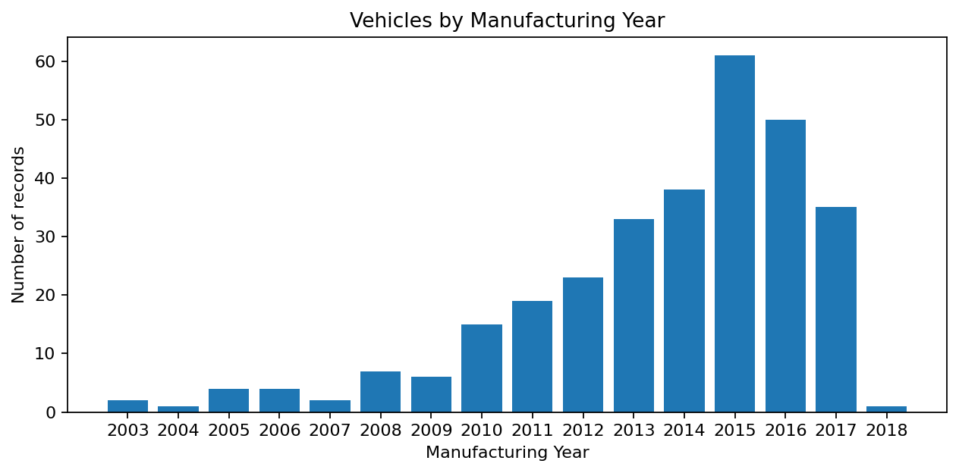
Dataset Overview & Data Quality
Total records
Unique models
Missing cells
Exact duplicate rows
301
98
0
2
Manufacturing years span 2003 to 2018.
Selling price ranges from ₹0.10 lakh to ₹35.00 lakh.
Present price ranges from ₹0.32 lakh to ₹92.60 lakh.
Kilometres driven ranges from 500 to 500,000 km.
Car Market Trends Analysis • Car Dekho Dataset • 6

Slide 7
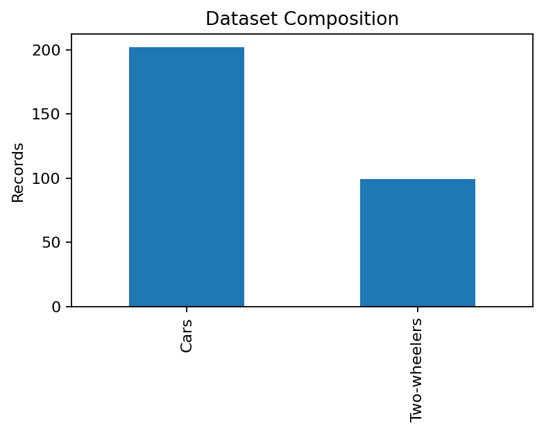
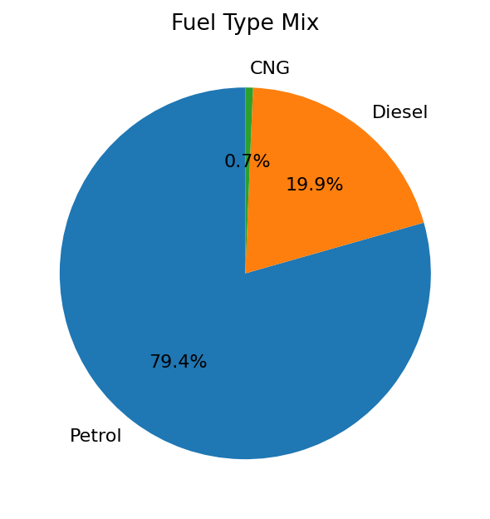
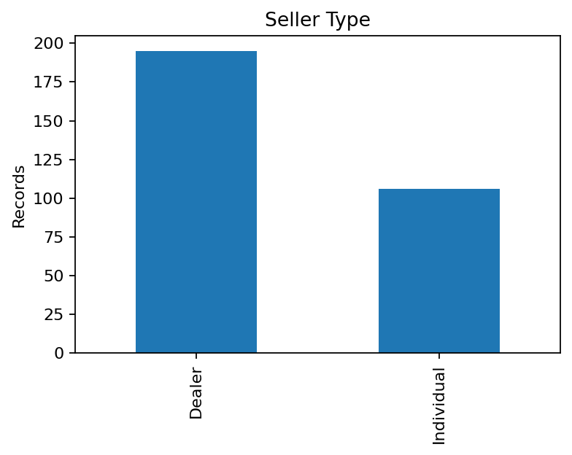
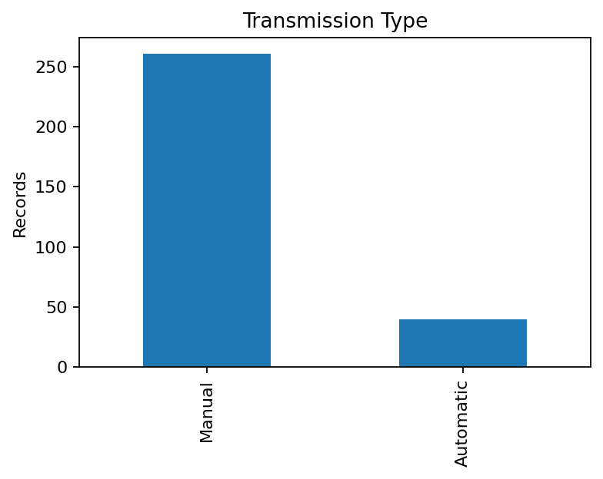
Market Composition
Cars: 202 (67.1%) • Two-wheelers: 99 (32.9%).
Fuel: Petrol 239, Diesel 60, CNG 2.
Seller: Dealer 195, Individual 106.
Transmission: Manual 261, Automatic 40.
Car Market Trends Analysis • Car Dekho Dataset • 7

Slide 8
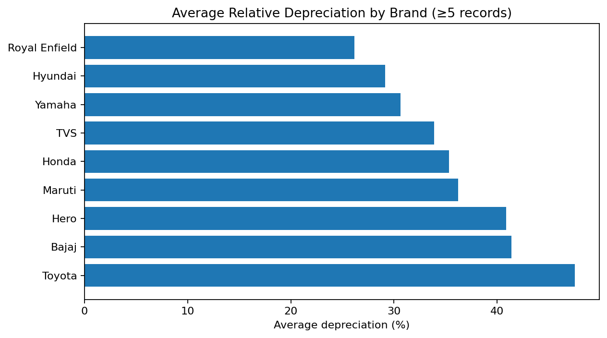
Depreciation Analysis
Depreciation = Present Price − Selling Price.
Highest absolute depreciation: land cruiser — ₹57.60 lakh.
Lowest absolute depreciation: Honda Activa 4G — ₹0.03 lakh.
Among brands with ≥5 records, Royal Enfield shows the lowest average relative depreciation (~26.1%).
Next strongest retention in this comparison: Hyundai (~29.1%) and Yamaha (~30.6%).
Brand results are descriptive, not causal; model mix and price segment affect depreciation.
Car Market Trends Analysis • Car Dekho Dataset • 9

Slide 9
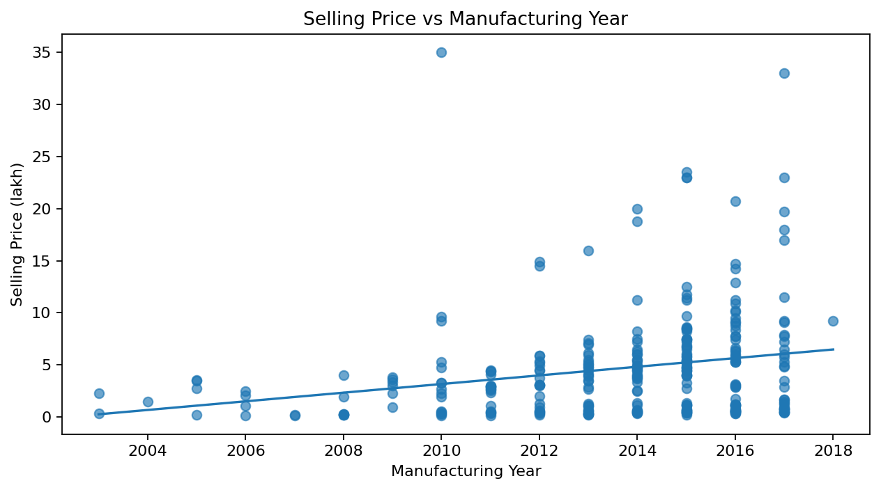
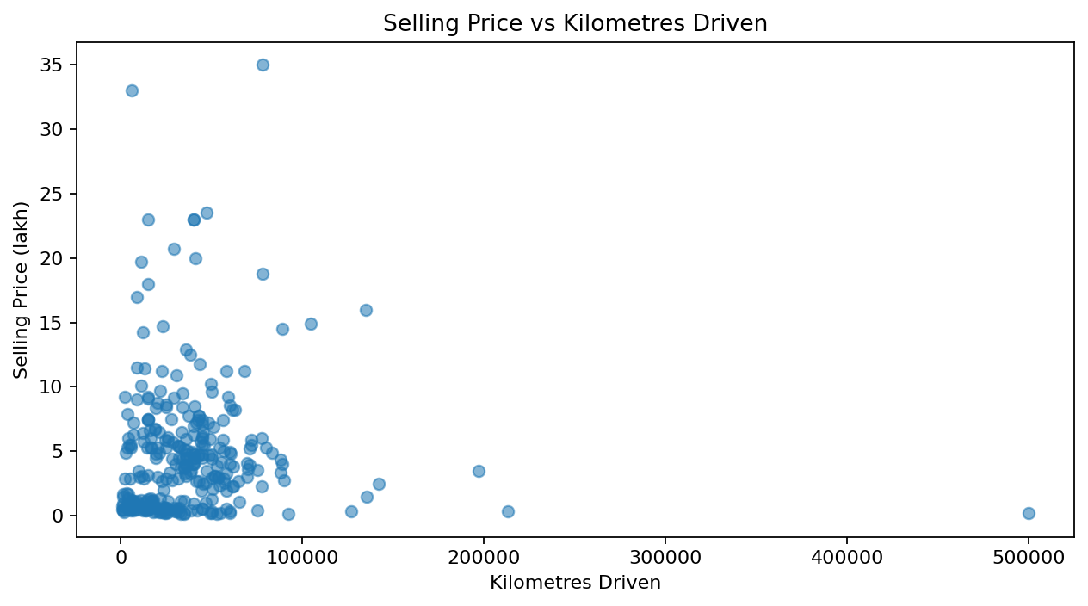
Does Age / Mileage Affect Selling Price?
Evidence from correlation and scatter analysis.
Selling price vs manufacturing year correlation: 0.236 → newer vehicles generally command higher prices.
Selling price vs kilometres correlation: 0.029 → mileage alone has a very weak linear relationship in this sample.
Therefore, age/year is visibly more informative than kilometres alone for this dataset.
Mileage still matters in individual deals, but it is not sufficient by itself to explain selling price.
Car Market Trends Analysis • Car Dekho Dataset • 10

Slide 10
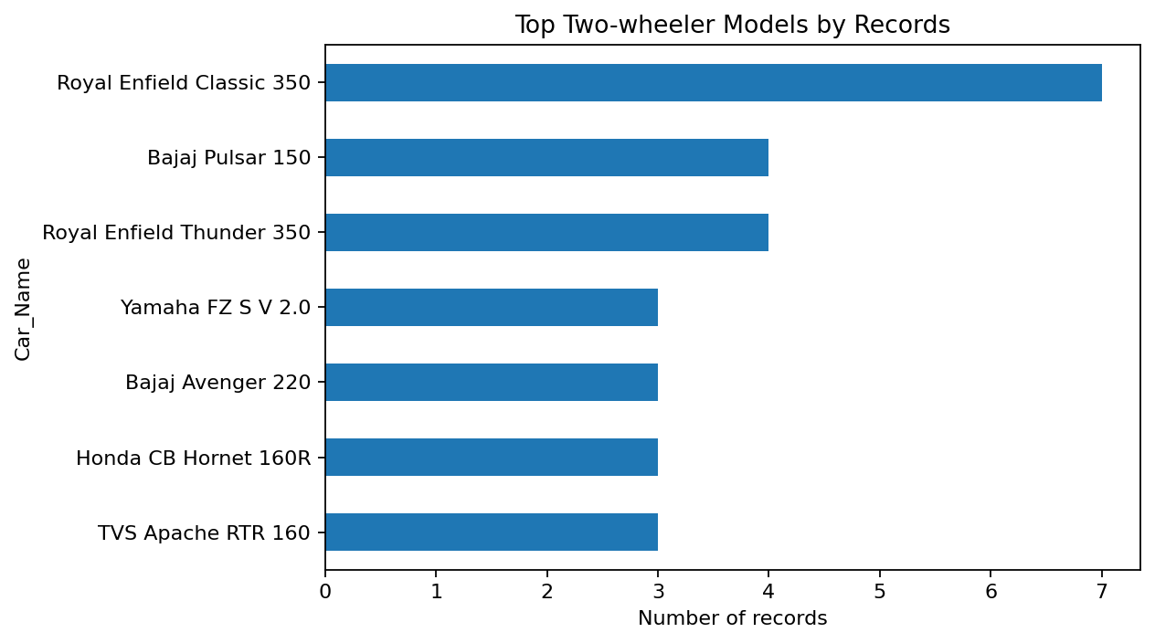
Two-Wheeler Analysis
Questions 17–21.
Two-wheelers identified: 99 records.
Oldest bike: Hero Super Splendor (2005) — sold at ₹0.20 lakh.
Newest bike year: 2017; 16 bikes share that newest year.
Most frequent two-wheeler model: Royal Enfield Classic 350 — 7 records.
Best resale-retention deal: Bajaj Avenger 220 (2017), 1,300 km, retention 94.7%.
Likely explanation: very recent model + very low kilometres + zero previous owners in the record; this supports stronger resale retention.
Car Market Trends Analysis • Car Dekho Dataset • 11

Slide 11
Car-Only Analysis
Questions 22–25.
Cars identified: 202 records.
Oldest cars: 800, sx4 — manufacturing year 2003.
Newest car: vitara brezza — 2018, sold at ₹9.25 lakh.
Best resale-retention deal: corolla altis (2016) — selling ₹14.73 lakh vs present ₹14.89 lakh.
Retention is 98.9% (depreciation only ₹0.16 lakh).
Likely explanation: comparatively recent vehicle, moderate mileage and zero previous owners; the model also has strong market value in this sample.
Car Market Trends Analysis • Car Dekho Dataset • 12

Slide 12
Case Study Answers — Q1 to Q13
1. Manufacturing years: 2003–2018.
2. Lowest selling price: ₹0.10 lakh.
3. Highest selling price: ₹35.00 lakh.
4. Records: 301.
5. Missing values: 0; exact duplicate rows: 2.
6. Different vehicle models: 98.
7. Most sold/listed model: city (26 records).
8. CNG vehicles: 2.
9. Individual sellers: 106.
10. Automatic transmission: 40.
11. Single-owner vehicles (Owner = 0): 290.
12. Highest depreciation: land cruiser (₹57.60 lakh); lowest: Honda Activa 4G (₹0.03 lakh).
13. Lowest relative depreciation among brands with ≥5 records: Royal Enfield (~26.1%).
Car Market Trends Analysis • Car Dekho Dataset • 13

Slide 13
Case Study Answers — Q14 to Q25
19. Newest bikes: 2017 models (16 records), including UM Renegade Mojave, KTM RC200, Bajaj Dominar 400 and Royal Enfield Classic 350.
20. Most sold/listed bike model: Royal Enfield Classic 350 (7 records).
21. Strongest two-wheeler deal by resale retention: Bajaj Avenger 220 — 94.7% retention; very low 1,300 km and 2017 model help explain it.
22. Cars: 202 records.
23. Oldest cars: 800, sx4 (2003).
24. Newest car: vitara brezza (2018).
25. Strongest car deal by resale retention: corolla altis — 98.9% retention; 2016 model, 23,000 km and zero previous owners are consistent with strong resale value.
Car Market Trends Analysis • Car Dekho Dataset • 14

Slide 14
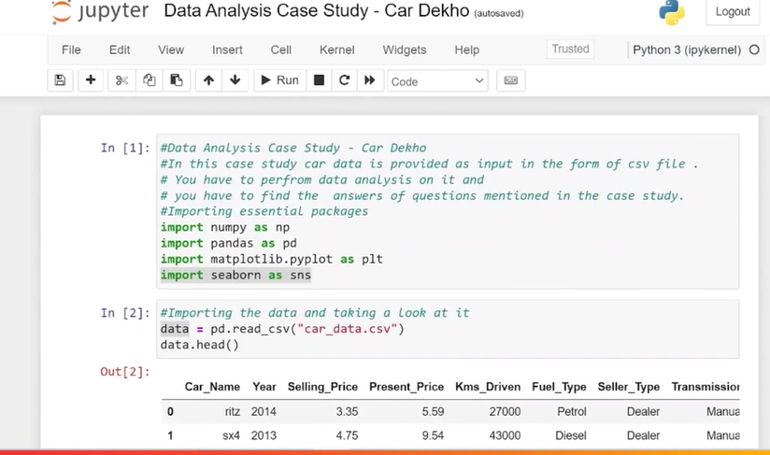
Jupyter Notebook Implementation
Evidence of the analysis workflow from the supplied case-study screenshots.
Load CSV → inspect head() → describe() → answer business questions with filters, value_counts(), groupby(), correlations and visualizations.
Car Market Trends Analysis • Car Dekho Dataset • 15

Slide 15
Key Takeaways
The dataset contains 301 records across 2003–2018, with no missing cells.
The market is dominated by petrol vehicles, dealer listings and manual transmission.
City is the most frequently listed model (26 records).
Cars account for 202 records; two-wheelers account for 99 records.
Newer manufacturing years are positively associated with selling price, while kilometres alone show little linear association.
Large absolute depreciation is concentrated in high-value models; relative depreciation gives a fairer brand comparison.
The best observed resale-retention examples combine newer model years, low mileage and zero previous owners.
Car Market Trends Analysis • Car Dekho Dataset • 16

Slide 16
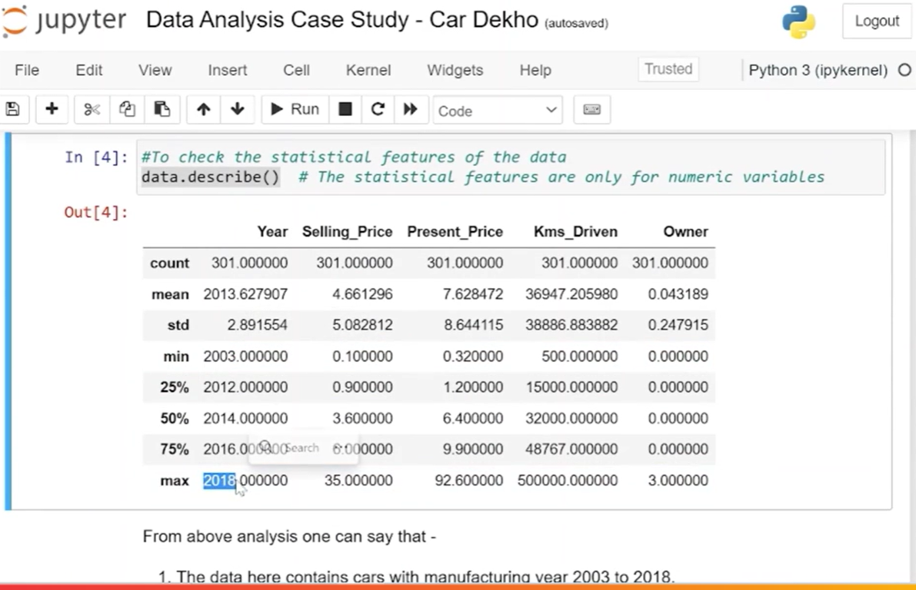
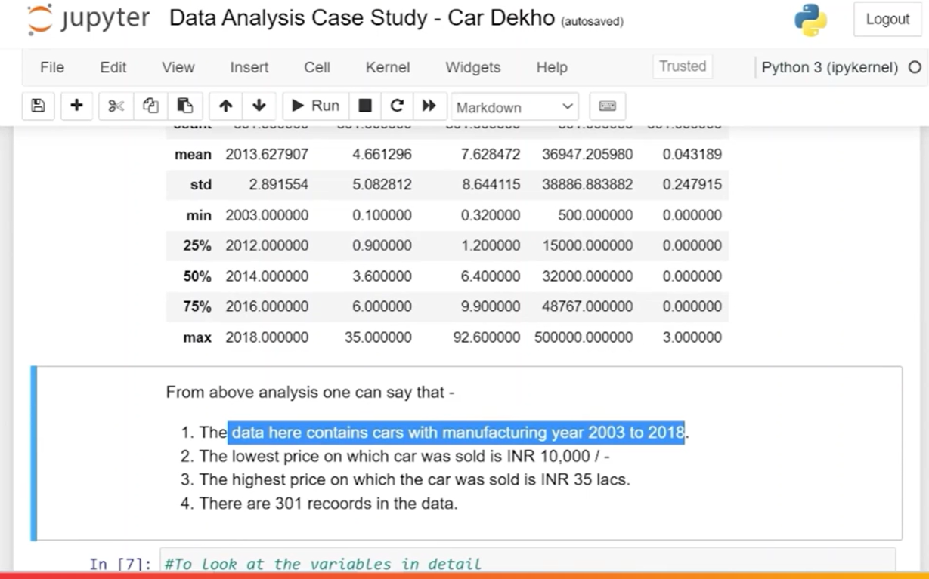
Jupyter Evidence — Dataset Validation
Source screenshots from the supplied case-study notebook.
The notebook confirms 301 records, 9 original columns, 2003–2018 manufacturing years and 0 missing values.
Car Market Trends Analysis • Car Dekho Dataset • 17

Slide 17
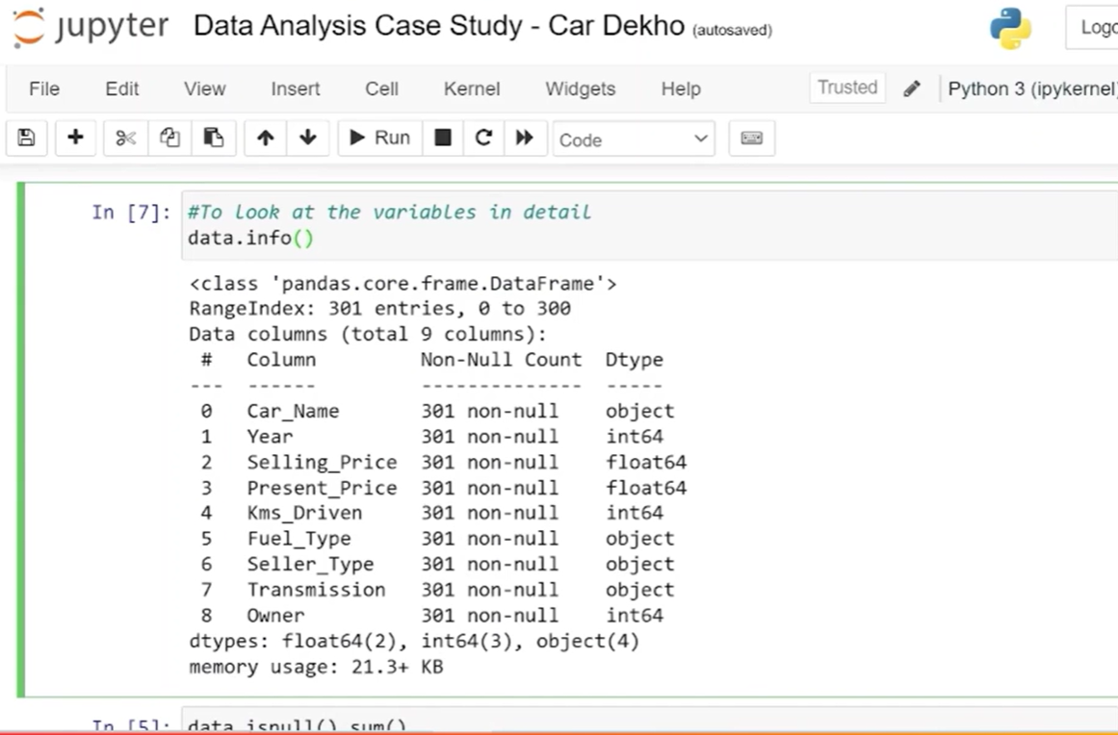
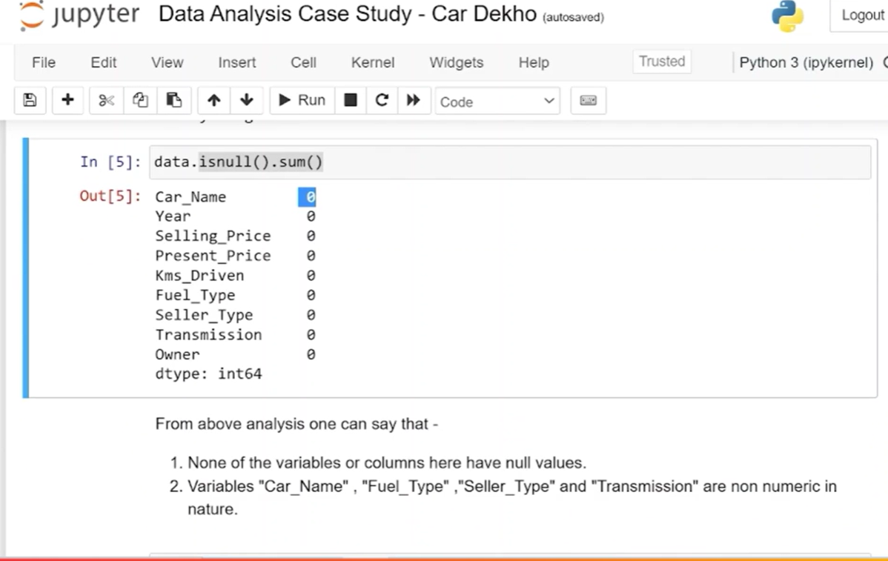
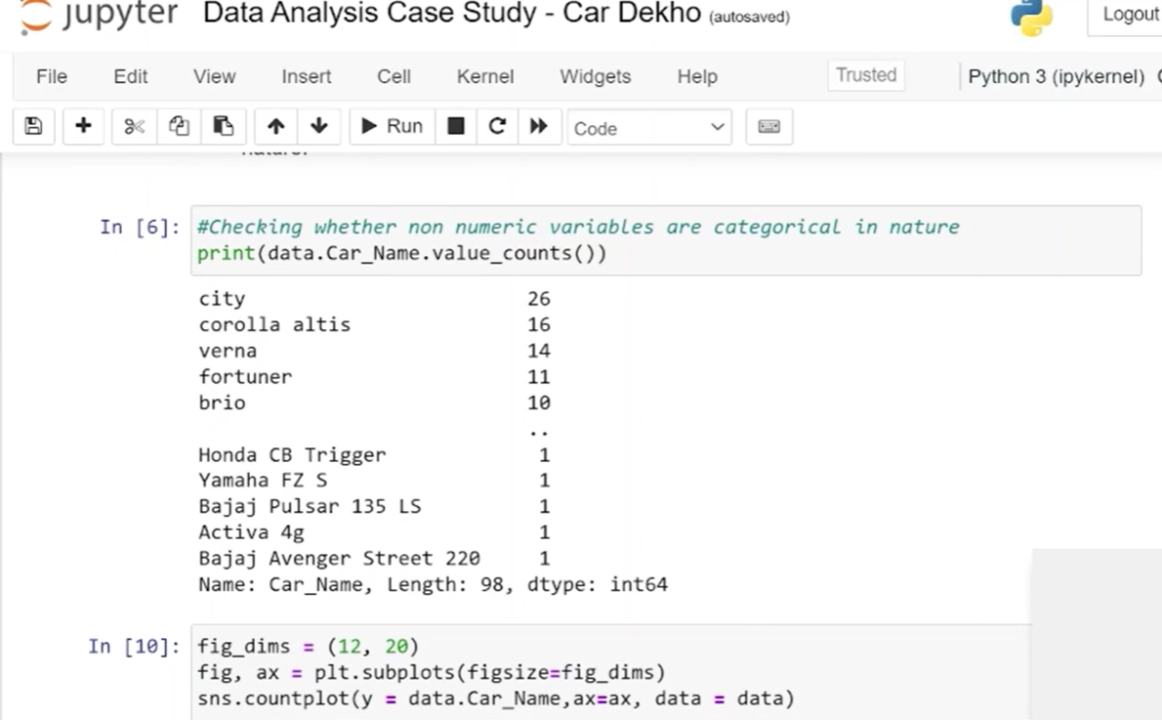
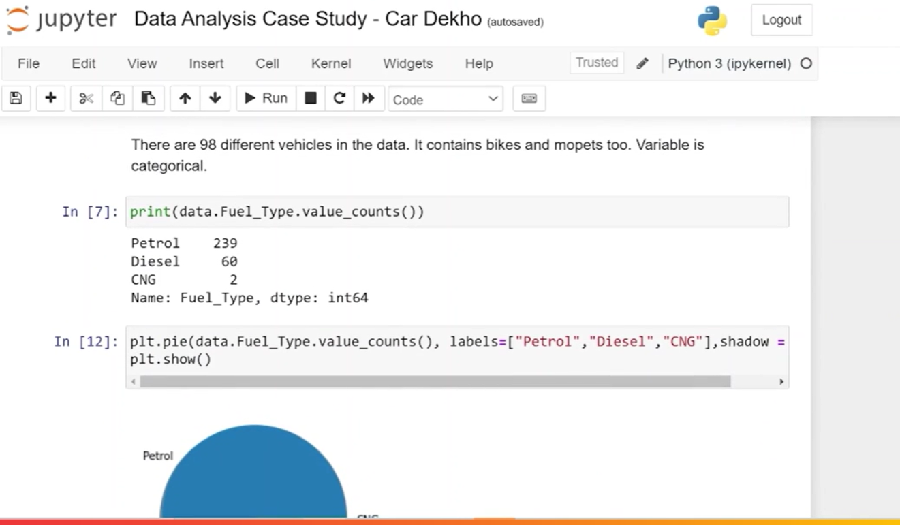
Jupyter Evidence — Categorical Analysis
Model frequency and fuel-type distribution from the original notebook.
Source findings: 98 unique vehicle models; City is most frequent (26); Petrol 239, Diesel 60, CNG 2.
Car Market Trends Analysis • Car Dekho Dataset • 18

Slide 18
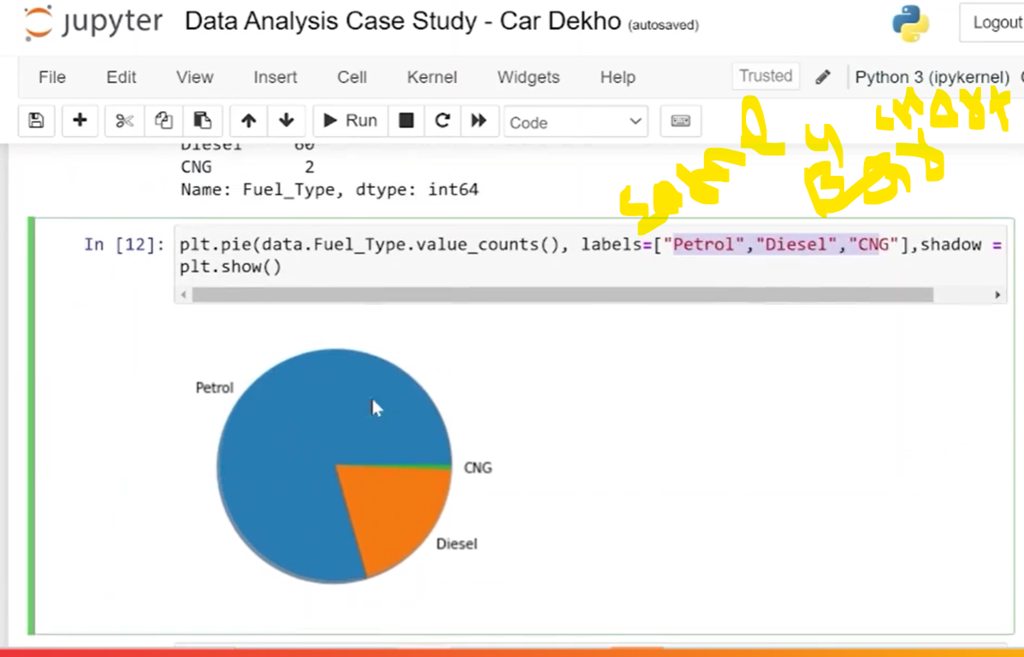
Jupyter Evidence — Visual Analysis
Additional notebook output used to support the presentation.
The evidence slides preserve the original notebook context while the main presentation uses cleaner, presentation-ready charts.
Car Market Trends Analysis • Car Dekho Dataset • 19

Slide 19
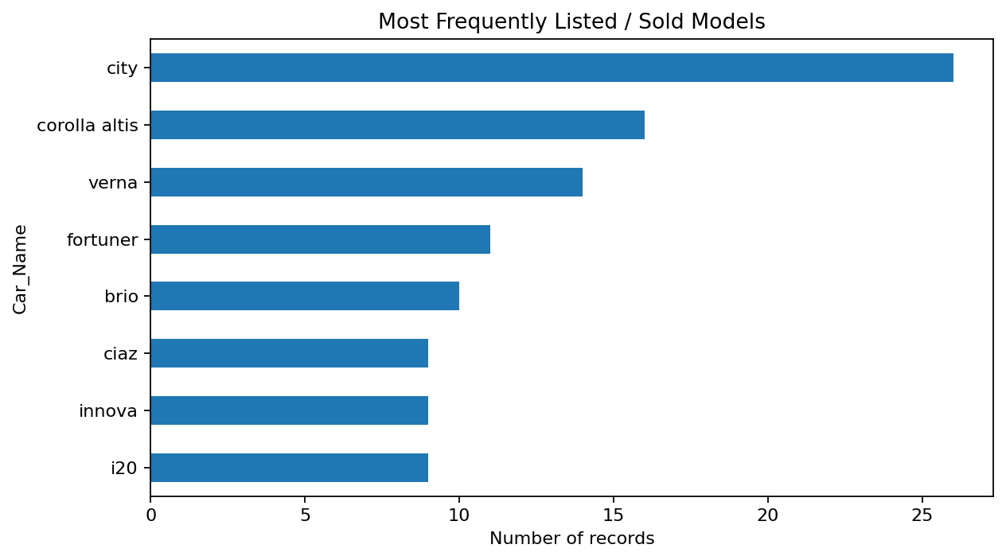
Conclusion
The Car Dekho dataset can be converted into clear market insights through a repeatable EDA workflow.
Pandas • NumPy • Matplotlib • Jupyter
Thank you

