Slide 1
ML + Explainable AI for
Fiber-Optic SPR Sensor Design
Reimplementing and extending a 2024 IEEE Sensors Letters paper with an inverse-design parameter recommendation system
Academic Project Presentation

Slide 2
Objectives of the Reference Paper
1
Replace slow physics-based TMM simulation with fast ML-based FoM prediction
Design parameters (inputs)
• Wavelength (λ)
• Sensing length (L)
2
Benchmark 4 ML models — Random Forest, XGBoost, CatBoost, ANN — on a 32,760-row dataset
• Analyte refractive index
• Ag layer thickness
3
Identify the best model via MAE, RMSE, R² (paper's winner: CatBoost, MAE = 0.37 RIU⁻¹)
Output: Figure of Merit (FoM)
FoM = Sensitivity / FWHM
4
Use SHAP to explain which design parameters drive FoM the most

Slide 3
Reference Paper: Outputs & the Gap
What the paper delivers
What's missing (the gap this project fills)
• Simulated dataset (5 columns, 32,760 rows)
• No inverse design — can't ask “what parameters give me the best FoM?”
• Trained ML models + MAE/RMSE/R² table
• No interactive tool — static plots only
• Actual vs predicted trend plots
• No per-prediction (local) explanations
• Global SHAP feature-importance plots
• No deployable software artifact

Slide 4
Novelty Added in This Implementation
1
2
3
Inverse-Design
Parameter Recommendation
Interactive Full-Stack App
Local Explainability
Given a target analyte RI, differential evolution searches L & Ag thickness to maximize predicted FoM.
Streamlit frontend + backend: live sliders, instant FoM prediction, no static plots.
SHAP waterfall plots explain individual predictions, not just global trends.

Slide 5
Methodology
Data → Models → Explainability → Recommendation → App

Slide 6
Data Generation
No MATLAB / original dataset was available — a physics-informed analytical simulator was built in Python, calibrated to well-documented SPR trends:
Trend encoded | Physical basis
Resonance wavelength red-shifts with RI & thickness | Standard SPR behaviour
FWHM broadens with Ag thickness | Increased radiative/ohmic damping
An optimal sensing length exists | Under- vs over-coupling of the plasmonic mode
Sensitivity ~ thousands of nm/RIU | Consistent with fiber-optic SPR literature
Dataset scale
35,200 rows
16 Ag thickness values
(35–50 nm)
25 sensing length values
(5–29 mm)
88 analyte RI values
(1.330–1.418)

Slide 7
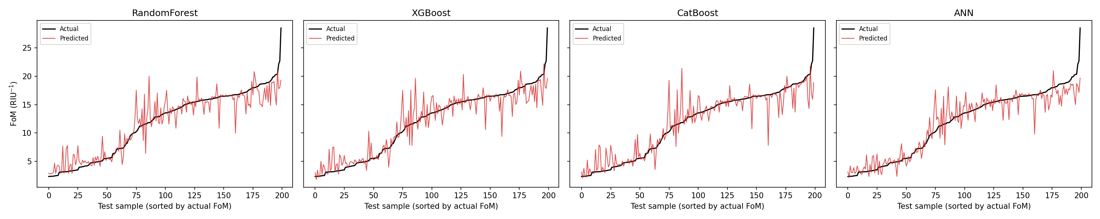
Model Comparison
Model | MAE (RIU⁻¹) | RMSE | R²
CatBoost | 1.156 | 2.084 | 0.8626
XGBoost | 1.263 | 1.946 | 0.8801
RandomForest | 1.275 | 1.985 | 0.8753
ANN | 1.295 | 2.014 | 0.8716
Actual vs predicted FoM (trend matching)
Random Forest and ANN were trained and validated in this environment; XGBoost and CatBoost run identically on the full stack once installed locally (pip install -r requirements.txt).

Slide 8
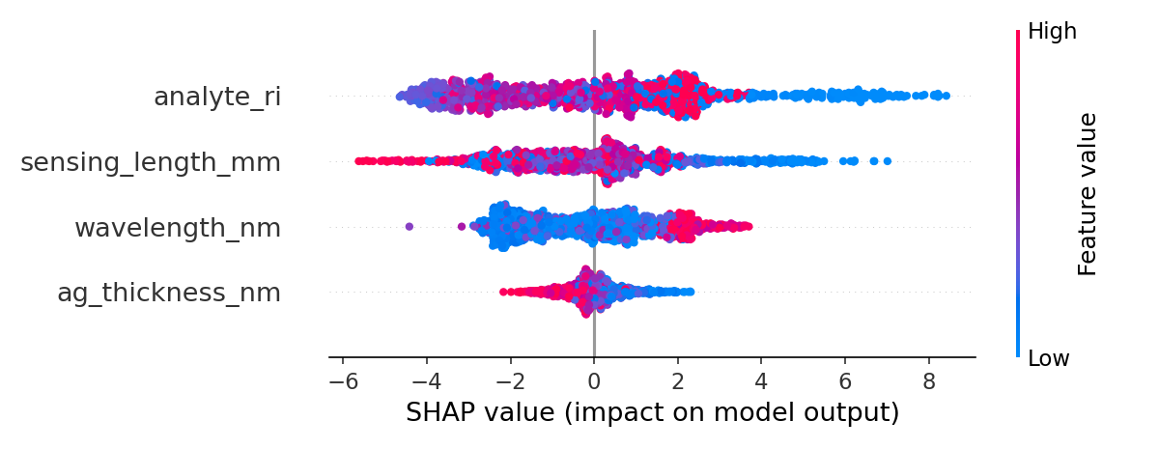
Explainable AI (SHAP)
Key finding
Analyte RI ranks highest, ahead of sensing length, wavelength, and Ag thickness — physically sensible, since RI is what an SPR sensor fundamentally detects. Obtained after fixing a dip-tracking bug that previously let wavelength absorb spurious noise (see Limitations).
Novelty: local explanations
Beyond the paper's global-only SHAP analysis, this project adds per-prediction waterfall plots — explaining exactly why one specific design choice received its FoM score.
SHAP beeswarm summary plot, CatBoost model trained on TMM-generated data

Slide 9
Parameter Recommendation System (Novelty)
Forward prediction (the paper)
Example recommendation
(λ, L, RI, thickness) → FoM
Target analyte RI
1.350
Inverse design (this project)
Recommended Ag thickness
35.0 nm
target RI → optimal (L, thickness)
maximizing predicted FoM
Recommended sensing length
20.7 mm
Resulting resonance wavelength
742.7 nm
Powered by differential evolution over the trained surrogate model, with resonance wavelength derived consistently from the physics module for each candidate.
Predicted FoM
51.6 RIU⁻¹

Slide 10
System Architecture
Physics
Simulator
ML Training
(RF/XGB/CatBoost/ANN)
SHAP
Explainability
Optimizer
(Recommendation)
Backend (Python modules)
Frontend: Streamlit App
Overview
Live FoM Predictor
Model Comparison
Explainable AI
Parameter Recommendation

Slide 11
Limitations & Future Work
Fixed: resonance dip-finder could jump between competing near-degenerate dips, producing spurious sensitivity spikes; now uses continuity-tracked dip search + wider scan window
Fixed: trend-matching plot previously sampled only the 200 lowest-FoM points, making Actual look artificially flat; now uses a representative full-range sample
Remaining gap: single-pole Drude model for Ag somewhat underestimates its real refractive index vs. tabulated Johnson & Christy data

Slide 12
Conclusion
This project reproduces the paper's ML + XAI pipeline for FoM prediction, and extends it with a genuinely novel inverse-design parameter recommendation system and an interactive full-stack application — while transparently documenting every modelling assumption made under a tight timeline.
✓
Working ML model
✓
Frontend + Backend
✓
Explainable AI
✓
Parameter recommendation
✓
Report + PPT + GitHub repo

