Slide 1

SANDBOX
TEAM MEMBERS:
HEMANTH GOWDA SR
DIVYANSH KUMAR
SIDDARAJ
FARIYA DEEBA

Slide 2

introduction
WHAT IS SANDBOX ?
With Sandbox, there’s no need for technical skills or design expertise—it's built for anyone who wants a quick, professional portfolio.
The platform offers a variety of themes that allow users to showcase their unique style and personal brand.

Slide 3

Problems
Who has time to start from scratch?
Most people don’t—it’s time-consuming.
What if you’re not a designer?
Design complexity makes it hard to create a polished look.
How can non-tech users manage?
Many lack the skills to build a custom site.
Why is Sandbox the answer?
Quick, no-code, LinkedIn-powered portfolios

Slide 4



How to use sandbox?
Effortless Portfolio Creation in Three Steps:
Connect Your LinkedIn: Seamless integration with just a username.
Select Your Theme: Choose from curated designs to match your style.
Launch Your Portfolio: Instantly generated and ready to share.

Slide 5

features
No Code Required: Build your portfolio effortlessly, no technical skills needed.
Seamless LinkedIn Integration: Automatically imports your professional data—experience, education, skills, and more.
Fully Customizable Themes: Choose from a variety of sleek, modern templates to match your personal brand.
Instant, Professional Design: Create a polished portfolio in minutes, ready to share with potential employers or clients.

Slide 6

Tech stack.
Frontend: React, Tailwind CSS.
Authentication: Clerk Auth.
External API: LinkedIn Rapid 8 API.
Full-Stack Framework: Next.js
Hosting: Vercel.

Slide 7
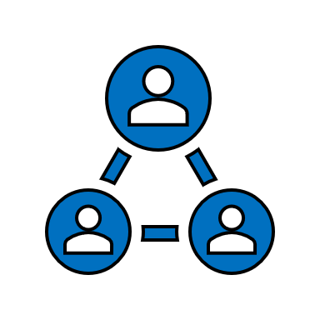
Connect with us
Website link: https://sandbox-no-code-portfolio.vercel.app/
GitHub link: https://github.com/HEMANTH123SR/sandbox-no-code-portfolio

