Slide 1
Autonomous Car Vision System
.

Slide 2
What are Autonomous Cars?
Autonomous cars are self-driving vehicles.
They use cameras, sensors, radar, LiDAR, GPS, and AI to understand their surroundings.
They detect roads, lanes, pedestrians, vehicles, and traffic signs.
They process real-time data using computer vision and artificial intelligence.
They estimate the distance to nearby objects to avoid collisions.
They automatically control steering, braking, and acceleration.
They follow traffic rules and choose safe routes to reach the destination.
They improve road safety, reduce human errors, and enhance driving efficiency.

Slide 3
Problem Statement
Detect roads, pedestrians, vehicles, and traffic signs accurately in real time.
Handle changing weather conditions such as rain, fog, and low light.
Correct camera distortions to obtain accurate visual information.
Estimate the distance between the vehicle and surrounding objects.
Identify moving and stationary obstacles to prevent collisions.
Process large volumes of image data with low latency.
Make safe and reliable driving decisions based on detected objects and distances.
Ensure smooth and efficient navigation in complex traffic environments.

Slide 4
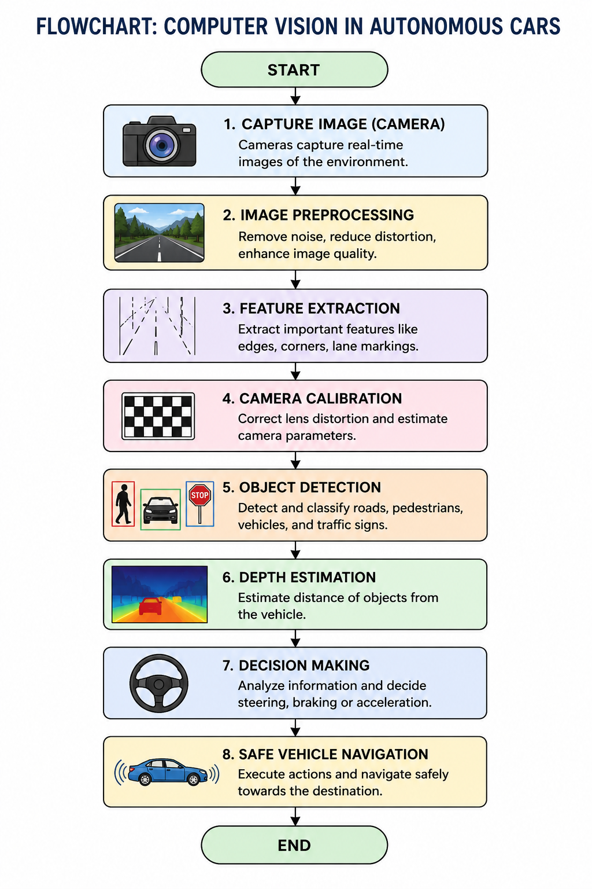
flowchart

Slide 5
Applications of Computer Vision in Autonomous Cars
Lane Detection – Identifies road lanes and keeps the vehicle centered.
Pedestrian Detection – Detects pedestrians to avoid collisions.
Traffic Sign Recognition – Recognizes speed limits, stop signs, and warning signs.
Vehicle Detection – Detects nearby vehicles for safe driving.
Obstacle Detection – Identifies obstacles such as animals, debris, and parked vehicles.
Collision Avoidance – Applies automatic braking or steering to prevent accidents.

Slide 6
Conclusion
Computer vision is the core technology behind autonomous vehicles.
Vision pipeline enables object detection and scene understanding.
Camera calibration improves image accuracy.
Depth estimation helps measure object distances.
Together, these technologies enable safe, reliable, and intelligent autonomous driving.

Slide 7
Future Scope
Improve autonomous driving using advanced AI and deep learning algorithms.
Achieve higher accuracy in detecting roads, pedestrians, and traffic signs.
Enhance performance in adverse weather conditions such as rain, fog, and snow.
Integrate multiple sensors (camera, LiDAR, radar, and GPS) for better environmental perception.
Develop fully autonomous (Level 5) vehicles with minimal or no human intervention.
Enable vehicle-to-vehicle (V2V) and vehicle-to-infrastructure (V2I) communication for smarter transportation.

