Slide 1
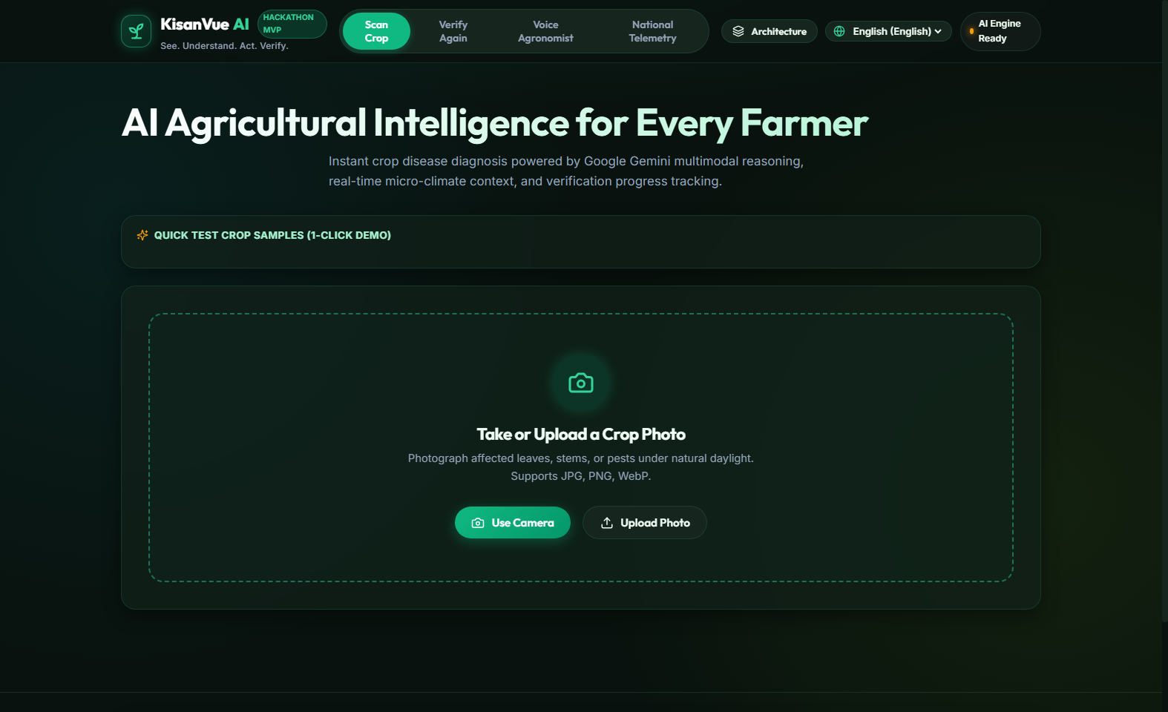
GOOGLE CLOUD · BUILD WITH AI · TRACK 4
KISANVUE AI
See. Understand. Act. Verify.
AI-Powered Agricultural Intelligence for India
Turning multimodal imagery, satellite signals, and soil dynamics into verified farmer decisions.
Multimodal AI
Google Gemini Reasoning
Earth Observation
Sentinel-2 NDVI & NDWI
Soil & Weather
SoilGrids & Open-Meteo
Closed-Loop
Verify-Again Engine
LIVE PLATFORM: https://kisanvue-ai.vercel.app/ | BACKEND: FastAPI + Render | OPEN SOURCE

Slide 2
TRACK 4: AGRICULTURAL INTELLIGENCE
The Challenge: Farm Decisions Are Still Fragmented
Small and marginal farmers need timely, localized guidance — but vital agricultural intelligence remains isolated in silos.
🌦 Weather Forecasts
Disconnected Micro-Climates
Rainfall or humidity alerts sit on general apps without linking to active fungal incubation windows or spraying timing.
🛰 Satellite Imagery
Inaccessible Earth Obs
Sentinel-2 NDVI & NDWI data exists in complex GIS dashboards far removed from daily smallholder comprehension.
🧪 Soil Test Reports
Static Physical Cards
Soil organic carbon (SOC) and texture (clay/sand) metrics remain in drawer records rather than guiding immediate inputs.
🌱 Crop Health Advice
Fragmented Field Diagnosis
Farmers receive isolated visual symptom guesses without validating against local climate, soil suitability, or past advisories.
CORE PROBLEM STATEMENT:
"How do we turn fragmented agricultural data into one actionable, verified farmer decision?"

Slide 3
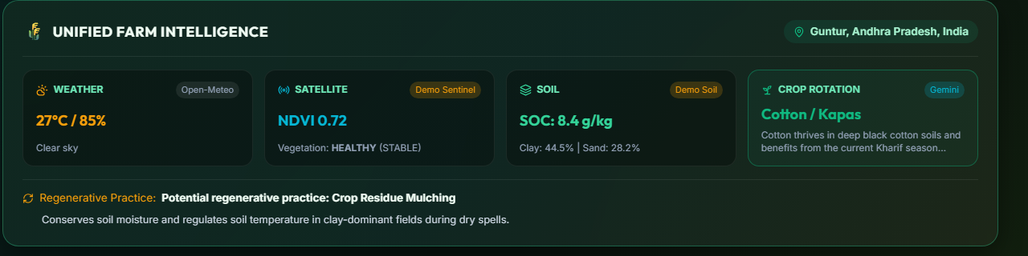
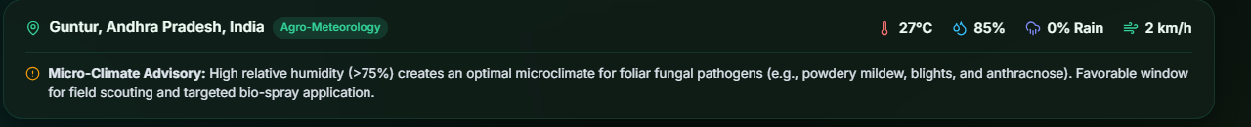
TRACK 4: AGRICULTURAL INTELLIGENCE
Our Solution: One Unified Intelligence Layer for the Farm
KisanVue AI fuses multimodal image reasoning with real-time field context into a single actionable advisory loop.
1. Google Gemini Multimodal AI
Visual pathology classification, lesion identification, and contextual agronomic reasoning.
2. Multi-Source Context Fusion
Integrates Open-Meteo weather, Sentinel-2 vegetation indices, and SoilGrids soil properties.
3. Regenerative Crop Planning
Soil- and weather-grounded crop rotations and regenerative organic soil practices.
4. Closed-Loop 'Verify Again'
Post-treatment comparative visual assessment tracking recovery progress over time.

Slide 4
TRACK 4: AGRICULTURAL INTELLIGENCE
The Core Workflow: From Field Observation to Verified Action
1. SCAN
Farmer uploads crop image or captures live photo under field daylight.
Supports leaf, stem, or vector infestation imagery.
2. UNDERSTAND
Google Gemini performs multimodal reasoning on foliar lesions.
AI-assisted visual assessment without unsupported claims.
3. CONTEXT
Fuses real-time Weather, Sentinel-2 NDVI, and SoilGrids.
Grounds visual diagnosis in active environmental reality.
4. RECOMMEND
Generates succession crops & regenerative practices.
Legume rotation, bio-mulching, and organic soil health.
5. ACT
Delivers localized, multilingual IPM bio-advisory.
Neem oil, sticky traps, balanced fertigation (Telugu/Hindi).
6. VERIFY
Farmer returns 5–7 days later with follow-up photo.
AI-assisted visual comparison computes recovery score.

Slide 5
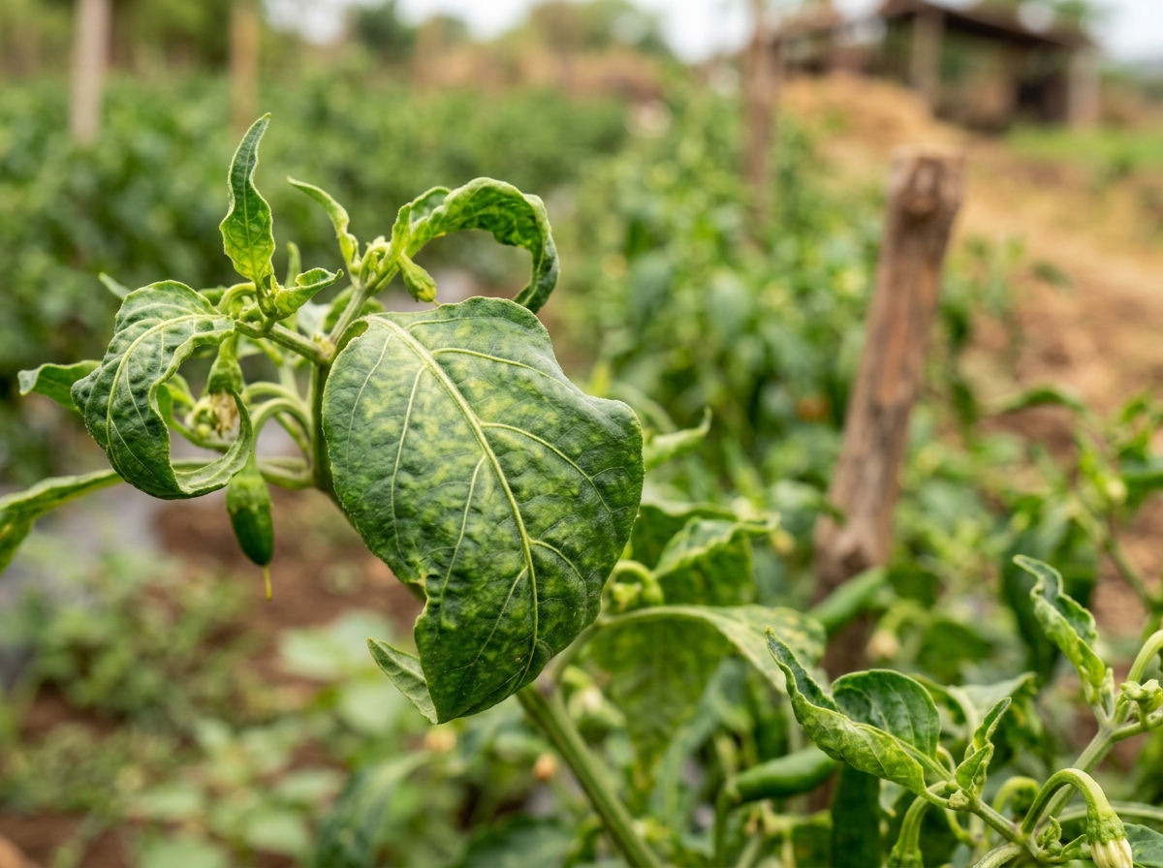
TRACK 4: AGRICULTURAL INTELLIGENCE
Multimodal Crop Intelligence: Gemini-Powered Visual Reasoning
Google Gemini turns raw foliar imagery into structured agronomic reasoning with transparent confidence markers.
GEMINI INFERENCE
Condition: Chilli Leaf Curl
Risk: HIGH (Vector active)
Confidence: 89%
Vector: Bemisia tabaci
Advisory: Neem oil bio-spray
AI-Assisted Visual Assessment
Clearly designated as visual advisory rather than laboratory-grade pathology, avoiding false claims and maintaining farmer trust.
Observed Foliar Indicators
Detects chlorosis, leaf curling, necrosis, fungal sporulation, and insect vectors (e.g., Bemisia tabaci).
Context-Aware Severity Scoring
Assigns calibrated risk levels (LOW / MEDIUM / HIGH) synthesized with local humidity and temperature windows.
Safe Actionable Advisory
Emphasizes Integrated Pest Management (IPM), bio-controls, and clear escalation thresholds to Krishi Vigyan Kendras (KVK).
TRANSPARENCY STANDARD:
Every diagnostic card displays 'AI-assisted advisory' to keep expectations realistic and scientifically responsible.

Slide 6
TRACK 4: AGRICULTURAL INTELLIGENCE
Environmental Intelligence: Earth Observation & Field Context
Diagnosis becomes significantly stronger when visual symptoms are cross-referenced with satellite, soil, and atmospheric data.
🛰 SATELLITE INTELLIGENCE
Sentinel-2 Multi-Spectral
• NDVI: 0.72 — Healthy vegetative density
• NDWI: 0.28 — Adequate canopy water index
• Trend: STABLE — Multi-temporal consistency
• Provider: — Live API + Domain Fallback
🧪 SOIL INTELLIGENCE
SoilGrids Global Dataset
• SOC: 8.4 g/kg — Moderate organic carbon
• Clay: 44.5% — Clay-dominant moisture retention
• Sand: 28.2% — Balanced structural drainage
• Texture: — Clay Loam field profile
🌦 WEATHER INTELLIGENCE
Open-Meteo Agro-Climate
• Temp: 27°C — Moderate field temperature
• Humidity: 85% — High fungal spore risk (>75%)
• Rain Risk: 0% — Dry foliar spray window
• Wind: 2 km/h — Ideal droplet deposition
SATELLITE + SOIL + WEATHER → TRIANGULATED AGRICULTURAL CONTEXT
High humidity (85%) warns of fungal spread, clay-heavy soil guides irrigation intervals, and NDVI confirms localized rather than plot-wide decline.

Slide 7
TRACK 4: AGRICULTURAL INTELLIGENCE
Crop & Regenerative Advisory: What Farmers Can Do Next
Moving beyond disease identification: empowering farmers with climate-smart rotations and regenerative soil practices.
RECOMMENDED ROTATION: Cotton / Kapas
• Agro-fit: Thrives in deep black clay-dominant soils of Andhra Pradesh.
• Season match: Current Kharif cycle matches thermal & solar curves.
• Soil benefit: Deep taproot system breaks soil compaction naturally.
• Water requirement: Medium irrigation tolerance fits rainfall forecast.
REGENERATIVE AGRICULTURAL PRACTICES
✔ Crop Residue Mulching
Spreading retained stubble conserves soil moisture, prevents surface crusting, and buffers root temperature in high clay soils.
✔ Biological Bio-Control
Prioritizes 5% Neem seed kernel extract (NSKE) and yellow sticky traps over synthetic organophosphates to protect beneficial pollinators.
✔ Organic Carbon Enrichment
Farmyard manure (FYM) and Jeevamrutha applications to systematically improve the 8.4 g/kg baseline SOC level.
✔ Responsible Framing
Strictly presented as 'potential regenerative practices' — preserving honesty without promising unrealistic guaranteed yields.
SUCCESSION CROP: Black Gram / Urad (Legume)
• Nitrogen fixation: Rhizobium nodules naturally replenish soil N.
• Break pest cycles: Non-host crop disrupts Begomovirus & whitefly vectors.
• Soil conditioning: Restores organic carbon (SOC) depleted by heavy feeders.
• Low water requirement: Highly resilient short-duration catch crop.

Slide 8
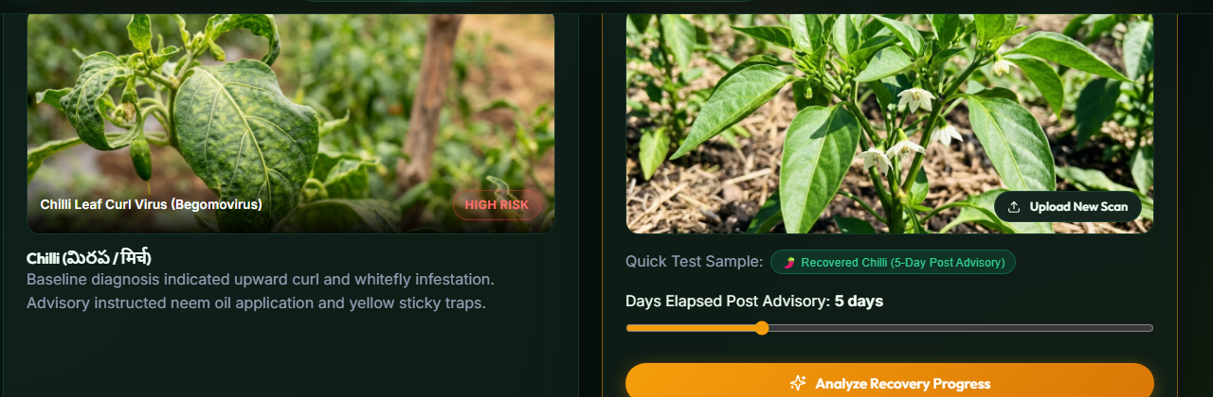
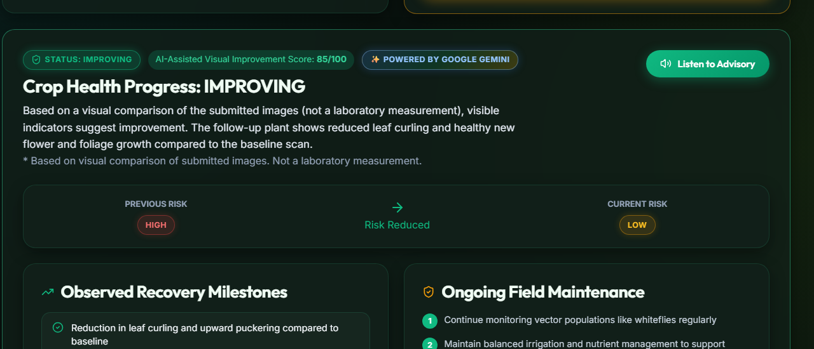
TRACK 4: AGRICULTURAL INTELLIGENCE
Verify Again: Closing the Agricultural Advisory Loop
Most AI agritech tools end at diagnosis. KisanVue AI introduces a continuous verification loop to assess real treatment efficacy.
THE 'VERIFY AGAIN' ENGINE
▶ The Industry Blind Spot
Traditional farmer apps give a single prescription and vanish. Farmers never know if treatments worked or wasted money.
▶ Multimodal Temporal Reasoning
Google Gemini compares baseline Day-0 foliar symptoms against Day-5 follow-up photographs to evaluate recovery trajectory.
▶ Quantitative Improvement Score
Outputs an 85/100 Visual Improvement Score, risk reduction delta (HIGH → LOW), and milestone progression.
▶ Rigorous Scientific Honesty
Explicitly labeled: 'AI-assisted visual improvement assessment — not a laboratory measurement'.
▶ Adaptive Recalibration
If symptoms worsen, the engine flags non-responsiveness and immediately triggers escalation to a local KVK agronomist.

Slide 9
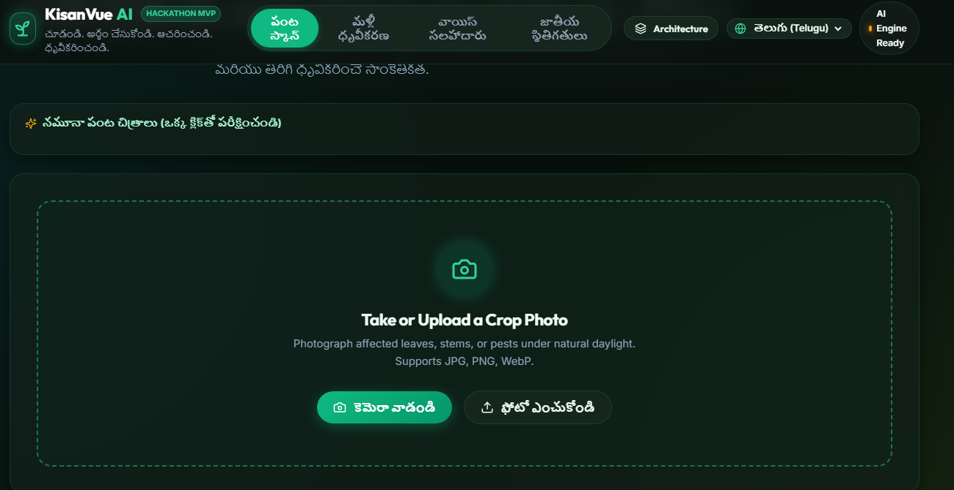
TRACK 4: AGRICULTURAL INTELLIGENCE
Built for India: Localized, Multilingual, Digital Public Good
Designed for India's linguistic, regional, and climatic diversity — making complex AI accessible to every marginal farmer.
English
Technical & Global Ag-Tech
Standard agronomic taxonomy, international soil definitions, and RESTful developer APIs.
తెలుగు (Telugu)
Andhra Pradesh & Telangana
చూడండి. అర్థం చేసుకోండి. ఆచరించండి. ధృవీకరించండి.
Localized vernacular advisory for chilli, cotton & paddy belts.
हिंदी (Hindi)
Northern & Central Hindi Belt
देखें. समझें. कार्य करें. सत्यापित करें.
Accessible agro-terminology for wheat, mustard, and soybean farmers.
DIGITAL PUBLIC GOOD ARCHITECTURE
• Scalable Hierarchy: Field → Village → Block → District → State level intelligence.
• No App Store Barrier: Zero-install progressive web application (PWA) running on mobile browsers.
• Voice-First Inclusivity: Speech synthesis and voice agronomist for non-literate farmers.
• Public Architecture: Designed to interoperate with open agricultural data standards across Indian agro-climatic zones.

Slide 10
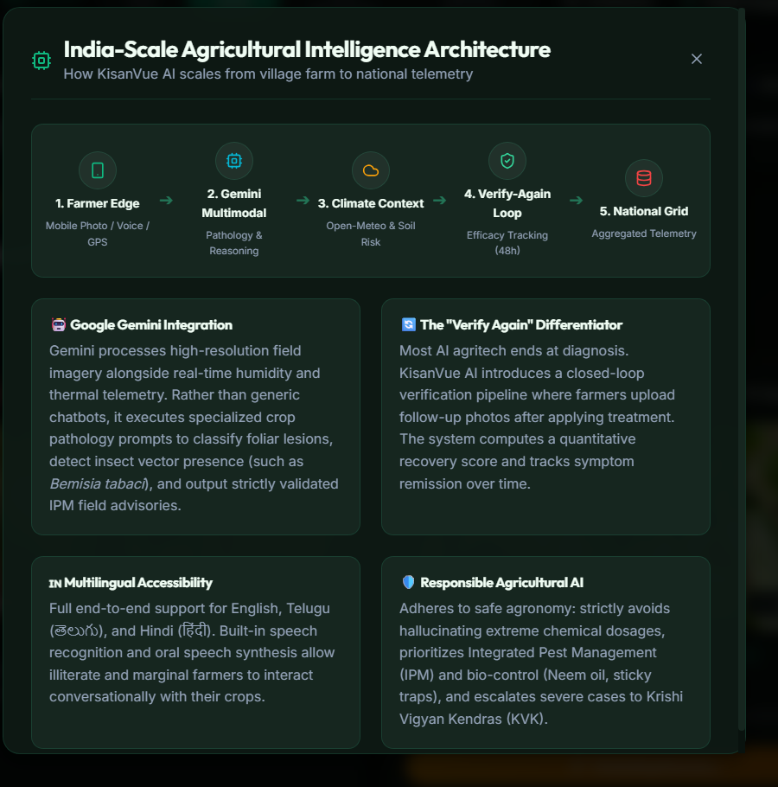
TRACK 4: AGRICULTURAL INTELLIGENCE
Technology Architecture: Composable Agricultural Intelligence
Production stack built for high reliability, rapid inference, and graceful degradation across variable rural connectivity.
Frontend Layer (Vercel) — React 18 + Vite SPA
Ultra-lightweight dark-mode UI, multilingual i18n dictionary (EN/TE/HI), camera API integration, zero heavyweight framework overhead.
API Gateway Layer (Render) — FastAPI / Python 3.12 Asynchronous Backend
Pydantic validated schemas, multi-threaded upstream aggregation, graceful demo/live fallback handlers, high-throughput REST endpoints.
Multimodal Intelligence (Google Cloud) — Google Gemini Multimodal API
High-resolution foliar image reasoning, visual symptom localization, structured JSON pathology outputs, and multi-temporal recovery comparison.
Environmental Integrations — Sentinel-2 + Open-Meteo + SoilGrids
10m NDVI & NDWI satellite indices, real-time agro-meteorology (temp, humidity, rain), and SoilGrids physical properties (SOC, clay%, sand%).

Slide 11
TRACK 4: AGRICULTURAL INTELLIGENCE
Potential Impact & Scalability: From One Field to National Telemetry
How localized farm insights aggregate into regional agricultural telemetry without compromising individual farm privacy.
1. SINGLE FIELD
Leaf photo + localized micro-climate + SoilGrids physical profile.
2. FARMER
Actionable IPM advisory, vernacular voice guidance & Verify-Again.
3. MANDAL / BLOCK
Early detection of vector hotspots (e.g. Whitefly in Chilli).
4. DISTRICT / STATE
Aggregated crop stress maps informing regional agricultural extension.
5. NATIONAL GRID
Composable, standardized agricultural APIs for research & public good.
PROJECTED VALUE PROPOSITIONS & SCALABILITY PATHWAYS
• Preventing Over-Chemicalization: By prioritizing bio-controls (Neem oil, sticky traps) and soil mulching, farmers avoid excessive chemical expense and soil toxicity.
• Early Stress Interception: Fusing 10m Sentinel-2 NDVI with real-time humidity alerts catches fungal outbreaks days before visual catastrophic crop loss occurs.
• Trust via Closed-Loop Verification: Farmers can track and prove recovery before spending additional capital on follow-up treatments.
• Frugal Rural Deployment: Operates efficiently on mobile browsers without requiring high-end smartphones or expensive proprietary sensors.

Slide 12
GOOGLE CLOUD · BUILD WITH AI : CODE FOR COMMUNITIES · TRACK 4
"KisanVue doesn't stop at diagnosis."
SEE
Farmer foliar scan & satellite Earth observation.
UNDERSTAND
Google Gemini multimodal agronomic reasoning.
ACT
Localized, soil-aware, weather-timed IPM advisory.
VERIFY
Follow-up visual score closing the loop.
KISANVUE AI — AI-Powered Agricultural Intelligence for India
Live Demo Application: https://kisanvue-ai.vercel.app/
GitHub Repository: https://github.com/HEMANTHSWAMY26/KISANVUE-AI
Track 4: Agricultural Intelligence

