Slide 1
VERIFYX
POINT. VERIFY. FIX. VERIFY AGAIN.
AI-Powered Physical-World Verification Engine
PHONE-FIRST • OFFLINE-FIRST • LOCAL AI VISION

Slide 2
THE PROBLEM
THE STANDARD IS DIGITAL. THE WORKPLACE IS PHYSICAL.
01. CHECKLIST
02. WALK
03. OBSERVE
04. PHOTOGRAPH
05. COMPARE
06. REPORT
MANUAL
Requires human inspectors to physically check every location manually.
SLOW
Compliance reports take hours or days to compile and submit.
INCONSISTENT
Subjective human checks lead to missed hazards and variance.
SCATTERED EVIDENCE
Inspection photos are isolated without structured audit context.
"Businesses have standards. People still have to manually verify reality."

Slide 3
THE SOLUTION
TURN THE PHONE INTO A VERIFICATION TOOL.
STEP 01
POINT
Aim camera or select evaluation scenario in workplace zone.
STEP 02
VERIFY
Local AI evaluates physical evidence against inspection rules.
STEP 03
FIX
Interactive visual feedback guides user to clear hazards.
STEP 04
VERIFY AGAIN
Re-scan confirms clearance & locks immutable evidence.
VERIFYX observes the physical environment, evaluates evidence against inspection rules, and guides the user toward a verifiable result.

Slide 4
HOW IT WORKS
PERCEPTION ➔ REASONING ➔ EVIDENCE
01. CAMERA / INPUT
Live feed or approved test sample
02. YOLO11n (ONNX)
10.15 MB WASM local model
03. OBJECT DETECTION
Raw bounding box & class label
04. CONFIDENCE POLICY
Confidence tiers (HIGH/MED/LOW)
05. SPATIAL RULE ENGINE
Corridor overlap & geometry reasoning
06. VERIFICATION DECISION
PASS / REVIEW / RESCAN state
07. EVIDENCE HISTORY
Initial violation & re-scan frames
08. INSPECTION REPORT
Printable audit record & JSON output
LOCAL INFERENCE • ASYNC SINGLE-FLIGHT PROCESSING • NO MANDATORY CLOUD AI

Slide 5
TECHNICAL DIFFERENTIATION
DETECTION IS NOT VERIFICATION.
AI PERCEPTION (YOLO11n)
"What is visible?"
• Identifies presence of trained object classes
• Generates raw 2D bounding box coordinates
• Outputs raw model probability / confidence
• Single-frame static observation snapshot
• Lacks awareness of workplace compliance rules
VERIFYX SPATIAL RULE ENGINE
"Does the evidence satisfy the rule?"
✔ Enforces strict confidence tiers (HIGH/MED/LOW)
✔ Applies object-size guardrails (< 32px rescan)
✔ Evaluates 2D spatial pathway corridor overlap
✔ Requires multi-observation temporal confirmation
✔ Preserves baseline & re-scan history side-by-side
CORE GUARANTEE: INSUFFICIENT EVIDENCE NEVER BECOMES AN AUTOMATIC PASS.

Slide 6
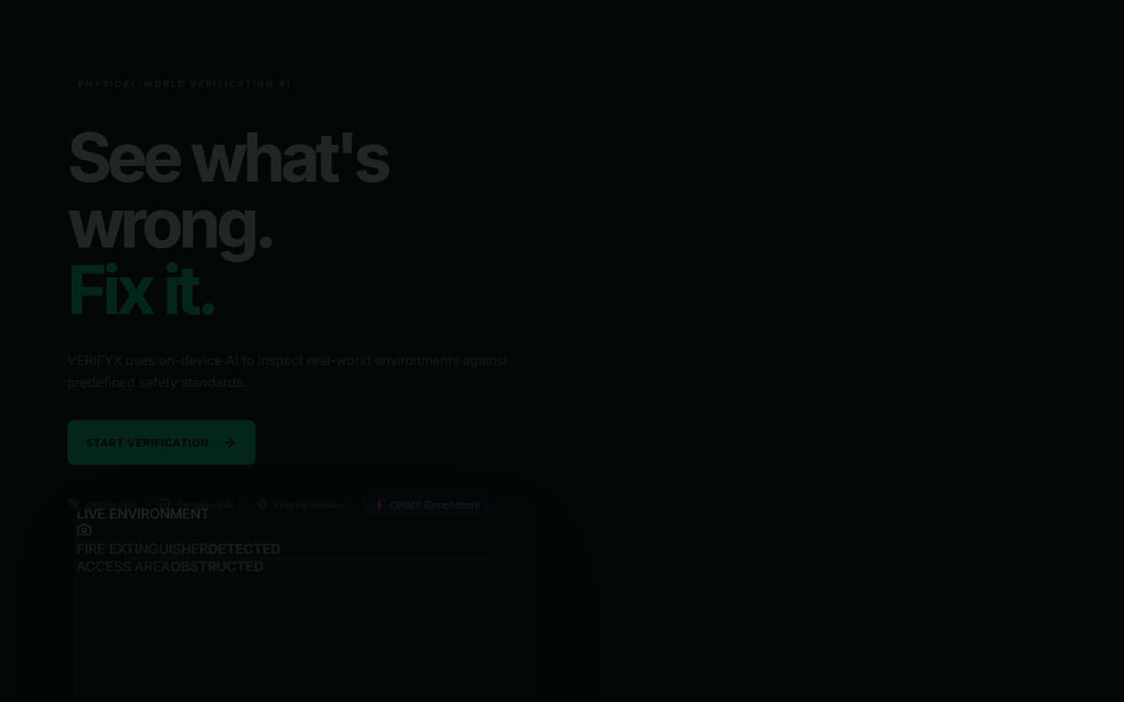
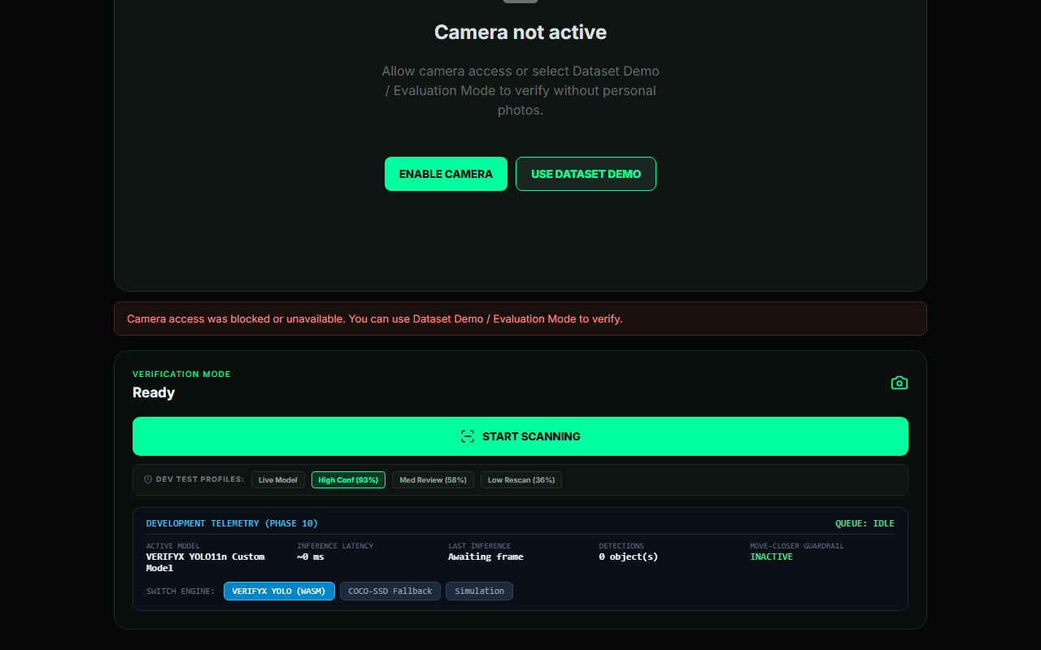
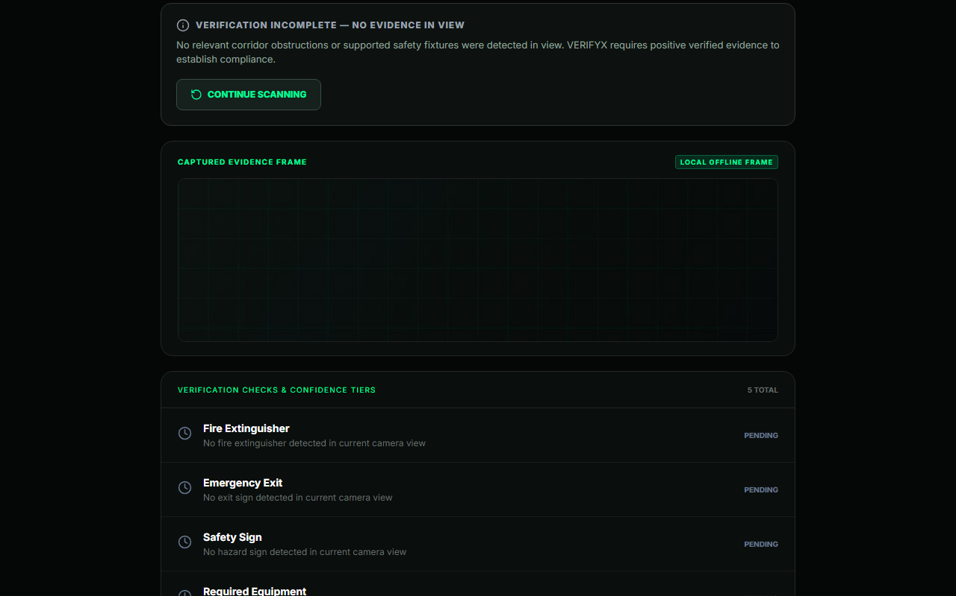
WORKING PROTOTYPE
FROM SCAN TO VERIFIED INSPECTION REPORT
01 START
02 SCAN
03 RESULTS
04 RE-SCAN
05 REPORT
INSERT ACTUAL VERIFYX SCREENSHOT
(04 RE-SCAN)
Dataset Demo / Evaluation Mode provides reproducible demonstration using approved held-out test imagery.

Slide 7
EXPERIMENTAL VALIDATION
MEASURED. TESTED. REPRODUCIBLE.
93.2%
FIRE EXTINGUISHER RECALL
Primary inspection zone (1.0m – 4.5m)
87.2%
EMERGENCY EXIT SIGN RECALL
Standard illuminated overhead signage
98.0%
HAZARD SIGN RECALL
Floor warning cones & safety placards
24 / 24
AUTOMATED TESTS PASSED
13 Spatial + 11 Report tests (100% pass)
10.15 MB
ONNX MODEL SIZE
640x640 resolution local WASM model
~2 FPS
BACKGROUND INFERENCE
~504ms latency with smooth 60 FPS video
* Measured evaluation results on prototype evaluation pool. Not certified compliance system.

Slide 8
FUTURE HORIZONS
FROM PROTOTYPE TO PHYSICAL-WORLD INFRASTRUCTURE
NOW (PROTOTYPE)
• Local browser ONNX inference
• Workplace safety verification
• Spatial pathway corridor reasoning
• Offline print & JSON report lifecycle
NEXT HORIZONS
• Native Android deployment
• Snapdragon NPU acceleration
• Expanded inspection rule profiles
• iQOO Office Kit companion bridge
ENTERPRISE VISION
• Custom inspection template builder
• Multi-location audit compliance
• Broader physical-world verification
• Autonomous drone/robot vision integration
"VERIFYX bridges the gap between digital standards and the physical world."
VERIFYX • POINT. VERIFY. FIX. VERIFY AGAIN. • Prototype only — not a certified workplace safety compliance system.

