Slide 1
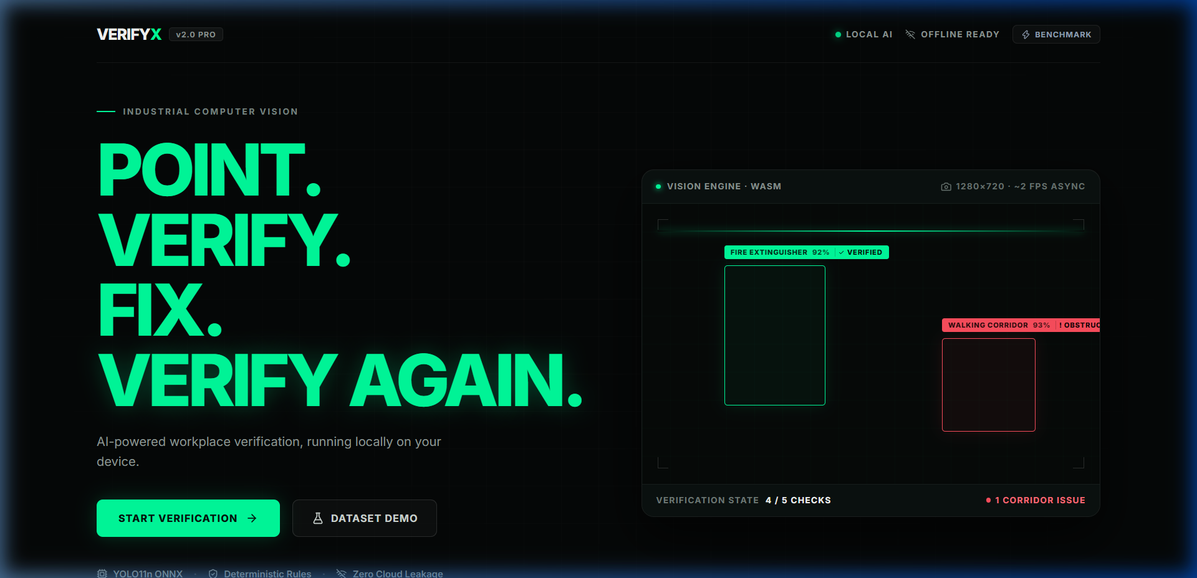
STAGE 01 // DEPLOYED APPLICATION · LIVE VERIFICATION ENGINE
● LIVE ON VERCEL
VERIFYX
"Verify Before You Trust."
AI-powered verification for detecting suspicious or potentially non-compliant physical workplace conditions.
A phone-first, in-browser AI verification engine. Reduces visual inspection ambiguity through automated object detection, deterministic spatial rule evaluation, and closed-loop audit reports.
24/24 UNIT TESTS PASS • DEVICE-LOCAL PROCESSING • ASYNC ~2 FPS HUD
AI • VERIFICATION • WORKFLOW | DEPLOYED: https://verifyx.vercel.app
Notes:
Judges, good morning. In an era where visual documentation and physical compliance are easily misdiagnosed or overlooked, trusting raw visual inspection alone creates massive operational blind spots.
This is VERIFYX — built around a straightforward operating principle: Verify Before You Trust.
VERIFYX is not a slide concept, not a mockup, and not an unvalidated research paper. It is an active, deployed web application running right now on Vercel at verifyx.vercel.app. It performs visual object detection, deterministic spatial reasoning, and closed-loop verification directly in the user's browser. Let me show you how it works.

Slide 2
STAGE 02 // MACRO CONTEXT · THE TRUST CRISIS
"Seeing is no longer believing."
The modern verification challenge across visual environments
CONTENT ───> UNKNOWN ORIGIN ───> MANIPULATION / INSPECTION RISK ───> UNCERTAIN TRUST
01
INFORMATION OVERLOAD
Facility managers, safety operators, and auditors encounter high volumes of visual scenarios and documentation daily.
The sheer volume and speed of modern operations can easily outpace manual review capacity.
02
PERCEPTION LIMIT
Human visual inspection can struggle with precise spatial relationships, clearance margins, and subtle hazard proximity.
Subjective human review suffers from fatigue, confirmation bias, and inconsistent evaluations.
03
FRAGMENTED VERIFICATION
Photos, notes, physical checklists, and audit reports frequently live in separate, disconnected workflows.
Without a continuous chain of evidence, verification details are lost between field inspection and sign-off.
"The problem isn't finding content. It's knowing whether to trust it."
Notes:
Every day, operations teams evaluate critical visual evidence: Is that exit corridor truly clear of obstructions? Is emergency equipment present and properly mounted? Has a previously flagged hazard actually been cleared?
Today, visual inspection fails because seeing is no longer believing. Humans are overloaded with visual checks, unable to reliably estimate spatial overlap percentages with the naked eye, and forced to manually copy-paste photos into disconnected spreadsheets.
When verification is fragmented, compliance degrades into guesswork.

Slide 3
STAGE 03 // ARCHITECTURAL PARADIGM SHIFT
"Verification should be a workflow, not a guess."
Transforming visual verification from subjective inspection to structured evidence
BEFORE // THE MANUAL GUESS
Capture ──> Inspect ──> Guess
• Uncalibrated visual appraisal
• Black-box subjective judgement
• No spatial dimension calculations
• Verbal remediation instructions left unverified
• High variance between individual inspectors
AFTER // THE VERIFYX WORKFLOW
CAPTURE ──> ANALYZE ──> VERIFY ──> EXPLAIN ──> REPORT
• Automated local object detection (YOLO11n ONNX)
• Geometric spatial rule evaluation (IoU overlap)
• Explicit explainability formula for every verdict
• Enforced Before/After rescan evidence for remediation
• Structured, timestamped JSON inspection records
PERCEPTION + REASONING = ACTIONABLE DECISION
"VERIFYX turns raw visual input into a structured, explainable decision."
Notes:
Our core insight is simple: Verification cannot be a one-off guess. It must be a continuous, structured workflow.
In legacy workflows, someone takes a photo, uploads it, squints at the image, and makes an uncalibrated call.
VERIFYX transforms this into a 5-stage closed-loop system: Capture the scene, Analyze bounding boxes and class detections, Verify against explicit geometric spatial rules, Explain the underlying decision formula, and export a structured Report.
We don't just output a probability score; we provide an explainable verdict.

Slide 4
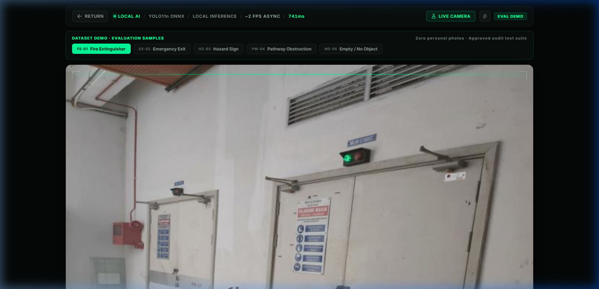
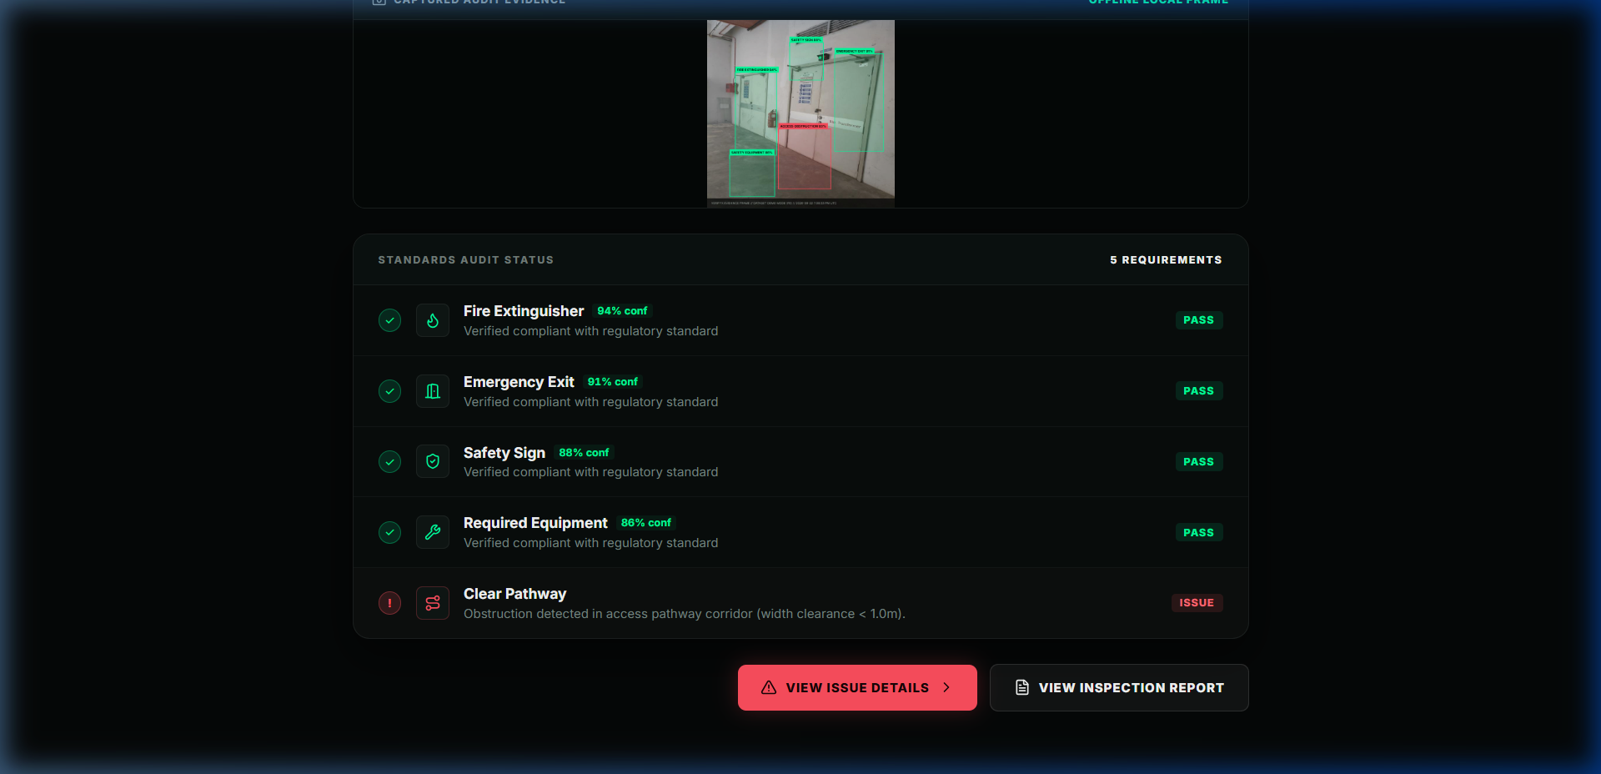
STAGE 04 // PRODUCT CAPABILITIES · LIVE SYSTEM
Meet VERIFYX.
An AI-powered verification workflow that turns ambiguous visual inputs into an explainable verification result.
01 LIVE SCAN
Real-time camera feed with in-browser inference reticles throttled at ~2 FPS async.
02 DATASET DEMO
Pre-loaded evaluation suite running 5 standardized workplace safety test cases.
03 VERIFICATION RESULTS
Real-time checklist resolution tallying verified standards (4 / 5 VERIFIED).
04 ISSUE DETECTION
Mathematical spatial rule engine identifying bounding box conflicts & pathway intrusions.
05 RESCAN
Closed-loop remediation workflow: side-by-side Before/After targeting confirming clearance.
06 AUDIT REPORT
Structured inspection log (VX-INSP-2026-XXXX) with timestamps and JSON export.
INPUT ──> AI ANALYSIS ──> SPATIAL RULES ──> VERIFICATION RESULT ──> REPORT
Notes:
Meet VERIFYX.
This is a functional, end-to-end verification engine. As you can see, VERIFYX allows an operator to point their device camera at a target scene — or run through our built-in dataset evaluation mode.
The engine scans the frame, isolates bounding boxes, checks spatial overlaps against safety rules, flags specific issues, requires a rescan to prove remediation, and packages the results into an inspection report.
You can try this right now at verifyx.vercel.app.

Slide 5
STAGE 05 // SYSTEM ARCHITECTURE & PIPELINE
Inside the VERIFYX verification pipeline.
A 4-tier decoupled architecture combining in-browser neural perception and deterministic spatial logic
USER LAYER
WebRTC Camera Stream (640x640 Canvas) • Dataset Evaluation Suite (5 Test Scenarios)
PROCESSING LAYER
Frame Normalization (RGB, Float32) • Temporal Confirmation (Sliding Window Buffer)
INTELLIGENCE LAYER
Primary: Custom YOLO11n ONNX via WebAssembly (onnxruntime-web 1.30.0)
Fallback: Local TF.js COCO-SSD · Deterministic Simulation Engine
Spatial Engine: Bounding Box Overlap, Size Guardrail (<32px), Egress Pathway Clearance
OUTPUT LAYER
Dynamic Reticle HUD • Issue Explainability Matrix • Structured JSON Report (VX-INSP-2026-XXXX)
TECHNICAL PRINCIPLE: Camera frames are processed locally in the browser; they are not transmitted to external servers.
Notes:
Let's look at the technical architecture that powers VERIFYX.
The system operates across four decoupled layers:
First, the User Layer acquires video via WebRTC canvas streams.
Second, the Processing Layer normalizes pixel tensors and applies a lightweight temporal confirmation buffer across consecutive frames.
Third, the Intelligence Layer: our primary engine runs a custom YOLO11n ONNX model executing inside browser WebAssembly via ONNX Runtime Web. It detects target objects, while our pure TypeScript Spatial Rule Engine evaluates bounding box overlap, minimum pixel dimensions, and clearance zones. If WASM encounters restrictions, it gracefully falls back to local TensorFlow.js or our deterministic simulation adapter.
Finally, the Output Layer renders interactive HUD overlays and generates structured JSON reports.
All image processing happens locally on the client device without sending video frames to cloud servers.

Slide 6
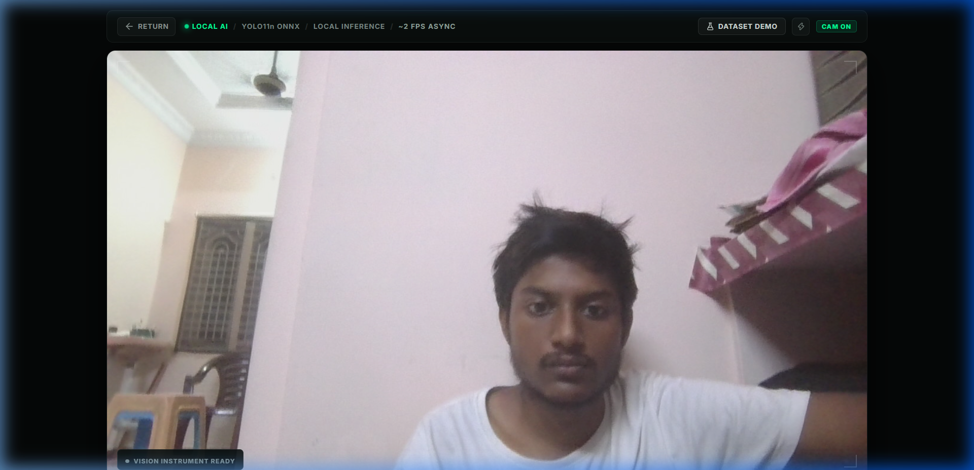
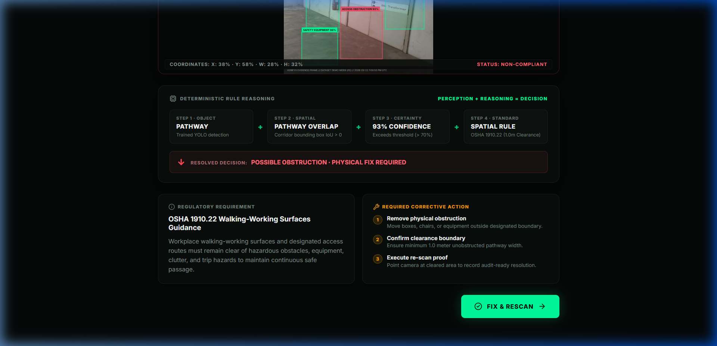
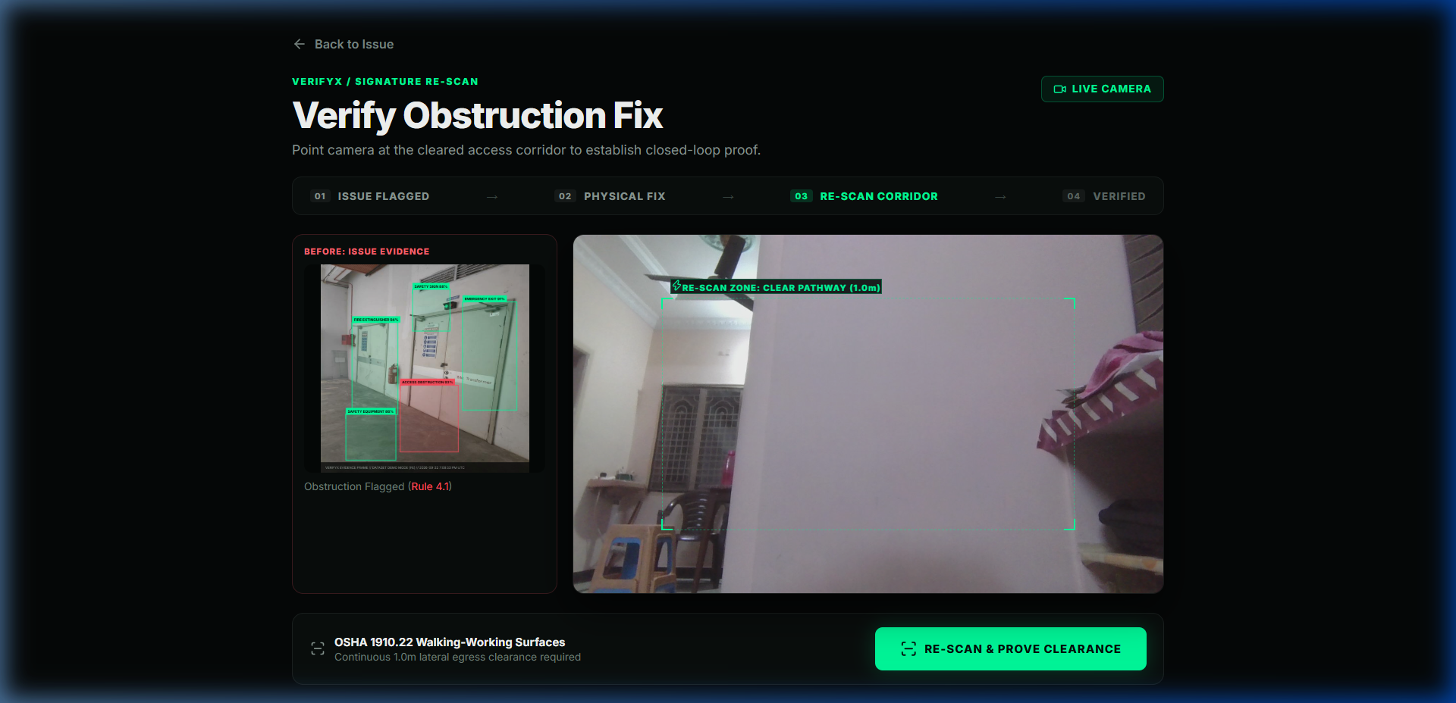
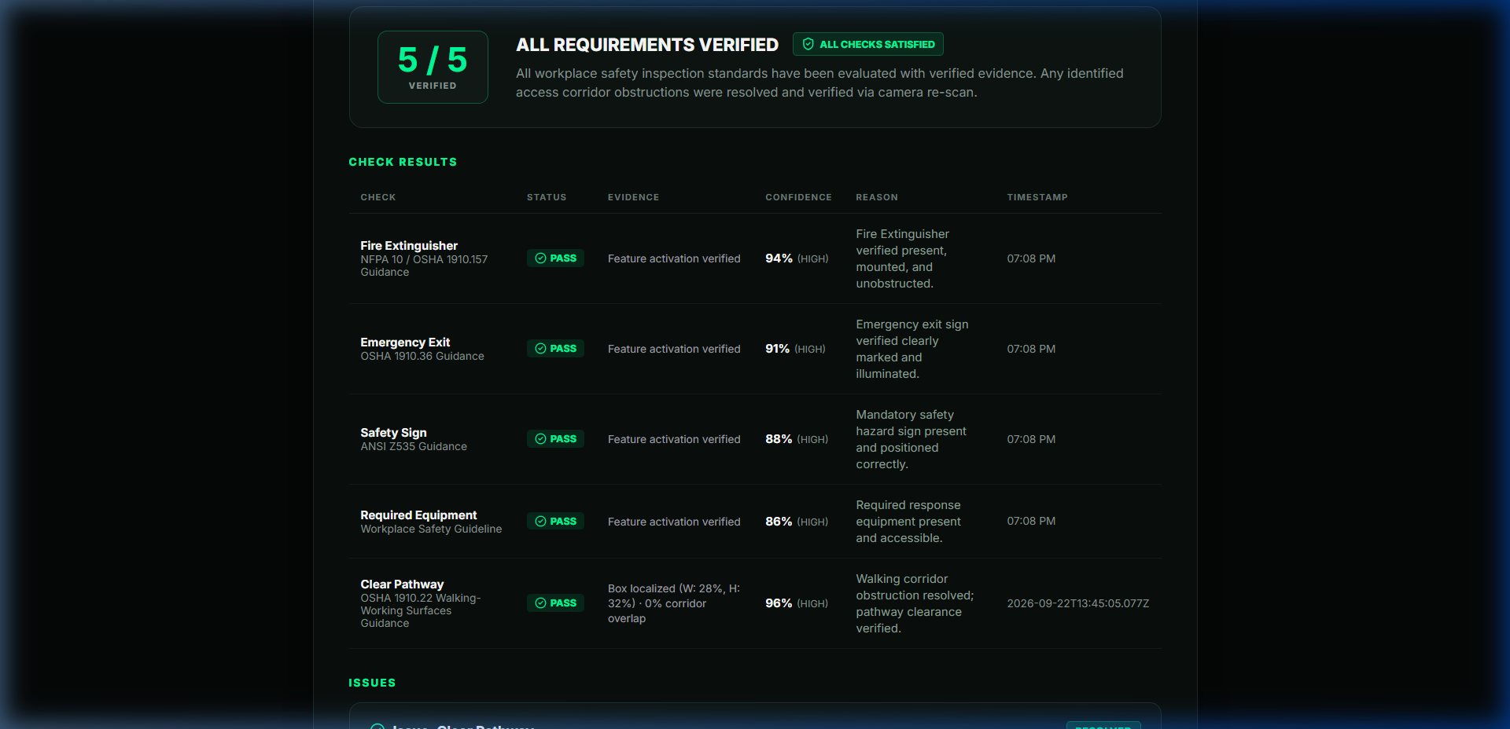
STAGE 06 // USER WORKFLOW & INTERACTION DESIGN
From scan to decision in one flow.
The complete closed-loop inspection journey: point, verify, fix, and verify again
01 LIVE SCAN
Real-time camera stream HUD
02 ANALYZE
In-browser YOLO inference
03 RESULT
Instant 4/5 checklist resolution
04 ISSUE DETAILS
Explicit decision formula
05 RESCAN
Before/After clearance check
06 REPORT
Structured audit log & export
EXPLAINABLE FORMULA: DETECTION [Chair @ (x,y,w), Conf: 88%] + SPATIAL RULE [Pathway Overlap > 10%] = POSSIBLE OBSTRUCTION
LIVE TARGETING
REASONING FORMULA
CLOSED-LOOP RESCAN
AUDIT RECORD
Notes:
An AI model alone is not a solution. A complete solution is a user workflow that resolves an inspection task without friction.
In VERIFYX, an operator completes a verification cycle in a single coherent flow:
They run a Live Scan, the engine evaluates the scene, displays a 4/5 checklist result, breaks down why item #4 was flagged, prompts an immediate physical correction and rescan, and generates an inspection record.
We closed the loop between detecting an issue and verifying that it was corrected.

Slide 7
STAGE 07 // WORKFLOW ADVANTAGE & POSITIONING
"VERIFYX doesn't just flag. It explains."
Objective architectural comparison between manual inspection methods and VERIFYX
DIMENSION
MANUAL INSPECTION METHODS
THE VERIFYX WORKFLOW
Tooling
Disconnected: Camera + Paper / Spreadsheets
Single In-Browser Web Application
Analysis
Subjective, uncalibrated visual estimate
Object Detection + Geometric Spatial Rules
Explainability
Intuition-based ('looks blocked')
Explicit Breakdown: Detection + Spatial Rule = Verdict
Remediation
Untracked verbal instruction
Enforced Before/After Rescan Evidence
Audit Trail
Fragmented photos & unlinked notes
Structured JSON with Session ID & Timestamps
Processing
Manual review after the inspection
Real-Time On-Device Assessment
CORE ADVANTAGE: DETECTION + SPATIAL RULE = EXPLAINED VERDICT
Notes:
Standard computer vision demos often present raw bounding boxes and confidence percentages. To an inspection or safety team, a raw probability number is not an actionable decision.
VERIFYX is built differently: We don't just flag; we explain.
When an obstruction is detected, VERIFYX presents the underlying formula: Detected Object, plus Pathway Zone overlap, plus Rule Threshold equals Required Action.
It transforms subjective visual assessments into structured, explainable findings.

Slide 8
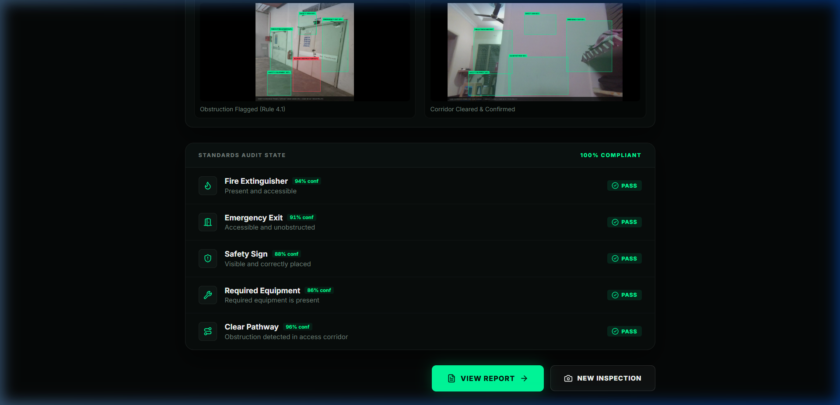
STAGE 08 // TECHNICAL CREDIBILITY & TEST RIGOR
Built. Tested. Deployed.
Demonstrated software engineering discipline with zero mockups and 100% test pass rate
24 / 24
TESTS PASSED (100%)
• 13 Spatial Rule Engine Tests
• 11 Report Lifecycle Tests
• Edge case validation (<32px guardrail)
• Temporal buffer tests
• No fabricated evidence test check
• Dev mock transfer bridge test
BUILD STATUS
PASS (Zero Errors)
MOBILE VIEWPORT
VALIDATED
Touch HUD
DESKTOP VIEWPORT
VALIDATED
Responsive
LIVE SCAN
PASS (~2 FPS Async)
DATASET DEMO
PASS (5 Test Cases)
CLOSED RESCAN
PASS (Remediation)
AUDIT REPORT
PASS (JSON Export)
GIT REPOSITORY
Commit afb0952
CLOUD HOSTING
Vercel Edge
LIVE APPLICATION
verifyx.vercel.app
Notes:
Judges, early-stage AI projects often look compelling in slides but fail when tested.
VERIFYX is grounded in verified software implementation:
- 24 out of 24 automated unit tests pass, validating edge cases, minimum object sizes (<32px), temporal confirmation, and report generation.
- Production build passes cleanly with zero TypeScript errors.
- Responsive layouts are validated across mobile and desktop browser viewports.
- Code is committed in Git under hash afb0952 and actively deployed on Vercel.
You can visit verifyx.vercel.app on your own device and inspect the live product.

Slide 9
STAGE 09 // ROADMAP & FUTURE WORKFLOWS
From verification prototype to inspection platform.
Clear separation between current live capabilities and future development horizons
TODAY // LIVE
IMPLEMENTED & TESTED
• In-browser verification web application
• YOLO11n ONNX via WebAssembly
• Spatial Rule Engine (clearance & size)
• Tiered fallback pipeline (TF.js / Sim)
• Closed-loop Before/After Rescan
• Structured JSON inspection reports
• Deployed on Vercel Edge Network
NEXT // ROADMAP
PLANNED (NOT YET IMPLEMENTED)
• REST & Webhook APIs for facility systems
• Additional inspection categories
• User-configurable spatial rule sets
• Browser extension for desktop verification
• Native iOS / Android wrapper packaging
• Export integrations for safety databases
FUTURE // VISION
RESEARCH (LONG-TERM)
• Cryptographic signing for tamper-evident records
• Multi-camera temporal tracking across zones
• Automated compliance export adapters
• Continuous on-device model adaptation
• Universal verification protocol
TARGET USE CASES: Egress corridor clearance, emergency equipment accessibility, facility maintenance records.
DISCLAIMER: VERIFYX is currently a prototype verification rule engine and not a certified safety compliance system.
Notes:
Where can VERIFYX go from here?
Today, we have demonstrated a working core thesis: explainable, in-browser visual verification with closed-loop rescan tracking.
Looking ahead, we plan to develop external webhook integrations, support custom user-defined spatial rules, and explore cryptographic signing for tamper-evident audit records.
Our goal is to build an accessible, explainable verification platform for routine inspection workflows.

Slide 10
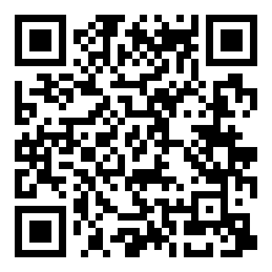
STAGE 10 // CALL TO ACTION · LIVE EVALUATION
DON'T JUST CONSUME INFORMATION.
VERIFY IT.
SCAN FOR LIVE DEMO
VERIFYX
"Verify Before You Trust."
https://verifyx.vercel.app
Runs directly on your smartphone browser.
No app download required.
● LIVE WEB APPLICATION ● 24/24 TESTS PASSED ● DEVICE-LOCAL PROCESSING
BUILT • TESTED • DEPLOYED | GITHUB COMMIT: afb0952
Notes:
In an environment where visual assumptions lead to overlooked hazards, having an explainable verification workflow matters.
Don't assume.
Verify before you trust.
The product is live right now at verifyx.vercel.app. Visit the link or scan the QR code to test VERIFYX directly on your phone.
Thank you, and I look forward to your questions.

