Slide 1
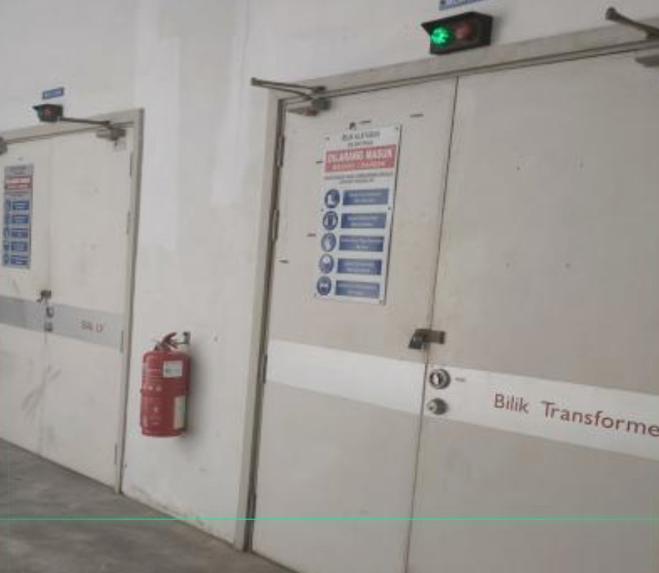
VERIFYX
VERIFY BEFORE
YOU TRUST.
AI-powered visual verification for physical workplace conditions.
● LIVE
● ON-DEVICE
● EXPLAINABLE
VERIFYX · AI VISUAL VERIFICATION ENGINE
verifyx-gray.vercel.app · 01 / 10
Notes:
Welcome to VERIFYX. Traditional vision models identify objects, but cannot verify whether physical workplace conditions satisfy safety standards. VERIFYX runs on-device in the browser to deliver immediate, explainable verification verdicts without server round-trips.

Slide 2
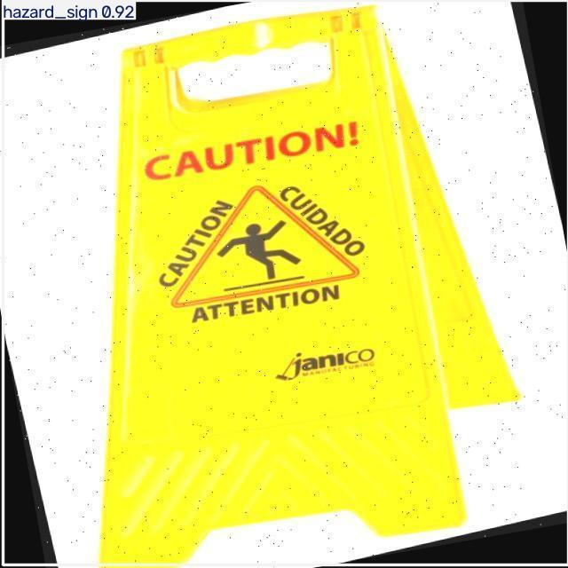
THE PROBLEM
VISUAL INSPECTION IS EASY TO MISS.
Critical spatial conditions are difficult to judge consistently.
01 · Human visual judgement
Subjective and prone to inspector fatigue across daily routines.
02 · Difficult spatial relationships
Clearances and pathway boundaries cannot be judged by eye reliably.
03 · Disconnected remediation
Issues are flagged manually without verifiable evidence of a fix.
VERIFYX · AI VISUAL VERIFICATION ENGINE
verifyx-gray.vercel.app · 02 / 10
Notes:
Human visual inspection is inherently subjective. Spatial relationships like minimum clearance width cannot be judged reliably by eye, and when problems are flagged, there is no closed-loop mechanism to prove they were ever remediated.

Slide 3
CORE INSIGHT
DETECTION ≠ VERIFICATION
Detecting an object is not the same as verifying compliance.
OBJECT
DETECTED
YOLO11n identifies target class & location
SPATIAL
RULE
Bounding-box overlap & clearance math
RESCAN
Closed-loop verification of physical fix
VERIFIED
Structured, explainable compliance record
+
+
=
VERIFYX turns visual detection into an explainable verification workflow.
VERIFYX · AI VISUAL VERIFICATION ENGINE
verifyx-gray.vercel.app · 03 / 10
Notes:
Detection alone is never verification. A bounding box doesn't tell an auditor if a safety rule passed. VERIFYX combines object detection with deterministic spatial rules and a closed-loop rescan to turn raw vision into verified compliance.

Slide 4
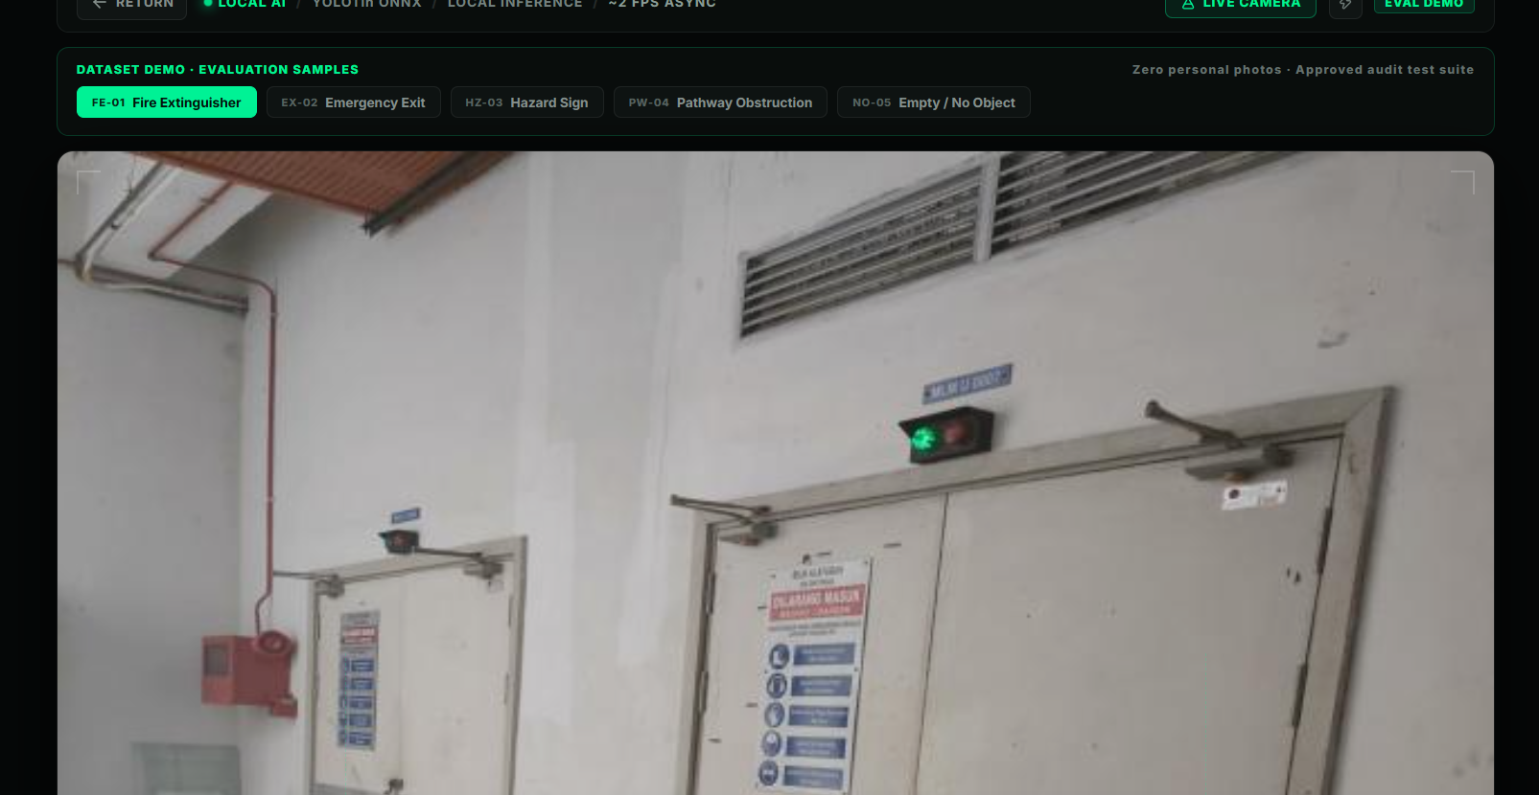
THE PRODUCT
POINT. VERIFY. FIX.
Real-time browser-local inspection interface.
LIVE SCAN
Target scene via mobile or desktop camera
DETECT
Run on-device YOLO11n ONNX inference
EXPLAIN
Evaluate geometric rules and state reasons
RESCAN
Confirm physical hazard removal before exit
VERIFYX · AI VISUAL VERIFICATION ENGINE
verifyx-gray.vercel.app · 04 / 10
Notes:
Here is the product interface. The operator aims the camera, VERIFYX scans the area, detects objects, checks spatial clearances against predefined safety standards, and prompts for a rescan if any remediation is required.

Slide 5
SYSTEM ARCHITECTURE
FROM CAMERA TO VERDICT.
A 6-stage deterministic pipeline running client-side.
01
02
03
04
05
06
CAMERA
Capture scene
HTML5 Video Feed
AI DETECTION
YOLO11n ONNX
ONNX Runtime Web
SPATIAL RULE
Bounding-box geometry
Overlap & Clearances
VERDICT
Explain why
Pass, Issue, Review
RESCAN
Verify correction
Closed-Loop Evidence
REPORT
Structured record
Portable JSON Audit
→
→
→
→
→
Camera frames are processed locally in the browser; they are not transmitted to external servers.
VERIFYX · AI VISUAL VERIFICATION ENGINE
verifyx-gray.vercel.app · 05 / 10
Notes:
The architecture consists of six sequential stages. Video frames are captured by the browser, fed to an on-device YOLO11n ONNX model via WebAssembly, evaluated against geometric rules, explained in human terms, re-verified upon fix, and stored as structured JSON.

Slide 6
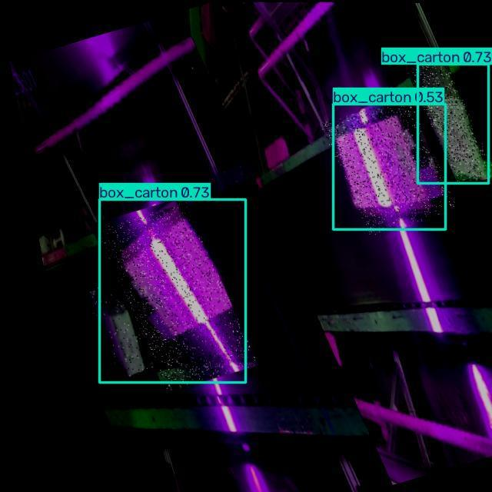
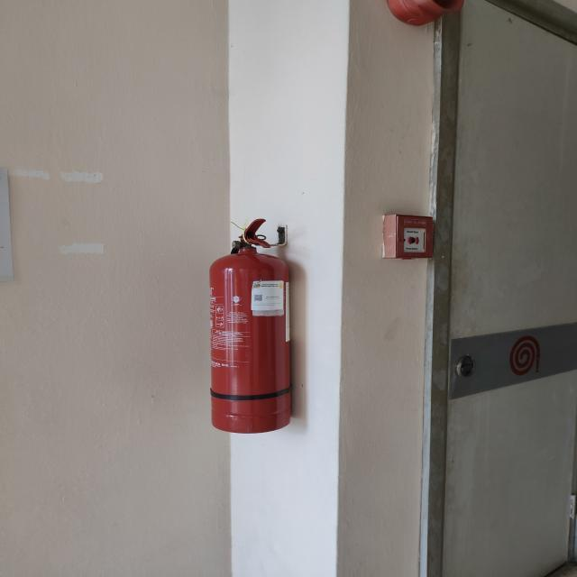
CLOSED-LOOP VERIFICATION
SEE IT. FIX IT. VERIFY IT.
Actual dataset detection evidence compared against clearance verification.
BEFORE · OBSTRUCTION DETECTED
AFTER · RESCAN VERIFIED
→
POSSIBLE OBSTRUCTION → CLEARANCE VERIFIED
VERIFYX · AI VISUAL VERIFICATION ENGINE
verifyx-gray.vercel.app · 06 / 10
Notes:
This slide proves the core workflow with real test evaluation data. On the left, an obstruction box is detected blocking the pathway. On the right, following physical relocation, the rescan confirms the zone is clear, creating verifiable evidence.

Slide 7
COMPETITIVE ADVANTAGE
NOT JUST A DETECTION.
A fundamental shift from subjective observation to deterministic verification.
TRADITIONAL
✕ Human visual judgement
✕ Subjective reasoning
✕ Manual remediation
✕ Fragmented evidence
VERIFYX
✓ AI detection
✓ Spatial reasoning
✓ Before/After rescan
✓ Structured evidence
VERIFYX · AI VISUAL VERIFICATION ENGINE
verifyx-gray.vercel.app · 07 / 10
Notes:
Traditional facility audits rely on human checklists, subjective opinions, and fragmented paper trails. VERIFYX replaces this with automated AI perception, geometric spatial rules, a mandatory Before/After rescan, and exportable digital proof.

Slide 8
VERIFIED EXECUTION
BUILT. TESTED. DEPLOYED.
Fully verified implementation running on production infrastructure.
24 / 24
13 Spatial Rule Tests · 11 Report Lifecycle Tests
BUILD ✓
MOBILE ✓
DESKTOP ✓
LIVE ✓
RESCAN ✓
REPORT ✓
Git Commit: afb0952 · verifyx-gray.vercel.app
VERIFYX · AI VISUAL VERIFICATION ENGINE
verifyx-gray.vercel.app · 08 / 10
Notes:
VERIFYX is not a mock concept. All 24 automated unit tests pass, covering 13 spatial rule edge cases and 11 report lifecycle states. The web application is built, verified across mobile and desktop devices, and running live on Vercel at commit afb0952.

Slide 9
ROADMAP
THE VERIFICATION LAYER CAN GROW.
A clear distinction between what is implemented and what comes next.
TODAY
Working verification engine
• YOLO11n ONNX in browser
• 5 spatial safety rules
• Closed-loop rescan flow
• Structured JSON export
NEXT
Custom rules, APIs, Integrations
• User-defined rule schema
• REST & Webhook push APIs
• Facility management export
• Batch multi-item audit
FUTURE
Tamper-evident records, Multi-camera workflows
• Cryptographic audit logs
• Multi-camera sync
• Automated work order trigger
• Spatial digital twin mapping
Prototype verification rule engine — not a certified safety compliance system.
VERIFYX · AI VISUAL VERIFICATION ENGINE
verifyx-gray.vercel.app · 09 / 10
Notes:
We have established clear architectural boundaries. Today we have a functional client-side engine with five rules. Next, we will introduce custom rule APIs and webhook notifications. In the future, we aim to support continuous multi-camera verification.

Slide 10
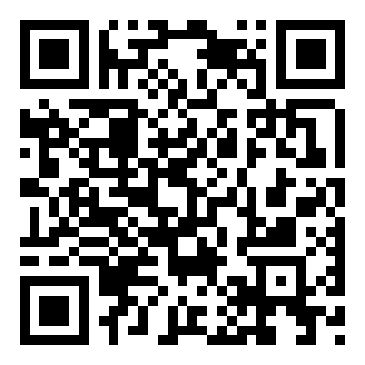
THE NEW STANDARD IN FACILITY AUDITS
DON'T JUST TRUST IT.
VERIFY IT.
Built • Tested • Deployed
https://verifyx-gray.vercel.app/
Deterministic AI visual verification running client-side.
verifyx-gray.vercel.app
Scan with your phone to test live
VERIFYX · AI VISUAL VERIFICATION ENGINE
verifyx-gray.vercel.app · 10 / 10
Notes:
Don't take our word for it—verify it yourself. Please scan the QR code to experience VERIFYX running live on your mobile device right now. Thank you, and we're ready for your questions.

