Slide 1
Secure Data Hiding in Image Using Steganography
Presented By : Perala Hemanth
Student Name : Perala Hemanth
College Name & Department : VNR VJIET [CSE]

Slide 2
OUTLINE
Problem Statement
Technology used
Wow factor
End users
Result
Conclusion
Git-hub Link
Future scope

Slide 3
Problem Statement
In an era of increasing digital communication, ensuring data privacy and security is crucial. Traditional encryption methods protect data but make its presence obvious. This project addresses the need for covert communication by securely hiding encrypted messages within images using Least Significant Bit (LSB) steganography. The combination of AES encryption and image steganography ensures that sensitive information remains both hidden and secure, preventing unauthorized access.

Slide 4
Technology used
Libraries:
Python – Core programming language
OpenCV – Image processing
Pillow (PIL) – Image handling
NumPy – Efficient array processing
Tkinter – GUI development
PyCryptodome – AES encryption

Slide 5
Wow factors
Dual Security: Combines AES encryption with image steganography for enhanced protection.
Invisible Communication: Messages remain undetectable to the human eye.
User-Friendly Interface: Intuitive Tkinter GUI for easy encryption and decryption.
Automatic File Management: Encrypted images and decrypted text are stored with unique timestamps to prevent overwriting.
Custom Key Protection: Uses a user-defined key to ensure only authorized decryption.

Slide 6
End users
Individuals & Organizations – For secure data sharing without suspicion
Journalists & Whistleblowers – To transmit sensitive information safely
Government & Defense Agencies – For covert communication
Cybersecurity Professionals – To research data hiding techniques
Privacy-Conscious Users – To keep personal data confidential

Slide 7
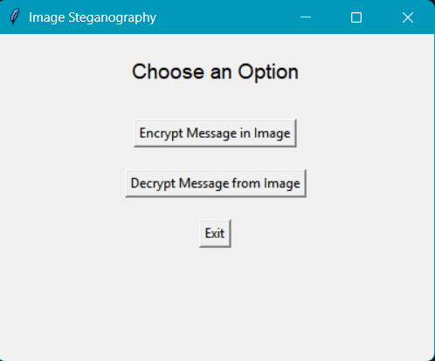
Results

Slide 8
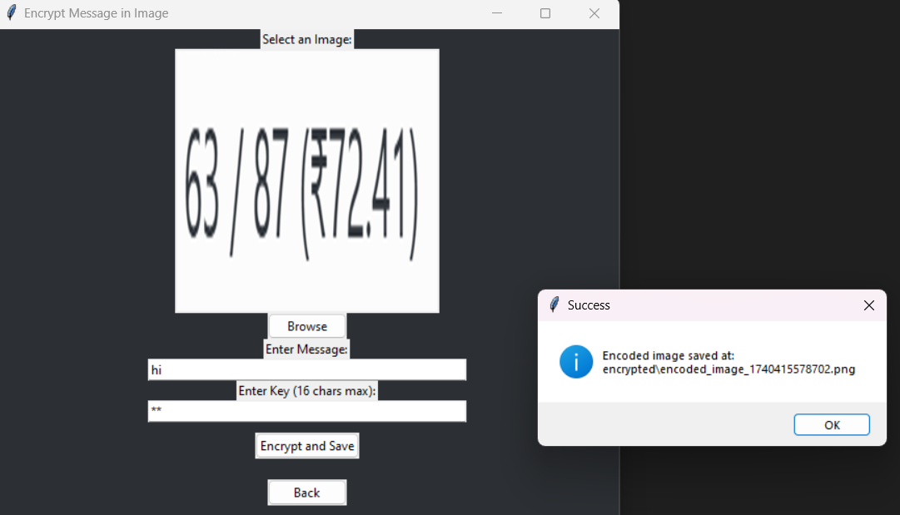
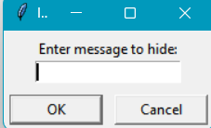
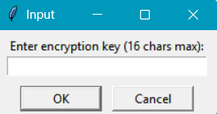
Results

Slide 9
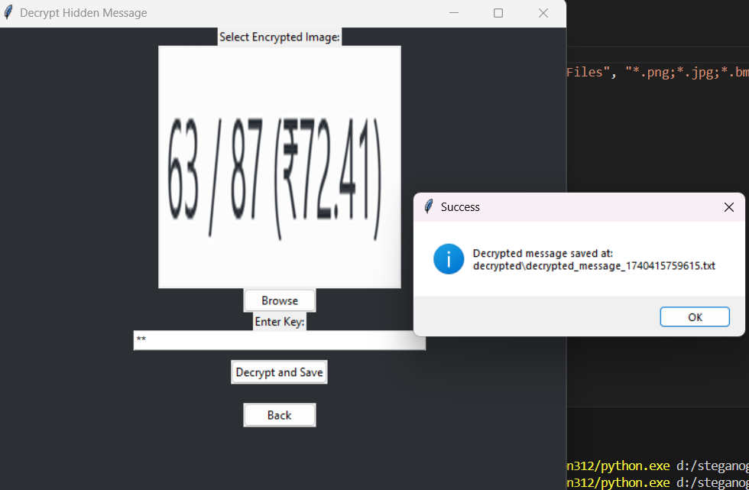
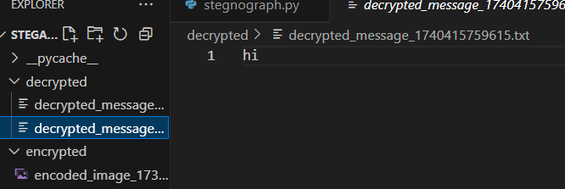
Results

Slide 10
Conclusion
This project provides a highly secure and covert method for data transmission by integrating AES encryption and LSB steganography. It ensures data confidentiality while keeping the presence of hidden information undetectable. The user-friendly GUI makes encryption and decryption accessible to non-technical users, making this a practical and efficient solution for secure communication.

Slide 11
GitHub Link
https://github.com/HEMANTHZ10/steganography

Slide 12
Future scope(optional)
Advanced Encryption Methods – Implementing AES-GCM, RSA, or hybrid encryption for added security.
Multiple Image Formats – Extending support for GIF, TIFF, and WEBP images.
Compression & Optimization – Reducing file size without data loss.
Mobile & Web Integration – Deploying as a mobile app or web tool for wider accessibility.
Deep Learning-Based Detection Resistance – Enhancing resistance against steganalysis using AI techniques

Slide 13
THANK YOU

