Slide 1
土製jPeG圖片壓縮
姓名：張恆安
學號：410986044

Slide 2
流程圖
KimberlyNCat.bmp
Read bmp
Data is temporarily stored in memory
Read information: R.txt、G.txt、B.txt、dim.txt
store information: R.txt、G.txt、B.txt、dim.txt
Data is temporarily stored in memory
Define bmp 、initialize bmp
Write bmp
ResKimberlyNCat.bmp
encoder
decoder

Slide 3
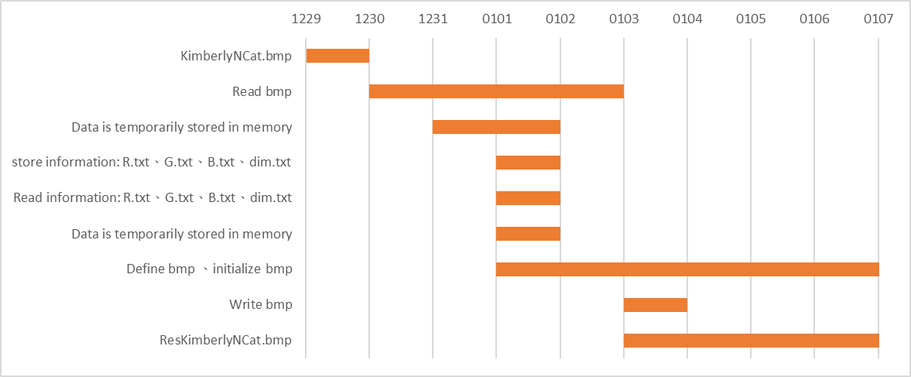
施工進度甘特圖回顧

Slide 4
心得、感想、許願、以及建議:
希望未來能把final project難度降低一些，把前面的part比分調高一些或是後面的part改用加分的形式。
希望能在課堂間實作一些小的assignment，類似鵬華老師上課的方式，不然有時候上課光是用聽的，實在是很抽象，回去作業又得重頭找資料，遇到bug時也不確定問題在哪，花費非常多的時間在debug上。

Slide 5
參考文獻
https://github.com/ryankurte/microgui/blob/master/source/bmp.c?fbclid=IwAR21TL5jV9sNjbsAFk9gOAhROCWIT7uRNK76jROBYHmh3Mb7nuKhNPYc4eI
https://blog.csdn.net/happyday_d/article/details/132757870?fbclid=IwAR3jjWJt7XOTDWwkq4F9oCzQ8T0DFbd1CkLJfbJ3pOxp0uXMZx6uVhDCyCw
https://qftm.github.io/2019/09/19/information-hiding-and-detection-based-on-bmp-image/?fbclid=IwAR0RtMl7g5bNEvh7_V_6DTT5Q_cORxJIaiq9IScIS83jn-N3NwpyRCLjfiI
https://www.oocities.org/gamestudio/technique/dib/dib.html?fbclid=IwAR21TL5jV9sNjbsAFk9gOAhROCWIT7uRNK76jROBYHmh3Mb7nuKhNPYc4eI
https://codereview.stackexchange.com/questions/196084/read-and-write-bmp-file-in-c
https://blog.csdn.net/l12345678/article/details/1745084
https://blog.csdn.net/l316194152/article/details/108563516

