Slide 1
NAME :- Manan Patel Seat NO :- 1421
R.K. DESAI ACHCHHARIWALA COLLEGE OF COMPUTER & APPLIED SCIENCES, VAPI

Slide 2
INDEX
Sr No | Topics | Slide No.
1 | Project Title | 3
2 | Introduction , Site Purpose | 4 - 5
3 | Development Use | 6
4 | Objective | 7
5 | Flow Chart | 8
6 | Data Flow Diagram | 9 - 11
7 | Project Limits | 13
8 | References | 14
9 | Live Preview | 15
10 | Thank You | 16

Slide 3
DICE ROLL

Slide 4
INTRODUCTION
A traditional die is a cube with each of its six faces marked with a different number of dots (pips) from one to six. When thrown or rolled, the die comes to rest showing a random integer from one to six on its upper surface

Slide 5
DEVELOPMENT USE
Front-end : HTML , CSS
Back-end : JAVASCRIPT
Editor : Visual Studio Code

Slide 6
SITE PURPOSE
To gamble or take a chance on something or someone

Slide 7
Flow Chart
Start
User Roll
Number Generate
Get Number
Game end

Slide 8
Data Flow Diagram
Zero Level / Context Level
User
Dice Roll
System Give response
User Request to System

Slide 9
1st Level of DFD
Response Server
1.0
Game start
Request user
User
2.0
Roll Dice
Response server
User Roll Dice
Response server
3.0
Number Generate
Read Number

Slide 10
Project Limits
In Feature add more features.
Build More User Friendly.
Game in add More Dice

Slide 11
REFERENCE
YouTube
Google

Slide 12
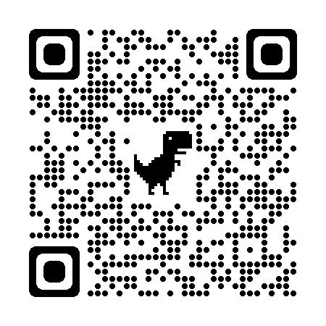
Live Preview

Slide 13
Thank You

