Slide 1
NAME :- Pratik Shankarbhai Patel Seat NO :- 1422 Guide :- Neha Ma’am
R.K. DESAI ACHCHHARIWALA COLLEGE OF COMPUTER & APPLIED SCIENCES, VAPI

Slide 2
INDEX
Sr No | Topics
1 | Project Title
2 | Introduction , Site Purpose
3 | Development Use
4 | Objective
5 | Flow Chart
6 | Data Flow Diagram
8 | Project Limits
10 | References
11 | Live Preview
12 | Thank You

Slide 3
Tic Tac Toe

Slide 4
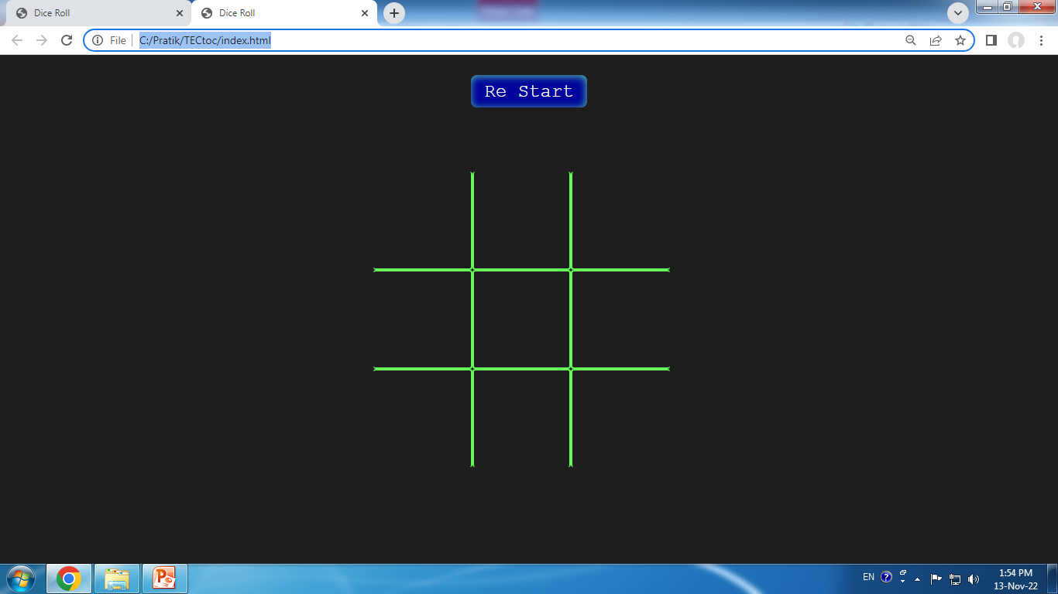
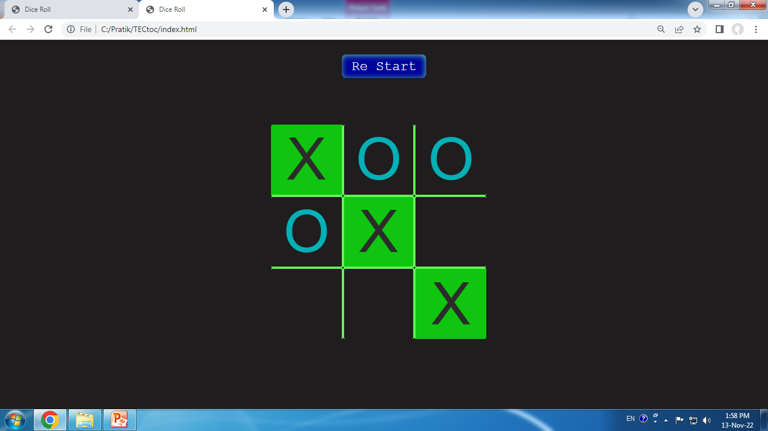


Slide 5
INTRODUCTION
Tec toc toe is a free online and offline multiplayer game that allows two different users to play game for fun.

Slide 6
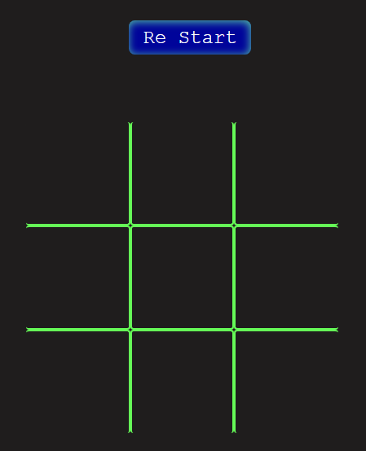
SITE PURPOSE
This game site is for entertainment purpose only. That allows user to play game for unlimited times. The main purpose of this gameing site is to save paper and save environment as this old game is traditionaly played on paper and results in wastage of paper.
There is a restart button given above the game chart

Slide 7
instructions
One of two user have to choose one sign from X and O
Once both the user have chosen the sign they have to click turn by turn.
The winning rule for any player is to set their sign in one line without inturuption of other user.
User can create straight vertical line, horizontal line or cross.
If all the blocks are filled up with signs then game will be tie.

Slide 8
DEVELOPMENT USE
Front-end : HTML , CSS
Back-end : JavaScript
Editor : Visual Studio Code
Icons : Bootstrap

Slide 9
Flow Chart
Start
User Connect with Browser
User input
False
Restart game
True
win
Game end

Slide 10
Data Flow Diagram
Zero Level / Context Level
User
Tic Tac Toe
System Give response
User Request to System

Slide 11
1st Level of DFD
Response server
1.0
Game start
USER Request
User
2.0
User input
Response server
User Play Game
Response server
3.0
Win/
lose
User Request

Slide 12
Project Limits
In Feature User Can play Private With One to One User.
User Can play multiple times without any limitation. .
Build More User Friendly.

Slide 13
REFERENCE
YouTube
Google

Slide 14
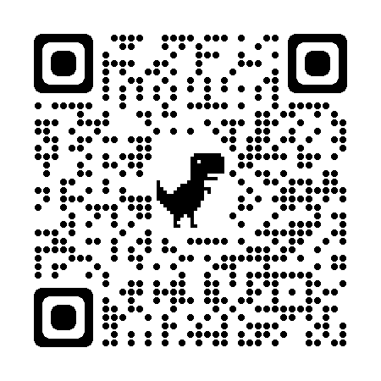
Live Preview
Scan Web Site QR code

Slide 15
Thank You

