Slide 1
NAME :- AKASHLAL YADAV AJAY Seat NO :- 1434 Guide :- MAHANOOR MAM
R.K. Desai achchhariwala college of computer & applied sciences, vapi

Slide 2
INDEX
Sr No | Topics
1 | Project Title
2 | Introduction , Site Purpose
3 | Development Use
4 | Objective
5 | Flow Chart
6 | Data Flow Diagram
7 | Project Limits
8 | References
9 | Live Preview
10 | Thank You

Slide 3
DIGITAL CLOCK

Slide 4
INTRODUCTION
A digital clock is an alternative to a traditional analogue clock. This type of clock shows numbers to display the time in a digital format, such as on a watch, phone or an alarm clock.

Slide 5
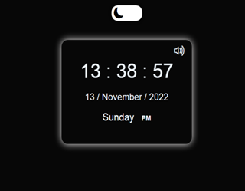
SITE PURPOSE
A digital clock is an alternative to a traditional analogue clock. This type of clock shows numbers to display the time in a digital format, such as on a watch, phone .

Slide 6
DEVELOPMENT USE
Front-end : HTML , CSS
Back-end : JAVASCRIPT
Editor : Visual Studio Code
Icons : Bootstrap

Slide 7
Flow Chart
Start
USER
Connect
With
Browser
Connected
Digital
Clock

Slide 8
Data Flow Diagram
Zero Level
USER
DIGITAL CLOCK
System response
Request to System

Slide 9
Project Limits
In Feature add more features.
Build More User Friendly.

Slide 10
REFERENCE
YouTube
Google

Slide 11
Thank You

