Slide 1
NAME :- Harsh Narendra Patel Seat NO :- 1420
R.K. DESAI ACHCHHARIWALA COLLEGE OF COMPUTER & APPLIED SCIENCES, VAPI

Slide 2
INDEX
Sr No | Topics | Slide No.
1 | Project Title | 3
2 | Introduction , Site Purpose | 4 - 5
3 | Development Use | 6
4 | Objective | 7
5 | Flow Chart | 8
6 | Data Flow Diagram | 9 - 11
7 | Project Limits | 13
8 | References | 14
9 | Live Preview | 15
10 | Thank You | 16

Slide 3
Number guessing

Slide 4
INTRODUCTION
The number guessing game is a popular game among programmers. In the number guessing game, the program selects a random number between two numbers, and the user guesses the correct number.

Slide 5
DEVELOPMENT USE
Front-end : HTML , CSS
Back-end : JAVASCRIPT
Editor : Visual Studio Code
Icons : Bootstrap

Slide 6
SITE PURPOSE
Take a step back clear your mind refresh your opinion.
Keep Your Mind clear in difficult Situation
Limits only exist in your mind.

Slide 7
Flow Chart
Start
User Guess Number
Check
False
Loss
True
win
Game end

Slide 8
Data Flow Diagram
Zero Level / Context Level
User
Tic Tac Toe
System Give response
User Request to System

Slide 9
1st Level of DFD
Login Success
1.0
Game start
Send Name and Password
User
2.0
Change
Level
Response server
User Set Level
Response server
3.0
User
input
User Guess Number
4.0
Win / Loss
Response server
User Read Result

Slide 10
Project Limits
In Feature add more features.
Build More User Friendly.

Slide 11
REFERENCE
YouTube
Google

Slide 12
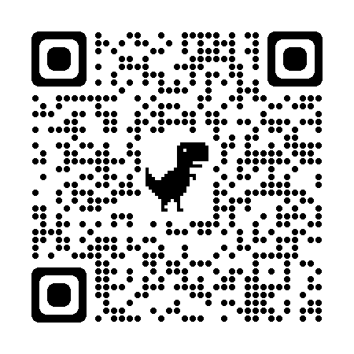
Live Preview

Slide 13
Thank You

