Slide 1
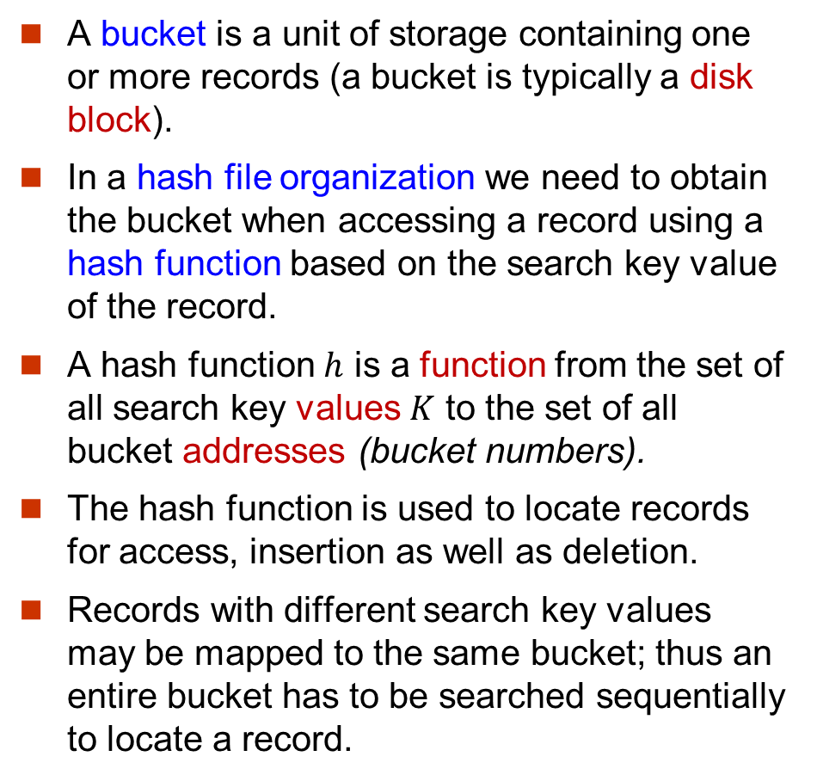
Hashing
A bucket is a unit of storage containing one or more records (a bucket is typically a disk block).
In a hash file organization we need to obtain the bucket when accessing a record using a hash function based on the search key value of the record.
A hash function $h$ is a function from the set of all search key values $K$ to the set of all bucket addresses (bucket numbers).
The hash function is used to locate records for access, insertion as well as deletion.
Records with different search key values may be mapped to the same bucket; thus an entire bucket has to be searched sequentially to locate a record.

Slide 2
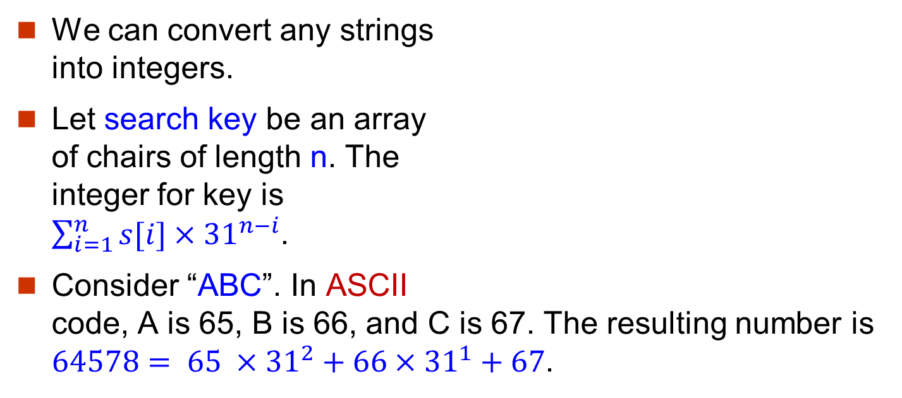
Convert Strings to Integers
| 0 NUL| 1 SOH| 2 STX| 3 ETX| 4 EOT| 5 ENQ| 6 ACK| 7 BEL|
| 8 BS | 9 HT | 10 NL | 11 VT | 12 NP | 13 CR | 14 SO | 15 SI |
| 16 DLE| 17 DC1| 18 DC2| 19 DC3| 20 DC4| 21 NAK| 22 SYN| 23 ETB|
| 24 CAN| 25 EM | 26 SUB| 27 ESC| 28 FS | 29 GS | 30 RS | 31 US |
| 32 SP | 33 ! | 34 " | 35 # | 36 $ | 37 % | 38 & | 39 ' |
| 40 ( | 41 ) | 42 * | 43 + | 44 , | 45 - | 46 . | 47 / |
| 48 0 | 49 1 | 50 2 | 51 3 | 52 4 | 53 5 | 54 6 | 55 7 |
| 56 8 | 57 9 | 58 : | 59 ; | 60 < | 61 = | 62 > | 63 ? |
| 64 @ | 65 A | 66 B | 67 C | 68 D | 69 E | 70 F | 71 G |
| 72 H | 73 I | 74 J | 75 K | 76 L | 77 M | 78 N | 79 O |
| 80 P | 81 Q | 82 R | 83 S | 84 T | 85 U | 86 V | 87 W |
| 88 X | 89 Y | 90 Z | 91 [ | 92 \ | 93 ] | 94 ^ | 95 _ |
| 96 ` | 97 a | 98 b | 99 c |100 d |101 e |102 f |103 g |
|104 h |105 i |106 j |107 k |108 l |109 m |110 n |111 o |
|112 p |113 q |114 r |115 s |116 t |117 u |118 v |119 w |
|120 x |121 y |122 z |123 { |124 | |125 } |126 ~ |127 DEL|

Slide 3
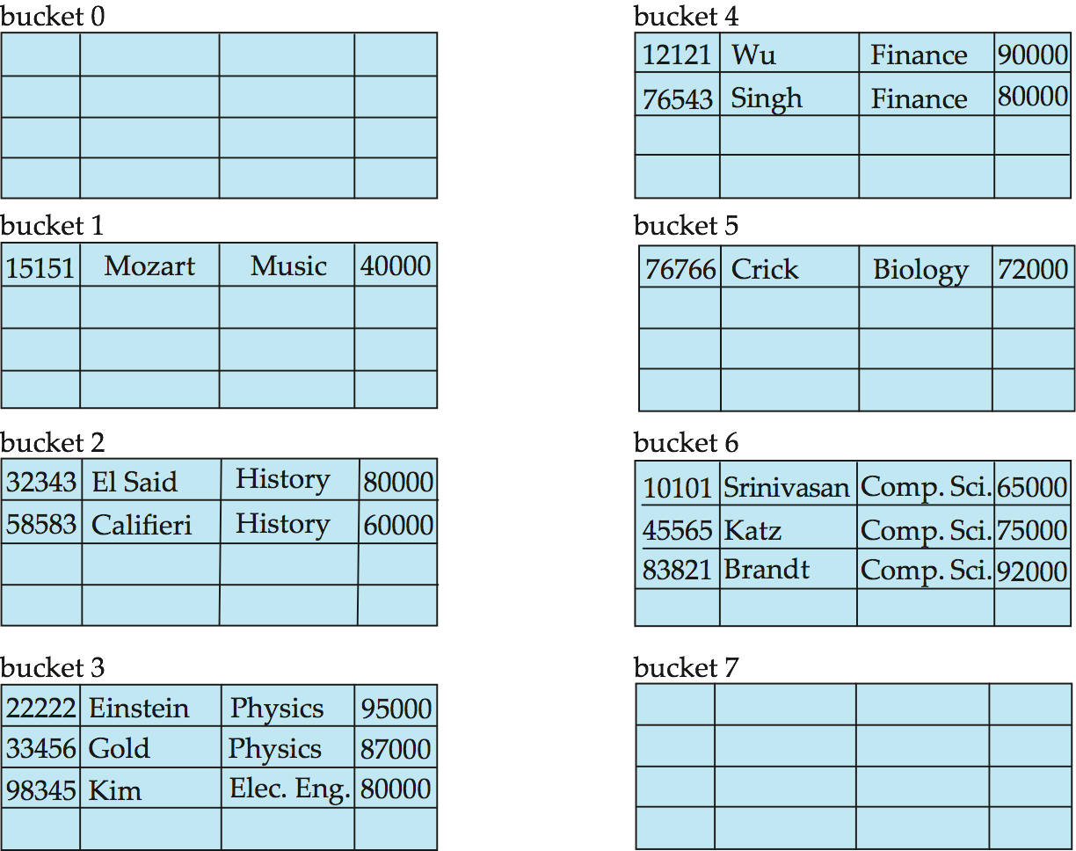
Hash File Organization: An Example
Hash file organization of instructor file, using dept_name as search key.
Suppose that there are 10 buckets.
For a string, we can covert it to a number first.
For a number x, a hash function h(x) can be x modulo 10.
E.g. h(‘Music’) = 1 h(‘History’) = 2 h(‘Physics’) = 3 h(‘Elec. Eng.’) = 3

Slide 4
Hash Functions
Worst hash function maps all search key values to the same bucket. This makes access time proportional to the number of search key values in the file.
We want to choose a hash function that assigns search key values to buckets in a way that the distribution has the following qualities.
The distribution is uniform. The hash function assigns each bucket the same number of search key values from the set of all possible values.
The distribution is random. That is, on average, each bucket will have nearly the same number of values, regardless of the actual distribution of search key values.

Slide 5
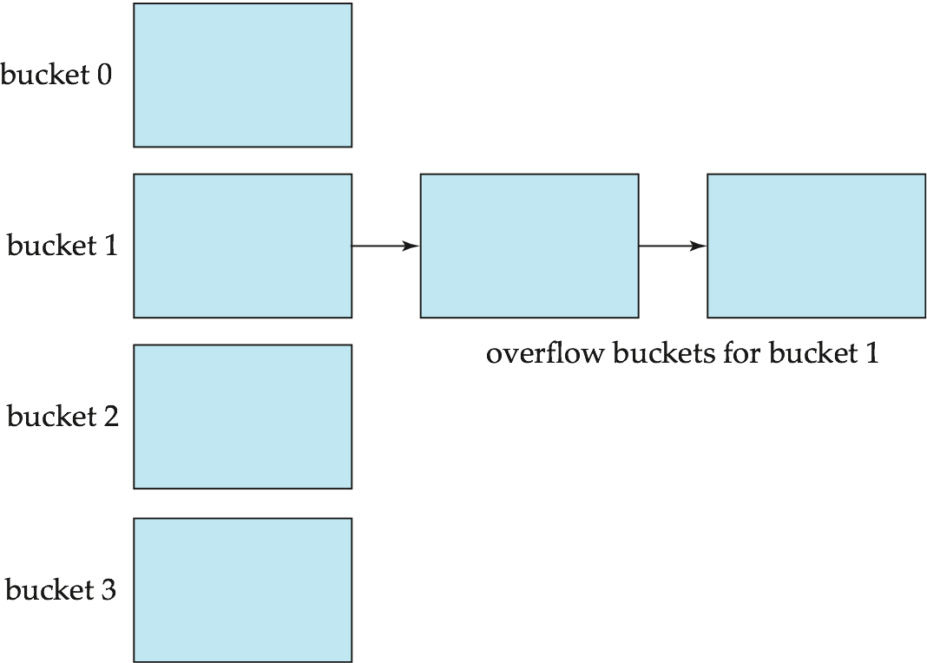
Handling of Bucket Overflows
Bucket overflow can occur
Insufficient buckets
Skew in distribution of records.
Multiple records have same search key value
The chosen hash function produces non-uniform distribution of key values
When bucket overflow occurs, it is handled by using overflow buckets.
Overflow chaining – the overflow buckets of a given bucket are chained together in a linked list. This scheme is called closed hashing.

Slide 6
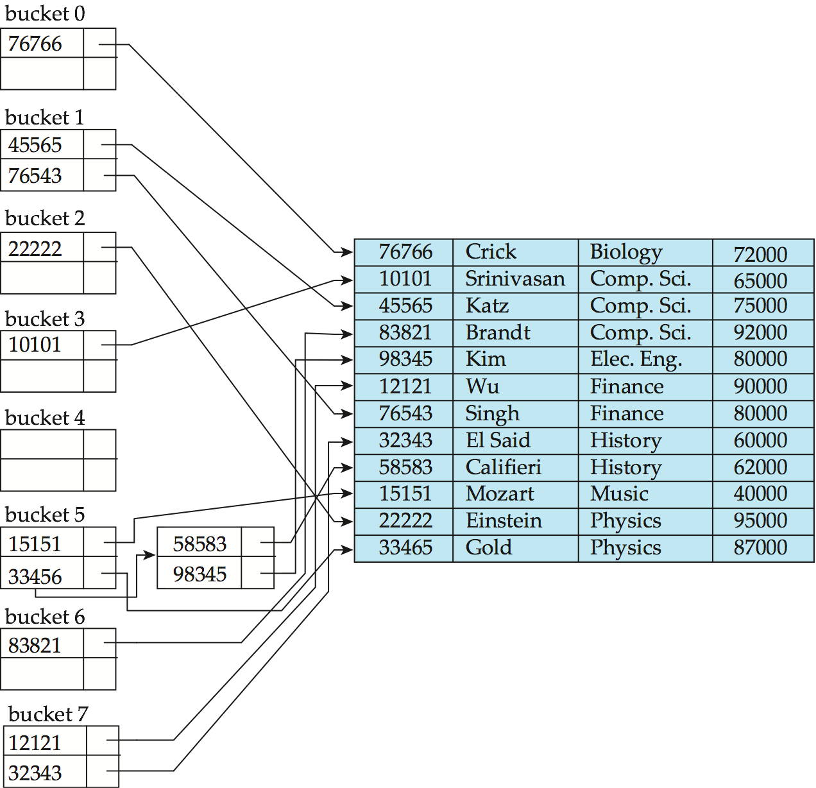
Hash Indices
Hashing can be used not only for file organization, but also for index-structure creation.
A hash index organizes the search keys, with their associated record pointers, into a hash file structure.

Slide 7
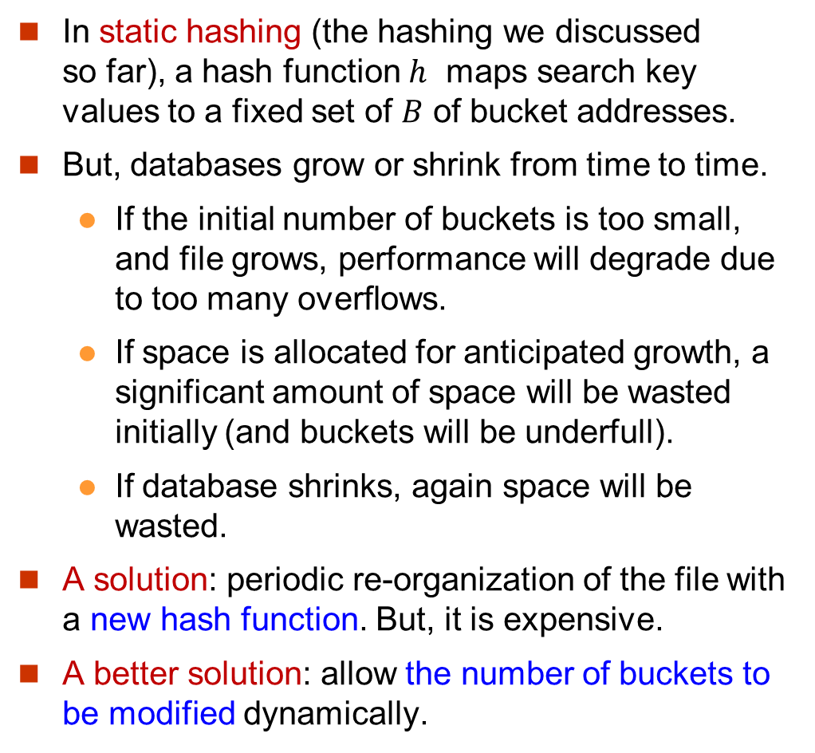
Static Hashing
In static hashing (the hashing we discussed so far), a hash function $h$ maps search key values to a fixed set of $B$ of bucket addresses.
But, databases grow or shrink from time to time.
If the initial number of buckets is too small, and file grows, performance will degrade due to too many overflows.
If space is allocated for anticipated growth, a significant amount of space will be wasted initially (and buckets will be underfull).
If database shrinks, again space will be wasted.
A solution: periodic re-organization of the file with a new hash function. But, it is expensive.
A better solution: allow the number of buckets to be modified dynamically.

Slide 8
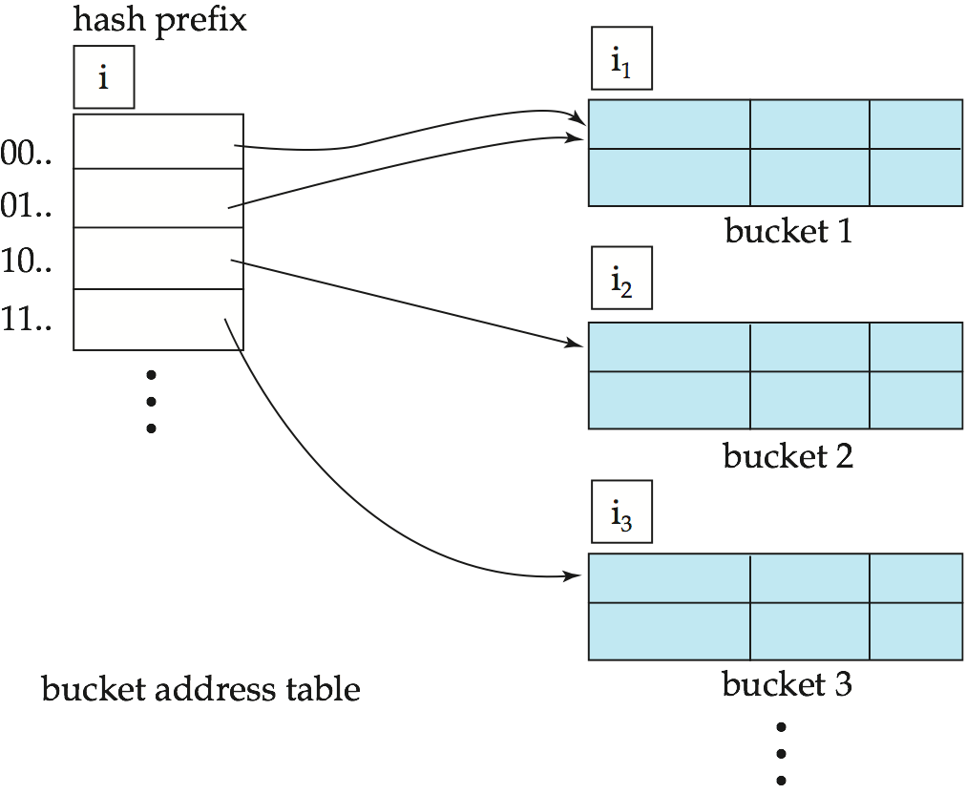
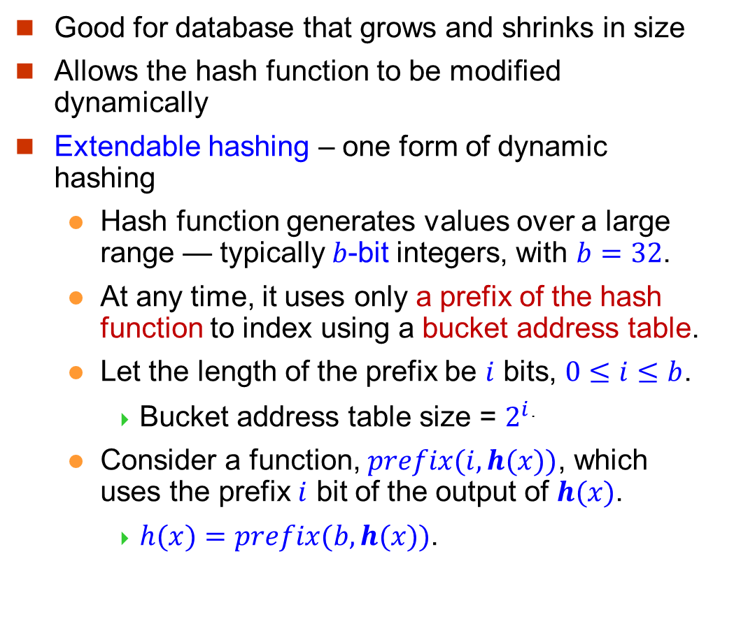
Dynamic Hashing
Good for database that grows and shrinks in size
Allows the hash function to be modified dynamically
Extendable hashing – one form of dynamic hashing
Hash function generates values over a large range — typically $b$-bit integers, with $b=32$.
At any time, it uses only a prefix of the hash function to index using a bucket address table.
Let the length of the prefix be $i$ bits, $0≤i≤b$.
Bucket address table size = $2^{i}$.
Consider a function, $prefix(i, h(x))$, which uses the prefix $i$ bit of the output of $h(x)$.
$h(x)=prefix(b, h(x))$.
The static hashing
The extendable hashing

Slide 9
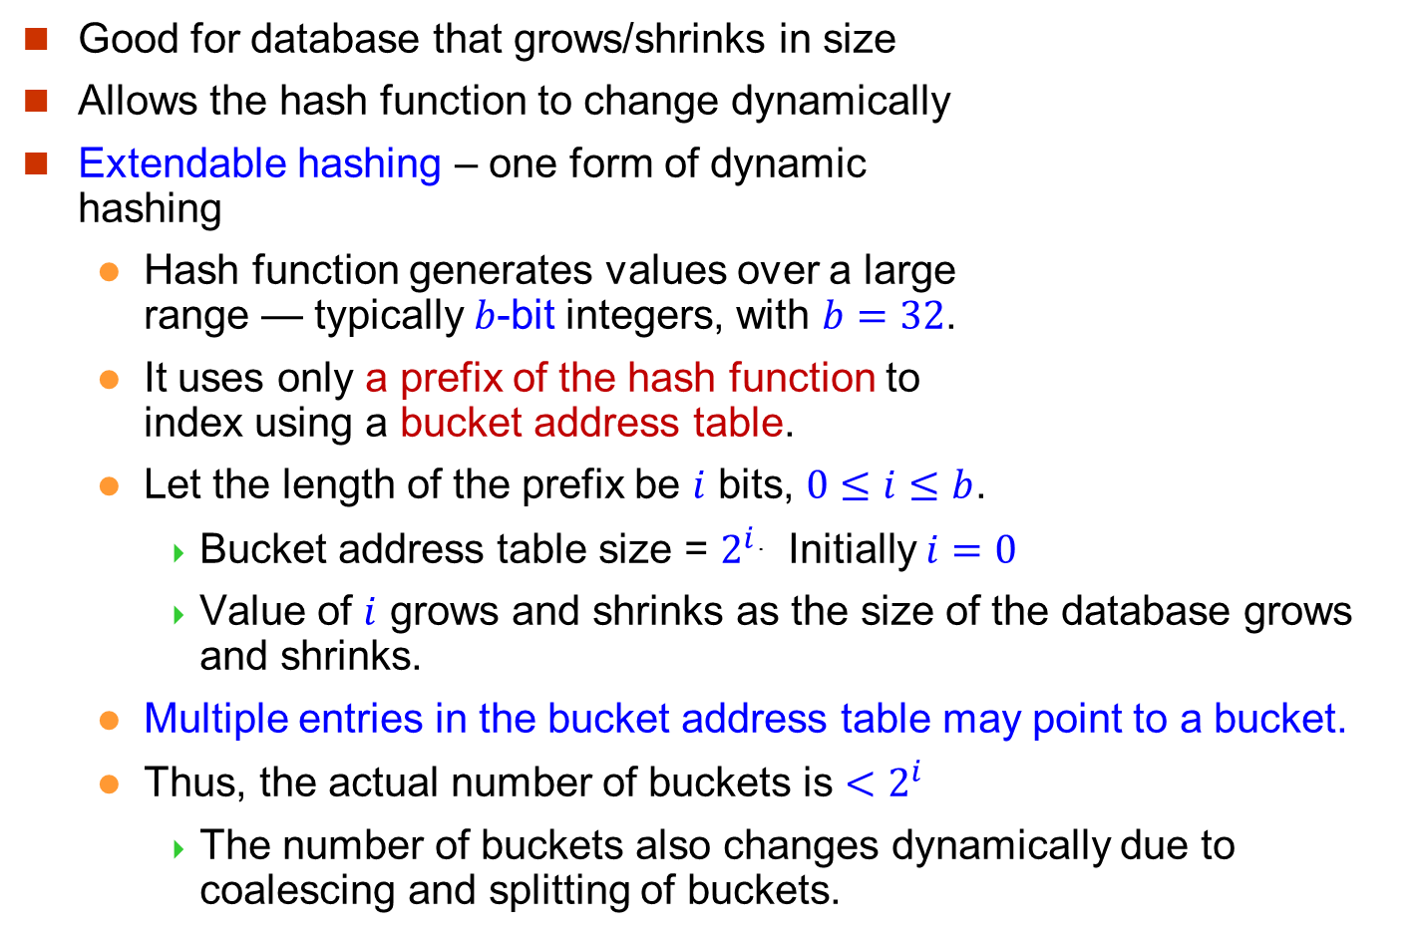
Dynamic Hashing
Good for database that grows/shrinks in size
Allows the hash function to change dynamically
Extendable hashing – one form of dynamic hashing
Hash function generates values over a large range — typically $b$-bit integers, with $b=32$.
It uses only a prefix of the hash function to index using a bucket address table.
Let the length of the prefix be $i$ bits, $0≤i≤b$.
Bucket address table size = $2^{i}$. Initially $i=0$
Value of $i$ grows and shrinks as the size of the database grows and shrinks.
Multiple entries in the bucket address table may point to a bucket.
Thus, the actual number of buckets is ${<2}^{i}$
The number of buckets also changes dynamically due to coalescing and splitting of buckets.

Slide 10
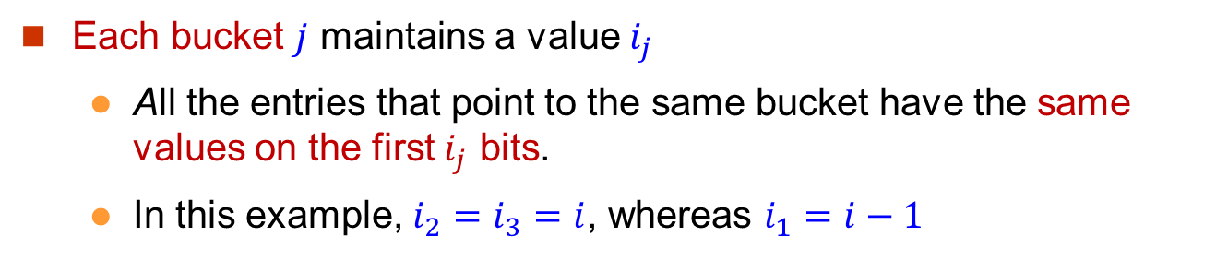
General Extendable Hash Structure
A static hash
Each bucket $j$ maintains a value $i_{j}$
All the entries that point to the same bucket have the same values on the first $i_{j}$ bits.
In this example, $i_{2}=i_{3}=i$, whereas $i_{1}=i−1$

Slide 11

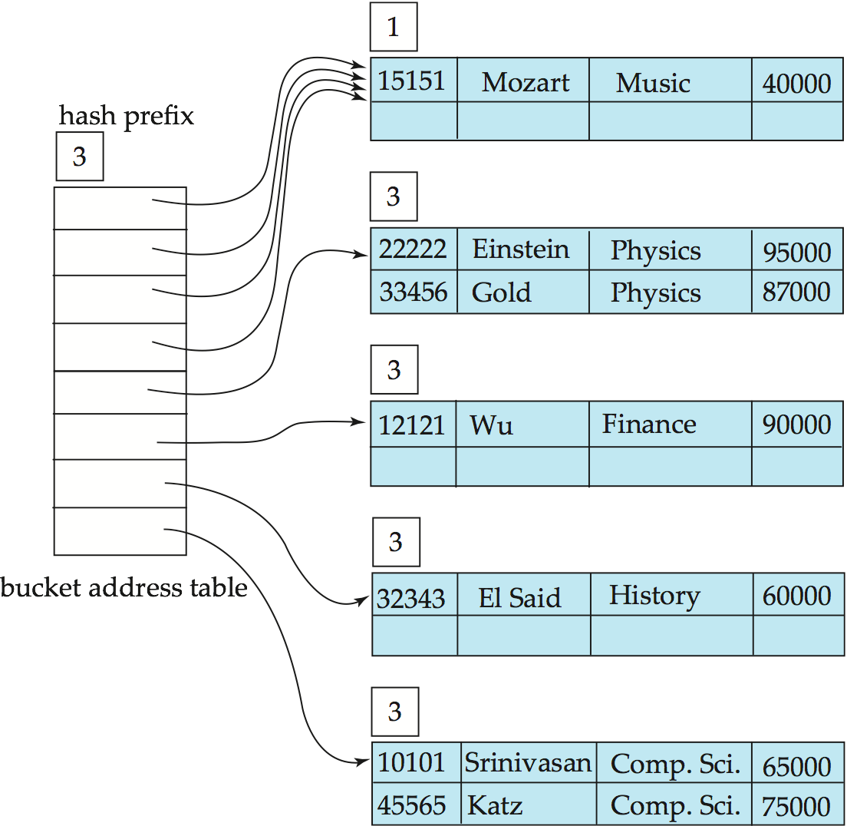













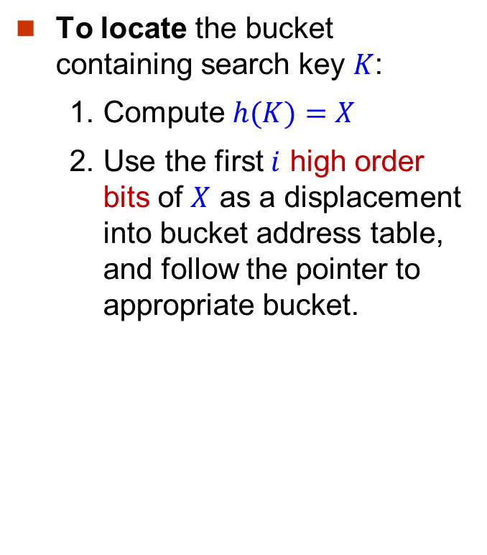
Use of Extendable Hash Structure
To locate the bucket containing search key $K$:
1. Compute $h(K)=X$
2. Use the first $i$ high order bits of $X$ as a displacement into bucket address table, and follow the pointer to appropriate bucket.
bucket 1
bucket 2
bucket 3
bucket 4
dept_name h(dept_name) Biology 0010… Comp.Sci. 1111… Elec.Eng. 0100… Finance 1010… History 1100… Music 0011… Physics 1001…
bucket 5

Slide 12
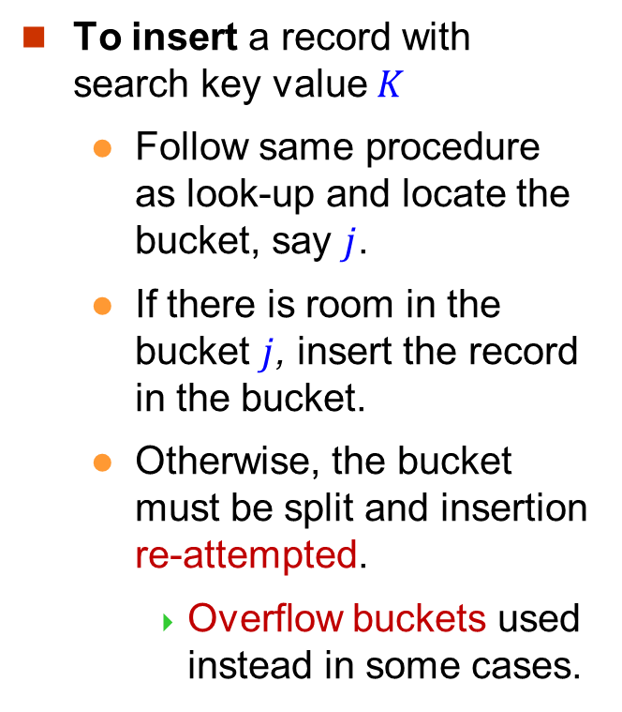
Insertion in Extendable Hash Structure
To insert a record with search key value $K$
Follow same procedure as look-up and locate the bucket, say $j$.
If there is room in the bucket $j$, insert the record in the bucket.
Otherwise, the bucket must be split and insertion re-attempted.
Overflow buckets used instead in some cases.
bucket 1
bucket 2
bucket 3
bucket 4
bucket 5

Slide 13
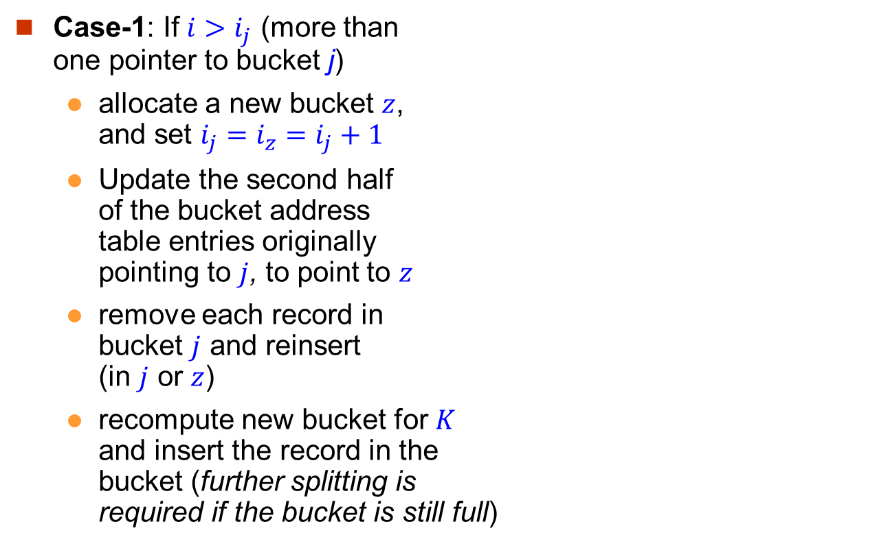
Insertion in Extendable Hash Structure (Cont)
To split a bucket $j$ when inserting record with search key value $K$:
Case-1: If $i>i_{j}$ (more than one pointer to bucket j)
allocate a new bucket $z$, and set $i_{j}=i_{z}=i_{j}+1$
Update the second half of the bucket address table entries originally pointing to $j$, to point to $z$
remove each record in bucket $j$ and reinsert (in $j$ or $z$)
recompute new bucket for $K$ and insert the record in the bucket (further splitting is required if the bucket is still full)
bucket 1
bucket 2
bucket 3
bucket 4
bucket 5

Slide 14
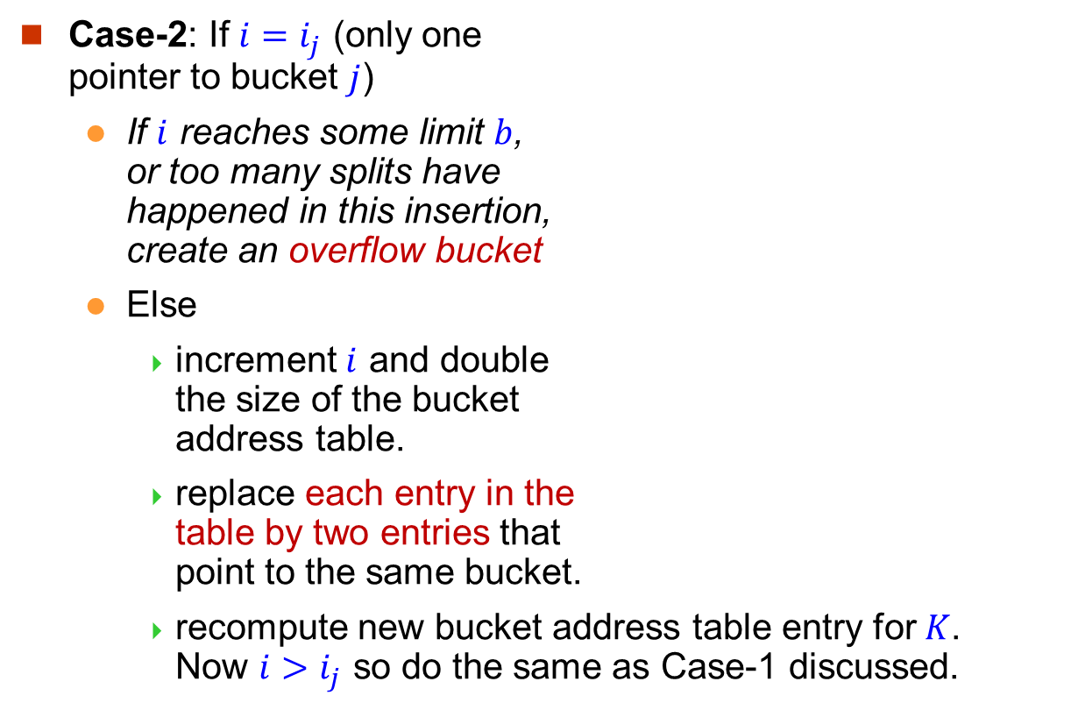
Insertion in Extendable Hash Structure (Cont)
To split a bucket $j$ when inserting record with search key value $K$:
Case-2: If $i=i_{j}$ (only one pointer to bucket $j$)
If $i$ reaches some limit $b$, or too many splits have happened in this insertion, create an overflow bucket
Else
increment $i$ and double the size of the bucket address table.
replace each entry in the table by two entries that point to the same bucket.
recompute new bucket address table entry for $K$. Now $i>i_{j}$ so do the same as Case-1 discussed.
bucket 1
bucket 2
bucket 3
bucket 4
bucket 5

Slide 15
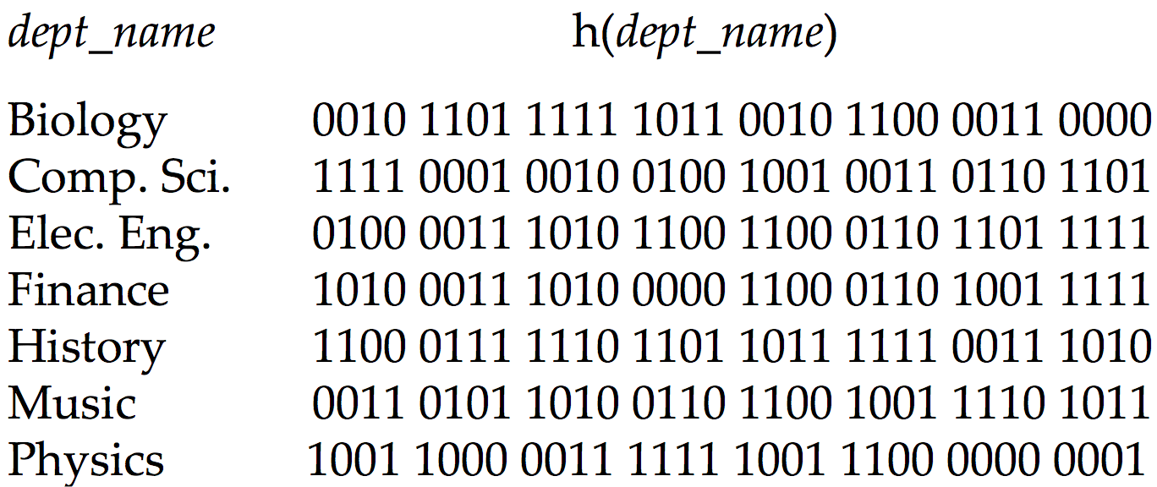
Example (1)

Slide 16
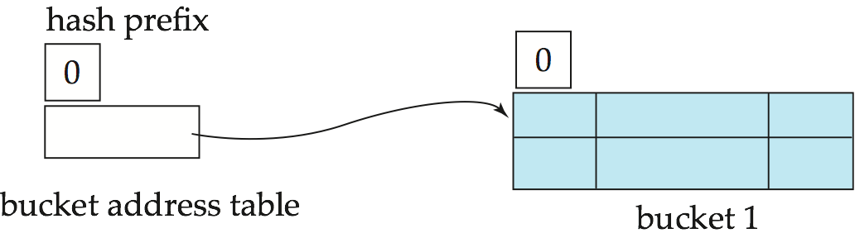
Example (2)
Initial hash structure; bucket size = 2

Slide 17
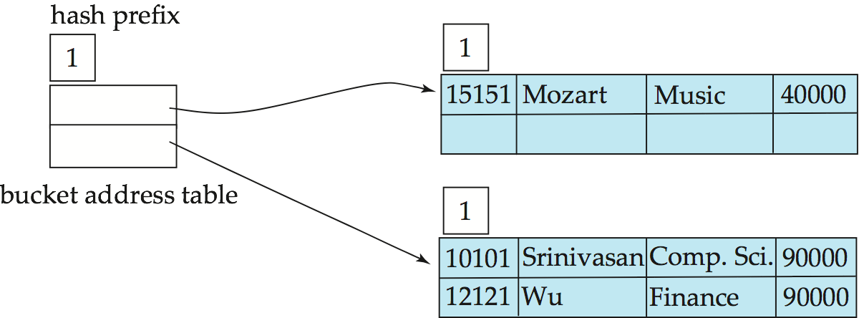
Example (3)
Hash structure after insertion of “Mozart”, “Srinivasan”, and “Wu” records
0
1
dept_name h(dept_name) Biology 0010… Comp.Sci. 1111… Elec.Eng. 0100… Finance 1010… History 1100… Music 0011… Physics 1001…

Slide 18
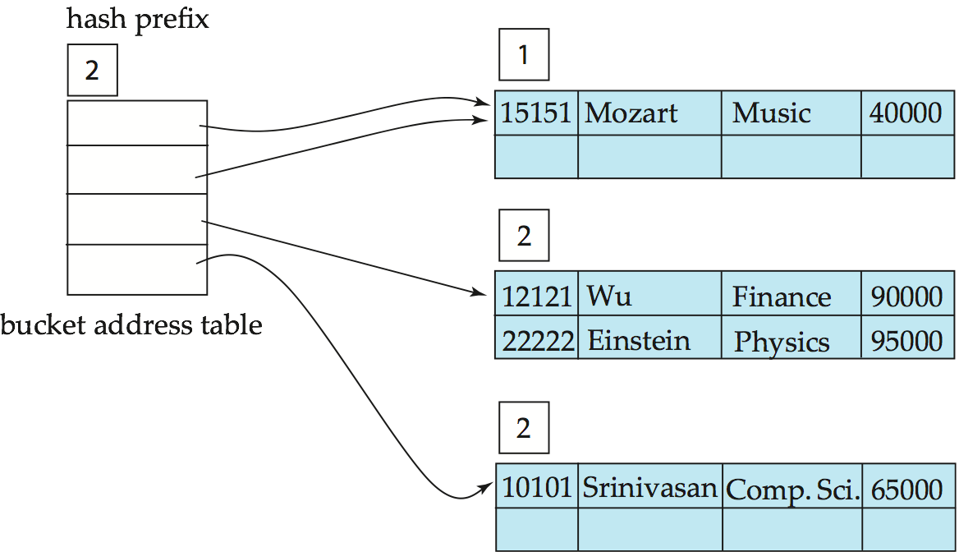
Example (4)
Hash structure after insertion of “Einstein” record
00
01
10
11
dept_name h(dept_name) Biology 0010… Comp.Sci. 1111… Elec.Eng. 0100… Finance 1010… History 1100… Music 0011… Physics 1001…

Slide 19
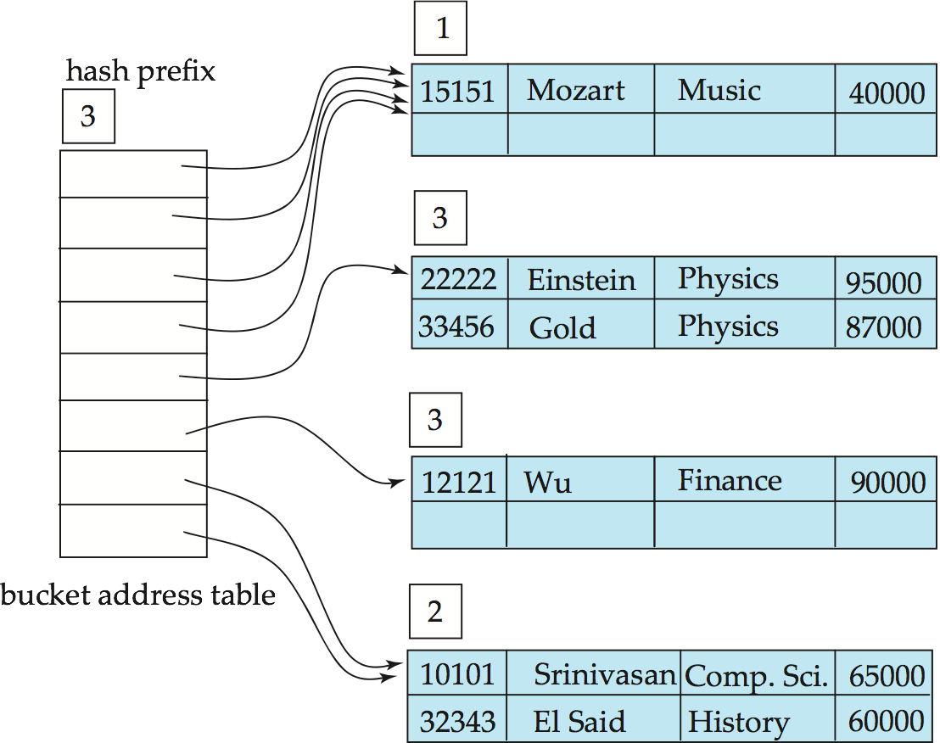
Example (5)
Hash structure after insertion of “Gold” and “El Said” records
000
001
010
011
dept_name h(dept_name) Biology 0010… Comp.Sci. 1111… Elec.Eng. 0100… Finance 1010… History 1100… Music 0011… Physics 1001…
100
101
110
111

Slide 20
Example (6)
Hash structure after insertion of “Katz” record
000
001
010
011
100
dept_name h(dept_name) Biology 0010… Comp.Sci. 1111… Elec.Eng. 0100… Finance 1010… History 1100… Music 0011… Physics 1001…
101
110
111

Slide 21
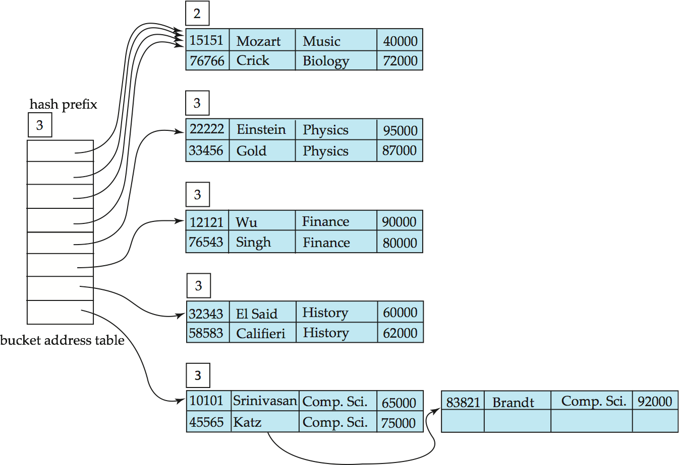

Example (7)
1
Suppose $b=3$ at most. After insertion of 11 records
dept_name h(dept_name) Biology 0010… Comp.Sci. 1111… Elec.Eng. 0100… Finance 1010… History 1100… Music 0011… Physics 1001…
000
001
010
011
100
101
110
111

Slide 22
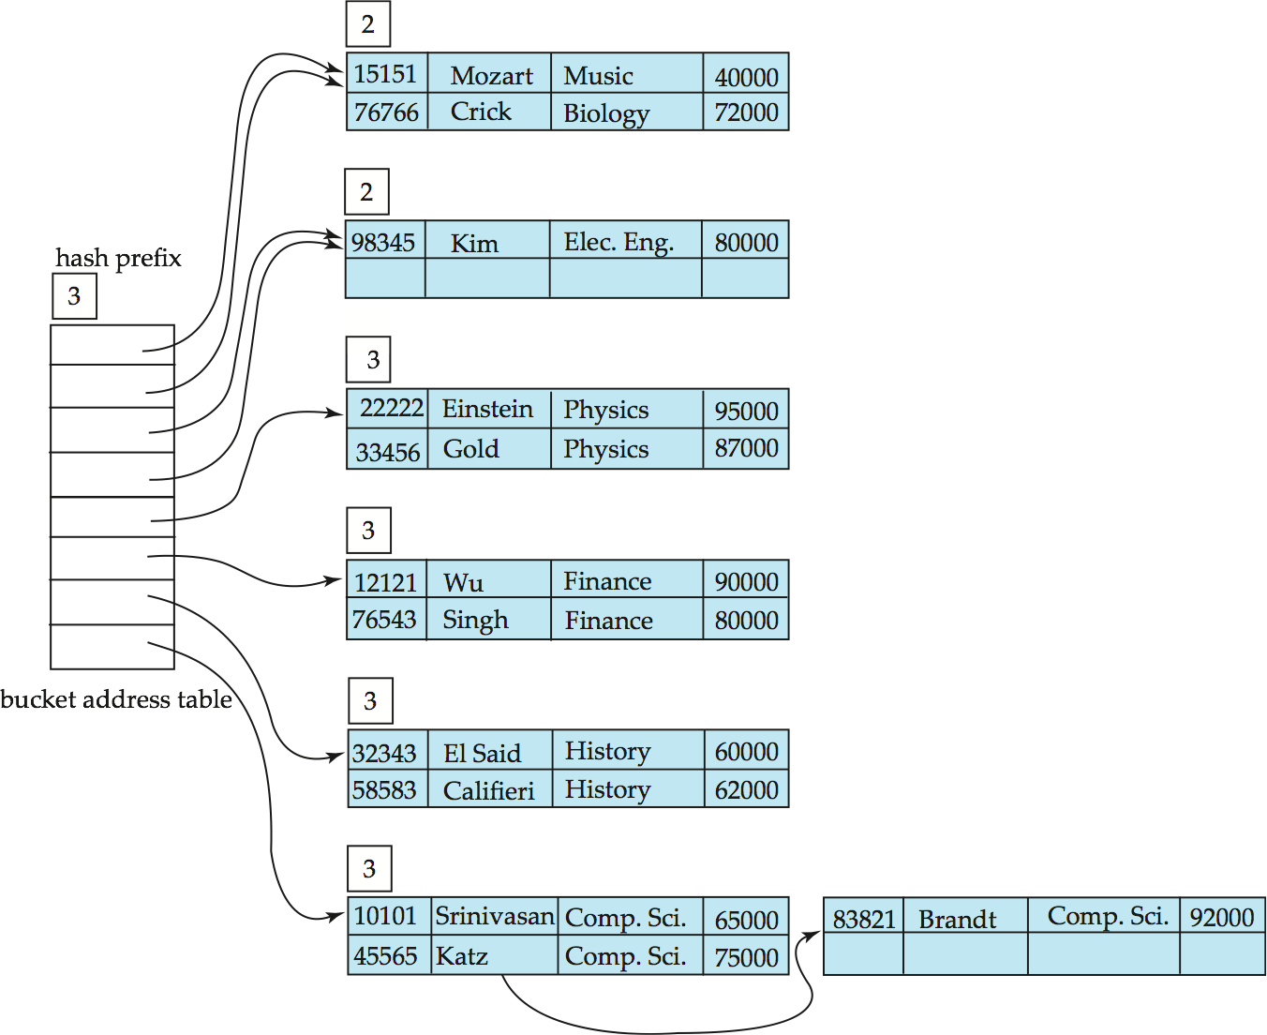
Example (8)
And after insertion of
“Kim” record in the previous
hash structure
dept_name h(dept_name) Biology 0010… Comp.Sci. 1111… Elec.Eng. 0100… Finance 1010… History 1100… Music 0011… Physics 1001…
000
001
010
011
100
101
110
111

Slide 23
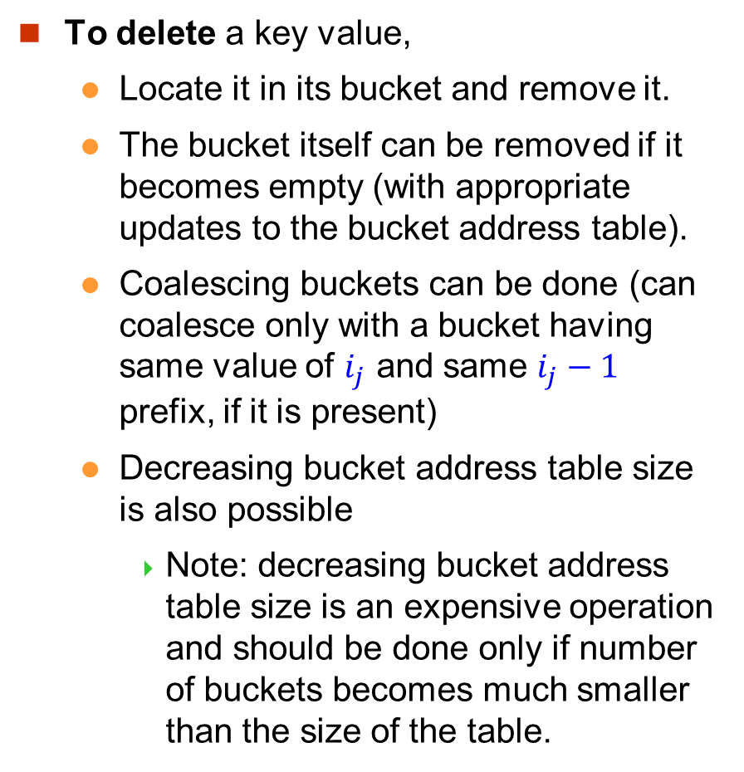
Deletion in Extendable Hash Structure
To delete a key value,
Locate it in its bucket and remove it.
The bucket itself can be removed if it becomes empty (with appropriate updates to the bucket address table).
Coalescing buckets can be done (can coalesce only with a bucket having same value of $i_{j}$ and same $i_{j}−1$ prefix, if it is present)
Decreasing bucket address table size is also possible
Note: decreasing bucket address table size is an expensive operation and should be done only if number of buckets becomes much smaller than the size of the table.

Slide 24
Extendable Hashing
Benefits of extendable hashing:
Hash performance does not degrade with growth of file
Minimal space overhead
Disadvantages of extendable hashing
Extra level of indirection to find the desired record. That is, it needs to access the bucket address table followed by the buckets.
Bucket address table may itself become very big.
Changing size of bucket address table is an expensive operation.

Slide 25
Comparison of Ordered Indexing and Hashing
Need to consider the cost of periodic re-organization for different relative frequency of insertions and deletions.
Expected type of queries:
Hashing is generally better at retrieving records having a specified value of the key.
Find a record with a specific instructor name
If range queries are common, ordered indices are to be preferred.
Find records within a range of salaries [10K, 80K].

